Slide 1
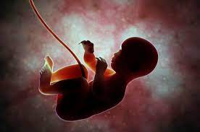
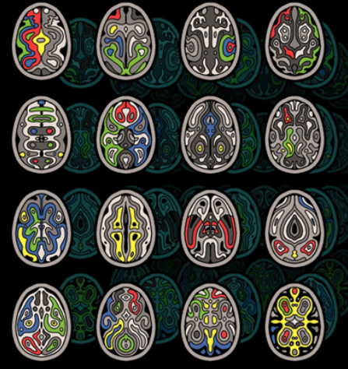
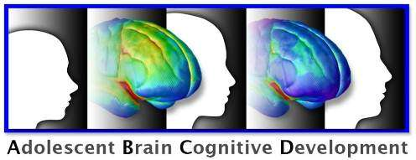
Centre for Healthy Brain Ageing (CHeBA) Dr Louise Mewton – Cognitive impacts of alcohol use across the lifespan https://med.unsw.edu.au/our-people/louise-mewton
Gestation
Adolescence
Older adulthood
Use ABCD Study data (n=12,000) to understand how childhood neurobiology impacts the development of adolescent alcohol use https://abcdstudy.org/
Use large-scale neuroimaging and questionnaire data from the landmark ABCD Study to determine the impact of alcohol use on childhood outcomes (n=12,000) https://abcdstudy.org/
Contribute to a large-scale trial (n=900) investigating the cognitive impacts of a digital intervention for alcohol use in older adults aged over 60 years
Meet CHeBA’s Research Manager Vibeke Catts: Meeting ID: 810 2402 6543 https://unsw.zoom.us/j/81024026543

