Slide 1
“Building the New Economy: activism, enterprise and social change”
16-17 August 2016 – Glebe Town Hall, Sydney
WORKSHOP 2pm Wednesday Session 4.3
Redefining people in sustainable economies:
The “consumer” has to go
Sabrina Chakori and Peter Daniels

Slide 2
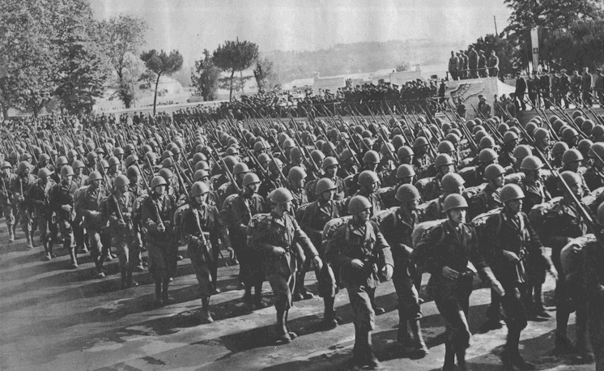

Consumption as a mean to ensure future prosperity…
Consumption

Slide 3


Collectivist idea of citizenship and individualised practice of the consumer

Slide 4

There is a lack of an alternative definition of consumers …

Slide 5
“Building the New Economy: activism, enterprise and social change”
16-17 August 2016 – Glebe Town Hall, Sydney
WORKSHOP 2pm Wednesday Session 4.3
Redefining people in sustainable economies:
The “consumer” has to go
We need a new term to replace calling people seeking wellbeing, “consumers” ☺

Slide 6
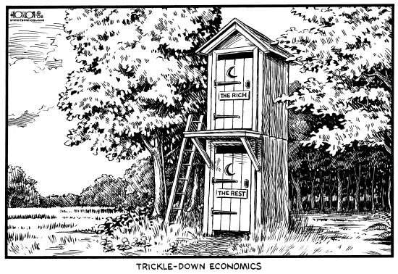
WORKSHOP : Redefining people in sustainable economies: The “consumer” has to go
ECONOMICS – any love?

Slide 7
WORKSHOP : Redefining people in sustainable economies: The “consumer” has to go
DOES LANGUAGE AFFECT THINKING, GOALS AND ACTION?

Slide 8
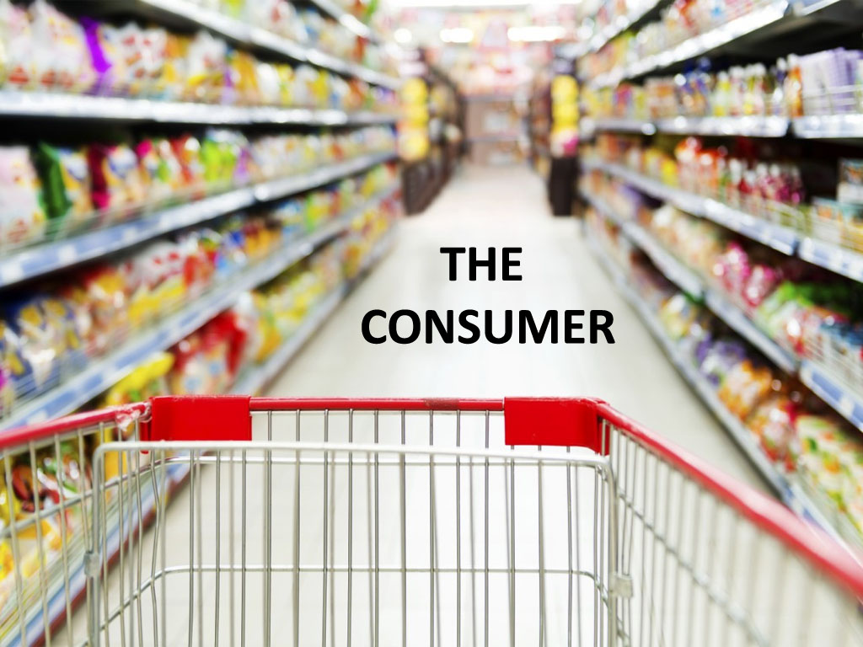
WORKSHOP : Redefining people in sustainable economies: The “consumer” has to go

Slide 9
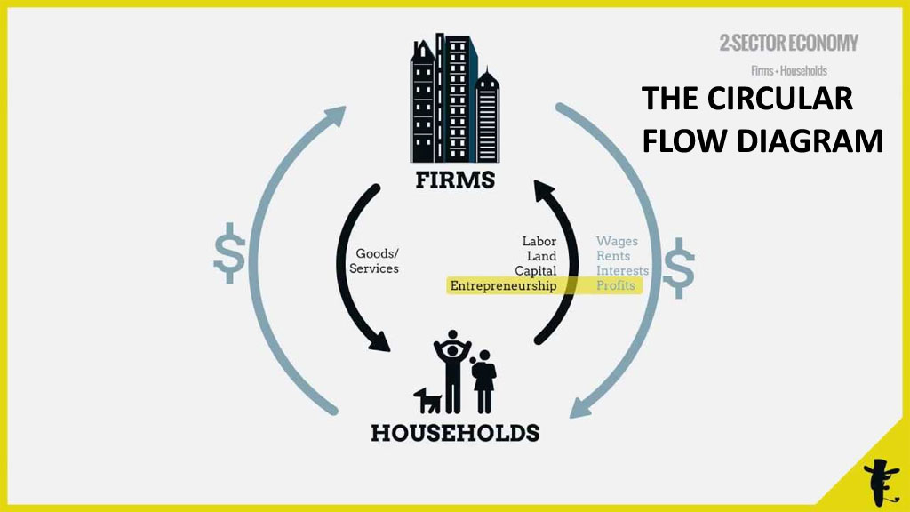
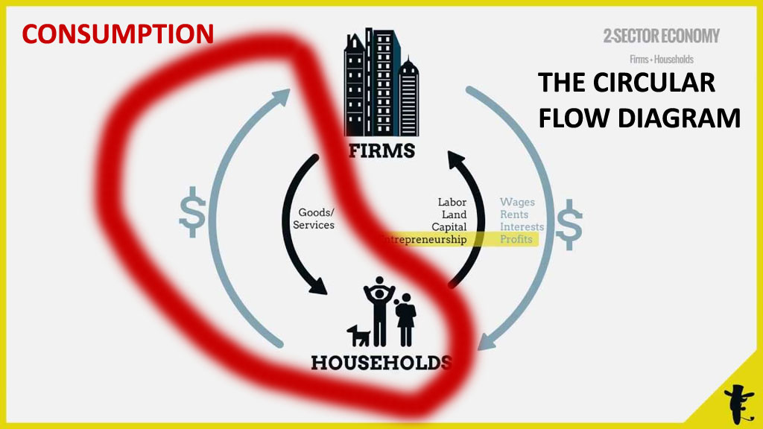
WORKSHOP : Redefining people in sustainable economies: The “consumer” has to go

Slide 10

CONSUMPTION IS A DIRTY WORD

Slide 11

CONSUMPTION IS A DIRTY WORD

Slide 12
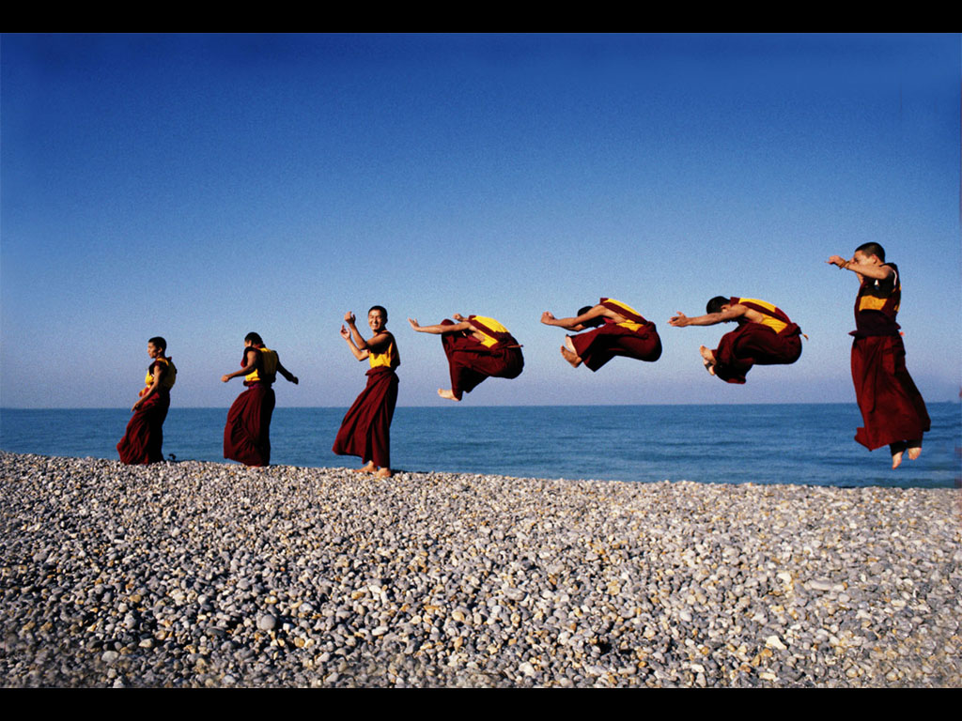
What really gives us happiness? (or, at least, life satisfaction)

Slide 13
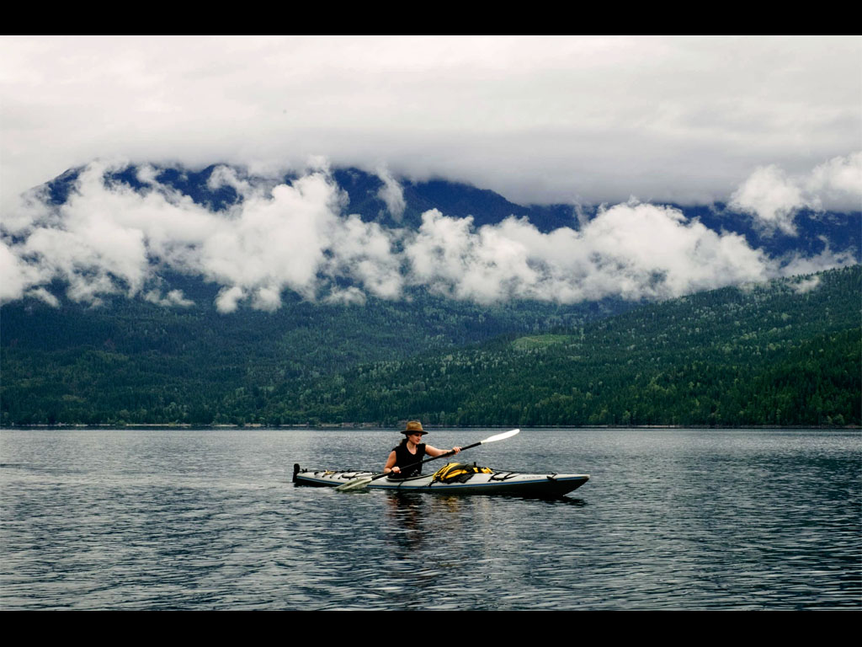
WORKSHOP : Redefining people in sustainable economies: The “consumer” has to go
Consumptive use of the world is only a (small) part of wellbeing

Slide 14
So… if we want goals and measures that are likely to help support and encourage thinking and action towards sustained high levels of wellbeing (SHI-WEB)
… we should not be calling the act of seeking well-being = > “consumption”
We need …
a much better term to cover all of the actions of this SHI-WEB seeker
(person seeking sustained wellbeing)

Slide 15

WORKSHOP : Redefining people in sustainable economies: The “consumer” has to go
Please help us find a better term
ACTIVITY 1 (10 minutes)
What terms would describe this person seeking wellbeing in a sustainable society? (SHI-WEB person)
E.g. citizen, demands, satisfaction

Slide 16
WORKSHOP : Redefining people in sustainable economies: The “consumer” has to go
Please help us find a better term
ACTIVITY 2 (10 minutes)
Find or make up a term to best describe this person?
E.g. demizen (“dem-izen” => a mix of “dem”= demand, and “izen” = citizen)

Slide 17
“Building the New Economy: activism, enterprise and social change”
16-17 August 2016 – Glebe Town Hall, Sydney
THE END
Thanks ☺
Redefining people in sustainable economies:
The “consumer” has to go
Sabrina Chakori and Peter Daniels
Please contact us if you have more ideas !

