Slide 1
A Very Beautiful Laundromat
www.averybeautifullandromat.com
Notes:
Pay my respects to the traditonal custodians of the land the gadigal people of the eora nation - and pay my respexcts to the elders both past and present.
Hi I am here to talk about an artist project that I am working on called A Very Beautiful Laundromat. This is the website if you want to check it out.

Slide 2
About me
Rebecca Conroy is an interdisciplinary artist and independent scholar working across site, community engagement, and performative interventions through artist led activity and philosophy. Her work is bound up in mimetic strategies and the playful occupation of non-art fields such as urban planning, economics, and housing, particularly where it concerns the behaviour of cities and the rise of the creative entrepreneur and finance capitalism. She has previously worked in the role of Festival Director (Gang Festival), Associate Director (Performance Space); Provocateur (Splendid Arts Lab & Artist Wants a Life) and has been the co-founder and co-director of two artist run spaces in Sydney, The Wedding Circle and Bill+George. She recieved her PhD in 2007 (University of Newcastle, Dept Drama/Conservatorium) Exploring oppositional performance practice in Post Suharto Indonesia.
Notes:
Before I explain about my obsession with laundromats, I think it’s important to clarify that when I identify as an artist, it doesn’t mean I am a painter.
The kind of work I make usually involves situations or encounters, is collaborative in design and interdisciplinary in nature.
I also work as a producer and curator and a writer/independent scholar. Perhaps mostly I identify as having an artist led practice and philosophy.
I will talk about this means later, but suffice to say I have cofounded a number of artist run spaces. The original coworking space! Predating them by about 3 decades.

Slide 3
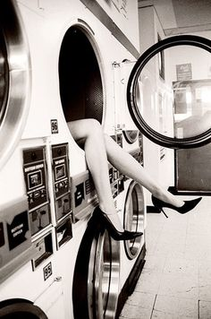
A Very Beautiful Laundromat is a curatorial platform and project-machine for expanded practice at the intersection of art and economy. Between 2016-2018 it will develop and present a number of public iterations as artist-led responses to doing economy differently.
Notes:
A very beautiful laundromat is a project machine for a range of projects investigating the nexus of art and economy. For the next three years most of the work I am making concerns the intersection of art and economy. Or what I call “doing economy differently”
Part of this is an enraged response to the increasing financialization of everything, and the imposition of non-arts neoliberal management and business models. Making artist behave like good little business managers. Homogenising the field and eliminating risk and speculation from our practice.
But also its about challenging the dull notion that artists don’t already manage and operate in their own complex economies.

Slide 4
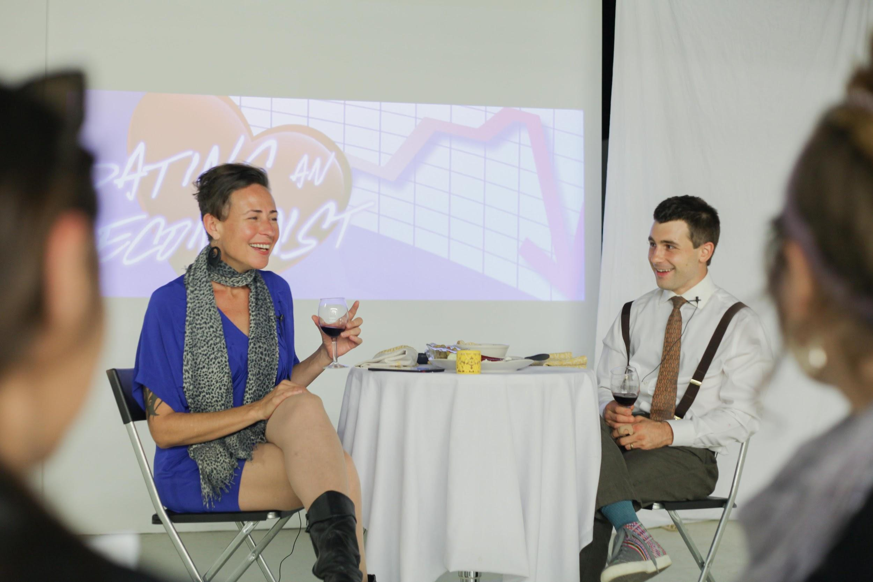
Dating an Economist
datinganeconomist.tumblr.com
Notes:
In 2015 I went on a series of dates with economists. The rules were simple. They chose the restaurant and I paid for the meal.
My key contention is that artists and economists share more common terrain than assumed - we both peddle in the art of fiction, and rely on trust.

Slide 5
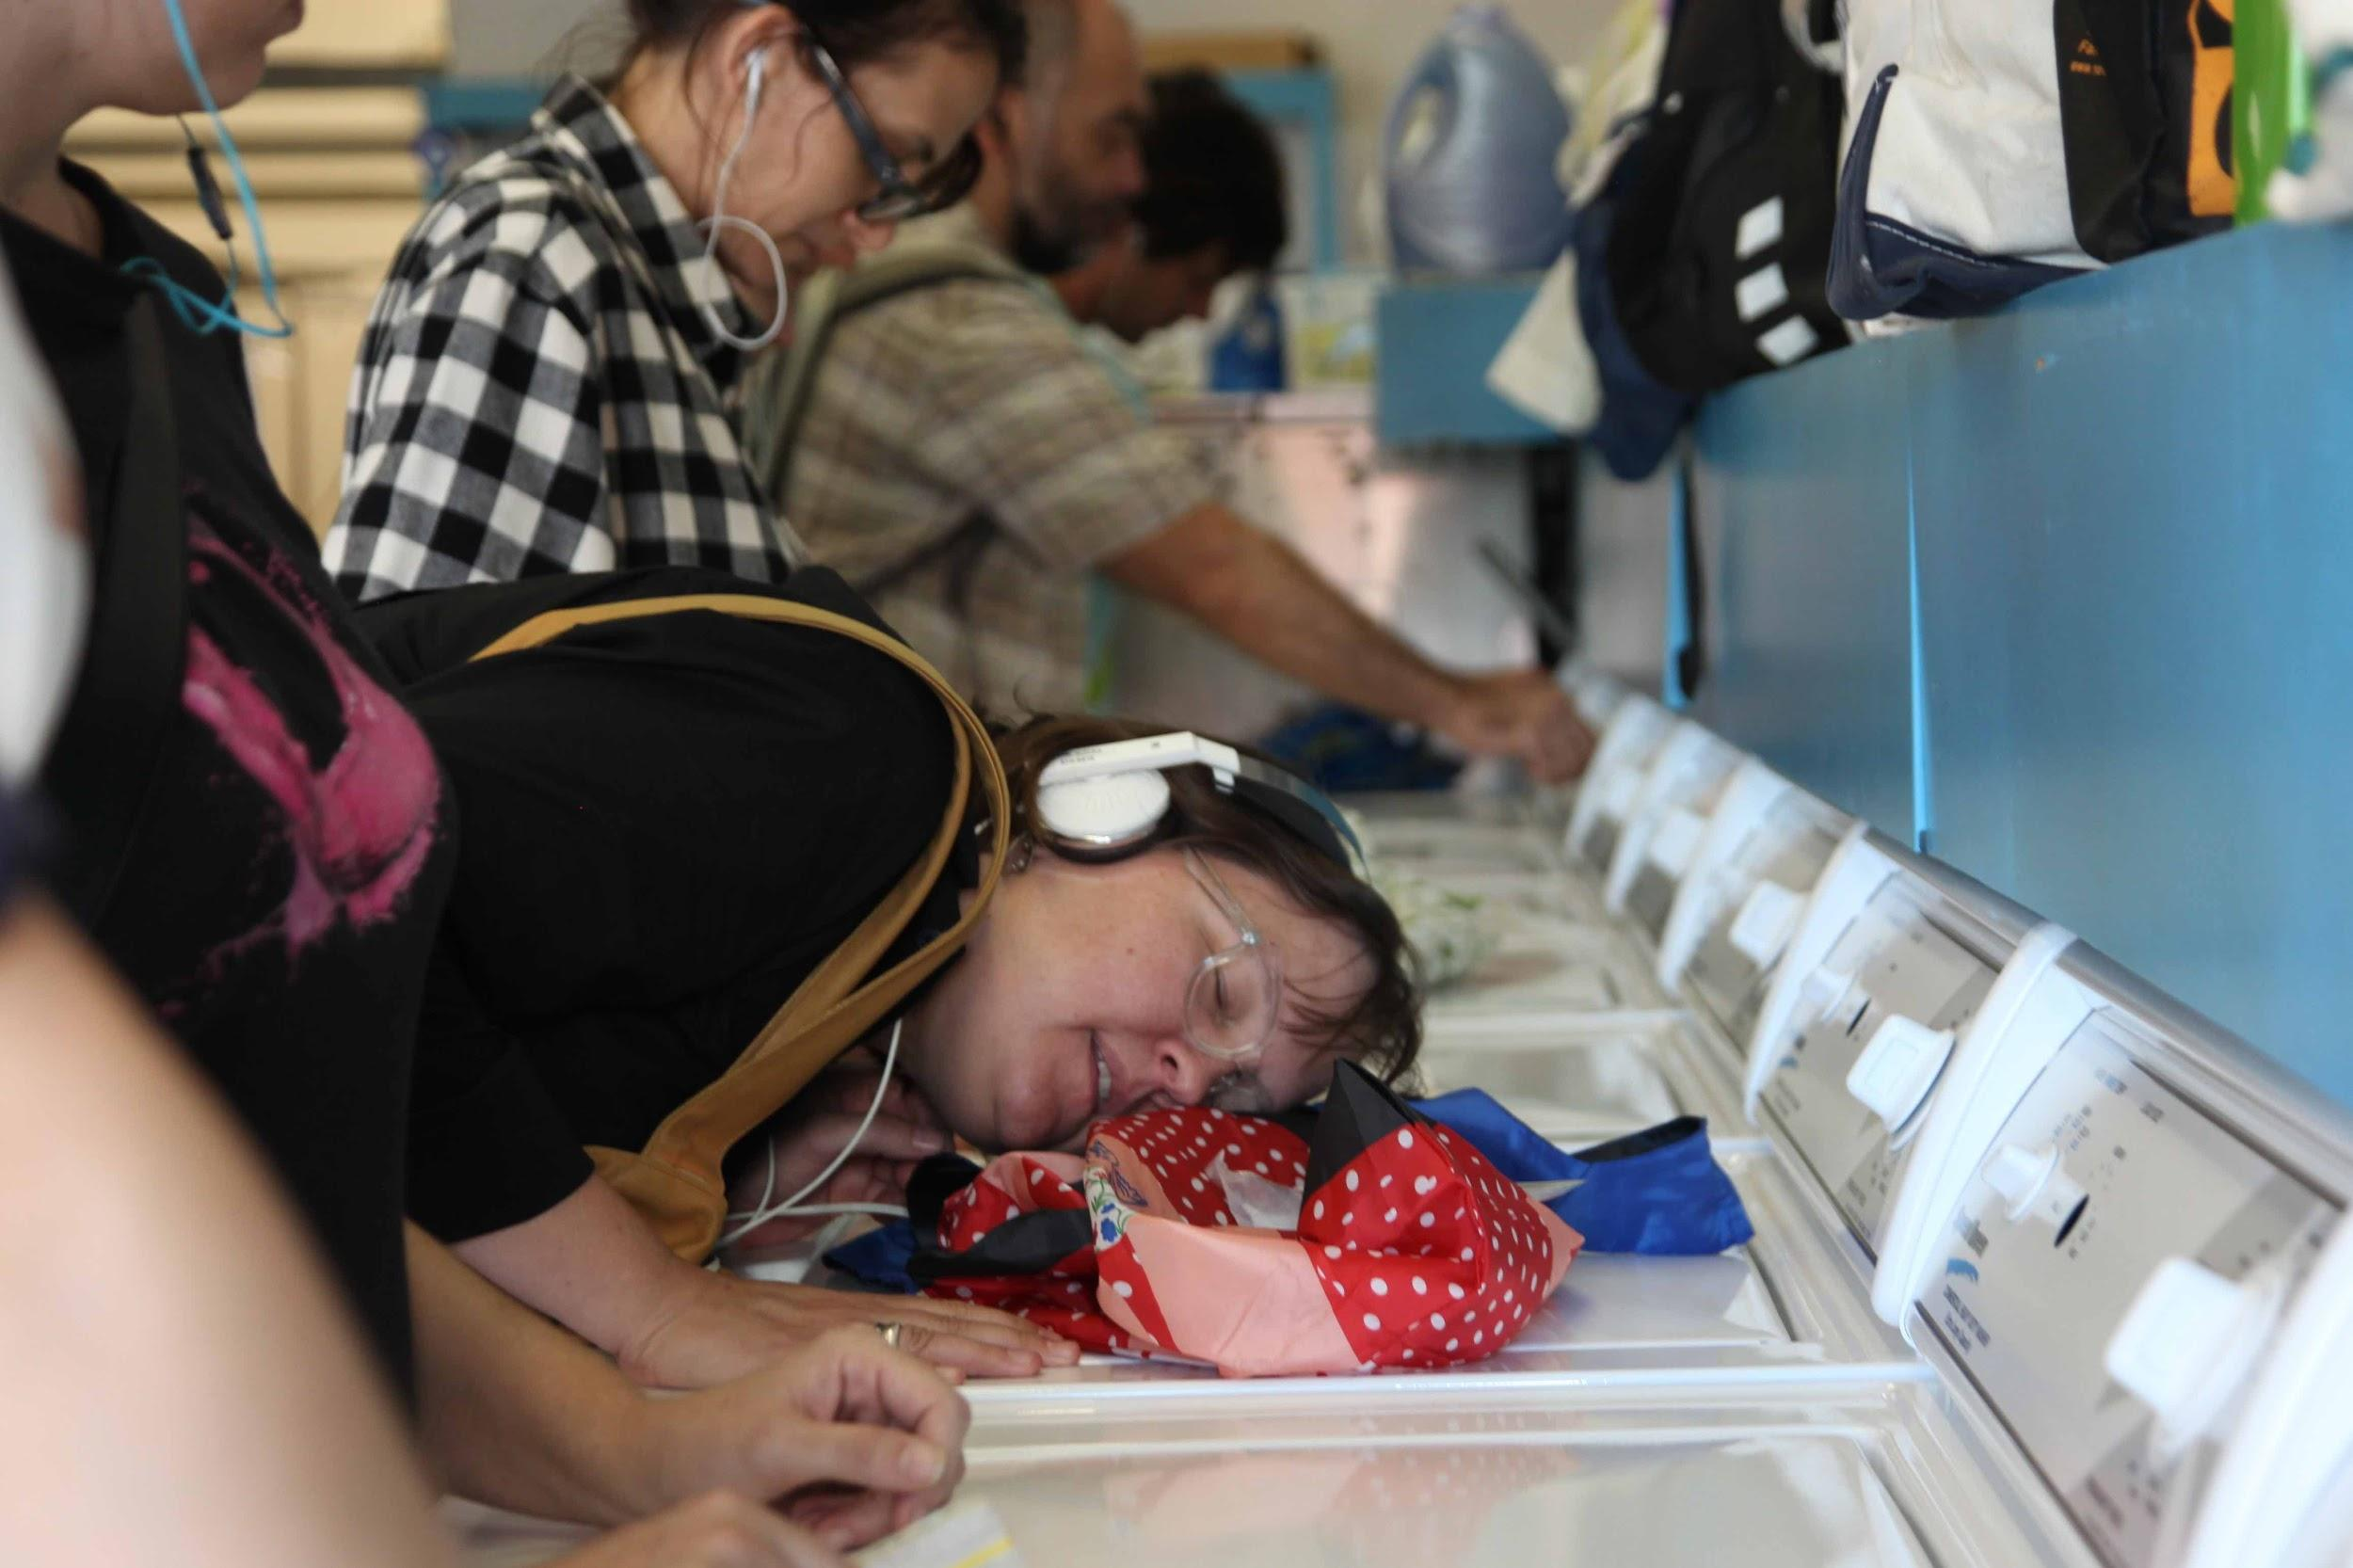
Walking to the Laundromat
www.walkinglab.org
Notes:
This was an audio walk I designed with SOUND ARTIST Dan McHugh -

Slide 6
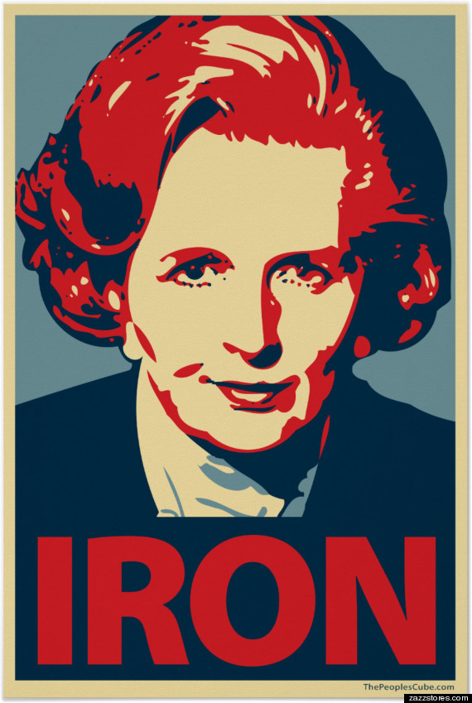
Iron Lady
www.theactualironlady.tumblr.com/
Notes:
This is my current commission from PADA to devise a new work for the city of adelaide - using the humble ironing board.
Iron Lady is a comedic intervention into the finance district by an artist armed with an ironing board.
This work starts from the premise that finance and the ‘business model’ is an experimental playground that peddles in speculation, fiction, and value creation.
This work straddles the boundary of a pop-up shop, participatory exchange, dating and counselling service, and artisanal salon.
This work starts from the premise that finance and the ‘business model’ is an experimental playground that peddles in speculation, fiction, and value creation.
This work straddles the boundary of a pop-up shop, participatory exchange, dating and counselling service, and artisanal salon.

Slide 7
Feast and Famine Economy
Notes:
Before laying out the embryonic thinking behind the laundromat - first it is important to identify the terrain that informs the concept.
Artists work precariously and stitch together a livelihood known as the feast and famine economy - also known as the gig economy.
The beautiful laundromat is a response to the unpredictable flux in behaviour of our gigs.

Slide 8
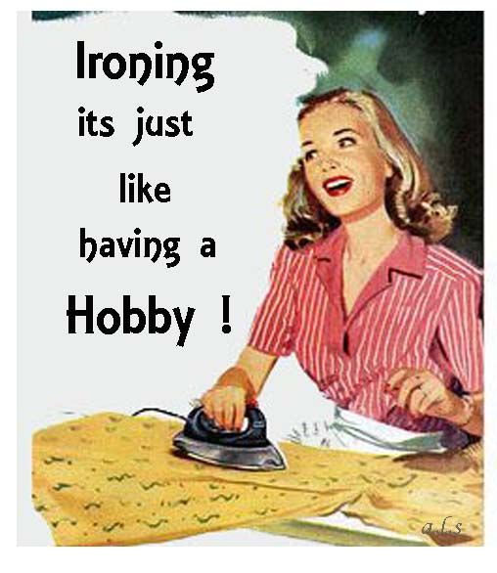
postfordism + artist labour
Notes:
Feast and famine is characteristic of what is commonly called the post-fordist economy.
Everyone now aspires to the condition of the artist - we work 247, we are very flexible, we can be hijacked by our emotions or make decisions to do a job based on our value system — but there are also some special properties of artist labour that I think could be celebrated.
It’s interesting how in this space of mobile offices and digital nomads - coworking spaces have emerged with vigor, discovering what many artist run spaces have been doing for decades, but now monetizing it. Removing the self-determining governance structures, in exchange for a fee schedule.

Slide 9
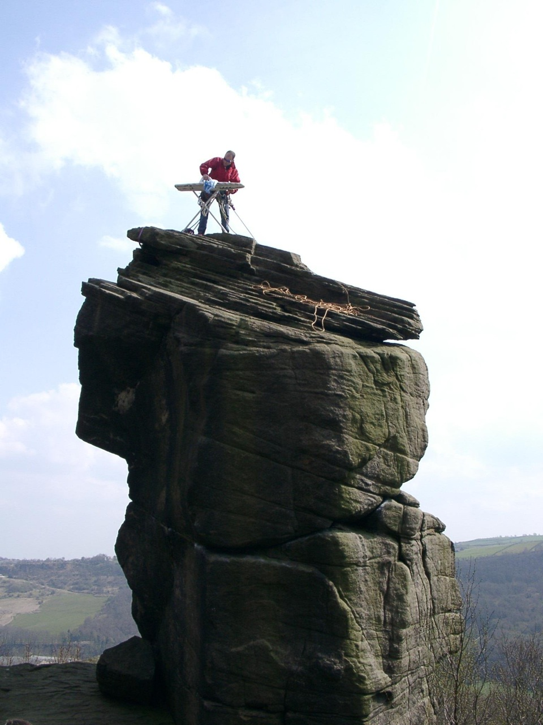
domestic + gendered + ordinary labour
Notes:
Much of artistic labour is quite ordinary and has much in common with invisible labour or gendered labour in the domestic sphere.
It also shares the conundrum of much care and emotional labour, where the intangible contributions it makes to the economy fit awkwardly in today’s metrics.
The laundromat is also an interesting space of public private zone - where the usually private laundering of clothes is made public and the labour behind it given a price tag.
Here is an image of a sport called Extreme Ironing

Slide 10
Artist-led economy
Notes:
I am calling this artist-led economy but this is because it’s shorthand for practice-led.
The things we do, the active things, need to shape the economy - and principally, in artist led economies, no one makes decisions who isn’t affected by the result of those decisions.
Practice led is coalface to use an antiquated and inappropriate metaphor.
When I work as a director, I have all the privilege of the status of when the gig goes right, but when it goes bad, it’s also my fault. It means I am connected and affected by the decisions I make.
I’m only as good as my work, and the division of labour is always about what is useful for the project that we are all working on.
If I’m a lighting designer, my interests are also with the performers.. Etc.
We have a shared interest in a successful art experience
Even individual artists don’t work on their own - there are multiple support systems that go into what is a shared enterprise and ecology.
Perhaps most importantly, artists use a value system to make decisions that frequently do not make “economic sense”

Slide 11
Why a Laundromat?
The enduring idea - you will always need washing
The commoning of what is essential domestic labour
Socialising hub - Hang out space -
Diversifying use of space - dual function of ordinary/extraordinary
Diversifying the main occupation of the artist - no longer exclusively just an artist
Art making is part of the mundane + ordinary everyday
The 247 use of space/building license
Putting artists in contact with an atypical audience and vice versa
Notes:
The enduring idea - you will always need washing
The commoning of what is essential domestic labour
Socialising hub - Hang out space - brings artists into contact a different
Diversifying use of space - making it dual function
Diversifying the main occupation of the artist
Art making is part of the mundane and ordinary and everyday - so is art making
The 247 use of space/building license
Putting artists in contact with an atypical audience and vice versa

Slide 12
Money Laundering
6 months of R&D
Governance models
Finance arrangements
Building Compliance
A business model
Notes:
6 months of R&D
Governance models
Finance arrangements
Building Compliance

Slide 13
A Very Beautiful Laundromat
www.averybeautifullandromat.com
Notes:
This a project that I am working on. This is the website if you want to check it out.

