Slide 1
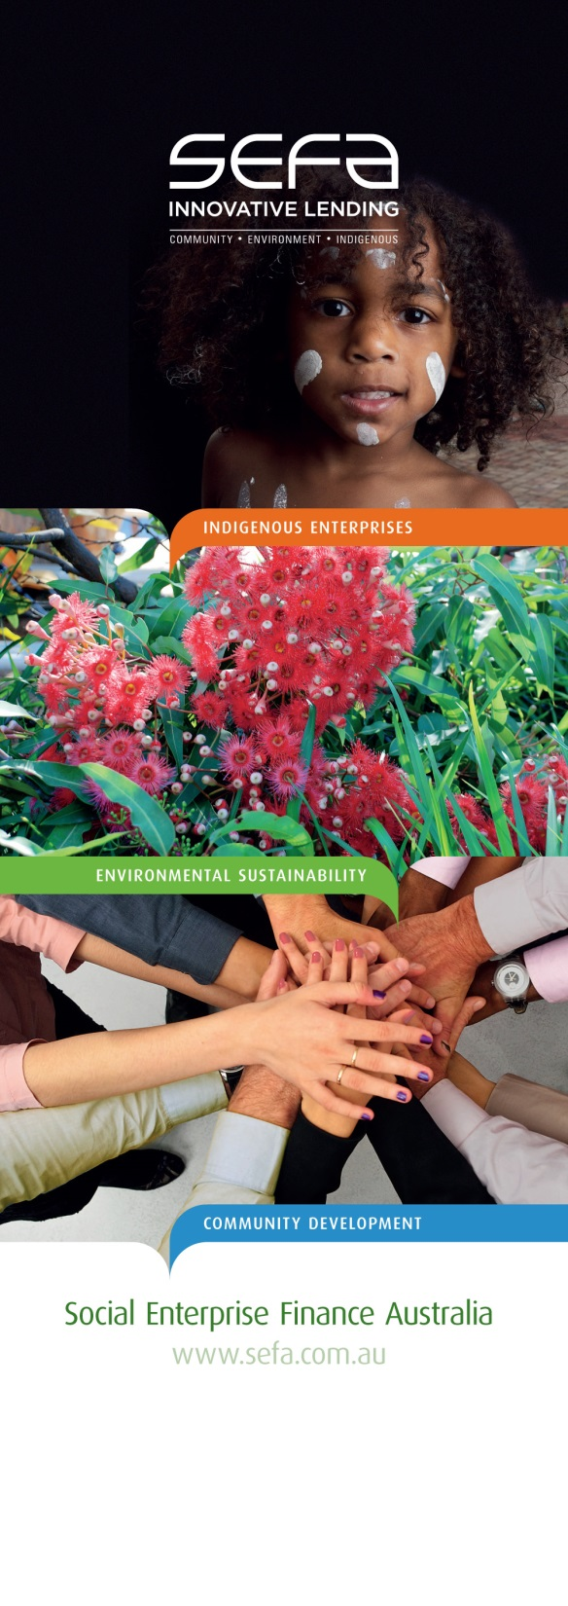
AELA – Building the New Economy
Building inner-city communities through co-operative housing
Hanna Ebeling, Relationship Manager, SEFA

Slide 2

Social Entrepreneurship and Social Finance

Slide 3
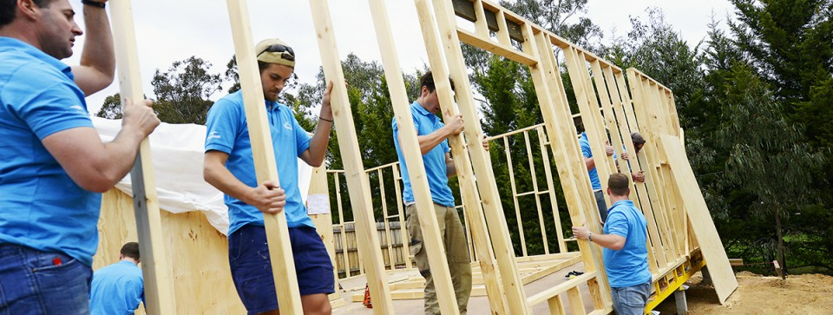

Home Ownership – HfH Victoria
Habitat for Humanity Victoria received an innovative finance structure from SEFA that leverages their successful business model:
Access to affordable housing
Improved long-term outcomes in the areas of education, employment, health and lifestyle for parents and children
Increased pace of construction
The outcomes are home ownership for low income families and pathway to financial sustainability for HfH Victoria.

Slide 4

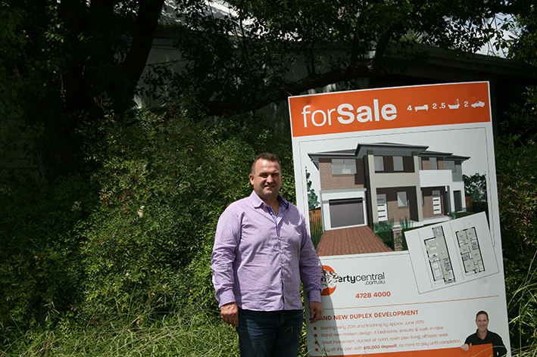
Social Housing – Sustain
Sustain Community Housing owns a plot of land in Western Sydney. SEFA & SVA are funding its development:
Sub-divide the land into three plots
Construct three duplexes
Sell two to repay investors (cross-subsidisation)
Retain the third duplex as social housing
The outcome is more social housing.

Slide 5
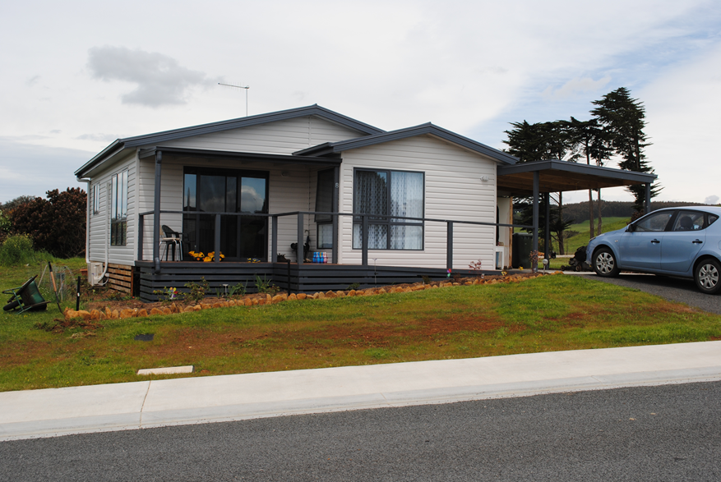
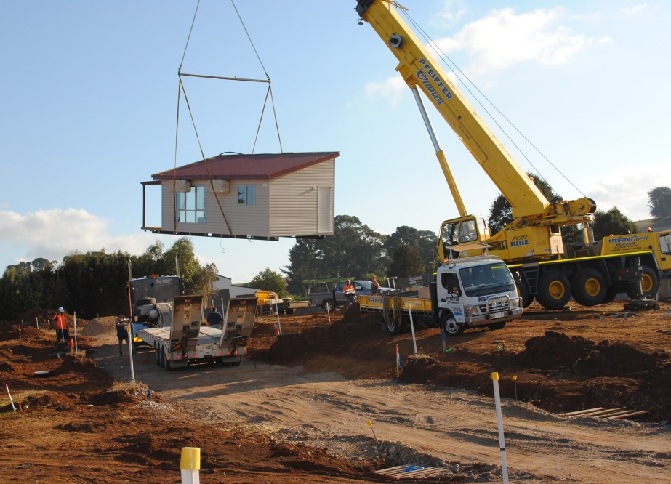
Affordable Retirement Homes– Myrtle Park
Myrtle Park is a community-led organisation in regional Tasmania (Yolla), providing affordable retirement accommodation for its members:
Increase affordable housing options for retirees from 6 to 11 units
The new units were prefabricated off-site to keep costs low
Members pay rent to cover (mainly finance) expenses
Enabling residents to retire in their ‘own’ community
The outcome is community empowerment to create integrated retirement housing solutions.

Slide 6

Finance for Housing Solutions
“… finding the magic recipe …”

Slide 7


Unlocking and Leveraging Housing Solutions
Capital stacking
Co-housing / Co-operatives (German Building Group Model)
99 year lease (Community Land Trust)
Sweat Equity
Mixed Tenancies / Developments
Shared Equity Schemes
Design & Sustainability

Slide 8
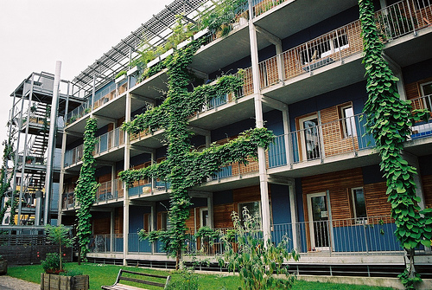
German “Building Groups” Model
Community empowerment
Affordability
Sustainability
Intergenerational equity
Advocacy
Government and industry support

Slide 9
Nightingale Housing Model
Financial Return
Sustainability
Financial Return
Sustainability
Liveability
Liveability
Traditional Developer Model
Nightingale Model

Slide 10
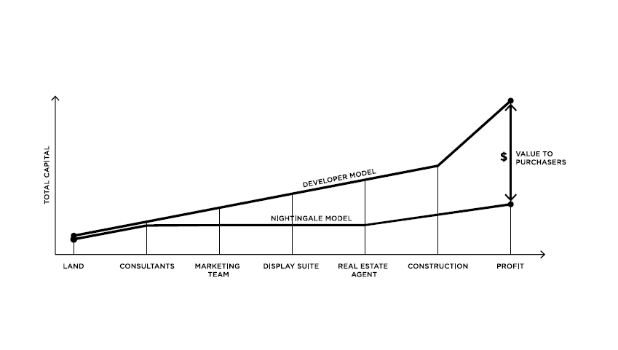
Nightingale Housing Model

Slide 11

First-home buyers form community
Legal Entity
(e.g. Pty Ltd with shareholders or cooperative with units)
Debt syndicate lends directly to legal entity:
Future owners deposit their “equity” in form of shares/cooperative units
Construction Finance
Transition to “blanket” mortgage

Slide 12
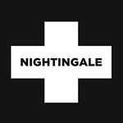

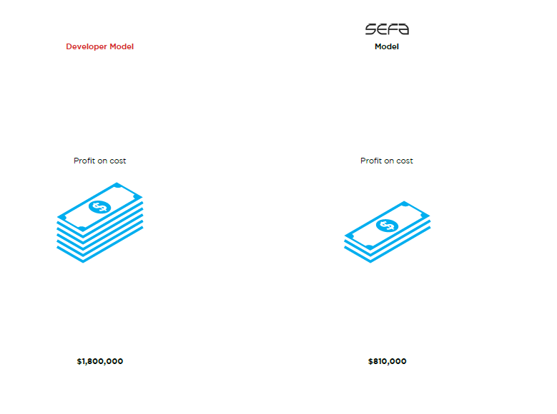

Nightingale Vision
Developer Model
Each apartment is 16% cheaper ($85k) compared to conventional development
Equity Profit on cost
Equity Profit on cost
Equity Profit on cost
$1,800,000
$810,000
$100,000
Notes: assumes 20 unit development

Slide 13
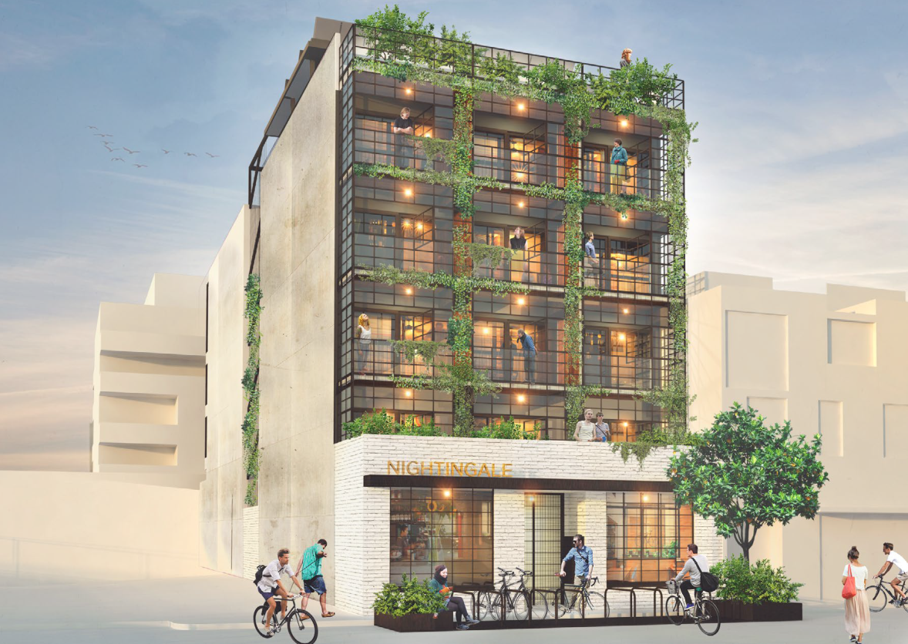
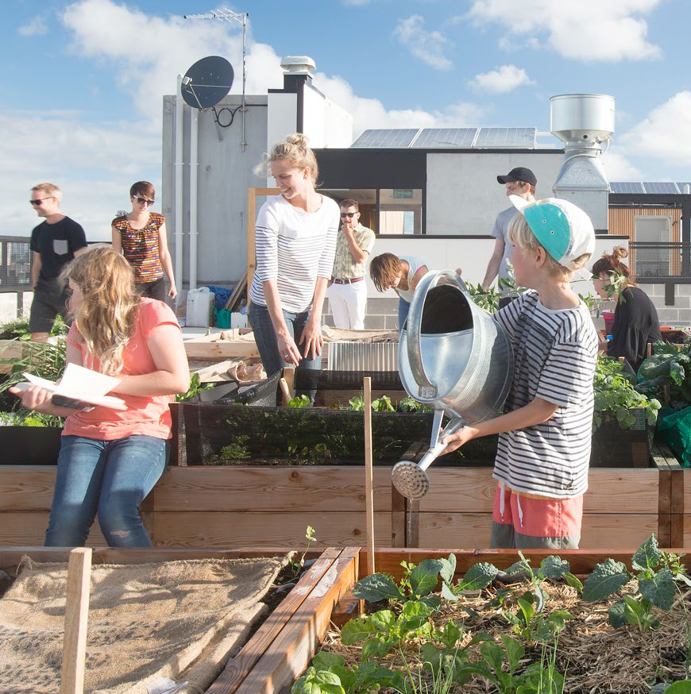
Nightingale on Florence Street
http://nightingalehousing.org/home#projects

Slide 14
Contact Us
SEFA
Hanna Ebeling, Relationship Manager
SEFA office: 02 8199 3360
hanna.ebeling@sefa.com.au
Website - www.sefa.com.au
SEFA Video introduction
MiHaven Video – social investment for indigenous outcomes

