Slide 1
Building the new economy: activism, enterprise and social change
Local Government plays a role in “New Economy”
Presenter – Adele Johns
Community Enterprise Officer
Central Coast Council

Slide 2
Local Governments plays a role in “New Economy”
Conference themes addressed by this presentation: work, exchange, and our relationship with the natural world
Keywords: Local Government; collaboration; sustainability; social enterprise.

Slide 3
Local Governments plays a role in “New Economy”
Local Government have an essential part to play in “the New Economy”.
Globally, local government entities are increasingly looking to new methods to build community capacity, stimulate growth and deliver services and programs within their shrinking revenue base.

Slide 5
Local Governments plays a role in “New Economy”
Local Council are positioned at the forefront of the community, providing essential services that meet the day to day needs of the community that they serve.
This provides access to the community, and like wise the opportunity to work with, and understand the communities unique requirements.

Slide 6
Central Coast Council
To meet the emerging trend Central Coast Council has developed a unique approach in support of emerging “community enterprise”
A key element of Councils Community Enterprise program is a desire to increase micro business development.
Combining community and economic development principles to build community capacity and cohesiveness, strengthen localised employment and training opportunities and stimulate local economic growth.

Slide 7
Central Coast Council -Launch Pad
At the core of this approach is a desire to stimulate local enterprise growth in a supportive environment, developing a program that encourages innovators to formulate their enterprise ideas enabling them to articulate and finesse the sustainability aspects to a ‘launch’ ready stage.

Slide 8
Central Coast Council -Launch Pad
In 2016, 14 local entrepreneurs joined the ‘Launch Pad program with some out standing results.

Slide 9
Central Coast Council -Launch Pad
A diverse array of project ideas are supported to be ‘launch’ ready during the Launch Pad program.
A sample of the participant ideas –
‘Duquaponics’ (a concept of food sustainability) now partnering with local manufacturing firms to pilot innovative solutions to sludge waste.
The Yarn Tree’ - a project with the aim of developing permaculture beds within a Council facility engaging local community members.

Slide 10
Central Coast Council -Launch Pad
Shoebox Revolution’ – providing care packages that support the homeless, engaging work for the dole participants as a pathway to employment.

Slide 11
Central Coast Council -Launch Pad
This supported learning environment is based on a six step process, engaging keynote topics for start-up enterprises to:
develop their edge,
get clear on their social impact,
look at their sustainability, and viability in the market,
honing leadership skills and business acumen.

Slide 12
Central Coast Council - Activate
The Activate project is a unique partnership project with shopping precincts and vacant retail spaces.
These partnerships create opportunities for a diverse range of enterprises, from Arts collaborative, to Vintage recycle to upcycling, to raising awareness of Fair trade concepts and vulnerable communities that need support via the social enterprise movement.

Slide 13
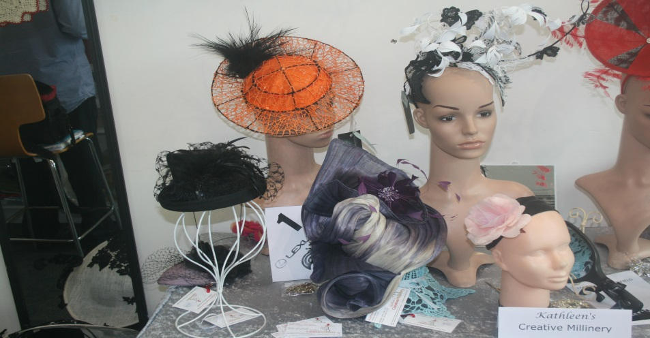
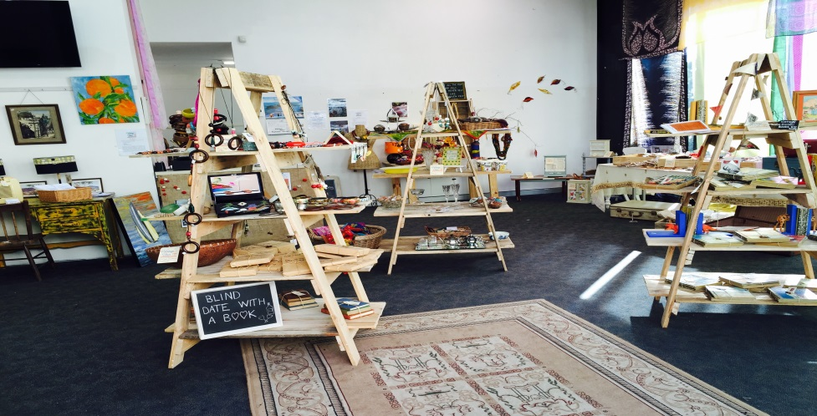
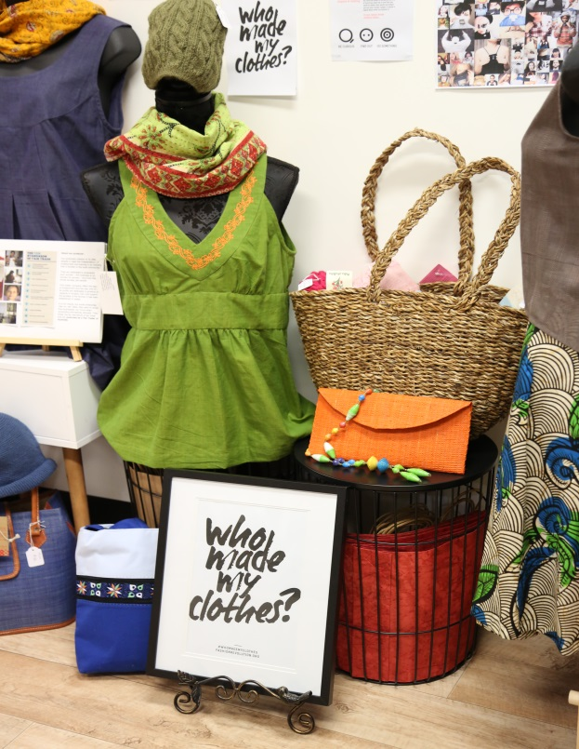
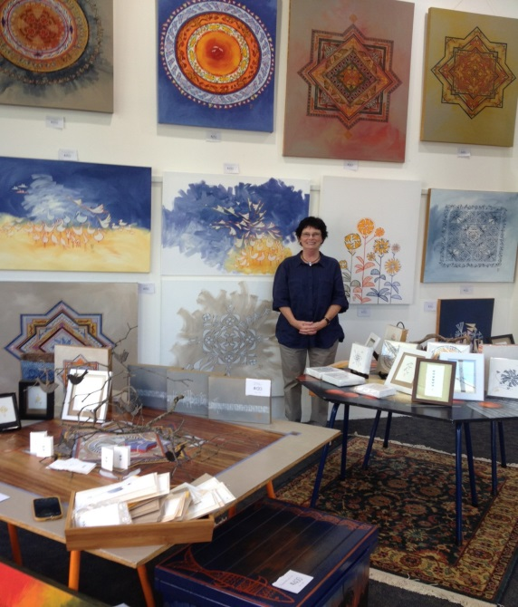

Central Coast Council - Activate
Kathleen’s Creative Millinery
Vintage Fair
Angels of the Rainbows
Art by Barbara
The Fair Trade Hub

Slide 14
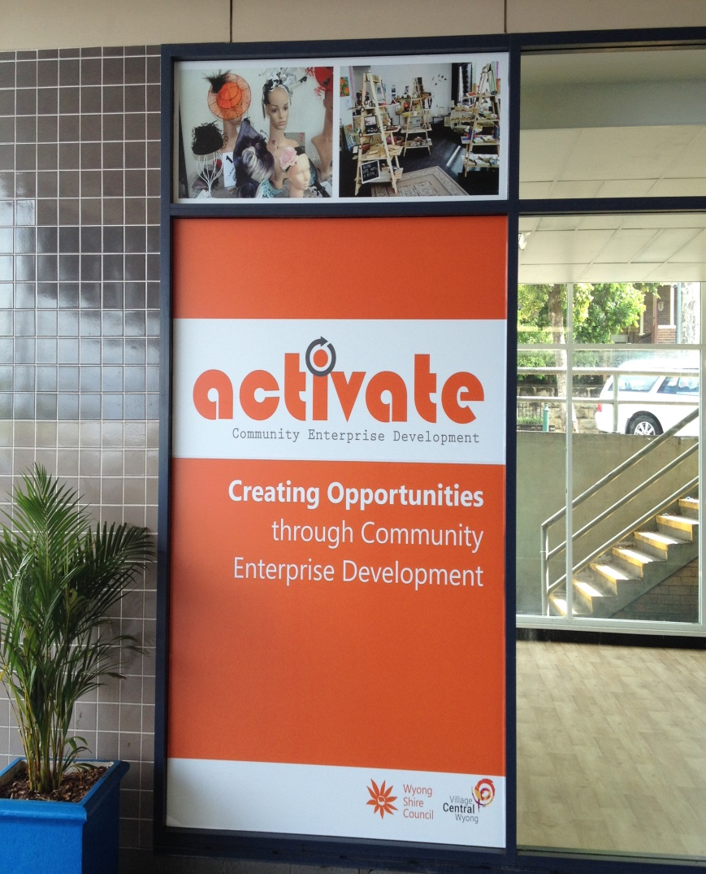
Central Coast Council- Activate
Tenants of the Activate project gained exposure to over 100,000 visitors a week plus the opportunity to ‘road-test’ their enterprise idea in a professional retail environment for a 28 day period.
Over 20 enterprises expressed an interest to be part of the Active project .

Slide 15
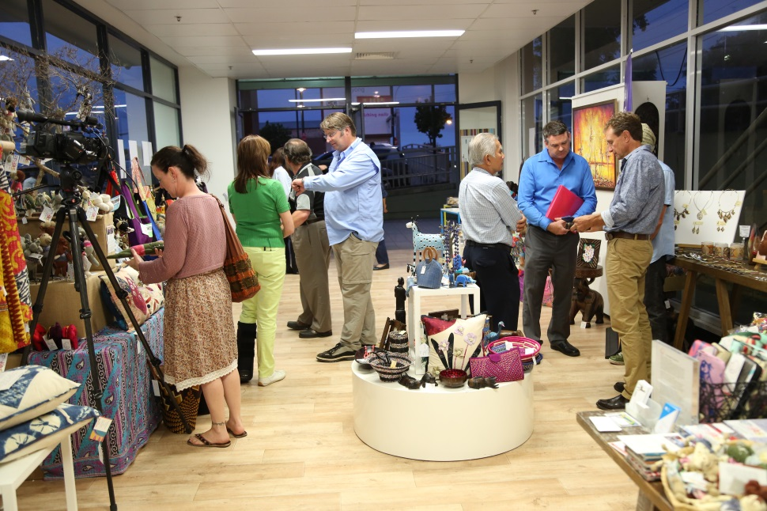
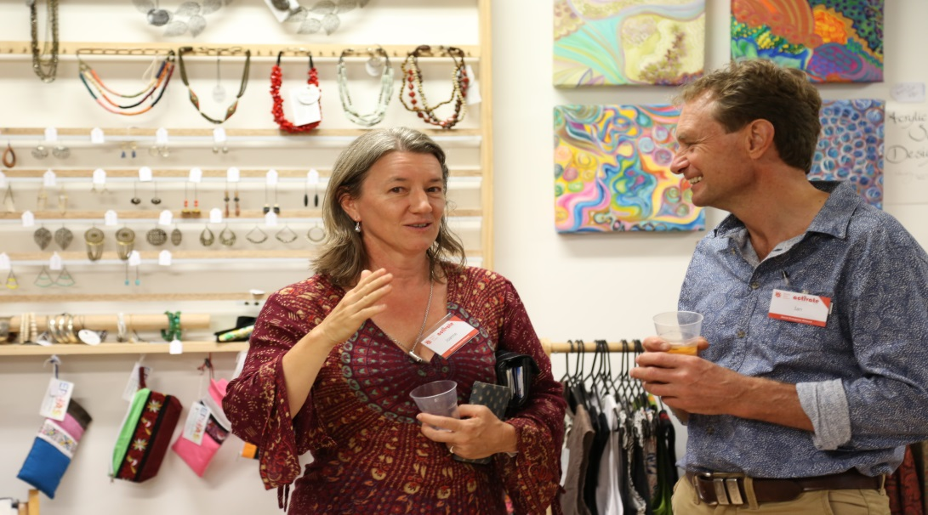
Central Coast Council- Activate
The Fair Trade Hub – a collective of 4 ethical traders came together to form the ‘pop-up’ experience, educating the local community of ‘Fair Trade’ issues and the opportunity to support remote communities.

Slide 16
Central Coast Council- Activate
Here is a snap shot of the economic outcomes over nine months of the Activate project.
Overall sales - $62,905
Foot traffic into the shop – 9362
Days open for trade – 308
Volunteers engaged within the shop – 75
Engaging 9 Enterprise concepts

Slide 17
Central Coast Council - Activate
Bed and Breakfast program –
52 local residence engaged in a Bed & Breakfast information session to ‘Activate’ unused ‘bedroom space’ to create economic returns, and socialisation.
With the development of a new Art House in the town of Wyong, it was an optimum time to provide alternate accommodation offerings for cast and crew, and audience.

Slide 18
Central Coast Council- Social Enterprise
From its inception the Social Enterprise program has:
Developed and delivered 45 capacity building workshops with 820 attendees, involving 48 different organisations
54 graduates have been through the entire workshop series
20 newsletters and updates to over 450 recipients

Slide 19
Central Coast Council- Social Enterprise
45 property owners, business chambers, shopping centres, government officials and entrepreneurs at Place Activation workshops
45 key stakeholders at Regional Planning events
90 attendees from Central Coast Social Procurement and Economic participation forum
10 networking events – over 400 attendees
Social leadership workshops with over 40 attendees

Slide 20
Central Coast Council- Blue Economy Forum
57 attendees at a recently staged Forum addressing the ten Blue Economy principals, creating a space for business, non-profits, entrepreneurs and individuals to come together - creating opportunities to collaborate in innovative ways in addressing waste emissions and effective resource allocation within the community.

Slide 21
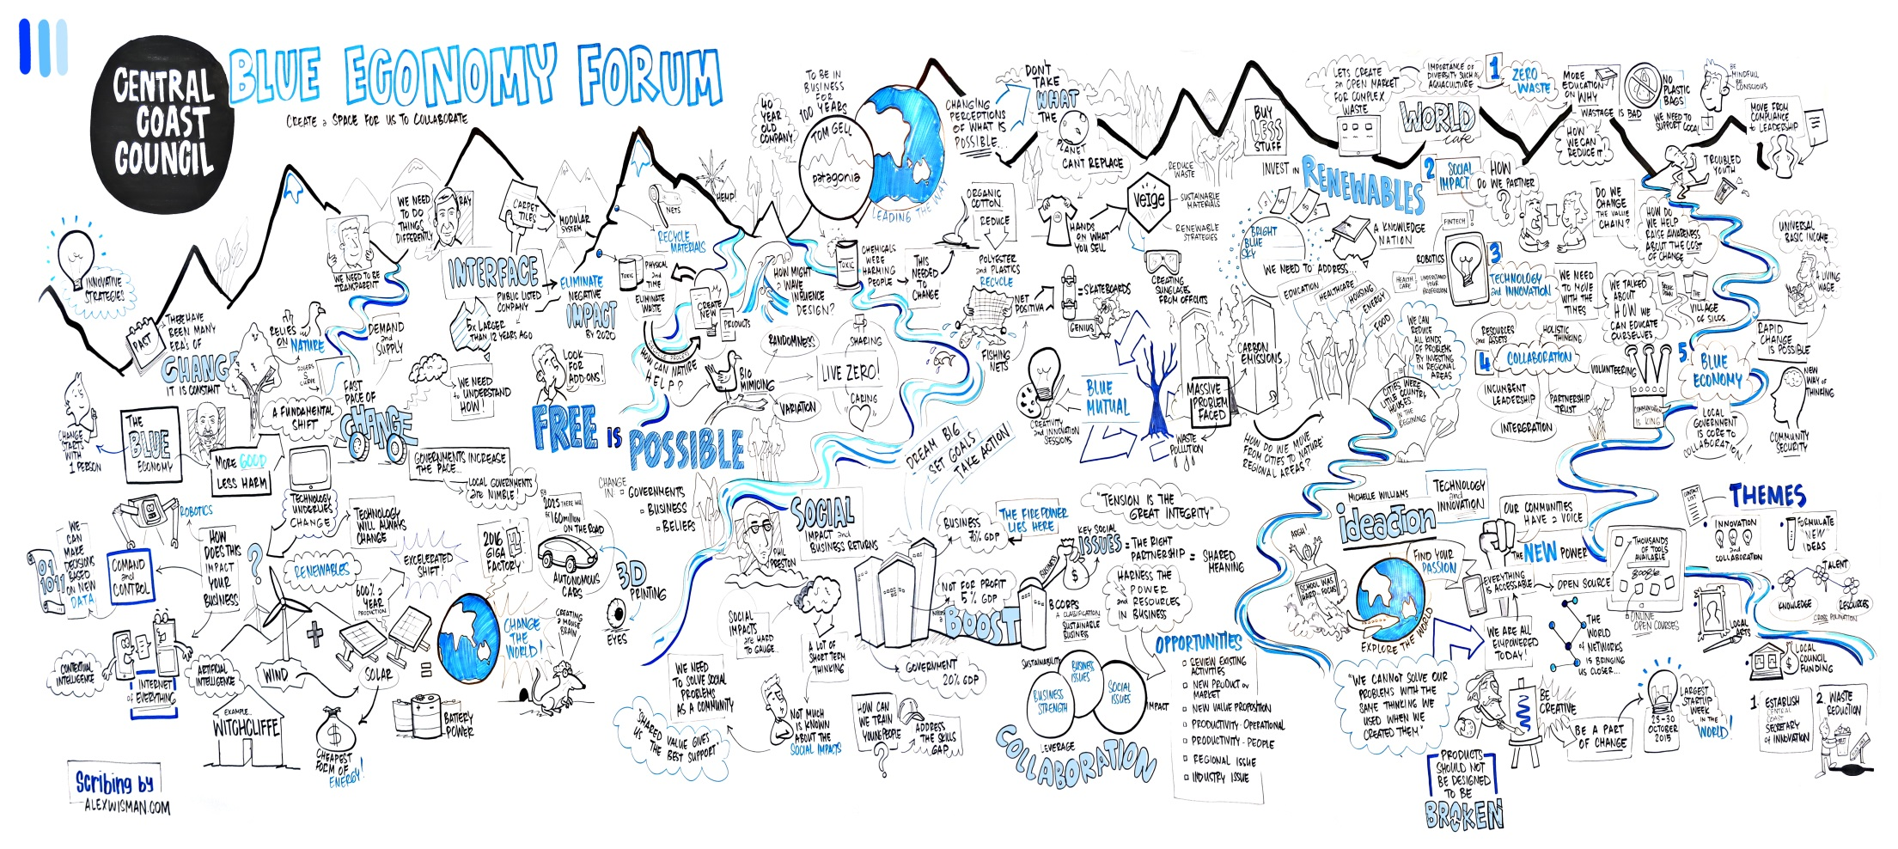
Central Coast Council- Blue Economy Forum

Slide 22
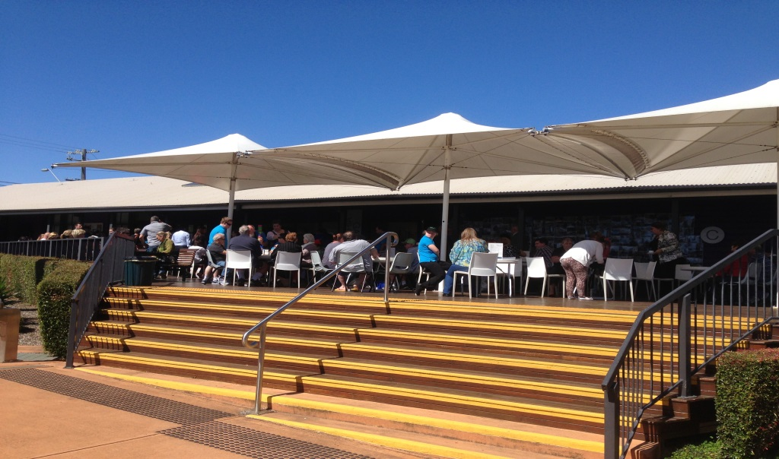
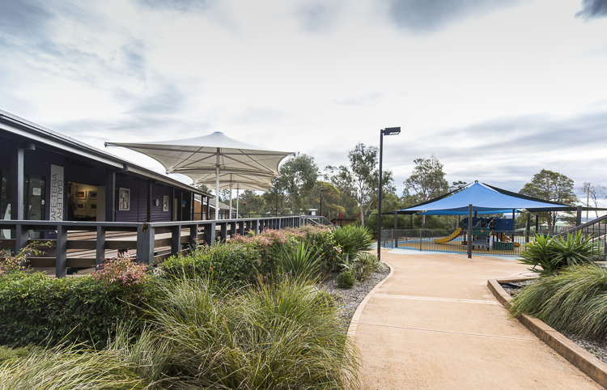
Social Enterprise Cafe’
Within a busy community hub at The Entrance, Council has been working with a local non profit association ‘Horizons Family Services’ to create pathways to employment and training via the Café for young families that have been receiving long term welfare benefits, this enterprise creates pathways to employment whilst providing healthy eating alternatives to the local community.

Slide 23
Central Coast Council
These projects that have been developed within Council to create and effect change for the community are great examples of how Council can and is engaging their community to provide opportunities that building ways for a ‘new economy’.

Slide 24
Central Coast Council
Thank you,
Adele Johns
Community Enterprise Officer
Central Coast Council
adele.johns@centralcoastcouncil.nsw.gov.au
0243505449

