Slide 1
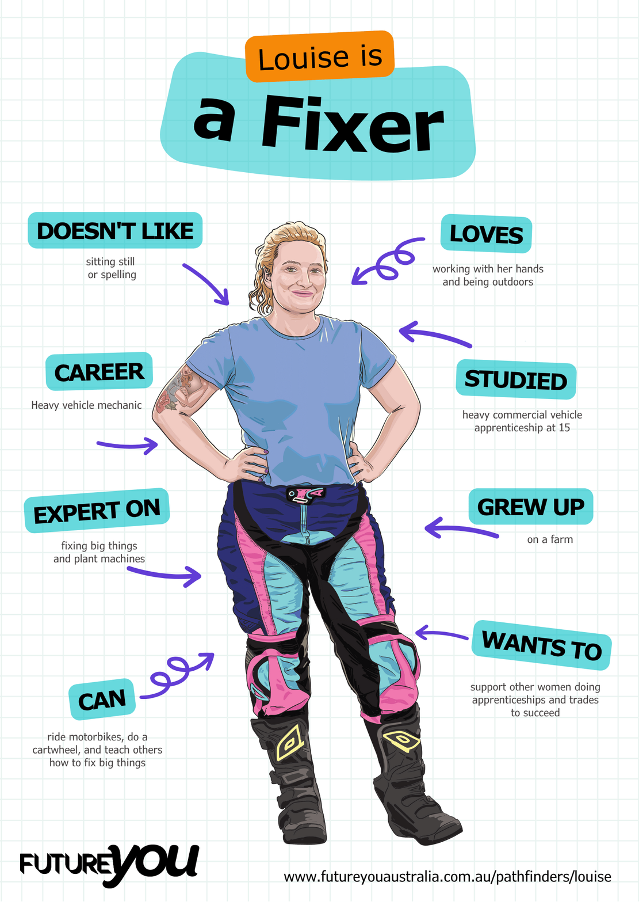

Lesson 2:
Sentence Types
Understanding different forms of sentences and their uses

Slide 2
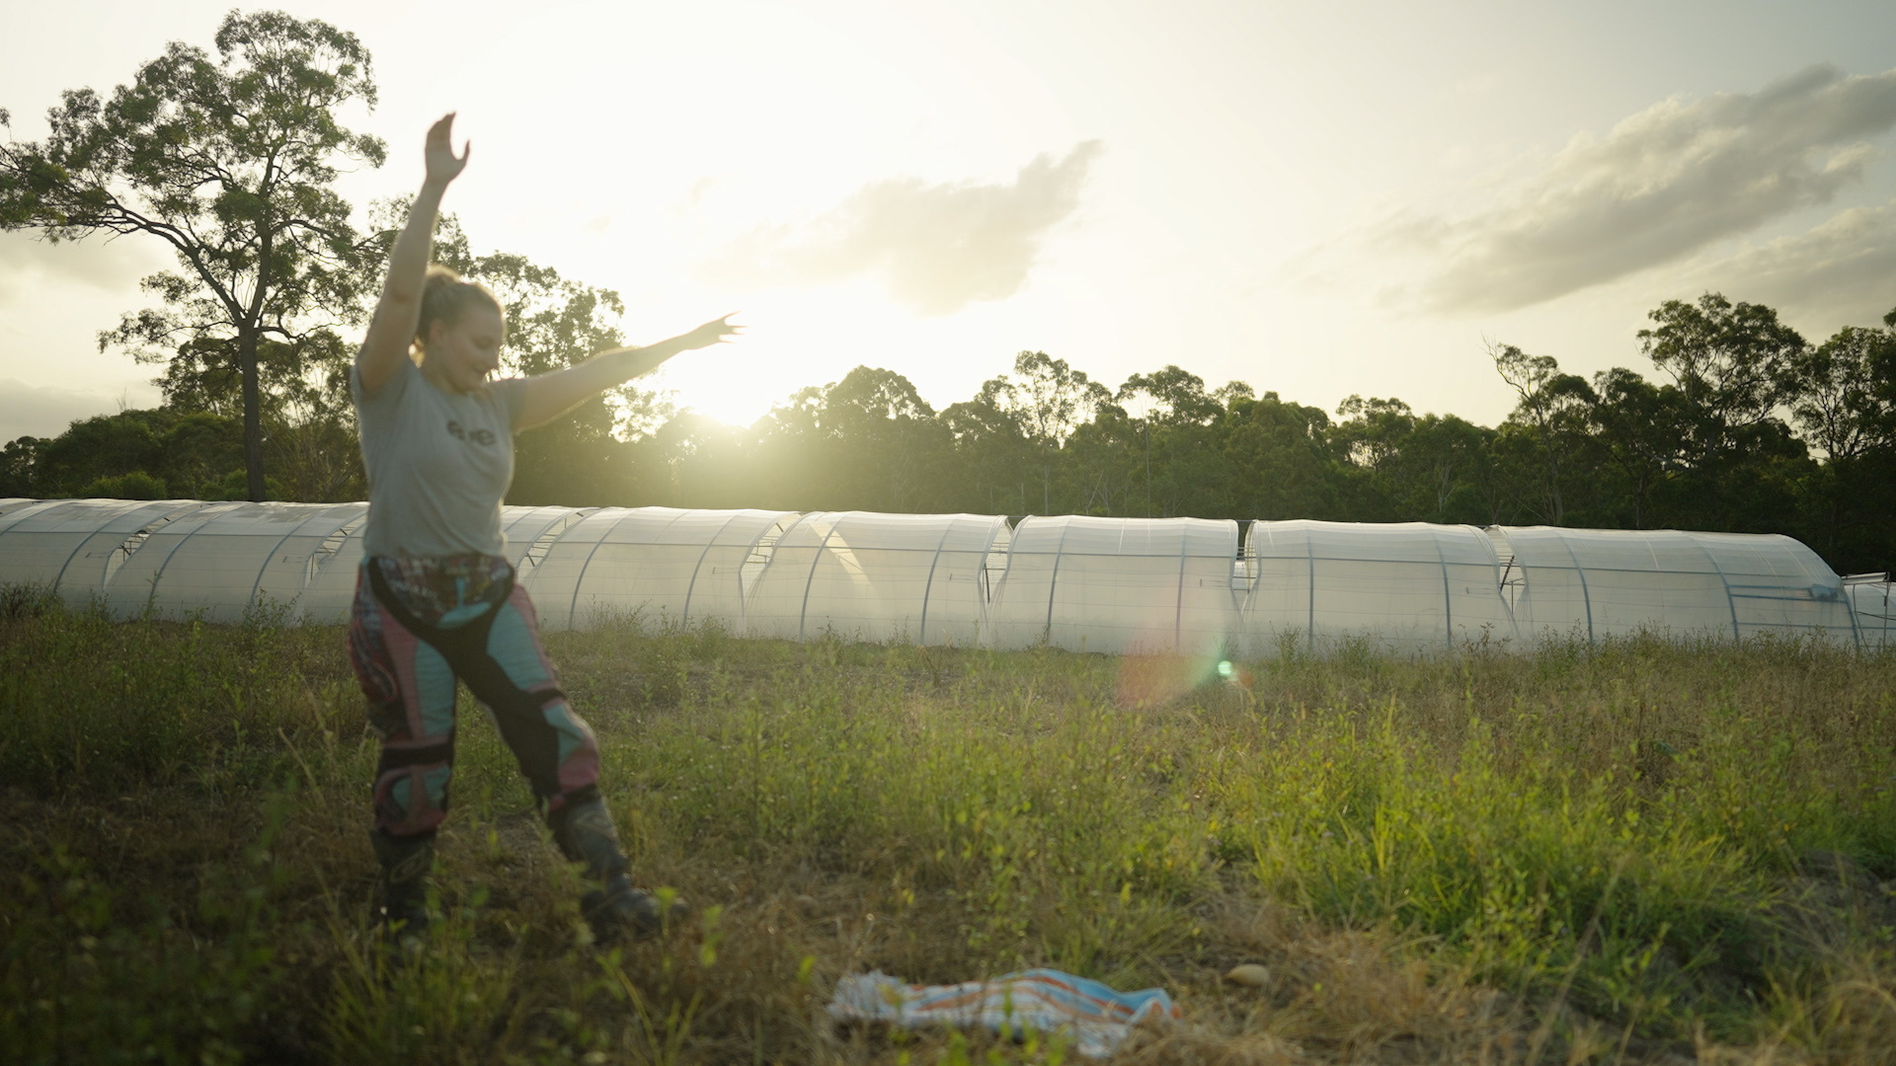
Lesson overview
Hook & Introduction
Group Work
Stretch & Share
Wrap-Up Reflection
5–7 mins
20 mins
15 mins
5 mins

Slide 3
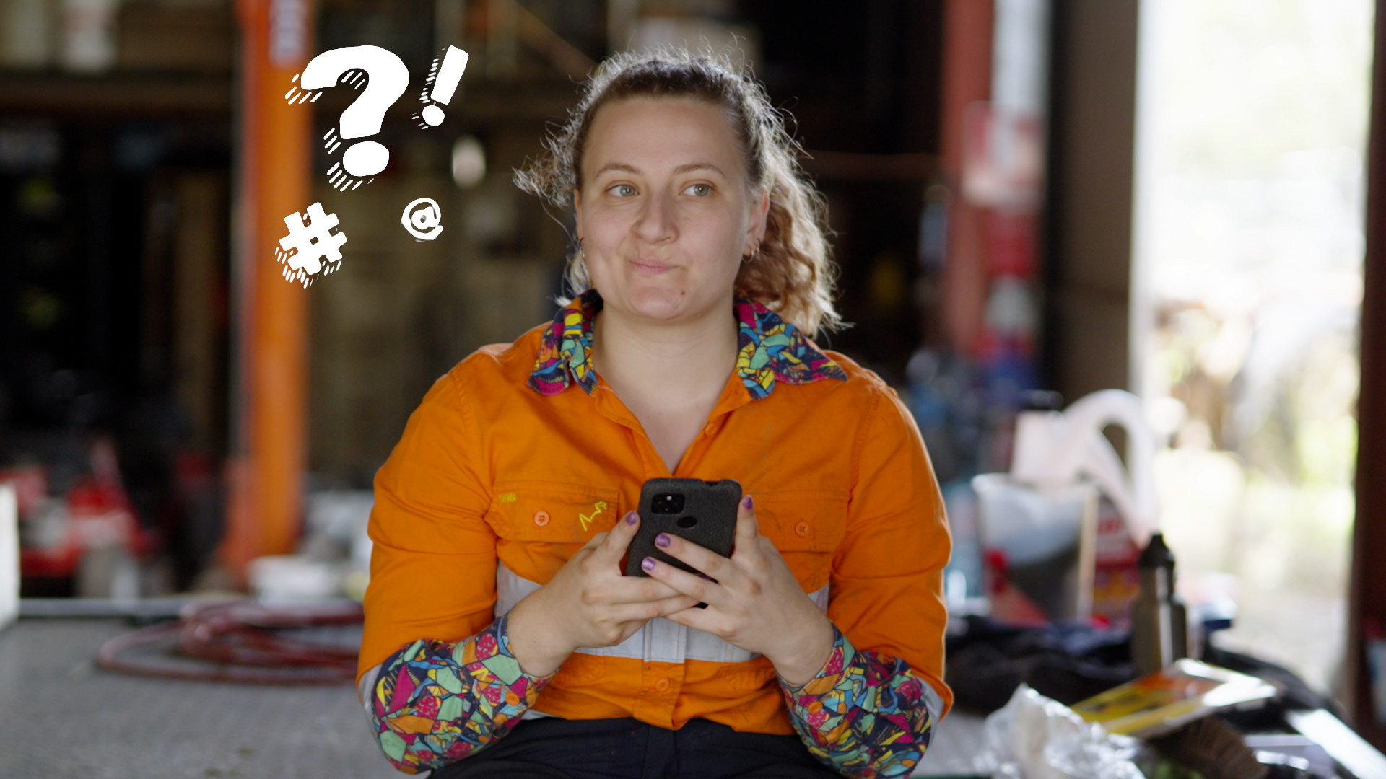
What makes a sentence?
Who knows what makes a sentence?
Let’s see what the class says.

Slide 4
What makes a sentence?
A sentence is a group of words that has a subject and a verb and makes sense on its own.
Notes:
On the board, point out the difference between a phrase and a clause that can also be a sentence. For example:
Phrase: under the truck ❌
Clause: Louise fixed the truck ✔️
Dependent clause: because the truck broke ❌
Sentence: Louise fixed the truck because it broke. ✔️

Slide 5
What makes a sentence?
A sentence starts with a capital letter,
and ends with one of these punctuation marks:
- a full stop
- a question mark
- an exclamation mark

Slide 6

What makes a sentence?
Examples:
I am going to the dentist this afternoon.
Do you think it will rain this weekend?
That dog is a happy and playful animal!
Notes:
It’s important to point out that a sentence can also be a question.

Slide 7
Sentence checklist
  Does the sentence make sense on its own and tell you a full idea?
If the sentence is confusing, it’s probably not complete.
  Does the sentence have a subject?
The subject is the "who" or "what" the sentence is about. This can be more than one thing.
  Does the sentence have a verb?
The verb is the action/feeling/linking word or "what" is happening/being felt.
  Does the sentence start with a capital letter?
Every sentence written down must begin with a capital letter.
  Does the sentence end with a punctuation mark?
Every sentence must end with punctuation, like a full stop (.), a question mark (?), or an exclamation mark (!).

Slide 8
Activity time: Is it a sentence?
Do you like to ride your bike?
ride bike like
I love doing puzzles!
Puzzles love
I have to finish my homework.
have homework finish

Slide 9
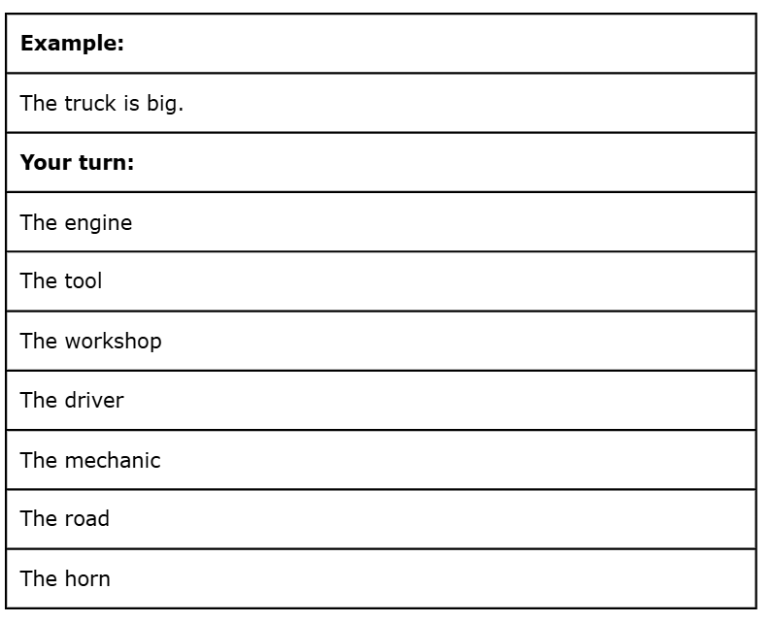
Individual activity:
Simple sentence lab
How it works:
Using the sentence starter cards, write three simple sentences.

Slide 10
Remember the checklist!
Sentence Checklist
  Does the sentence make sense on its own and tell you a full idea?
  Does the sentence have a subject?
  Does the sentence have a verb?
  Does the sentence start with a capital letter?
  Does the sentence end with the right punctuation mark?

Slide 11
Compound sentences
A compound sentence is made by joining two short sentences with a word like ‘and’, ‘or’, ‘but’ to make one longer sentence.
For example:
Simple:
The engine was loud.
The truck was big.
Compound:
The engine was loud and the truck was big.

Slide 12
Compound sentences
Joining words are called conjunctions. They join words, phrases, and sentences together. The most common type of conjunction is coordinating conjunctions.
The easiest way to remember your coordinating conjunctions is:
for
and
nor
but
or
yet
so
Notes:
These FANBOYS words help connect similar parts of a sentence. For example:
Nouns: peanut butter and jelly
Adjectives: small but mighty
Clauses: I wanted to go to the beach, but Daniel refused.
So, whenever you see a FANBOYS word, it’s probably joining two ideas together. That’s what makes sentences flow better and sound more interesting!

Slide 13
Compound sentences
Which FANBOYS conjunction will complete each of these compound sentences?
She loves reading, he enjoys writing.
and
It was freezing, they went swimming.
yet
but
I wanted to go to the park, I had to finish my homework first.
Would you like to watch a movie, do a puzzle?
or
I was tired, I went to bed early.
so
He didn’t call, did he send a message.
nor
I stayed home, it was raining outside.
for

Slide 14
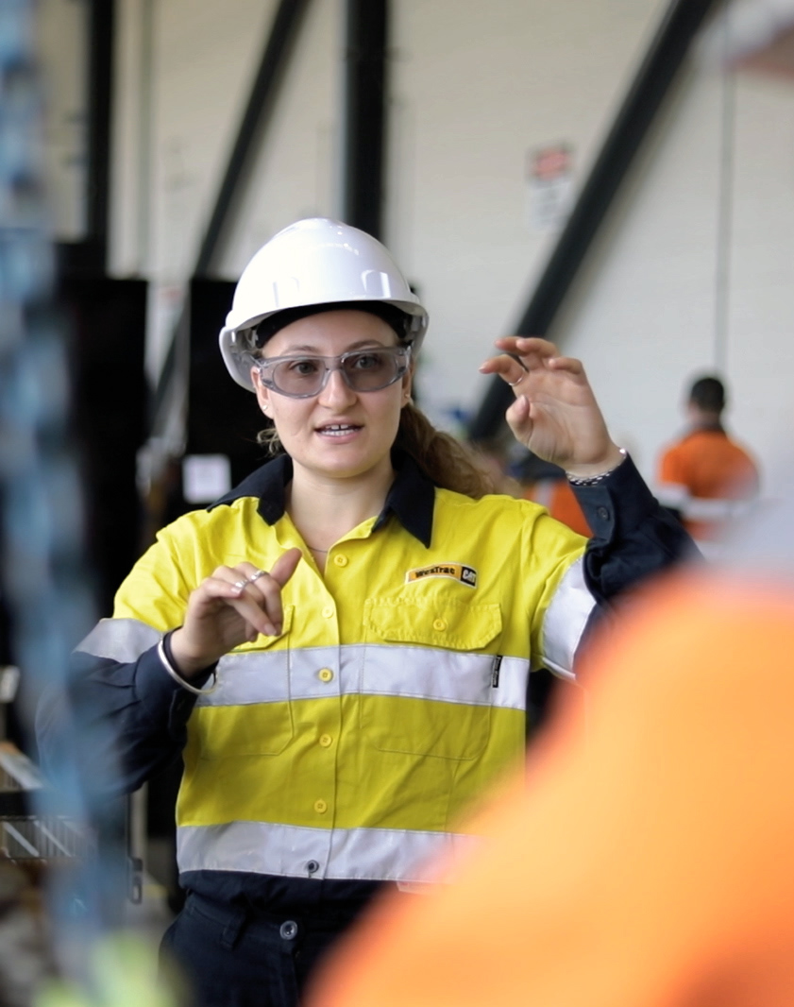
Group activity:
Sentence Builders
How it works:
  This is a fast-paced challenge.
  Use your sentence starters and your FANBOYS.
  Take turns adding one word at a time until the sentence includes one (or more) FANBOYS, and is in the correct order.
  Once complete, the group reads the sentence aloud to the class.
  The class votes on whether it is a complete compound sentence.
Notes:
This activity can extend with points for identification of subject and verb (and circumstances where used).
You can also add a digital literacy element which can be used by lower ability groups to check sentences by more advanced groups: https://www.writinglab.io/sentence-structure-checker

Slide 15
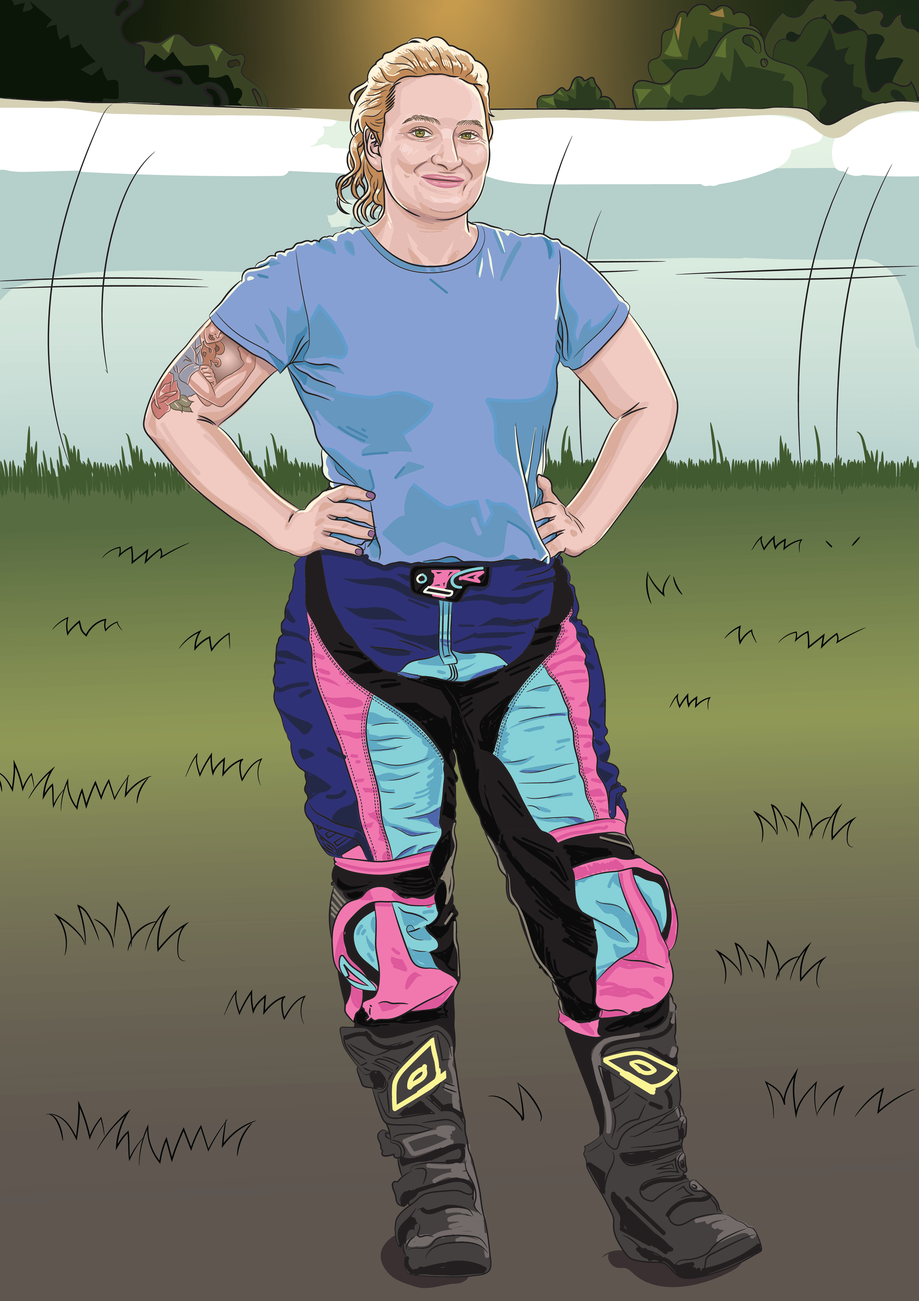
Reflect and Share
What makes a sentence?
What kind of sentences did you write today?

Slide 16
Reflect and Share
Write one complete sentence before leaving.
Lesson 2

