Slide 1
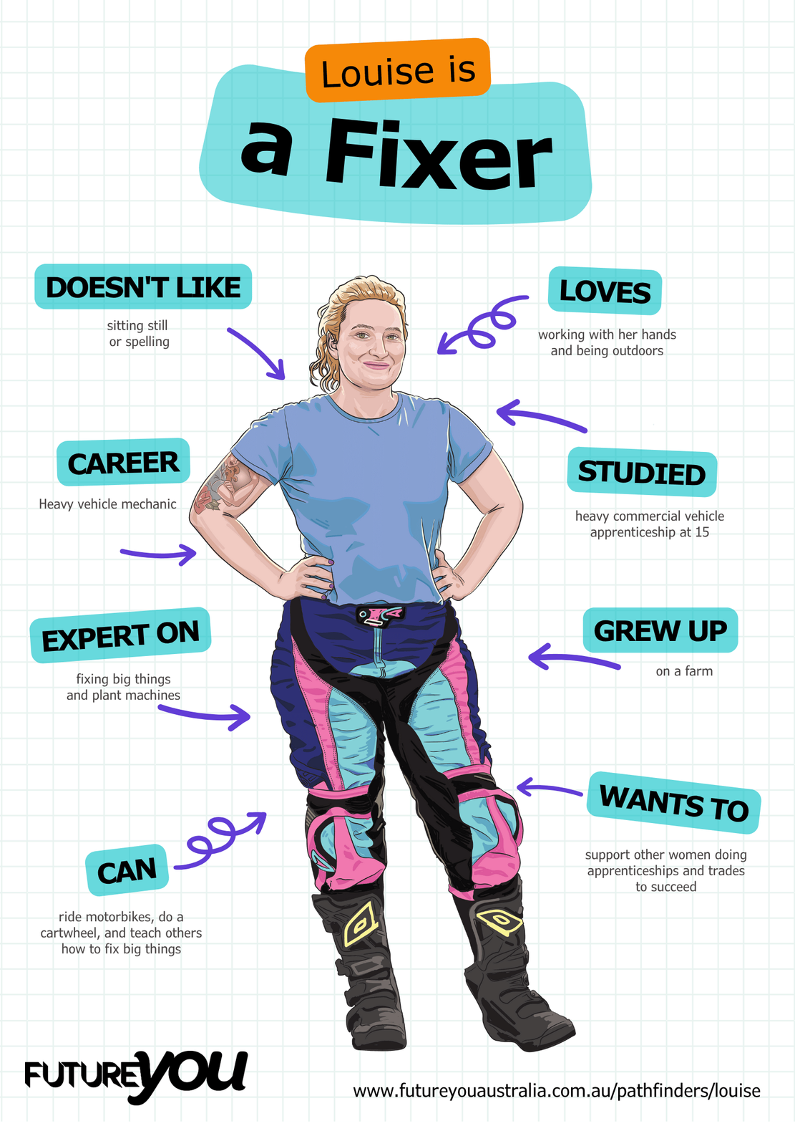

Lesson 6:
Scaffolding Report Writing
It’s time to start combining everything we’ve learned so far.

Slide 2
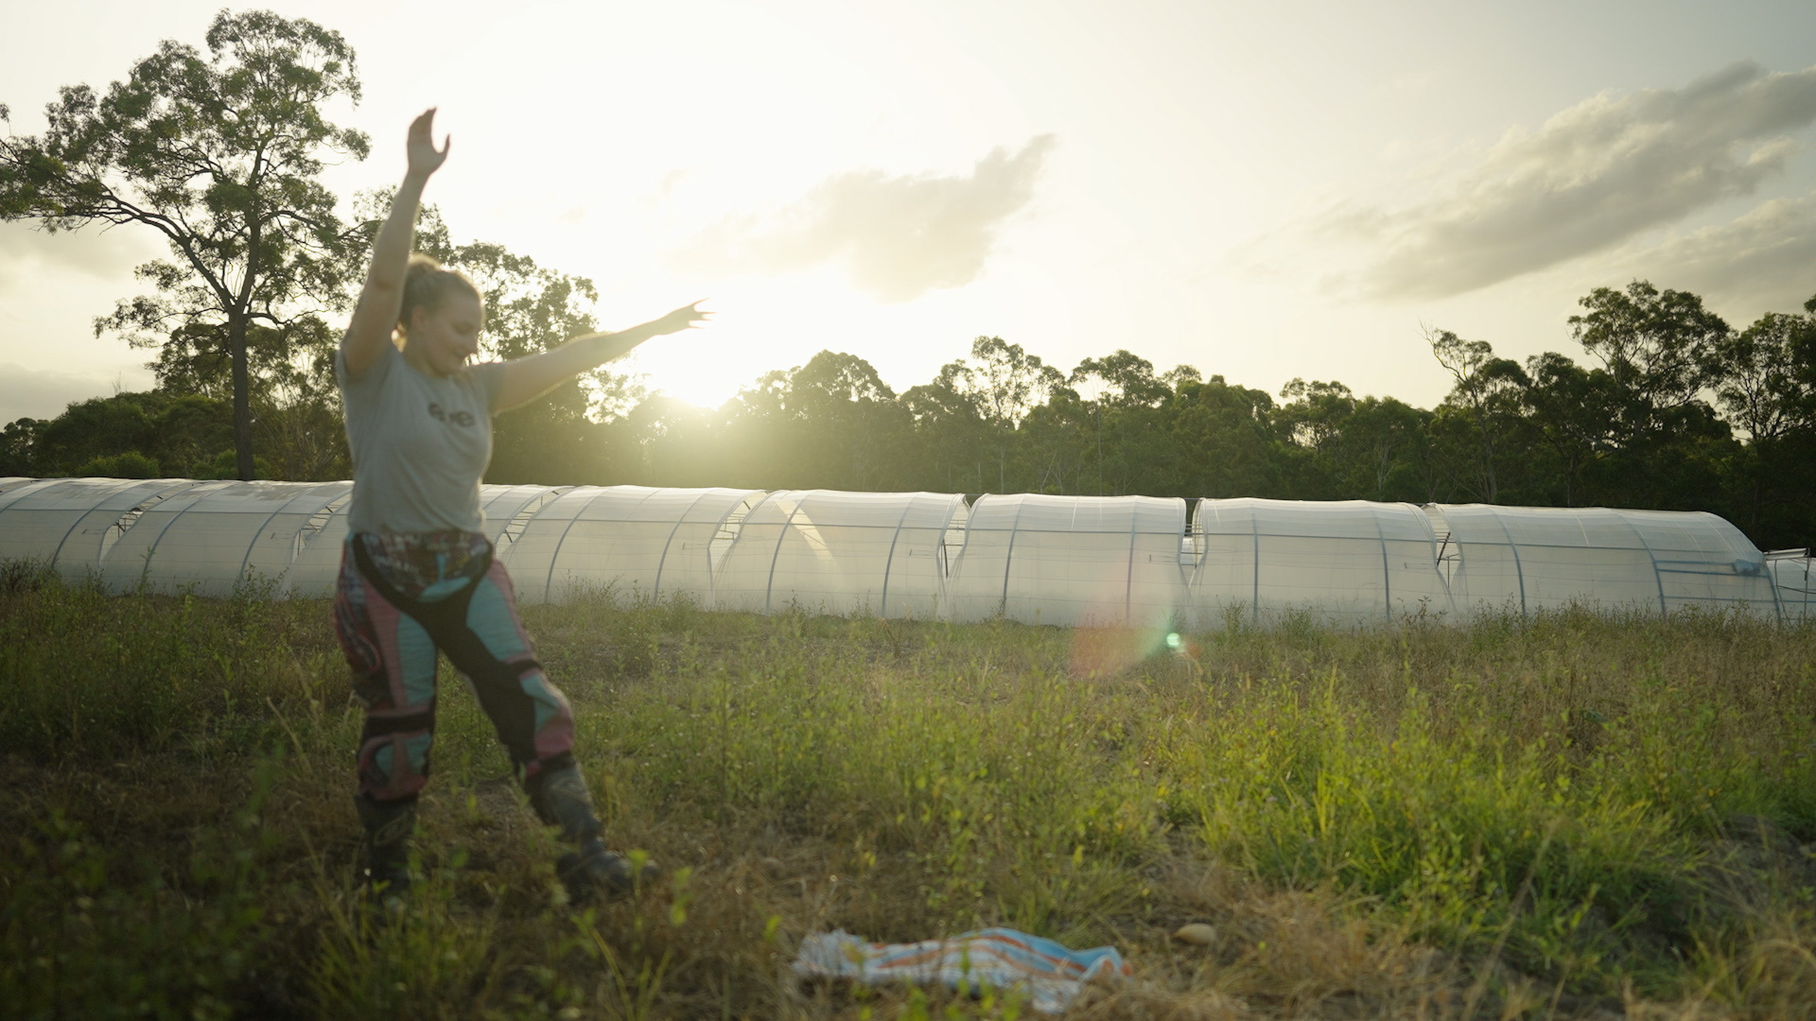
Lesson overview
Hook & Introduction
Group Work
Stretch & Share
Wrap-Up Reflection
10 mins
15 mins
10 mins
5 mins

Slide 3
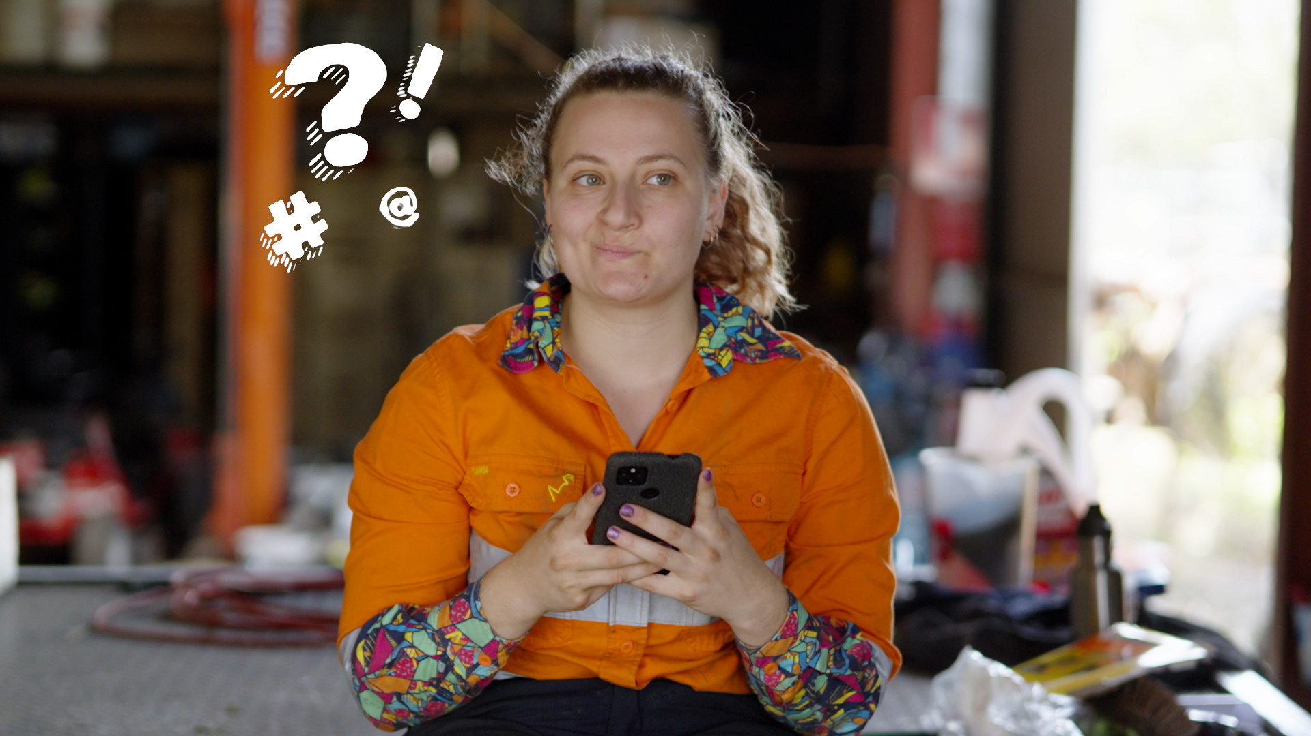
Who is this?
What is her job?
Tell me three things she does in her job?

Slide 4
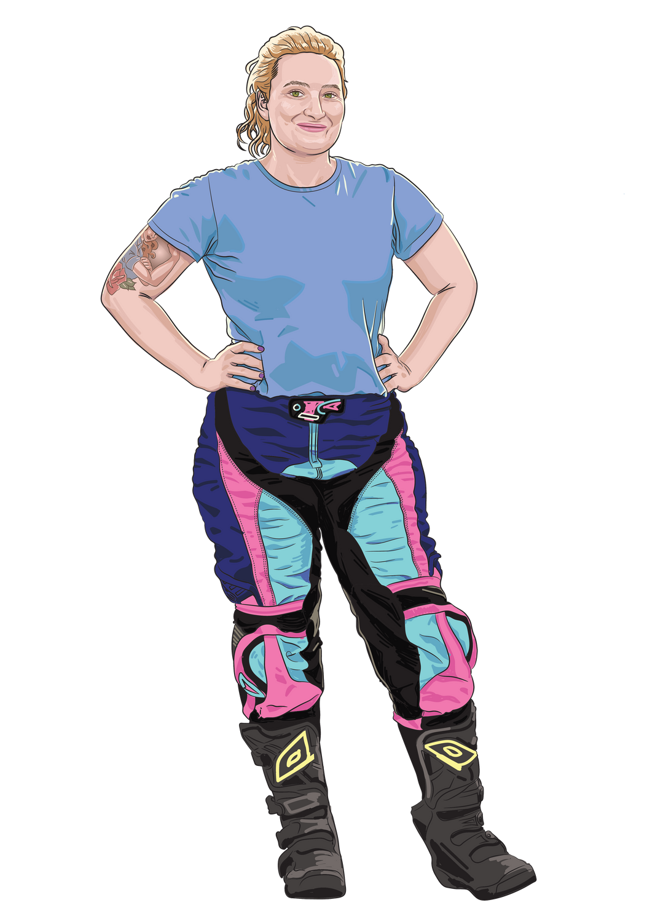
Louise
Heavy Vehicle Mechanic
She teaches people
She fixes big things
She works with her hands
She uses tools
She knows how things work
She writes reports

Slide 5
Meet the experts
Pssst. That’s you!
I need 2 volunteers!

Slide 6

The truck made a loud grinding noise when slowing down. A mechanic inspected it, and found the brake pads were worn out.
Notes:
This is a good opportunity to do some review and play a game.
Use the table provided in the student activity pack with the selection of nouns/verbs/adjectives/clause starter. Students use their cards to build a simple sentence with a clause starter to give circumstantial information. Once students have built their sentence, ask what would happen if move the phrase starter? How can they turn their simple sentence into a complex sentence? This also encourages them to use punctuation, such as commas.
Simple sentence structure: The + [noun] + [verb] + a/an + [adjective] + noise/vibration.
Complex sentence structure: [Phrase starter], the + [noun] + [verb] + a/an + [adjective] + noise/vibration.

Slide 7
  What information did they talk about that sounded like something Louise would say?
  What nouns did they use?
  What verbs did they use?
  What information would Louise use to write the report?

Slide 8
Clauses
Vocabulary
Paragraphs
Sentences

Slide 9
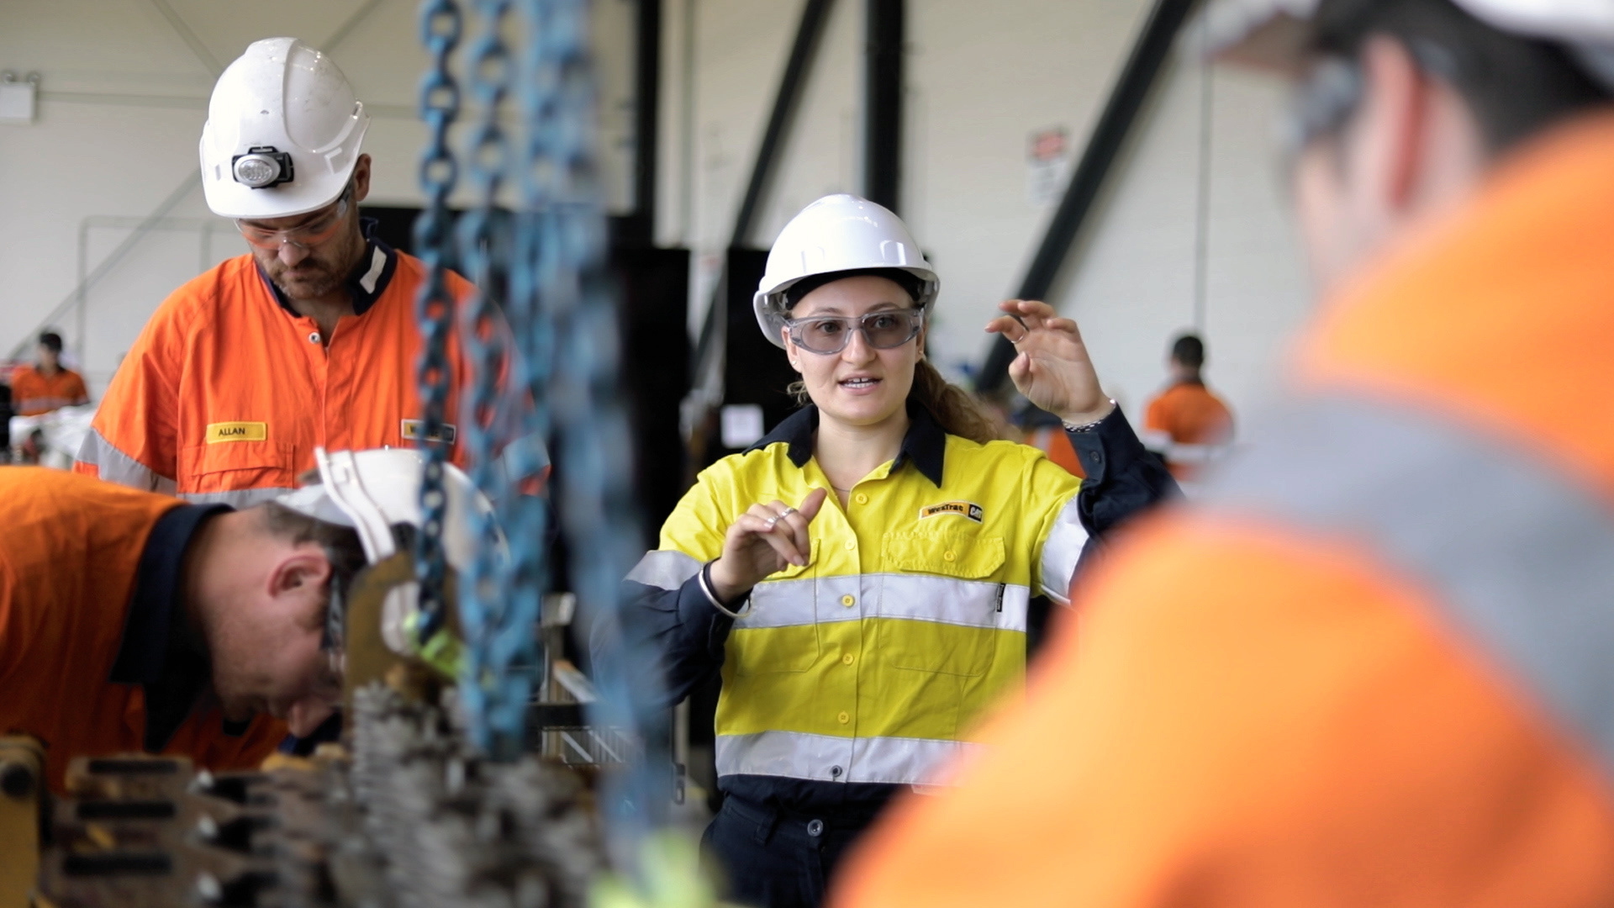
Activity time:
Role Play
How it works:
  Work in pairs
  Choose one scenario
  Perform a 30–45 second role-play: one is the customer, one is the mechanic.
  After the role-play, independently write three notes using:
    Correct nouns and verbs
    At least one term Louise would use in her job.
  Turn one note into a simple sentence.
Notes:
Provide students with note-taking cards. These have been scaffolded to support varying levels of understanding/ability for students.

Slide 10
Scenario 1
The truck makes a loud clunking noise when driving.
Scenario 2
There is black smoke coming out of the exhaust pipe.
Scenario 3
Only hot air comes out of the air conditioner.

Slide 11
Remember the checklist!
Sentence Checklist:
  Does each sentence make sense on its own and tell you at least one full idea?
  Does the sentence have a subject?
  Does the sentence have at least one verb?
  Does the sentence start with a capital letter?
  Does the sentence end with a punctuation mark?

Slide 12
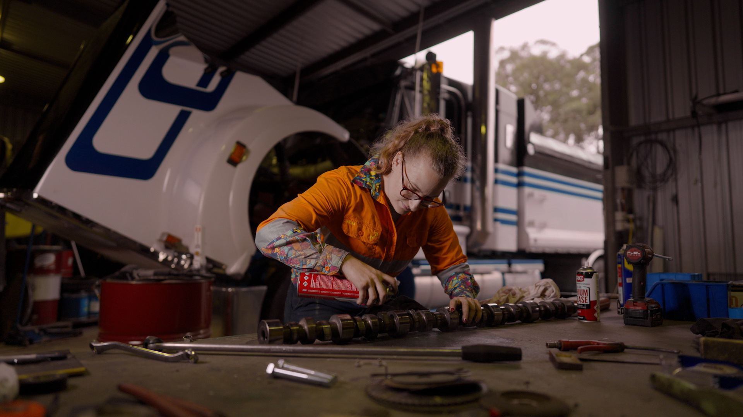
Activity Time:
Paragraph Construction
How it works:
  Work individually
  Expand your sentence into a short paragraph which includes:
    Topic sentence
    3 x supporting sentences
    Concluding sentence
  Make sure you use:
    One dependent clause
    Terms that Louise would use.

Slide 13
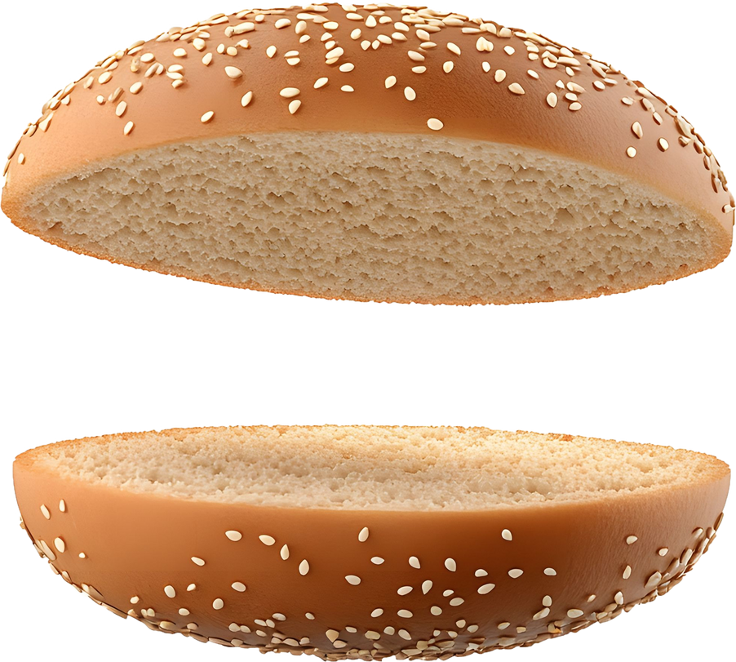


Remember!
The Hamburger Method
Clauses
A dependent clause can’t be a sentence on its own.
Why?
It doesn’t make full sense without more information.
Topic Sentence
Supporting Sentence 1
Supporting Sentence 2
Supporting Sentence 3
Concluding Sentence

Slide 14
S T R E E E E E E T C H
It’s time to level-up those sentences!
How it works:
  Each group member reads their paragraph aloud.
  Choose one sentence from each paragraph to improve. This might be done by using:
    more terms Louise would use,
    a more suitable verb
    a conjunction word to create a compound sentence.
  Write the improved sentence into your workbook.
Notes:
Extension opportunity: Invite students to include adjectives and/or adverbs here to make the sentence more informative.

Slide 15

Examples of language a mechanic uses:
A verb is most commonly an action word, like run, jump, or read:
  mechanic
run
jump
read
  tyres
  brake pads
  change
Conjunction words
  truck
  measure
  tools
  engine

Slide 16
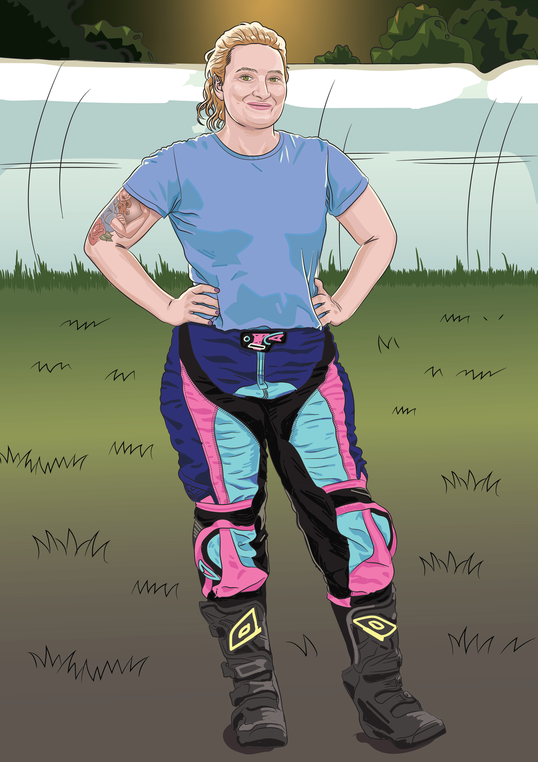
Reflect and Share
Write down your answers to these three prompts.
  One thing I used in my writing today (noun/verb, clause, sentence type, or relevant term).
  One thing I improved today.
  One question I still have about writing reports.

Slide 17
Lesson 6

