Slide 1
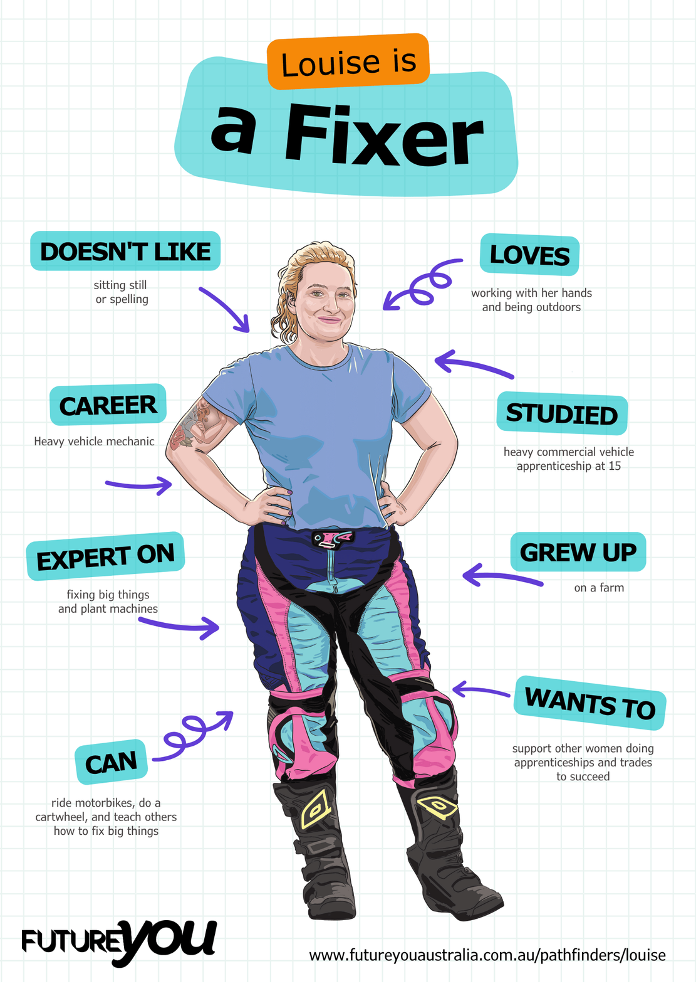

Lesson 8:
Writing the Report
Write your own full report using everything you’ve learned.

Slide 2
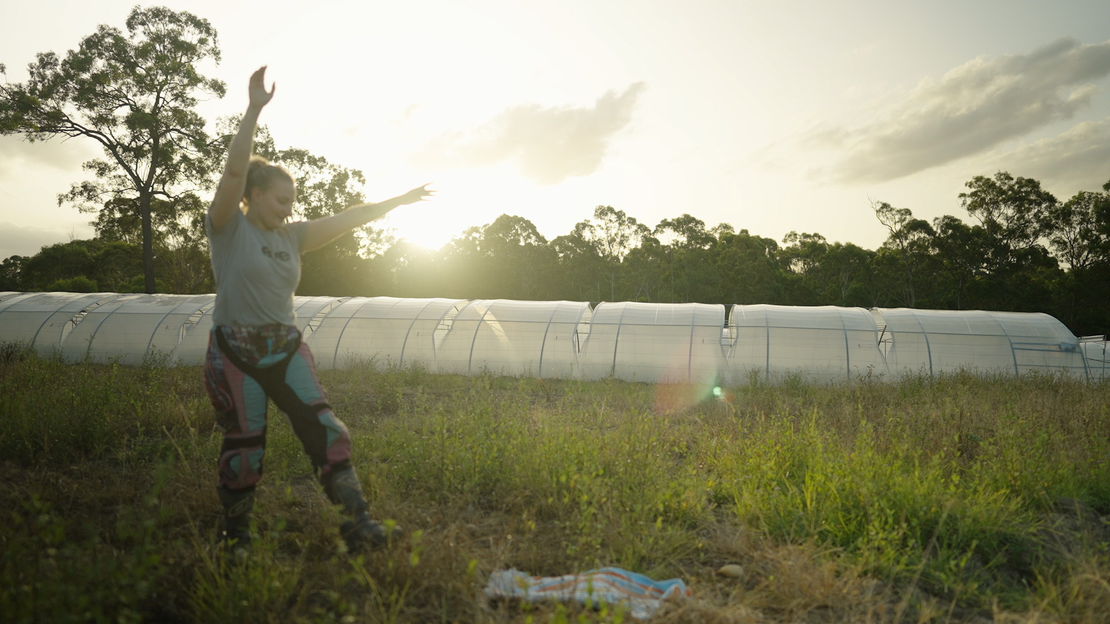
Lesson overview
Hook & Introduction
Individual/group Work
Stretch & Share
Wrap-Up Reflection
5-7 mins
25 mins
5 mins
5 mins

Slide 3

Today you are real mechanics!
You will write your own reports using everything you’ve learned.

Slide 4
Scenario: The tractor is making a loud squeaking noise.
Option 1
The tractor was brought into the workshop because it was making a loud squeaking sound that worried the farmer. Whenever the tractor slowed down, the squeak became even louder, which caused the farmer to think that something important might be rubbing or wearing out. As the tractor is an older model and is used every day to feed the animals, the farmer wanted to ensure it remained safe to operate. For this reason, a detailed inspection was requested so the noise would not worsen. The tractor was therefore booked in for a careful check‑up to determine the cause of the squeak.
To begin the inspection, the tractor was safely lifted off the ground using the workshop jack. Once raised, the tyres, wheel nuts, and brakes were checked for any loose or unstable components. The wheel cover was then removed, and a torch was used to examine internal parts for signs of wear or damage. After the visual inspection, the brakes were tested again while the wheel was slowly rotated by hand, allowing the squeak to be more easily located. These steps helped narrow down the source of the unusual noise.
The inspection confirmed that the brake pads were the main cause of the loud squeaking. Due to age and frequent use, the brake pads had worn down and begun rubbing directly against the metal brake drum. This friction created the squeal, especially when the tractor slowed down. Daily operation on steep, dusty ground caused the brake pads to wear out more quickly than normal, eventually becoming too thin to grip properly. The worn brake pads were clearly responsible for the noise and required urgent attention.
To resolve the issue, replacement of the brake pads is strongly recommended. New pads will eliminate the squeaking and improve braking performance, particularly when the tractor is operating on steep or dusty surfaces. To maintain safety and reliability, the brakes should be inspected again in approximately three months, as the tractor is used daily. Regular checks and timely replacement will help keep the tractor safe, dependable, and ready for ongoing work.
Option 2
The tractor was noisy so it came in. We looked at it and checked some stuff. Something in the wheel area was making the noise. The brakes didn’t seem right. We think something is worn out. It probably needs fixing soon.

Slide 5
Let’s review!
Which one would help a customer
understand the problem?
What features made the
report clear and useful?

Slide 6
Your reports need:
Background:
Describe the vehicle and the issue reported.
Use technical nouns (tyre, screw, engine, workshop).
Diagnosis:
Explain steps taken to find the problem.
Use precise verbs (lift, check, remove, tighten).
Findings:
Present the issue in detail using technical terms.
Include possible causes.
Recommendations:
Suggest repairs or replacements and explain why.
Use clear reasoning (e.g., “Replacing the belt will stop the loud squeal.”).

Slide 7

Remember to use:
A variety of sentence types
Relevant terms
Correct paragraph structure

Slide 8

Let’s write!
How it works:
  Work individually
  Choose a scenario (next slide)
  Use the planning sheets to plan each section
    Background
    Diagnosis
    Findings
    Recommendations
  Check in with another student if needed.

Slide 9
Scenarios
The tractor has an oil leak, which is making a bad smell.
Someone left the headlights on all night, and the battery is flat.
The truck’s tyre is flat. It looks like a nail has gone through it.
The car is making a loud squeal because the timing belt snapped.

Slide 10
Seek feedback
How it works:
  Swap your report with a classmate.
  Answer these two questions.
    Is there a variety of sentence types in each section?
    Is the topic sentence clear?
  Make changes to your reports based on the feedback.
Notes:
Students can also use the Report Checklist for this task.

Slide 11
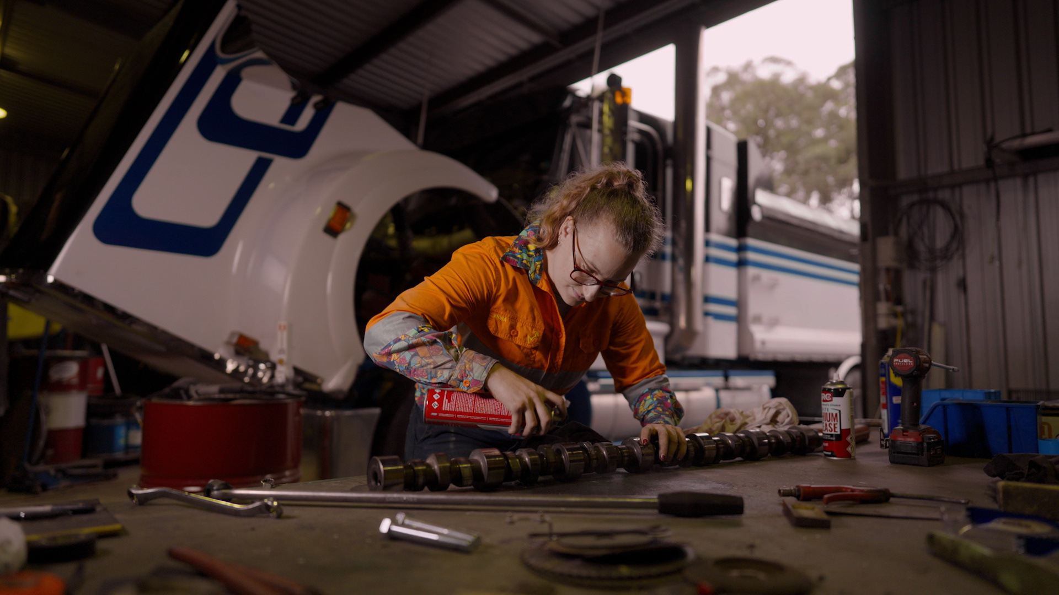
Level-up
How it works:
  Work individually
  Choose one paragraph
  Make the following improvements
    Add a dependent clause to create a complex sentence
    Choose one verb or noun to improve
    Add a relevant term for better clarity
    Can you edit/improve any sentences, like the concluding sentence, to be better and give direction to the next paragraph?
Notes:
Collect final work for formative assessment.

Slide 12
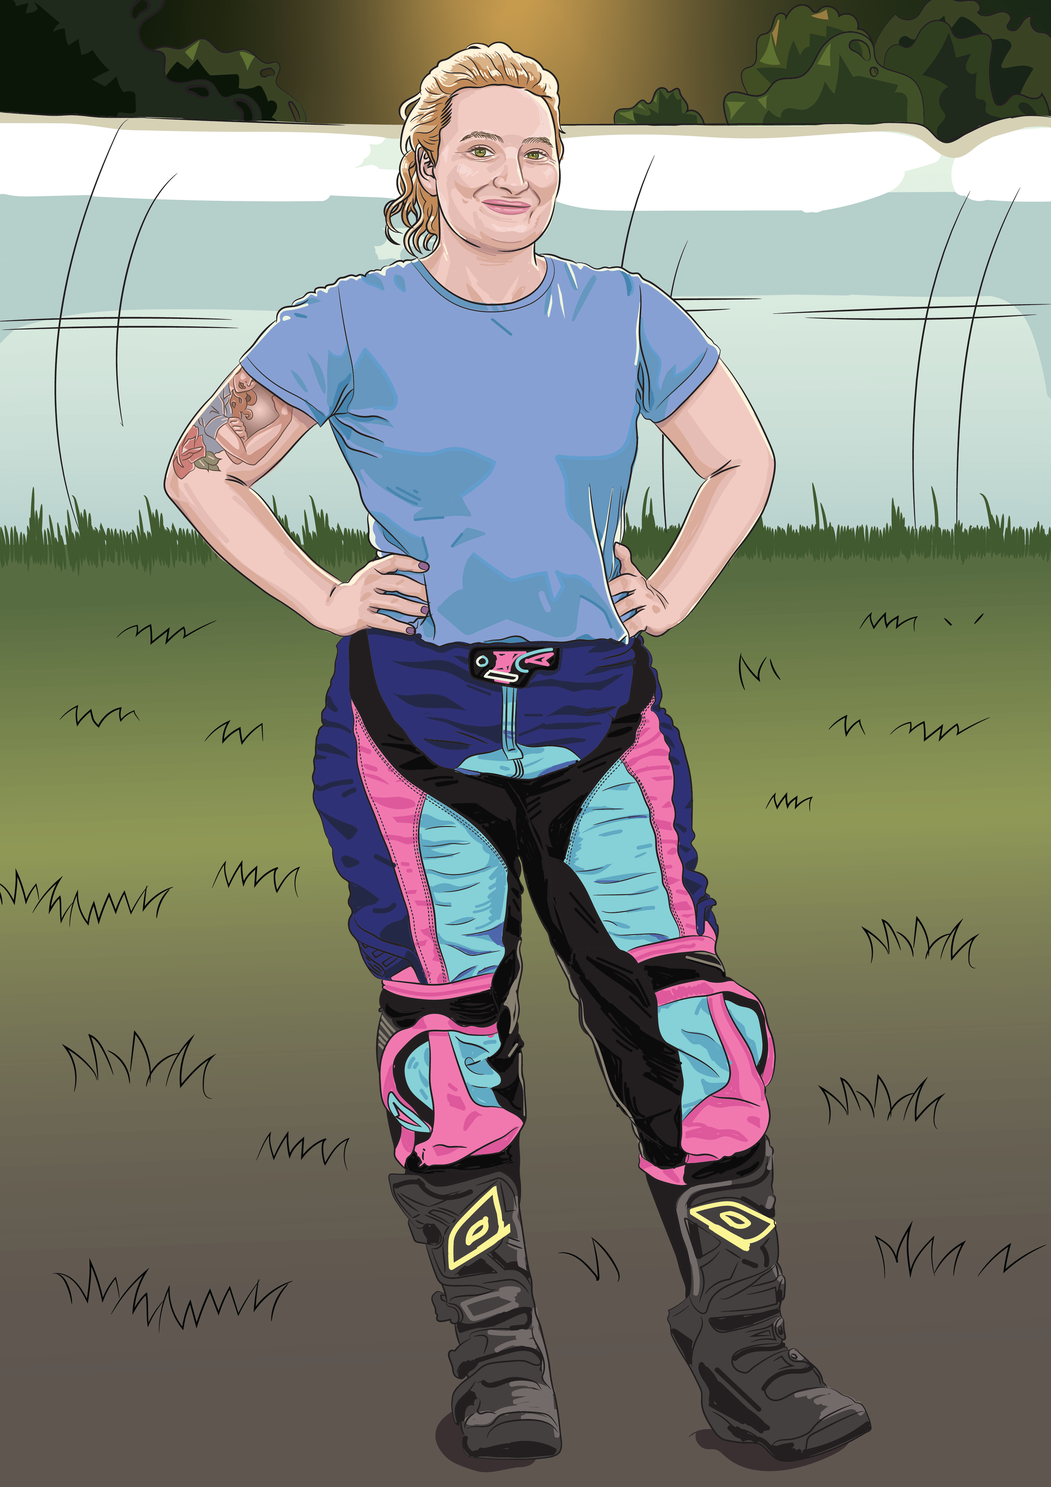
Reflect and Share
Write down your answers to these:
  One thing I used well in my report today was…
  One thing I want to get better at is…

Slide 13
Lesson 8

