Slide 1


Lesson 1:
Introduction and Vocabulary Building
Learning the skills to become expert report writers

Slide 2
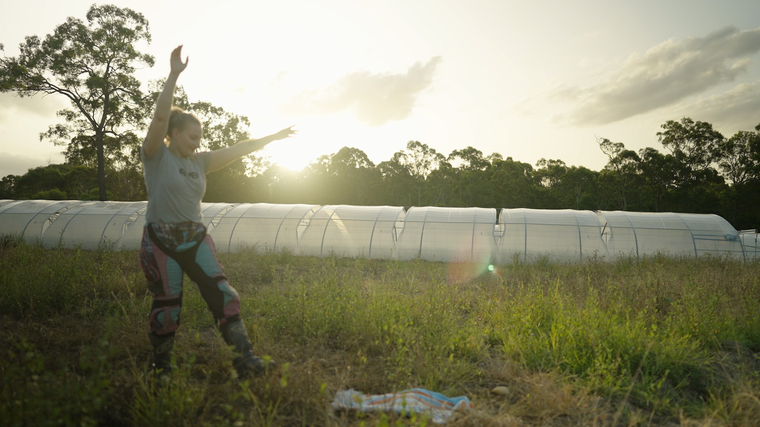
Lesson overview
Hook & Introduction
Group Work
Stretch & Share
Wrap-Up Reflection
10 mins
15 mins
15 mins
5 mins

Slide 3
Learning intentions
I can identify nouns and verbs
I recognise topic-specific vocabulary
I know that words can have different meanings in different contexts

Slide 4
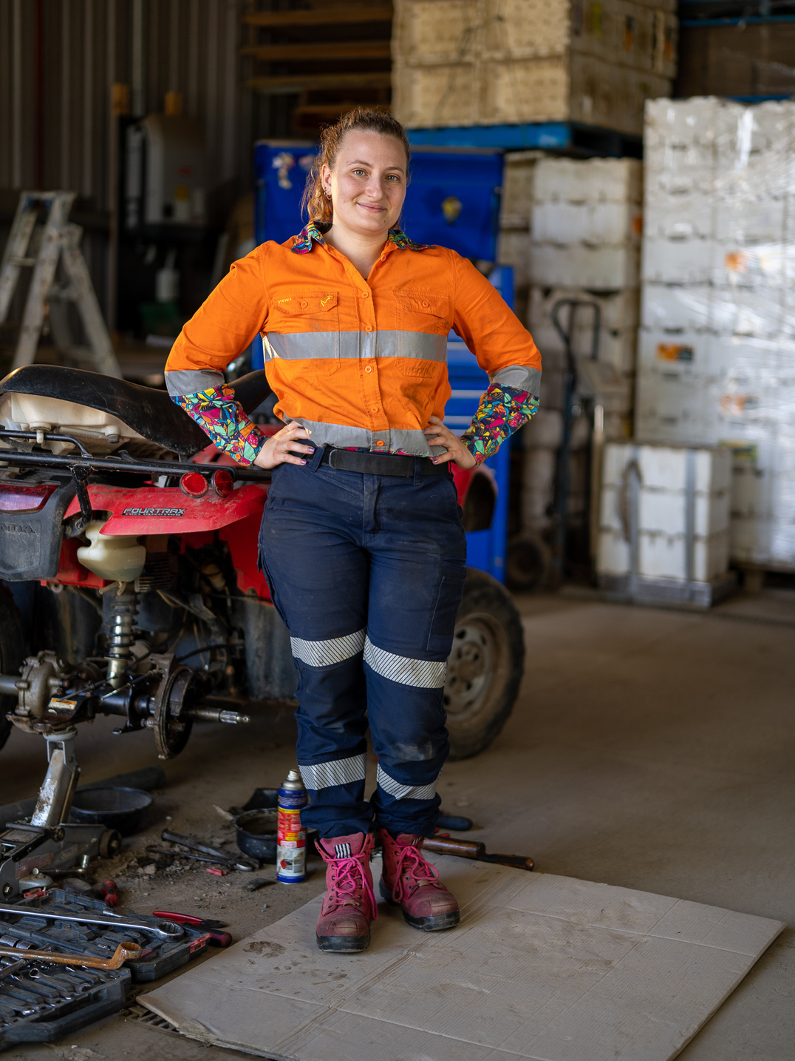
Meet Louise
What do we think Louise does for a job?
Split into groups and look for clues.
Notes:
Use this task as an opportunity to start a discussion among students. Observe which children require additional support to build their knowledge (i.e. English as a second language, lack of exposure to mechanics, children in urban spaces might not have seen any of these tools).
Ask students, “What are the clues?” Divide them into small groups to decide together and allocate one speaker to give clue and what the group thinks it might suggest.

Slide 5

Notes:
This video runs for 3 minutes. Subtitles can be turned on using the button on the bottom right of the video. Ask students to make notes of things that Louise says that are relevant to her job.

Slide 6

Louise is a heavy vehicle mechanic

Slide 7
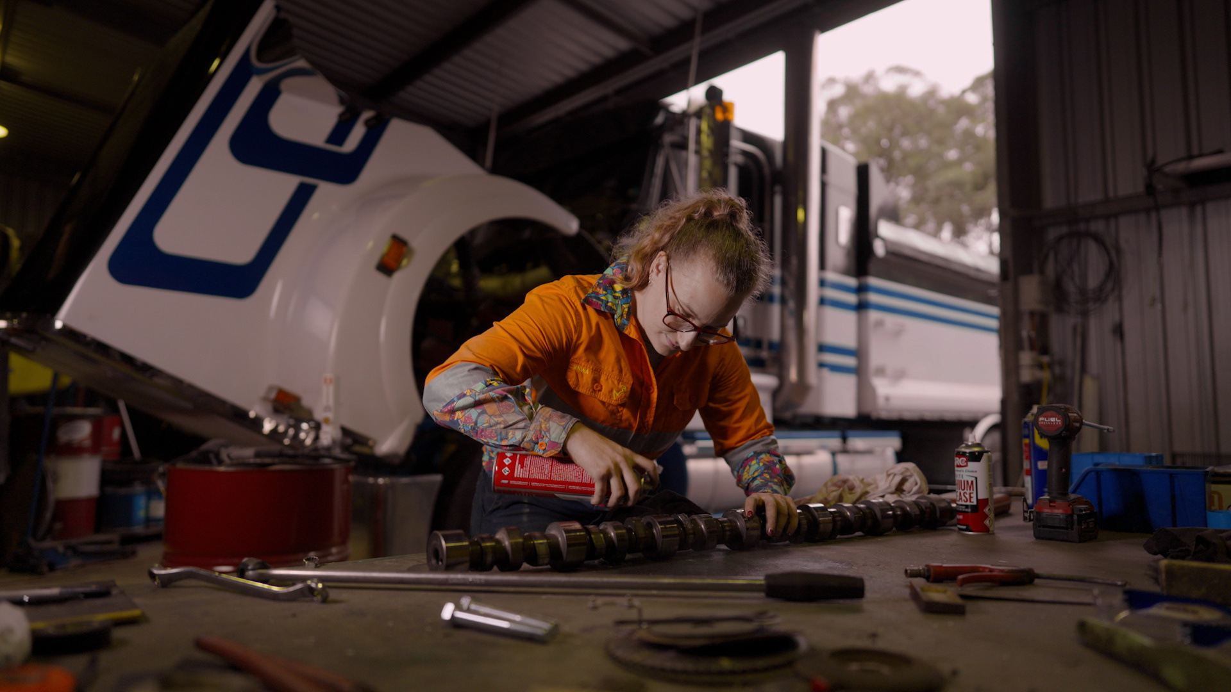
What does Louise do?
She teaches people
She fixes big things
She works with her hands
She uses tools
She knows how things work

Slide 8

What else does Louise do?
She writes reports for her customers.

Slide 9
Reports
A report is a very important document a mechanic prepares.
  It includes the mechanic’s findings
  It uses clear language
  It outlines the work the mechanic has done
  It includes recommendations
The report must clearly communicate complex information so the customer understands the situation and can make the best decision about repairs.

Slide 10
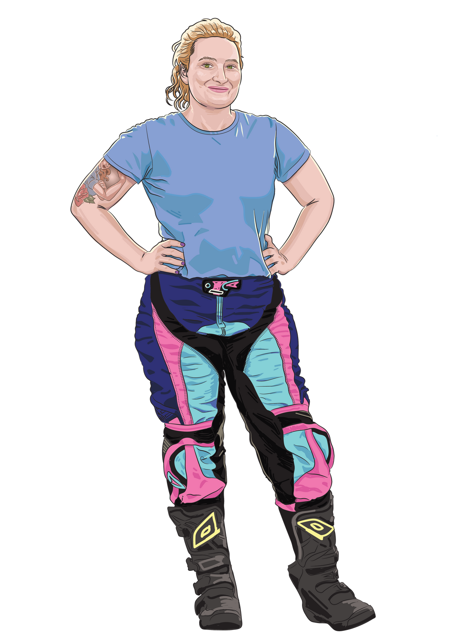



Becoming the experts
You are all going to learn the skills
needed to become excellent report writers.

Slide 11
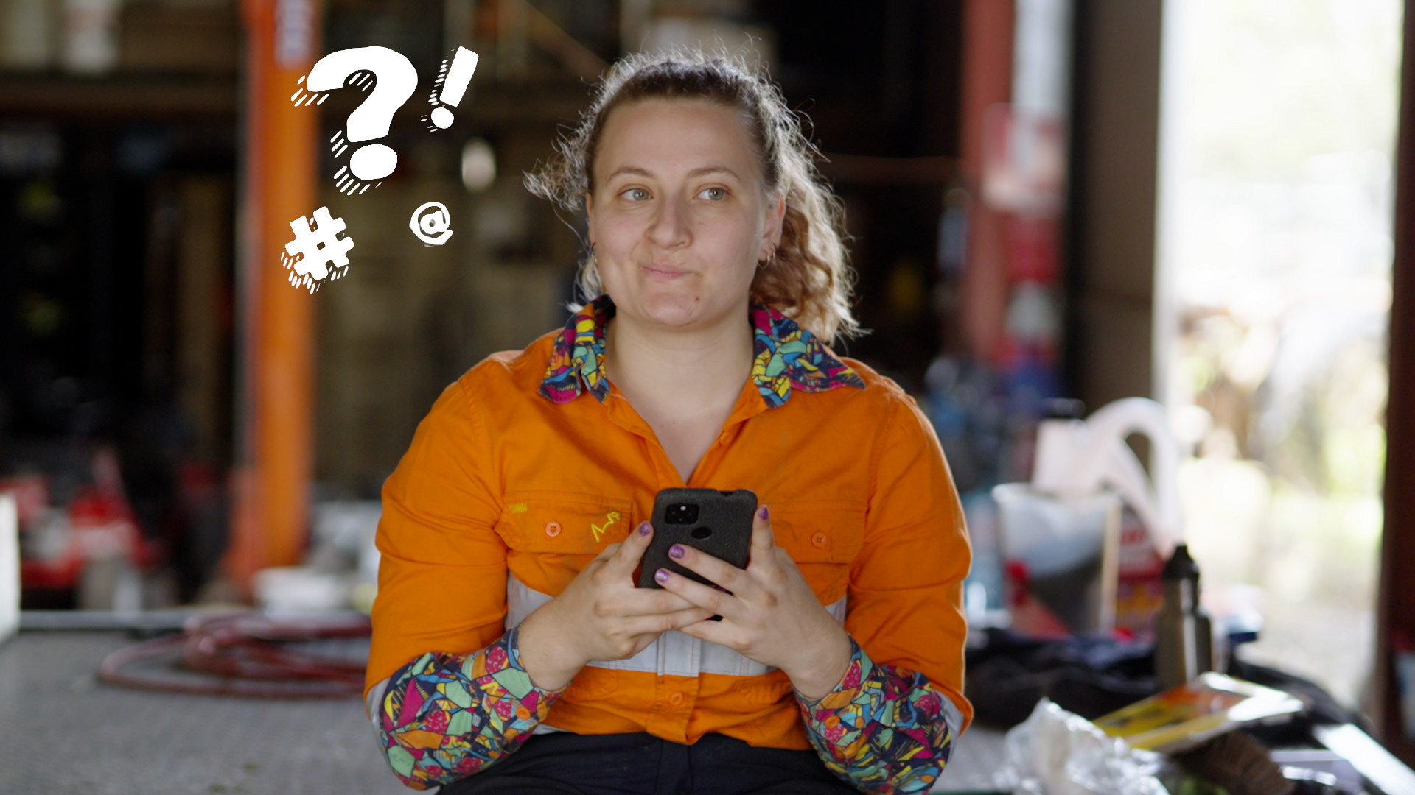
How?
1: Build vocabulary
2: Learn about sentence types
3: Explore clauses
4: Discover how to improve flow

Slide 12
How?
5: Learn about paragraphs
6: Develop ideas for a report
7: Plan full reports
8: Write and refine reports

Slide 13
Nouns vs Verbs
What are they?
A noun is a word for a person, place, thing or thinking action:
a friend
a book
a school
an idea

Slide 14
Nouns vs Verbs
Verbs are words that show actions, thoughts, feelings, or states of being.
They can also help other verbs show time or possibility.
Action words like:
Run
Jump
Read
Relating/linking words like:
Is
Are
Seem
Mental/sensing words like:
Think
Feel
Notice
Helping/modal words like:
Am
Have
Should

Slide 15
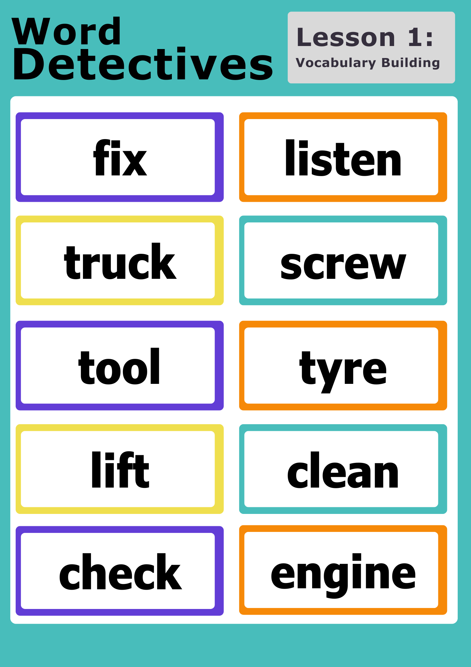
Activity time:
Word Detectives
Nouns
Verbs
Notes:
Teachers – feel free to edit this slide to suit your classroom needs. Here’s one suggested way to run this activity:
Work alone, in pairs, or small groups
Each student/pair/group gets an activity sheet and a pile of word cards
Students sort the cards into nouns and verbs (or both) and write them down on the activity sheet.
Once complete, pass your activity sheet to the student/pair/group next to you so they can check your work.

Slide 16

Remember!
A noun is a word for a person, place, or thing:
A verb is most commonly an action word, like run, jump, or read:
a friend
run
a school
jump
a book
read

Slide 17
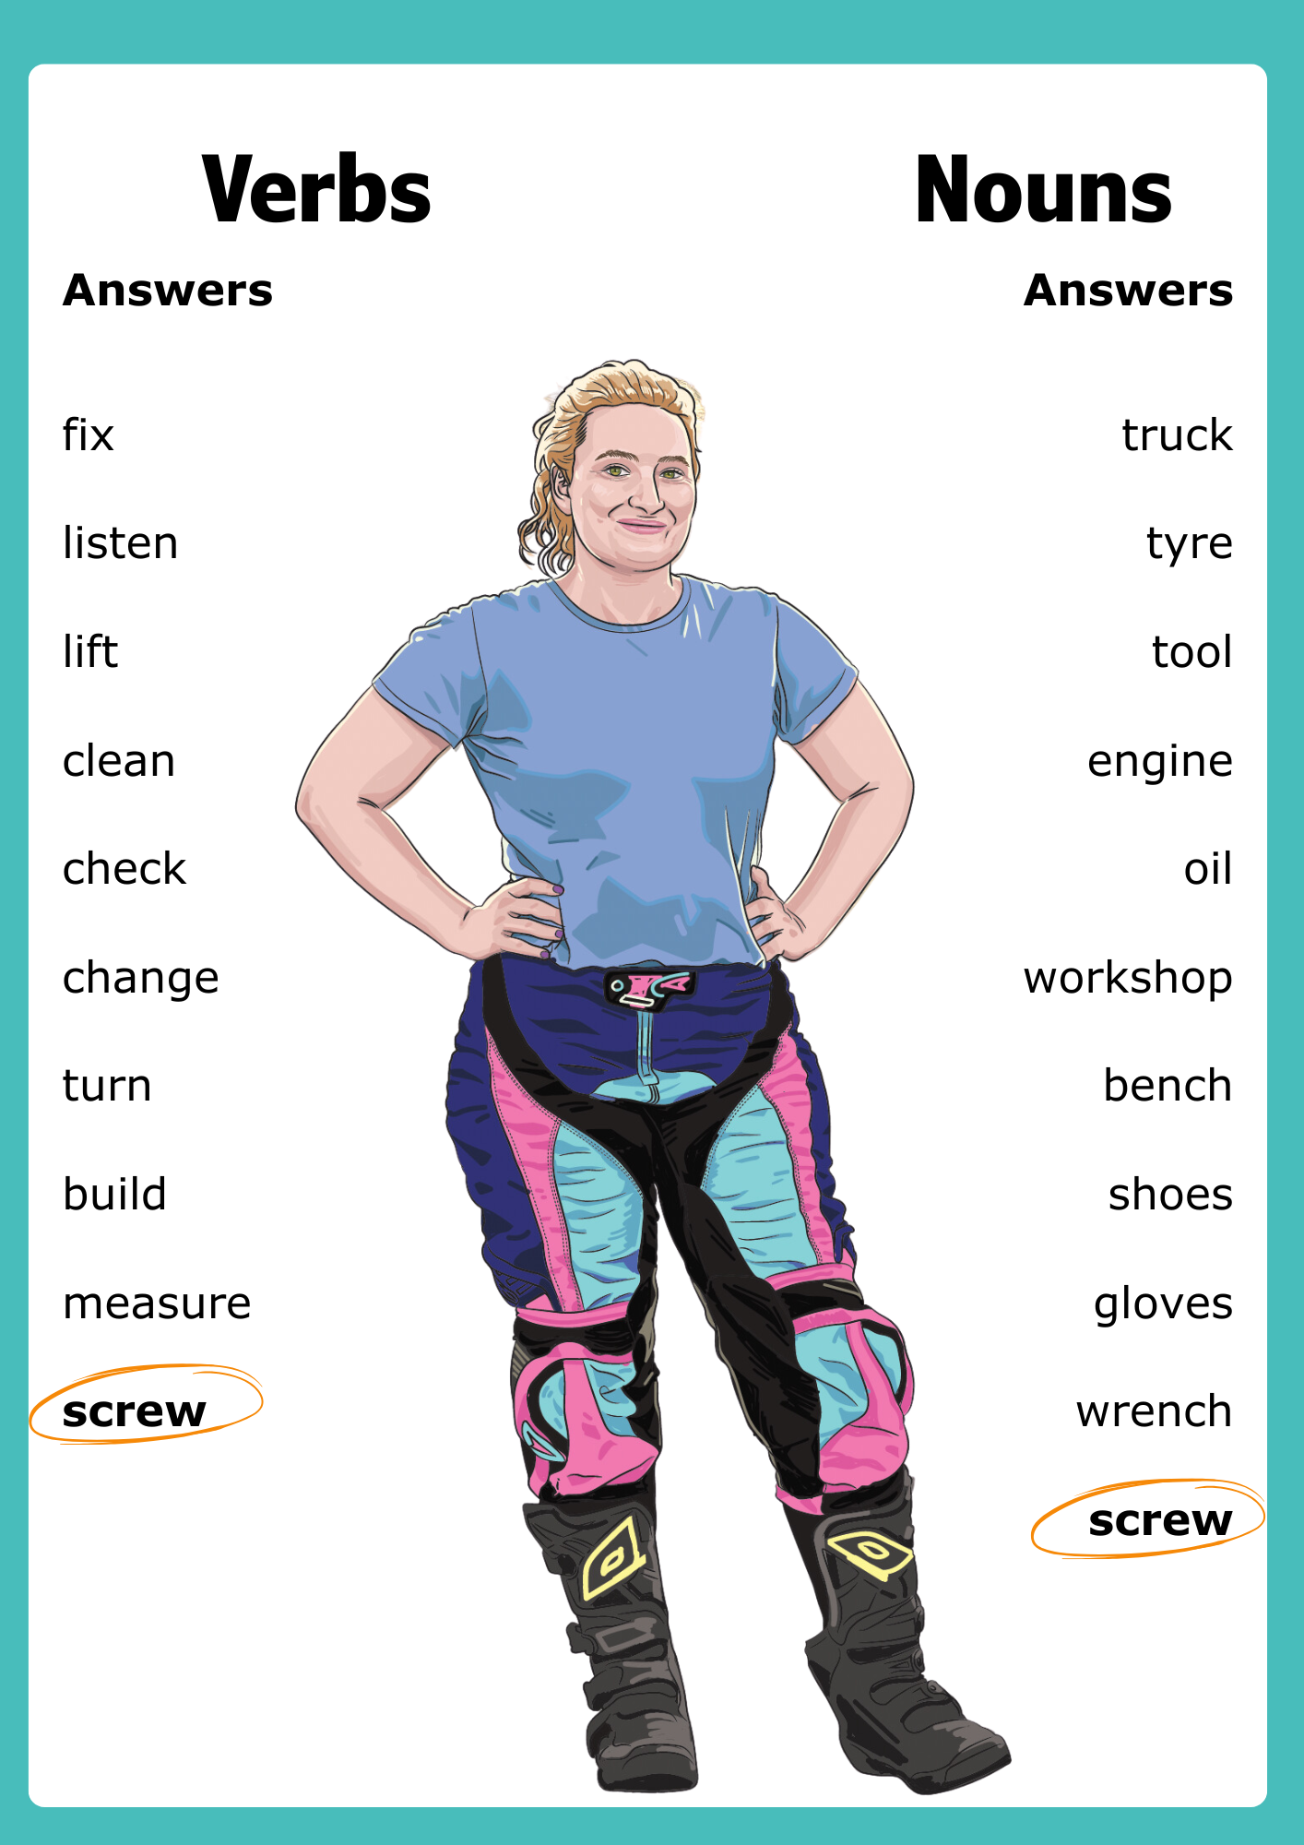
Word Detectives
Check your answers.
One or more of these words can be both a noun and a verb.
Did you spot it?
Notes:
Note: “Check” can also sometimes be a used as a noun. For example, put a check on something or do a do a check on someone.
Extension activity: This could be used as an extension activity with a digital online dictionary. Students can see if there are other uses for any of these words. I.E. Check. Screw. Lift.

Slide 18

Caption That!
Can you tell people what I do?
It’s time to get creative and make your own “What does a mechanic do?” poster
Use 3 nouns
Use 3 verbs
I change the oil in your car
Write 3 captions
Too easy? Write your own caption using a noun and a verb we didn’t use today.

Slide 19
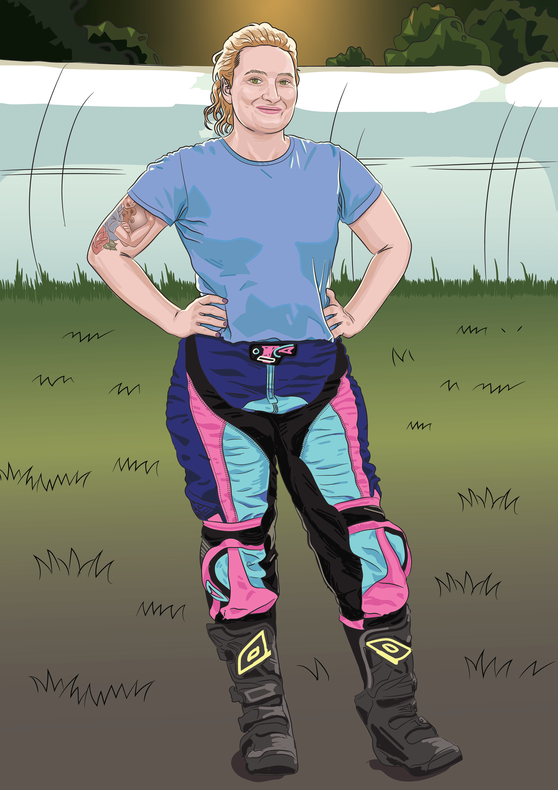
Reflect and Share
Share your posters.
What new words did you learn today? Write them on a sticky note and leave on your desk.
Can you use one of those words in a sentence?

Slide 20
Reflect and Share
Write down one noun used in Louise’s job before leaving.
Lesson 1
Notes:
Optional: Display a ‘Word Wall’ of nouns/verbs students can add to across the unit. This gives the new vocabulary somewhere to live beyond Lesson 1, and students can refer to it frequently. Alternatively, ask students to write the new vocabulary they’ve learned into a notebook. Students can refer to this book throughout the unit, to support them with future activities.

