Slide 1
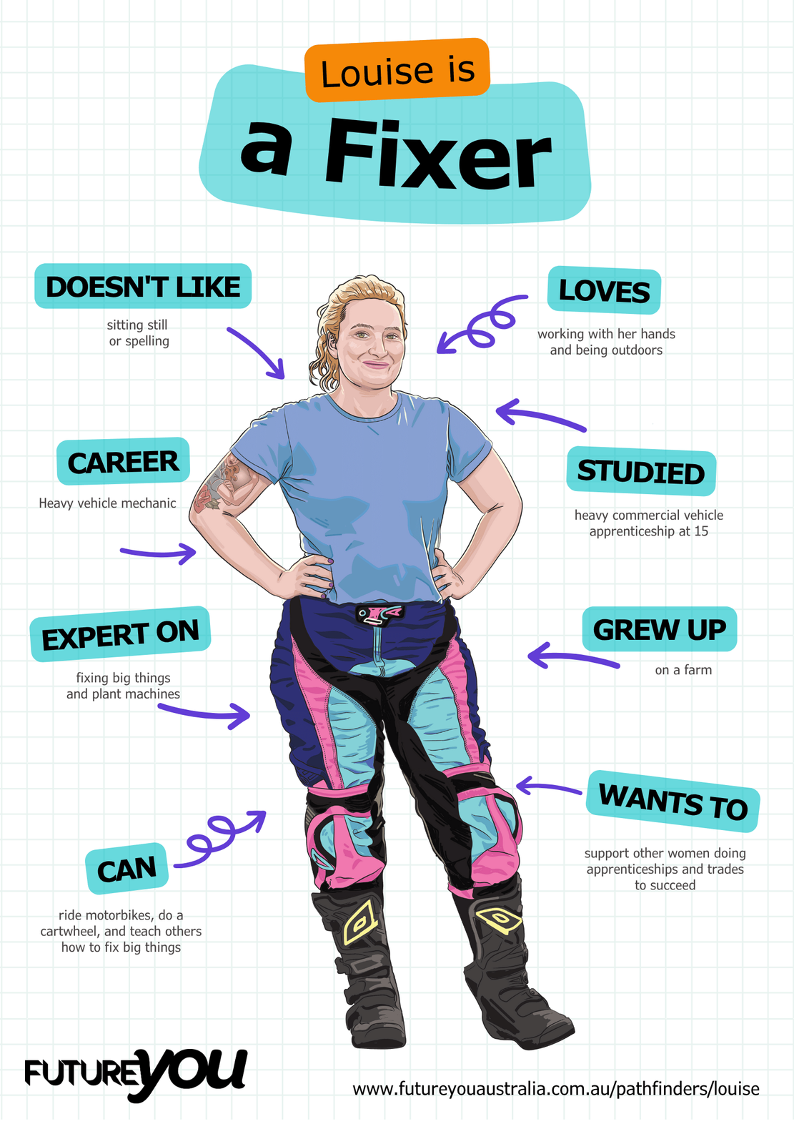

Lesson 3:
Cracking Clauses
Finding out more about how sentences are constructed

Slide 2
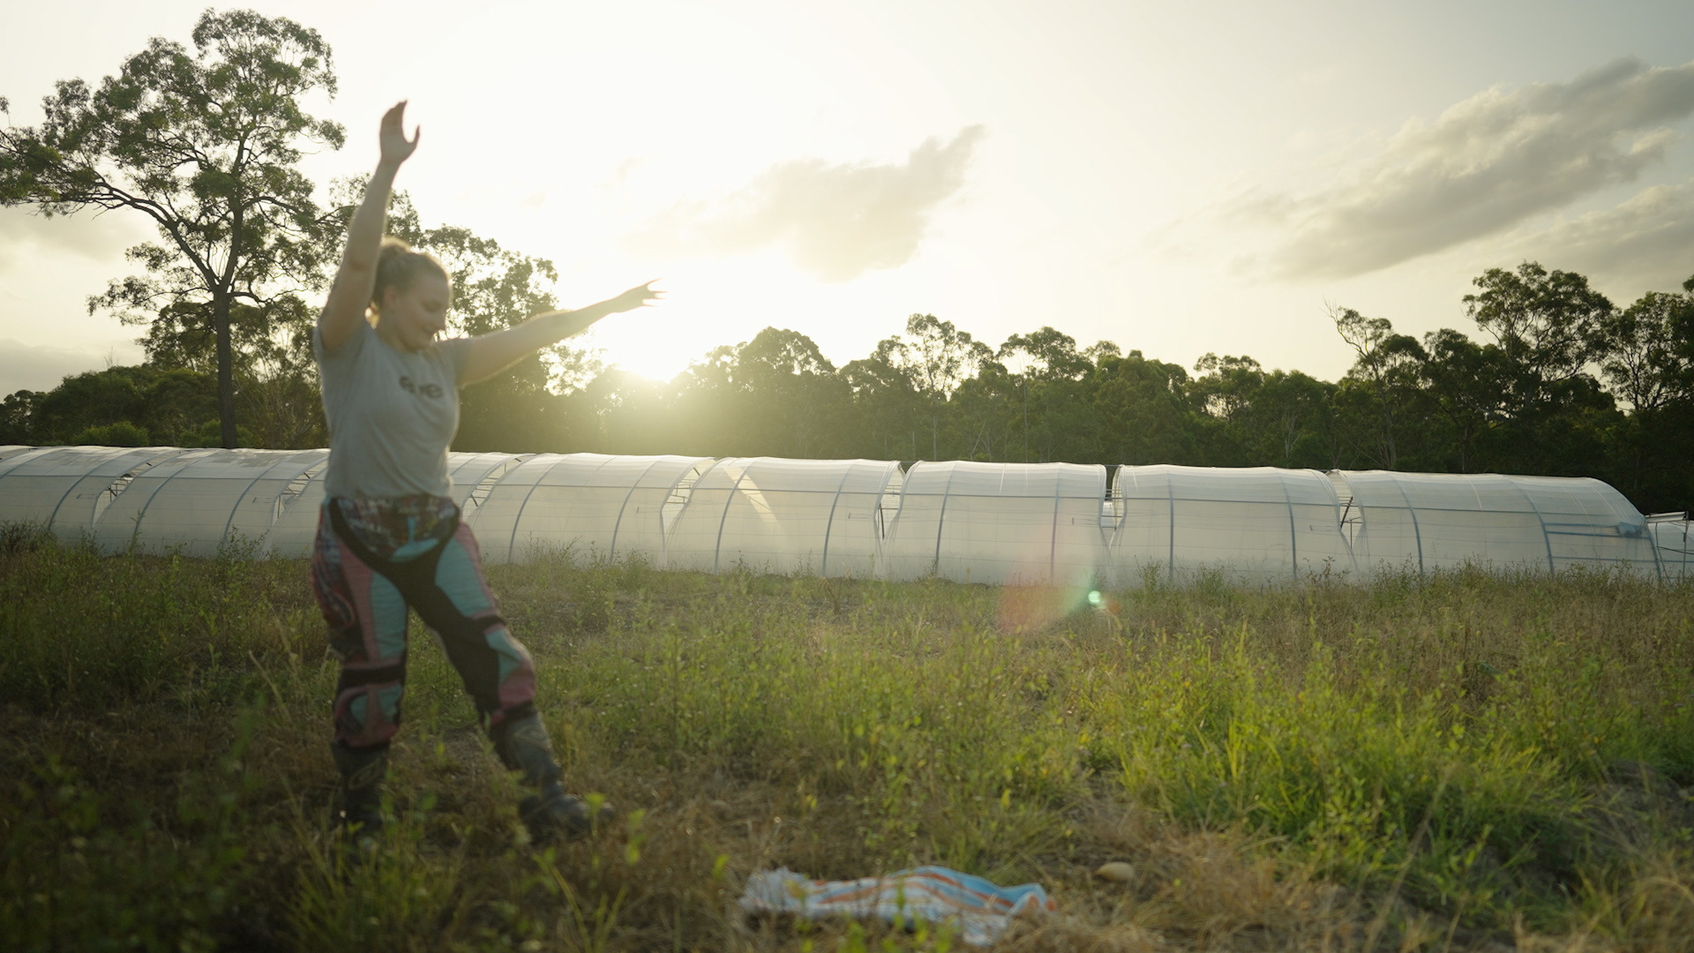
Lesson overview
Hook & Introduction
Group Work
Stretch & Share
Wrap-Up Reflection
10 mins
15 mins
10 mins
5 mins

Slide 3
Learning intentions
I recognise clauses as complete ideas that make sense on their own.
I can identify independent and dependent clauses.
I can use independent and dependent clauses to create simple and complex sentences.

Slide 4
We will be learning about clauses!

Slide 5

No, not that type of Claus!

Slide 6
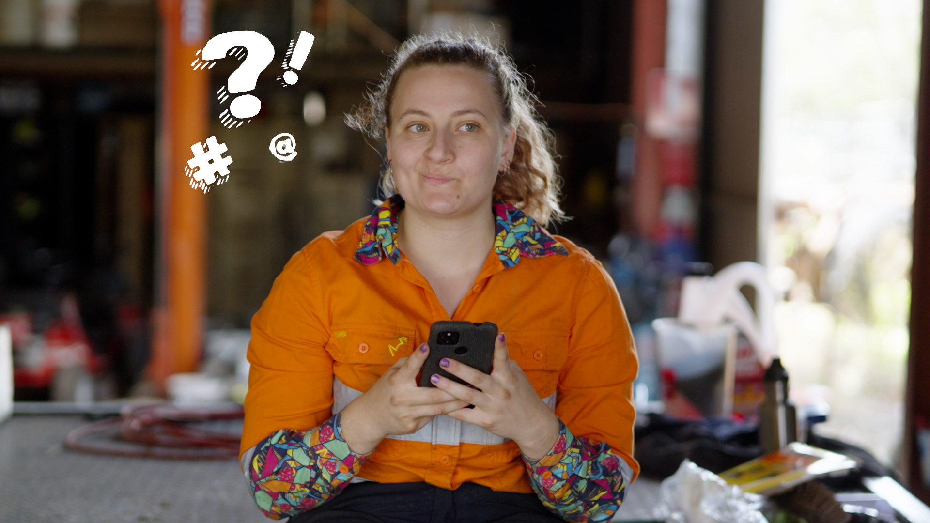
Memory check!
Who remembers what makes a sentence?
Let’s see what the class says.

Slide 7
What makes a sentence?
A sentence starts with a capital letter,
and ends with a punctuation mark like:
- a full stop
- a question mark
- an exclamation mark

Slide 8
But wait! There’s more.
Every sentence also has at least one clause.
A clause is a group of words
with a subject (noun) and a verb.

Slide 9
What is a noun?
A noun is a word for a person, place, thing or thinking action.
What is a verb?
A verb is most commonly an action word, like run, jump, or read.
Notes:
Depending on student abilities, you can explore the other types of verbs as well, and write them on the board.

Slide 10
What does this mean?
Notes:
Depending on student abilities, you can explore the other types of verbs as well, and write them on the board.

Slide 11
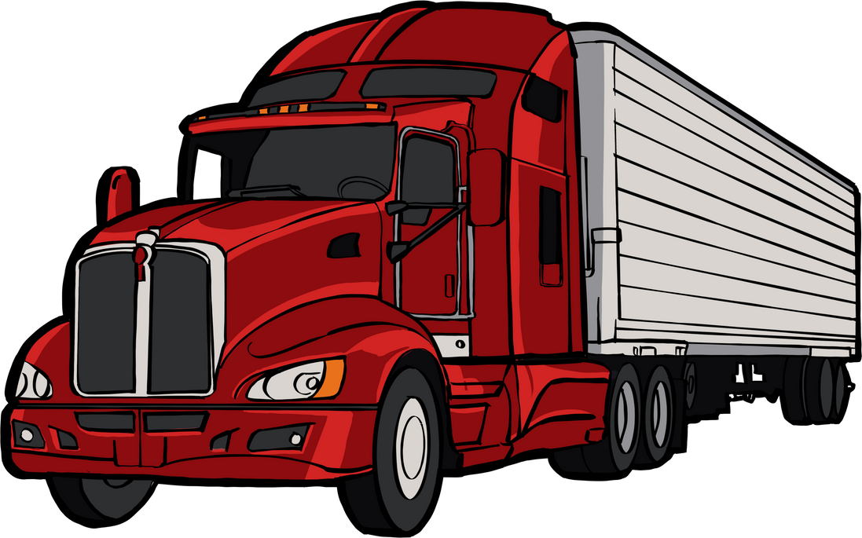
The truck slowed down, and it made a loud noise.
Notes:
Explain the role of the comma. And write it the other way around to show the change in punctuation.​
The truck made a loud noise when it slowed down. What is the subject? Truck. Is it a noun or a verb? It is a thing, so is a noun. ​
Why do we not use the word “truck” twice in this sentence? What is ”it” – It is also the subject as it refers to and represents the word “truck”. There are two verbs – what are they? This means there are two clauses? “made” and “slowed” are verbs of physical activity/action.

Slide 12
The truck slowed down,
and it made a loud noise.

Slide 13
There are two main types of clauses:
Independent Clause
Dependent Clause
No Santa, not you.

Slide 14
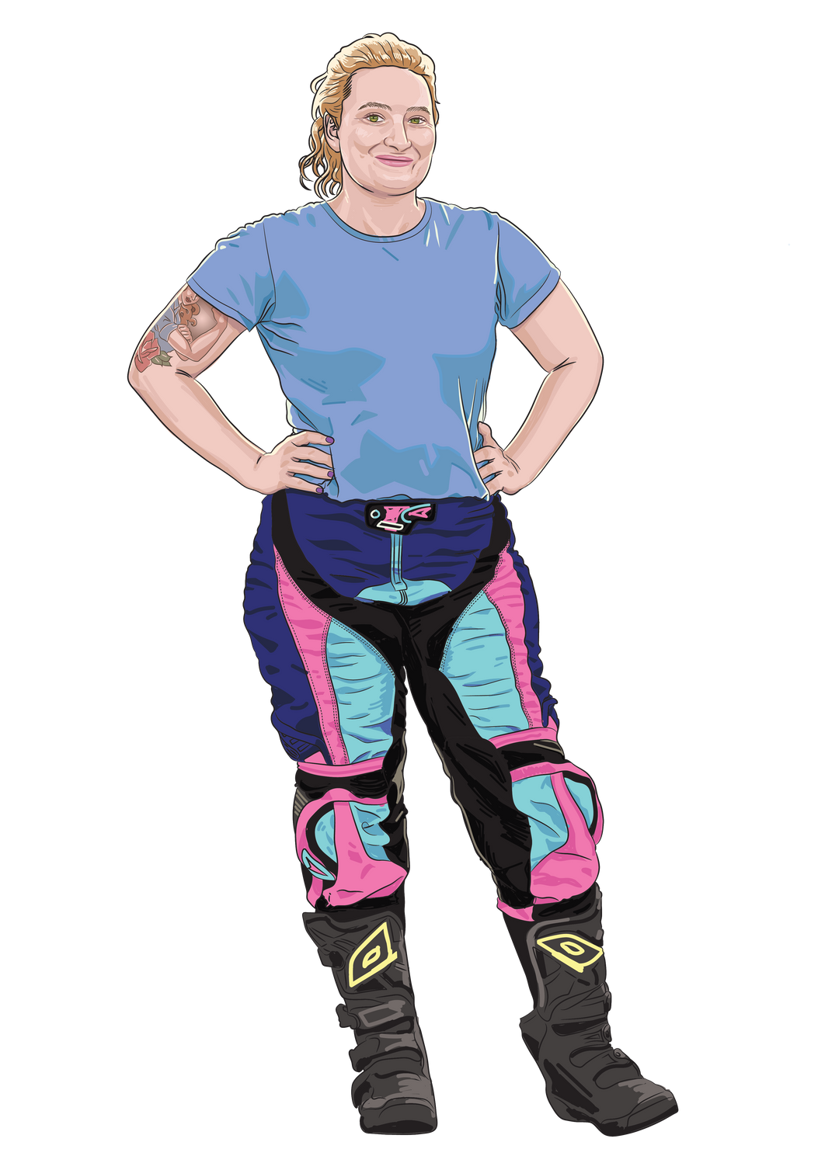
Independent Clause
This kind of clause can be its own sentence.
Why?
Because it makes sense all by itself.
Example: The truck made a loud noise.

Slide 15
Dependent Clause
This kind of clause can’t be a sentence on its own.
Why?
Because it doesn’t make full sense
without more information.

Slide 16
Dependent Clause
Example: When the truck slowed down.
This makes you wonder…
What happened when the truck slowed down?
But if you add an independent clause, “It made a loud noise.”, the sentence makes sense:
When the truck slowed down, it made a loud noise.

Slide 17
Activity Time!
Clause Workshop
And remember, an independent clause makes sense all by itself.
How it works:
  Work individually.
  Each student receives a worksheet.
  Underline, highlight or circle the independent clause in each sentence.
Notes:
Possible extension activity: The class does a Clause Hunt in a shared class text (something currently being read). This shows students that clauses are everywhere, not just in sentences to do with informative reports or mechanics.

Slide 18
Answers
When the truck made a loud noise, it scared the nearby workers.
Although Louise is confident she's found the cause of the sound, she thinks it might be the truck's brake pads.
Now that Louise has found the problem, she confirms it with a brake inspection.

Slide 19
Answers cont.
Because the brake pads are worn, they need to be replaced.
After Louise replaced the brake pads, she tested them to make sure they were working properly.

Slide 20
Activity Time!
Diagnose and Repair
How it works:
  Work as individuals, in pairs, or small groups.
  Each individual/pair/group gets 6 independent clauses, and 6 dependent clauses.
  Students sort the clauses into two separate piles.
  Once sorted, pair the independent clauses with a dependent clause.
  Write the sentences in your workbooks. You should have 6 complete sentences.

Slide 21
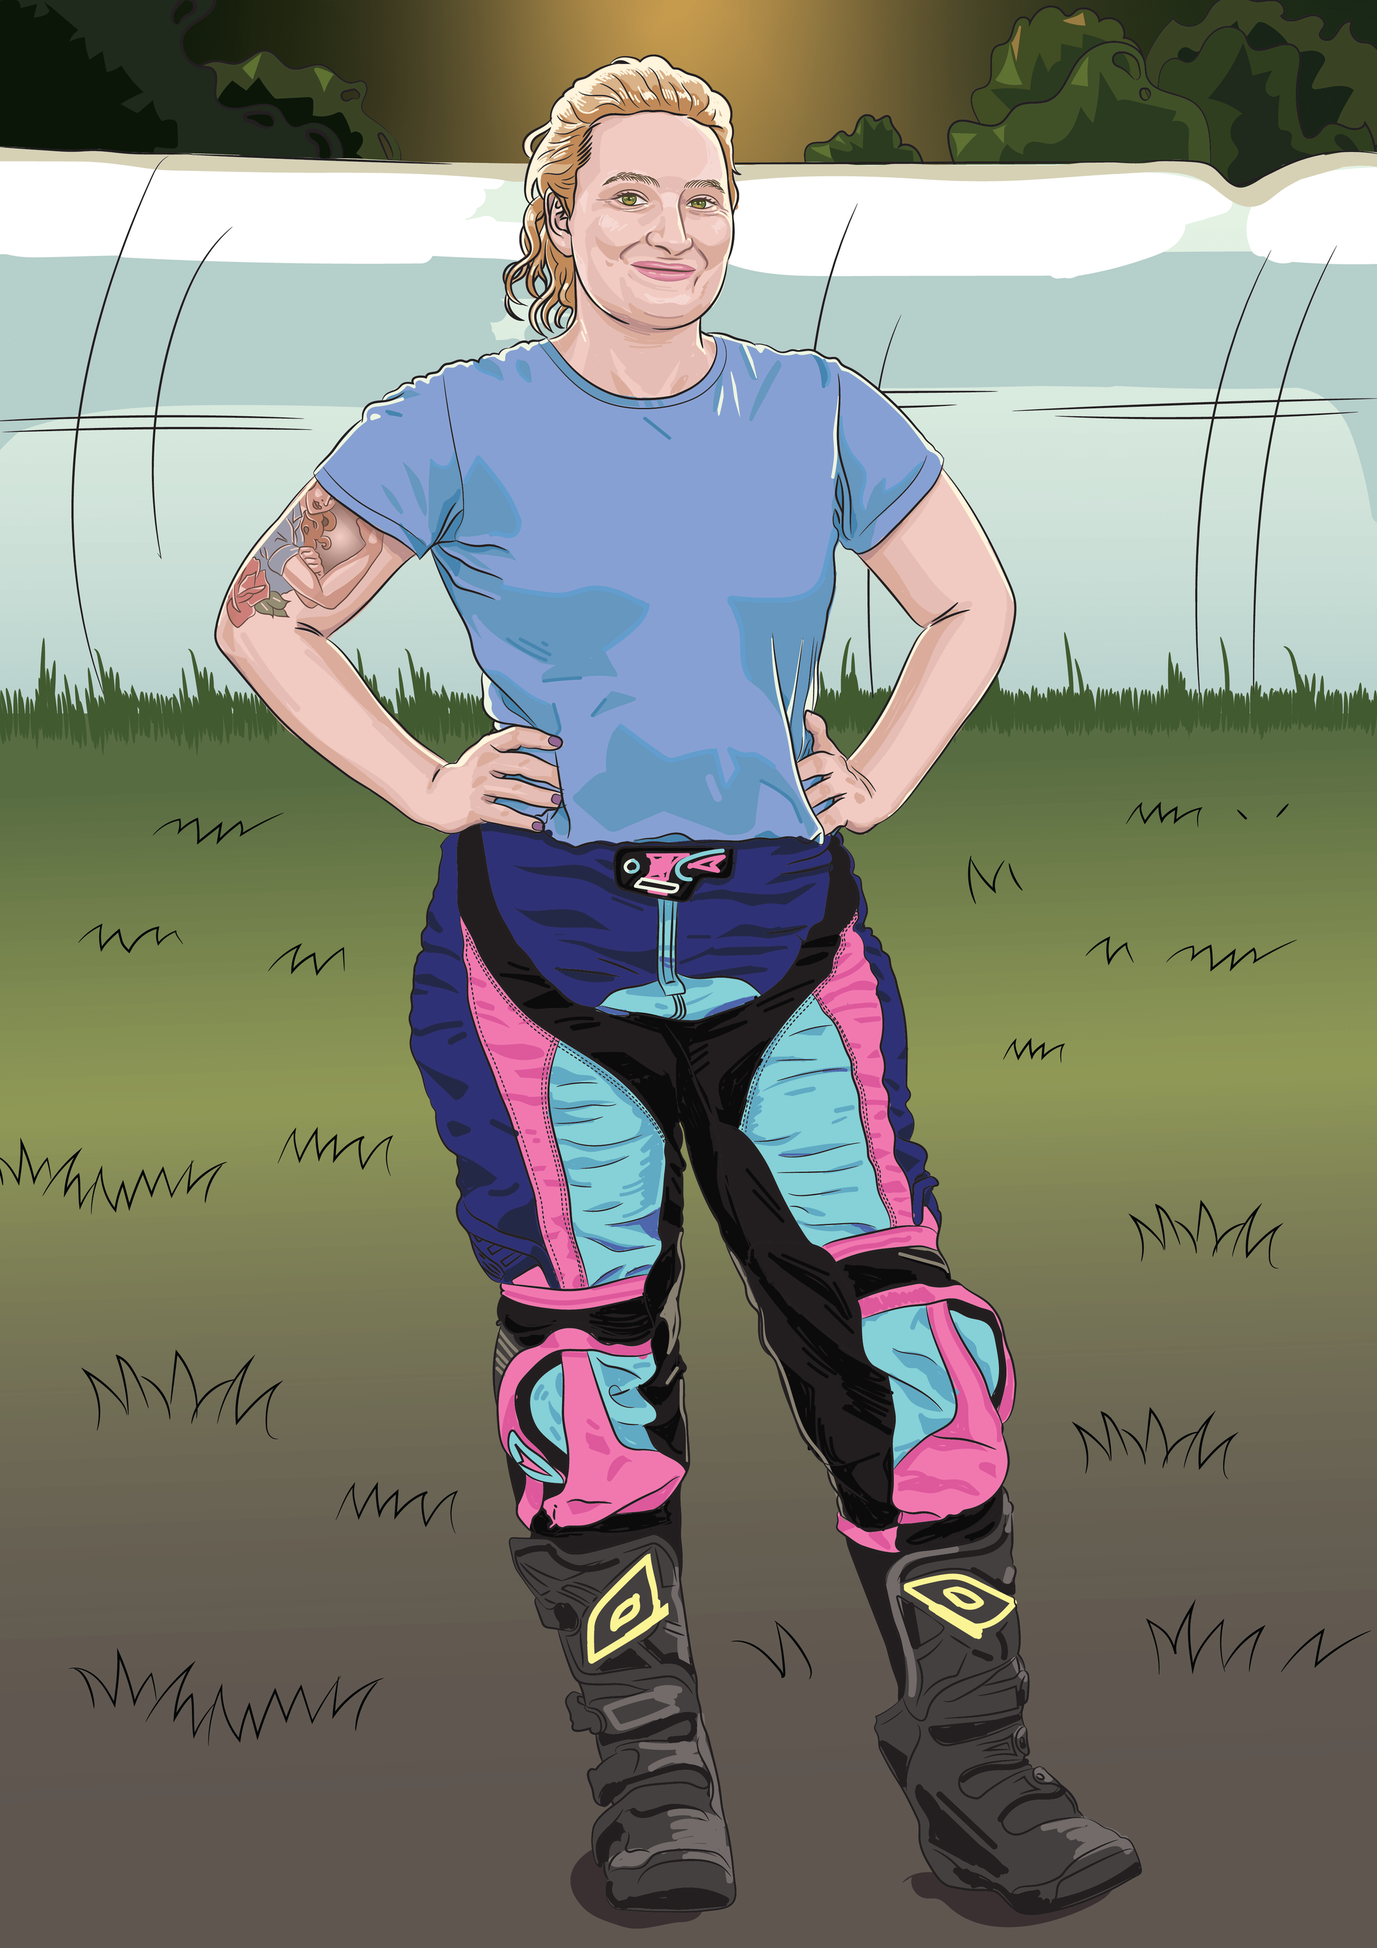
Reflect and Share
What are the two
types of clauses?

Slide 22
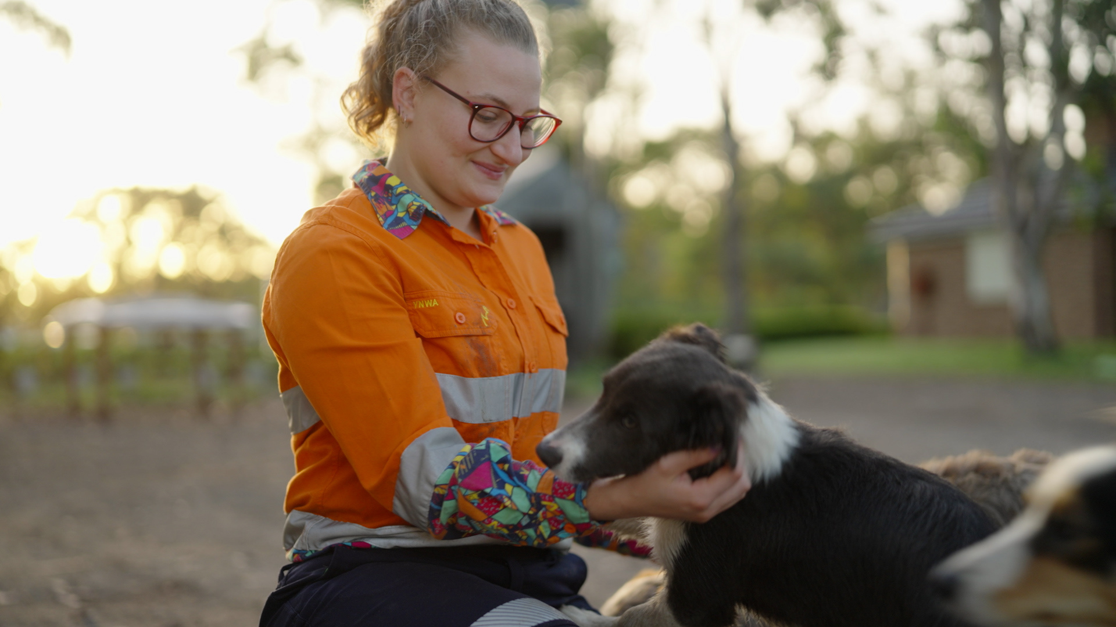
Quick check in!
Is it independent or dependent?
D
When we wrote down six sentences today
I
We worked hard during the lesson
I
The students shared their answers with the class
I
Everyone understood the difference between the clauses
D
After the class highlighted the nouns and verbs
D
Because everyone completed the matching activity
Notes:
Extension opportunity: Can you add any required punctuation? Comma at end of the dependent clause if it comes first in the sentence. Full stop at the end of the independent clauses. Which capitals need to change as they are not at the beginning of the sentence now?

Slide 23
Lesson 3

