Slide 1
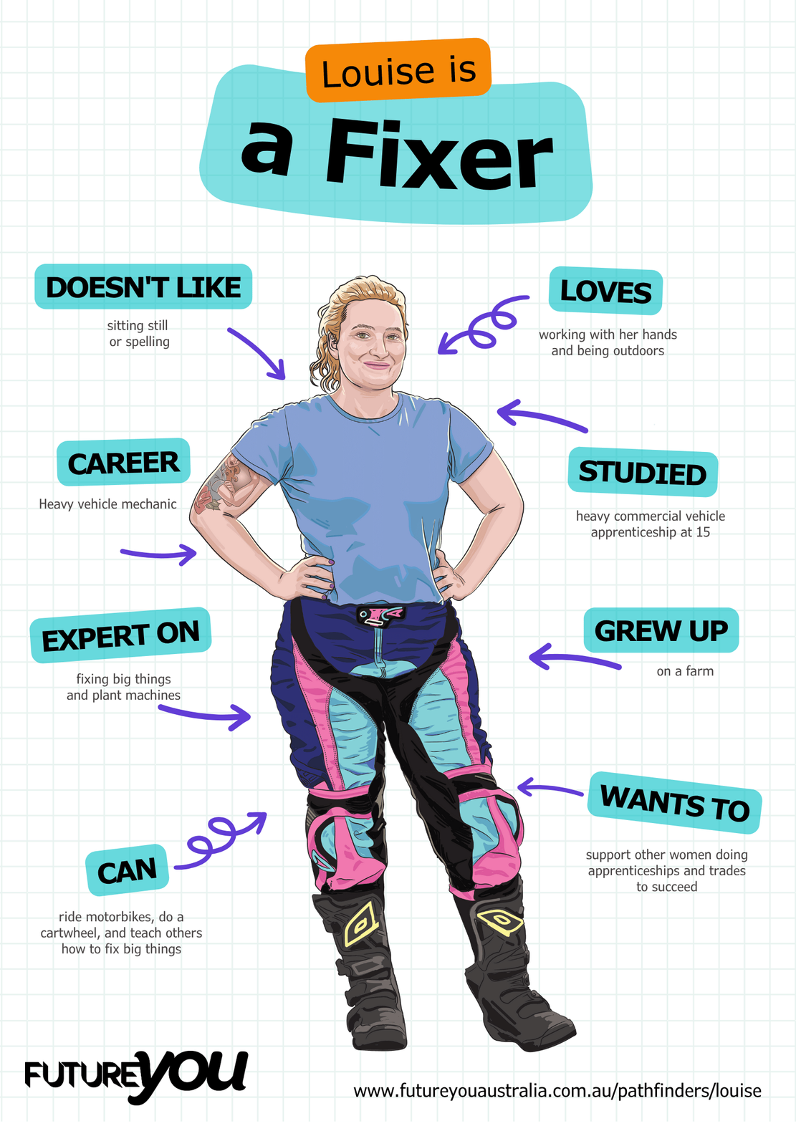

Lesson 4:
Punctuation and Conjunctions
Understanding the importance of punctuation and creating flow

Slide 2
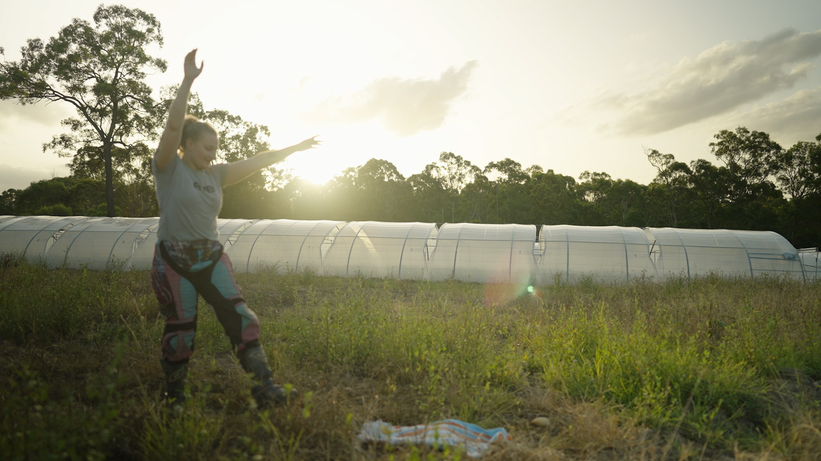
Lesson overview
Hook & Introduction
Individual or Pair Work
Stretch & Share
Wrap-Up Reflection
5 mins
20 mins
10 mins
5 mins

Slide 3
Learning intentions
I can explain why punctuation is important in writing.
I can use capital letters, full stops, and commas correctly.
I can use conjunctions to connect ideas in sentences.

Slide 4
Activity time:
Spot the problem
How it works:
  First, read the paragraph silently
  Then read the paragraph aloud with a partner
  Take turns asking each other these questions:
    Where did you want to pause?
    What made this hard to read?

Slide 5
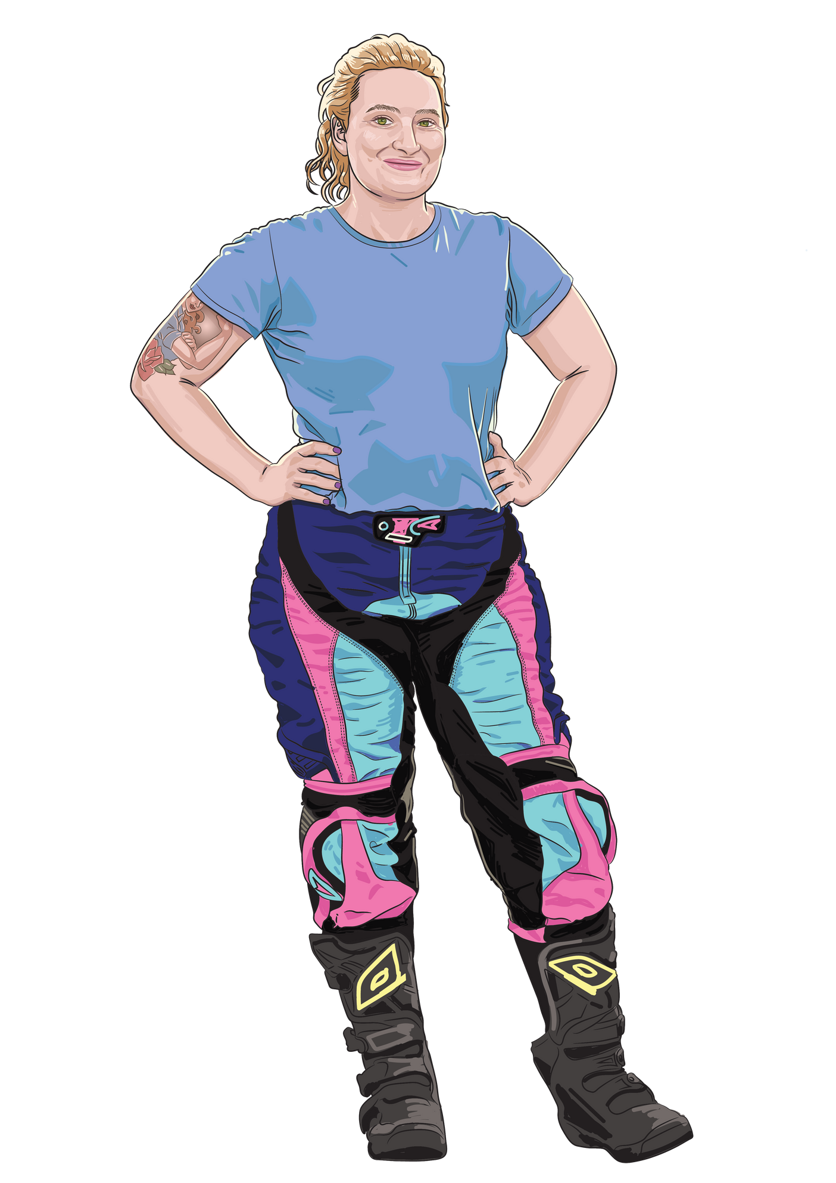
mechanics check brakes they change tyres they test vehicles this keeps people safe.
Notes:
While students discuss, observe and note:
- students who pause naturally in sensible places
- students who read straight through with no pauses
- students who mention capitals, full stops, or missing glue words
- students who struggle to explain why it sounds wrong
This gives immediate insight into:
- sentence boundary awareness
- early understanding of sentence flow
- which students may need extra modelling later in the lesson
(No recording required — quick mental notes or tick marks are enough.)

Slide 6

What made that paragraph
hard to read?

Slide 7
What was that paragraph missing?
Capital letters - used to start sentences.
Full stops, question marks, and exclamation marks - used to end ideas.
Commas - help separate parts of a sentence.

Slide 8
Let’s fix this paragraph.
mechanics check brakes they change tyres they test vehicles this keeps people safe.
Notes:
While students discuss, observe and note:
- students who pause naturally in sensible places
- students who read straight through with no pauses
- students who mention capitals, full stops, or missing glue words
- students who struggle to explain why it sounds wrong
This gives immediate insight into:
- sentence boundary awareness
- early understanding of sentence flow
- which students may need extra modelling later in the lesson
(No recording required — quick mental notes or tick marks are enough.)

Slide 9
Option 1 - punctuation only
Mechanics check brakes. They change tyres. They test vehicles. This keeps people safe.
What do you notice?
It’s clearer.
Each idea is separate
It makes sense now, but does it flow?
Notes:
While students discuss, observe and note:
- students who pause naturally in sensible places
- students who read straight through with no pauses
- students who mention capitals, full stops, or missing glue words
- students who struggle to explain why it sounds wrong
This gives immediate insight into:
- sentence boundary awareness
- early understanding of sentence flow
- which students may need extra modelling later in the lesson
(No recording required — quick mental notes or tick marks are enough.)

Slide 10
Option 2 - Add conjunctions
First, mechanics check brakes. Next, they change tyres. Then, they test vehicles. This keeps people safe.
What do you notice?
The order is clear.
Ideas are connected.
Which words helped you know what came next?
Notes:
While students discuss, observe and note:
- students who pause naturally in sensible places
- students who read straight through with no pauses
- students who mention capitals, full stops, or missing glue words
- students who struggle to explain why it sounds wrong
This gives immediate insight into:
- sentence boundary awareness
- early understanding of sentence flow
- which students may need extra modelling later in the lesson
(No recording required — quick mental notes or tick marks are enough.)

Slide 11
Option 3 - Add cause and result
First, mechanics check brakes to make sure vehicles can stop safely. Next, they change tyres so cars can grip the road. Then, they test vehicles to check everything is working. As a result, people can travel safely.
This shows how and why, not just what.
Notes:
While students discuss, observe and note:
- students who pause naturally in sensible places
- students who read straight through with no pauses
- students who mention capitals, full stops, or missing glue words
- students who struggle to explain why it sounds wrong
This gives immediate insight into:
- sentence boundary awareness
- early understanding of sentence flow
- which students may need extra modelling later in the lesson
(No recording required — quick mental notes or tick marks are enough.)

Slide 12
What are commas?
Commas are little pauses in your writing. Think of them like a small breath when you read.
They help your sentences make sense and stop everything from running together.

Slide 13
When do we use commas?
To separate things in a list.
Example: I packed my hat, sunscreen, water bottle, and lunch!
After a word that starts a sentence.
Example: Yes, I finished my homework.
To add a tiny pause so the sentence is clearer.
Example: When we got home, the dog barked.

Slide 14
Where does the pause go?
The truck is heavy so it needs strong brakes.

Slide 15
The truck is heavy
so it needs strong brakes.
A comma shows the reader where to pause when two ideas are joined.

Slide 16
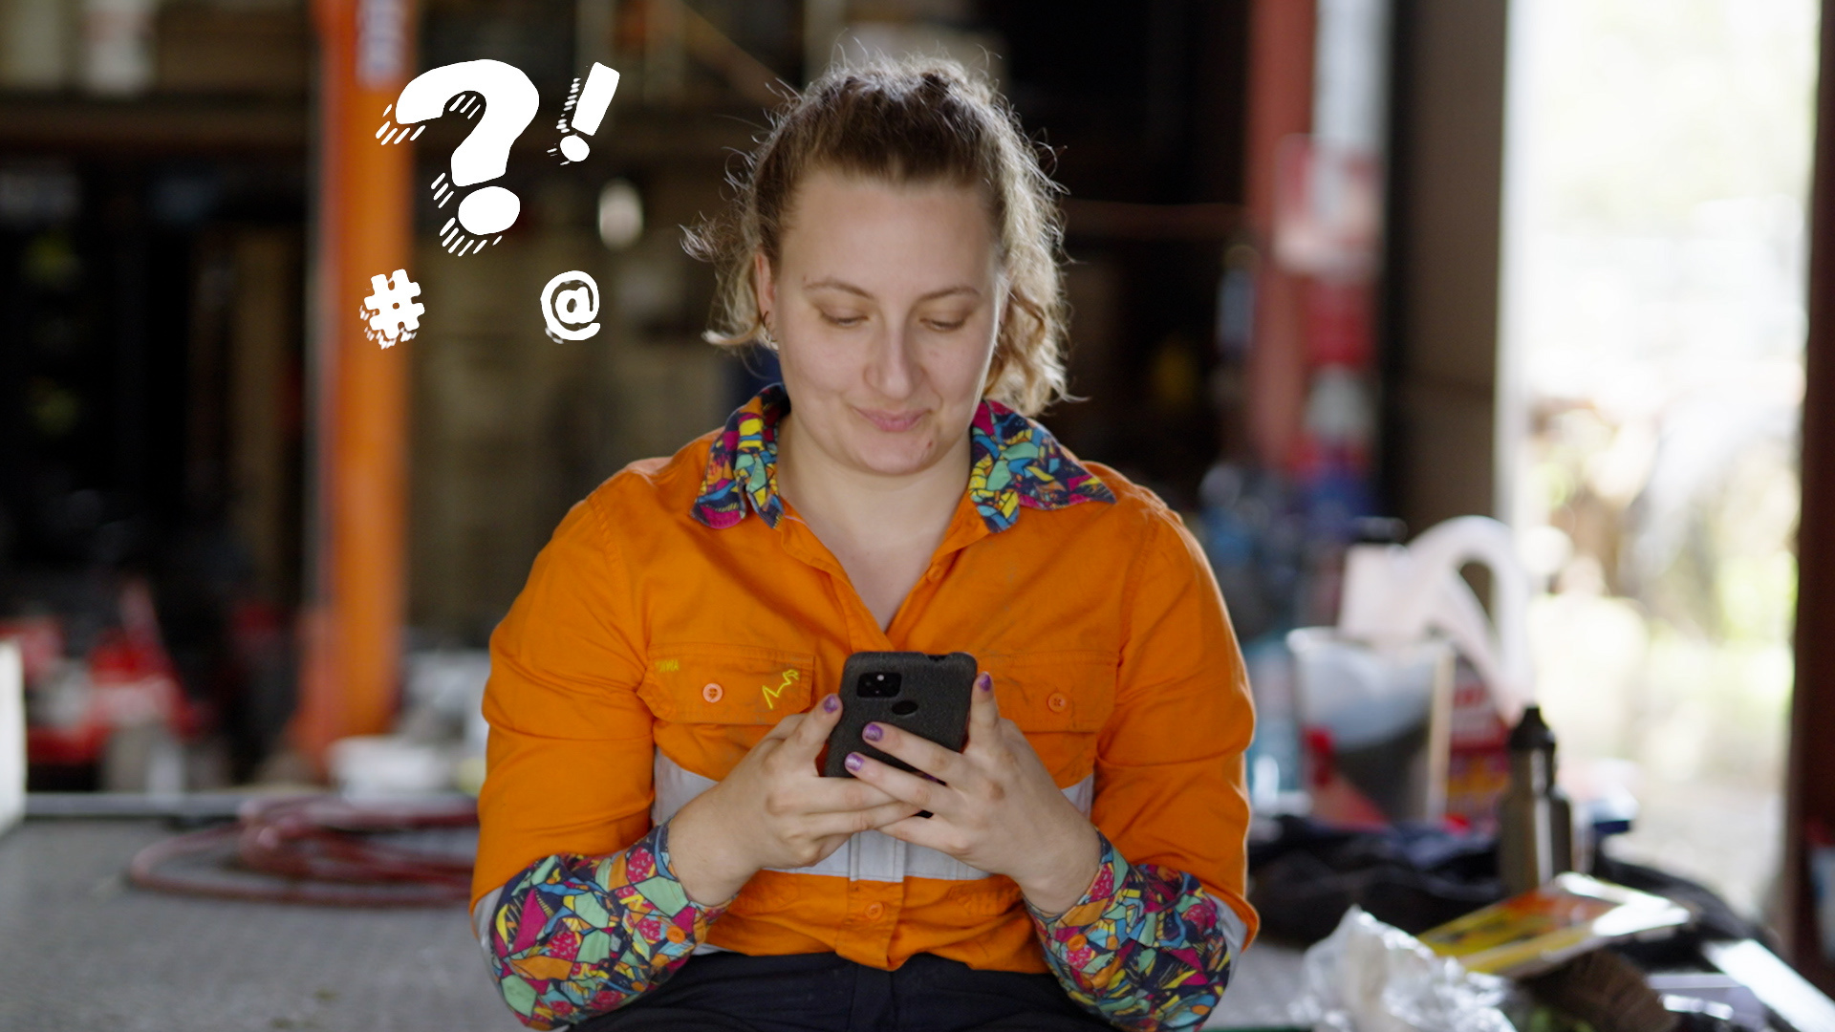
Activity time:
Add the comma!
How it works:
  Work individually or in pairs
  Read each sentence aloud. Take turns if working in pairs
  Decide where the pause belongs
  Add the comma
  Read one of your sentences aloud to the class and explain:
    Why you put the comma there
    Stretch: what the two ideas are

Slide 17
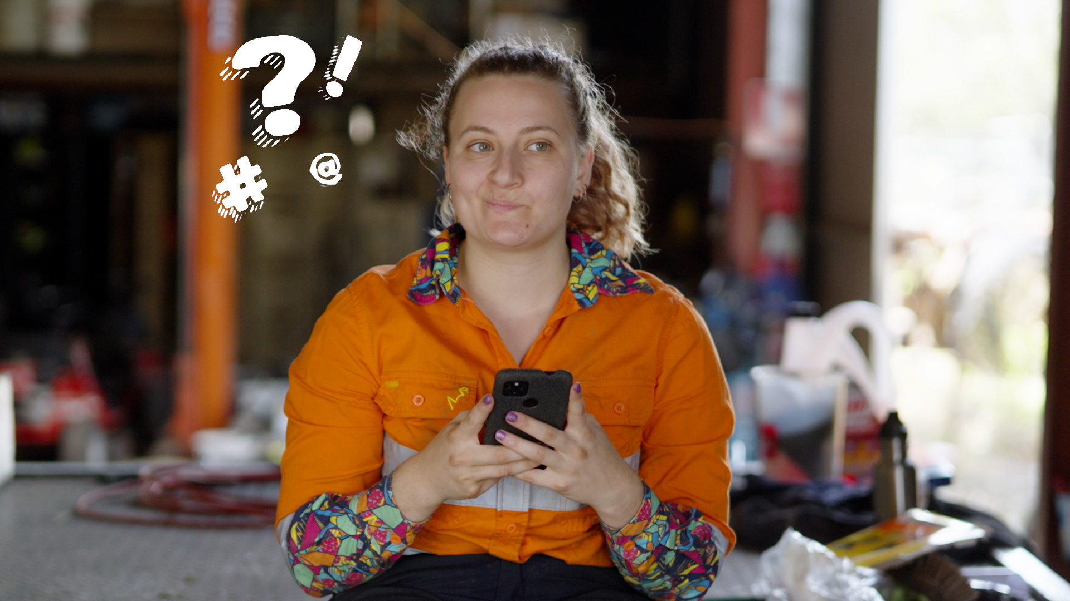
But wait…
What are conjunctions?

Slide 18

Conjunctions
Conjunctions are glue words. They help your writing stick together and make sense. Conjunctions connect ideas, so your sentences flow smoothly.
They also help you show how your ideas are related and stop you from repeating the same words too much.

Slide 19
Why do we use them?
  Link ideas so they make sense together
  Show how ideas are connected
  Help the reader follow your thinking
  Make your writing clearer, more interesting, and better organised
  Stop you from repeating the same words too much

Slide 20
Types of conjunctions
Coordinating Conjunctions
Last lesson we looked at:
for
(because)
and
(adds an idea)
nor
(not this,
not that)
but
(shows
contrast)
or
(gives a
choice)
yet
(but)
so
(shows result)

Slide 21
Other types of conjunctions
Subordinating Conjunctions
These join a main idea with a supporting (dependent) idea.
Correlative Conjunctions
These come in pairs.
because, although, if, when, while, before, after, since
either/or, neither/not, both/and, not only/but also
Example: I took an umbrella because it looked like it might rain.
Example: You can have either
pizza or pasta, not both.

Slide 22
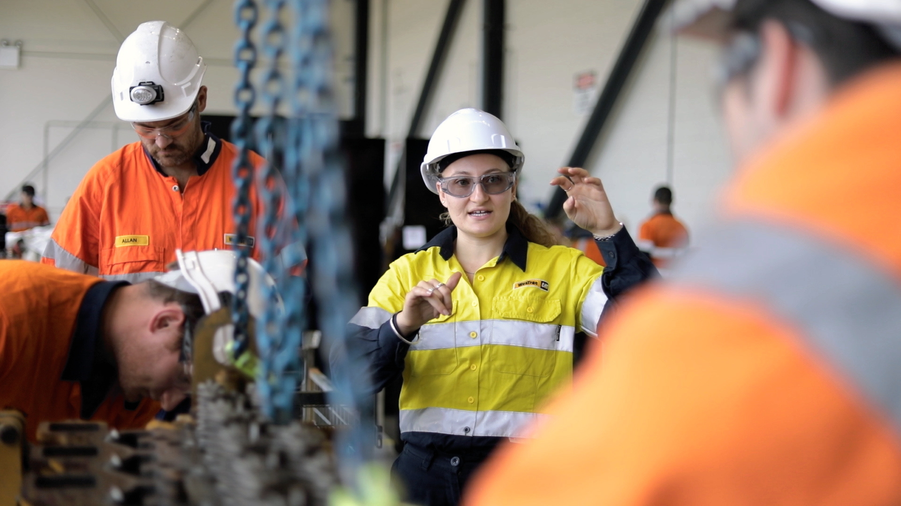
Activity time:
Repair that sentence!
How it works:
  Work individually or in pairs
  Add conjunctions to the sentences provided
  Fix punctuation (capital letters, full-stops, question marks, commas).

Slide 23
Bridge Activity
Make these sentences flow.
As a class, we are going to:
  reorder the sentences
  add two conjunctions
  link some sentences together with conjunctions and correct punctuation

Slide 24
The mechanic checks the brakes.
The truck is noisy.
The tyres are worn.
The mechanic changes the tyres.
The truck grips the road much better.
The truck is safe to drive.
Conjunction word bank:
  because
  so
  after that
  as a result

Slide 25
The mechanic checks the brakes because the truck is noisy.
The tyres are worn, so the mechanic changes the tyres.
After that, the truck grips the road much better.
As a result, the truck is safe to drive.

Slide 26
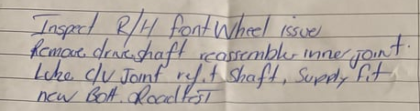
Let’s stretch!
How could we improve this real excerpt from a mechanic’s report?
Inspect right hand front wheel issue.
Remove drive shaft reassemble inner joint
Lube C/V joint refer to shaft,
Supply fit new bolt. Roadtest

Slide 27
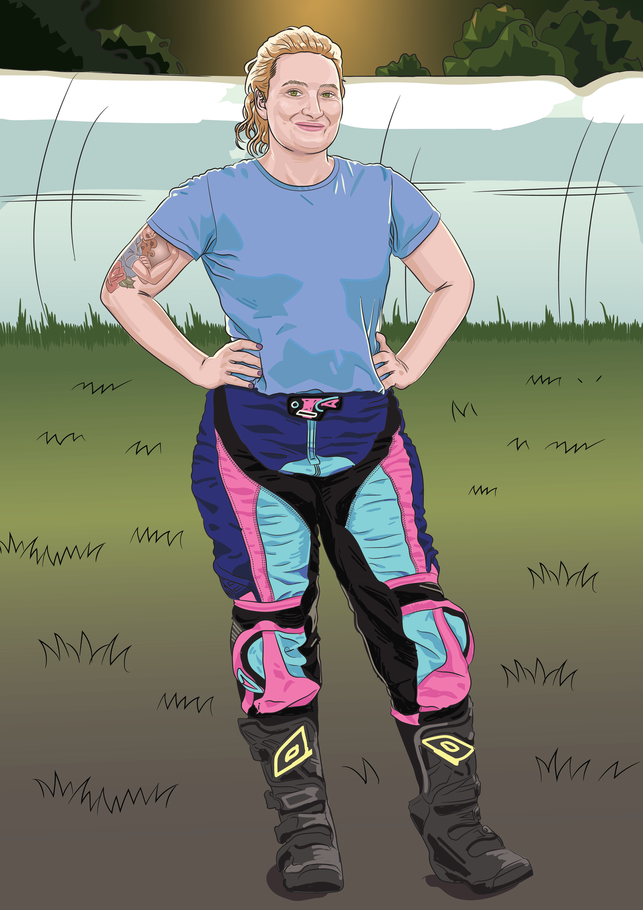
Reflect
How do punctuation and glue words help your reader?

Slide 28
Lesson 4

