Slide 1
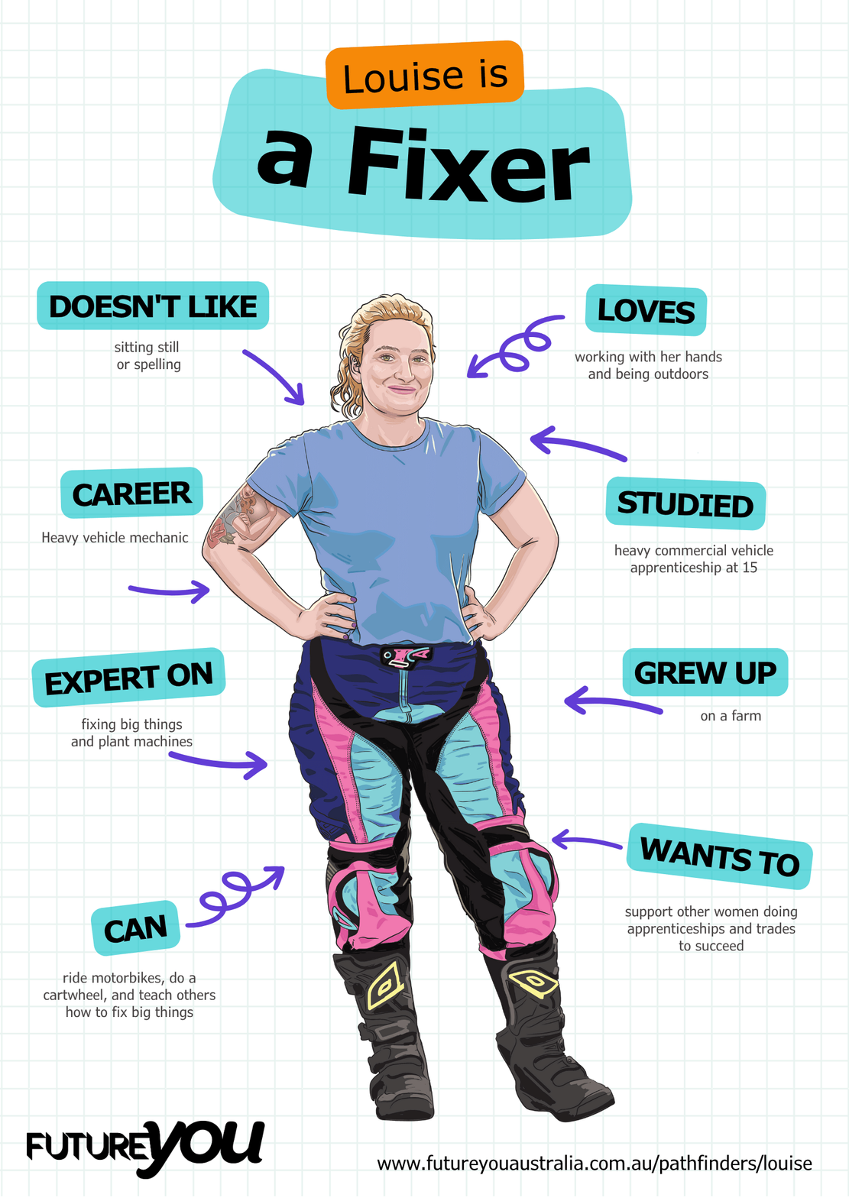

Lesson 5:
Paragraph Building
Learning how good paragraphs are structured

Slide 2
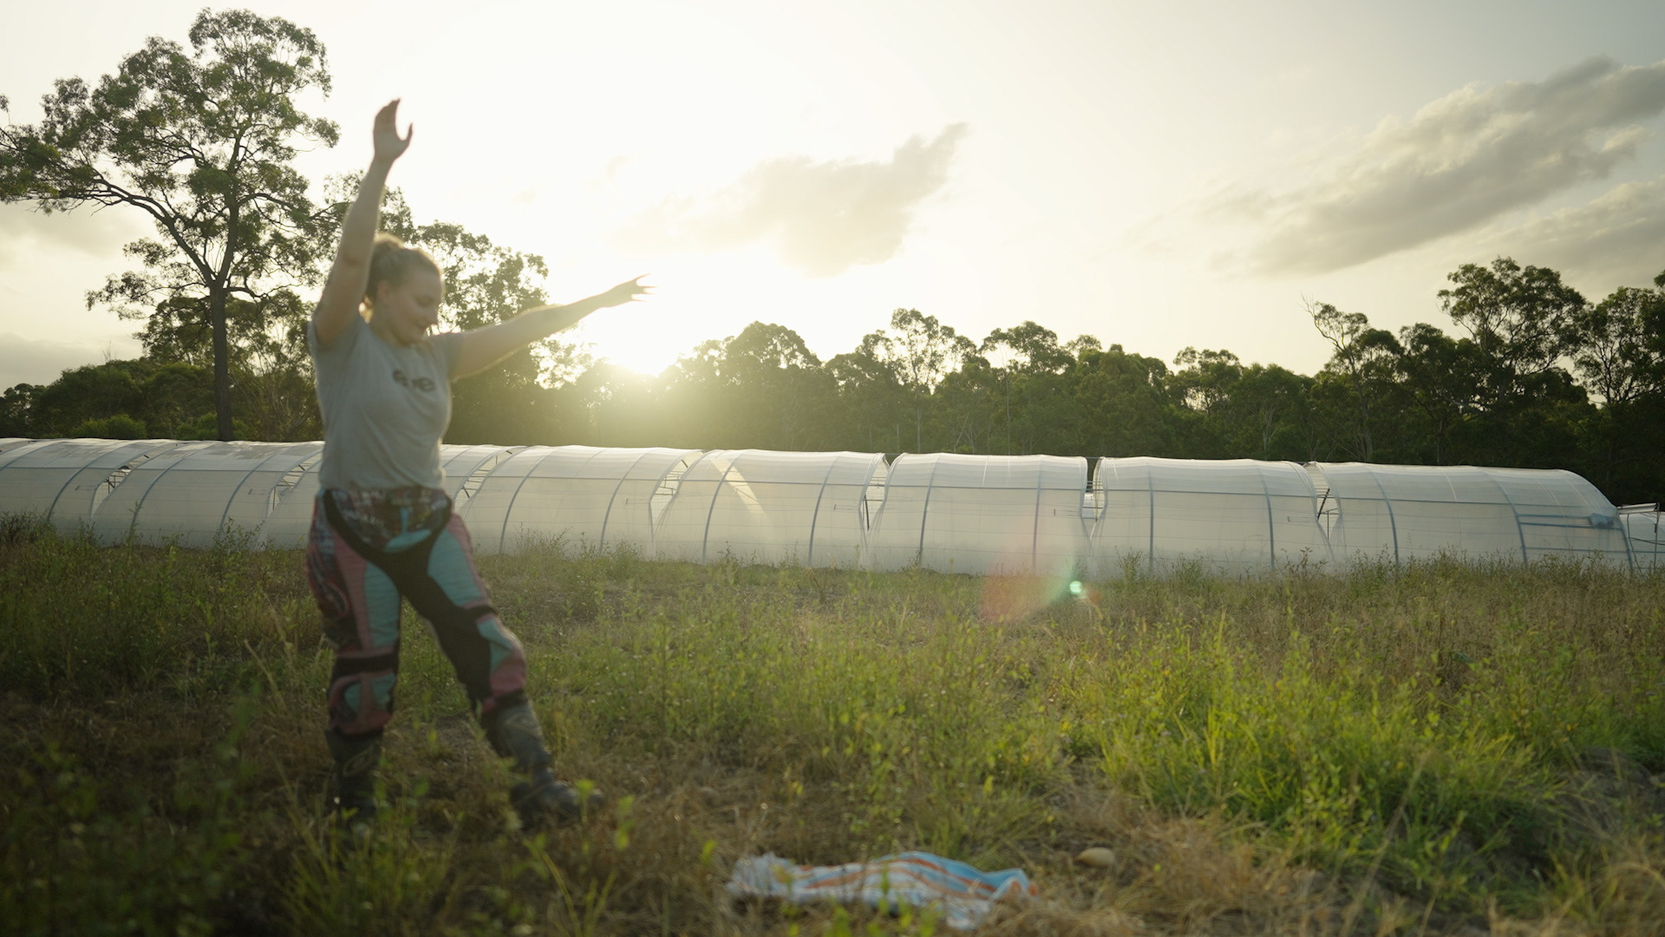
Lesson overview
Hook & Introduction
Group Work
Stretch & Share
Wrap-Up Reflection
10 mins
15 mins
10 mins
5 mins

Slide 3
Learning intentions
I understand how paragraphs are structured and organised.
I can identify topic sentences.
I recognise that supporting details are necessary for strong paragraphs.

Slide 4
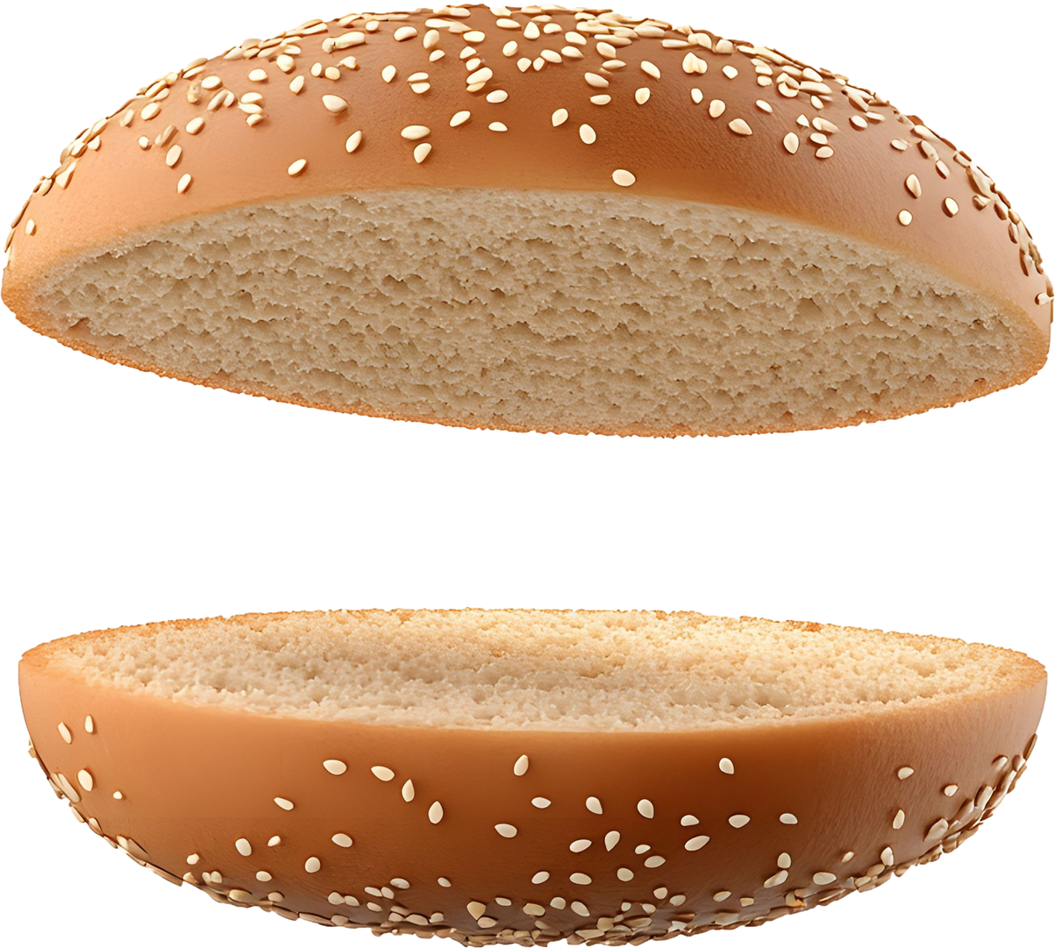

Is this a cheeseburger?

Slide 5
No!
Let’s make a cheeseburger.

Slide 6
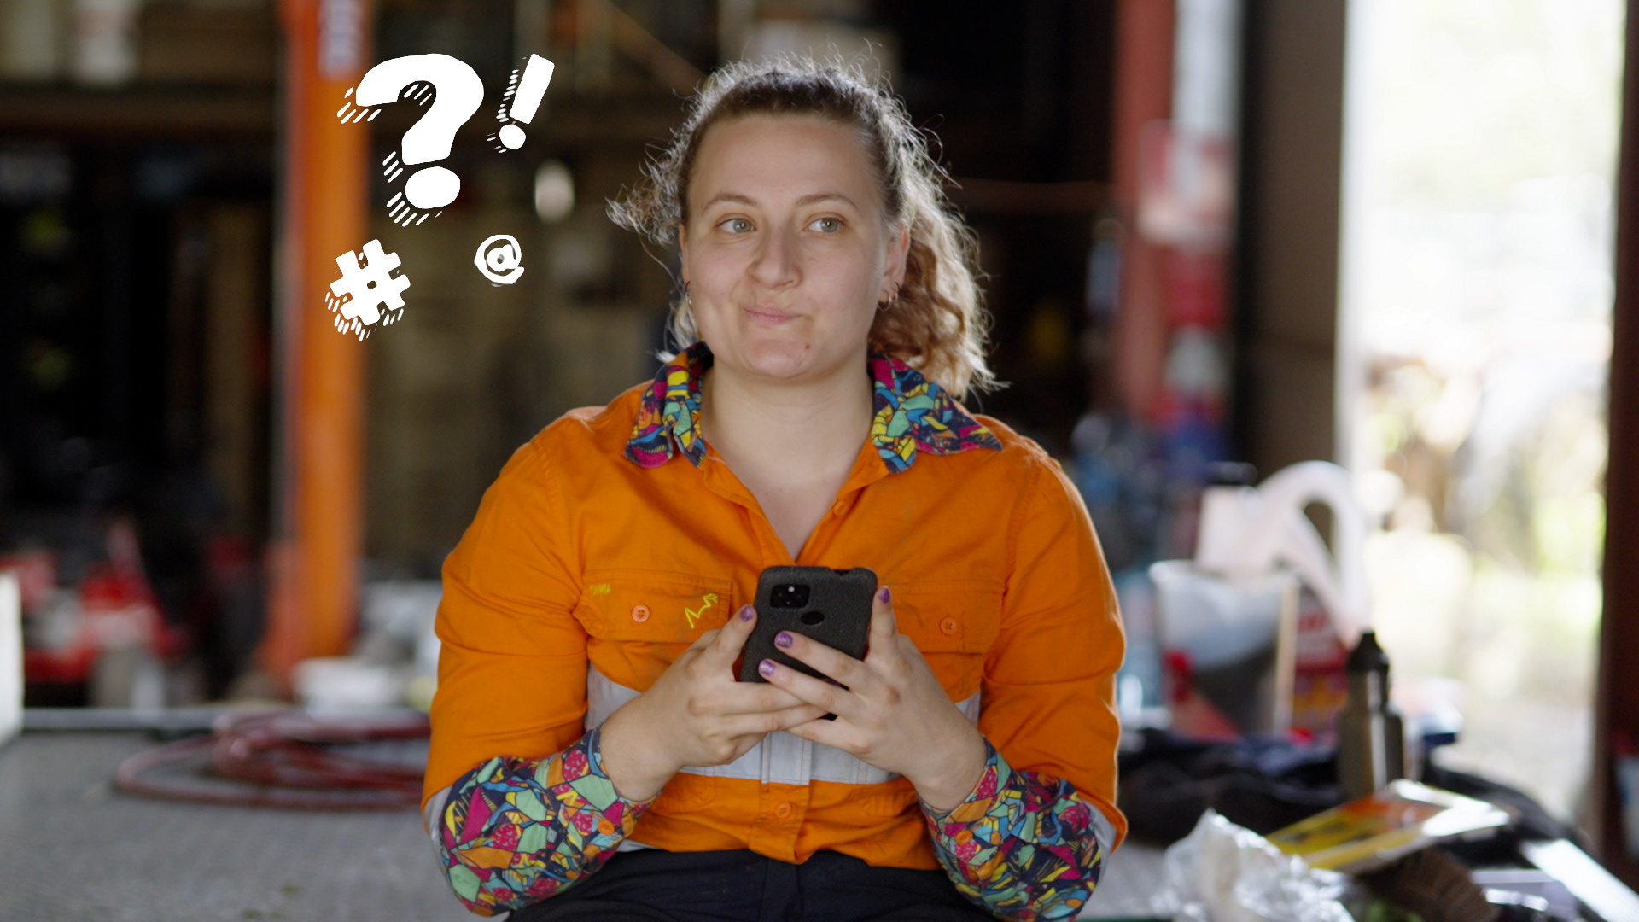
But wait…
Why are we learning about burgers?
We’re not. We’re learning how to build paragraphs.

Slide 7

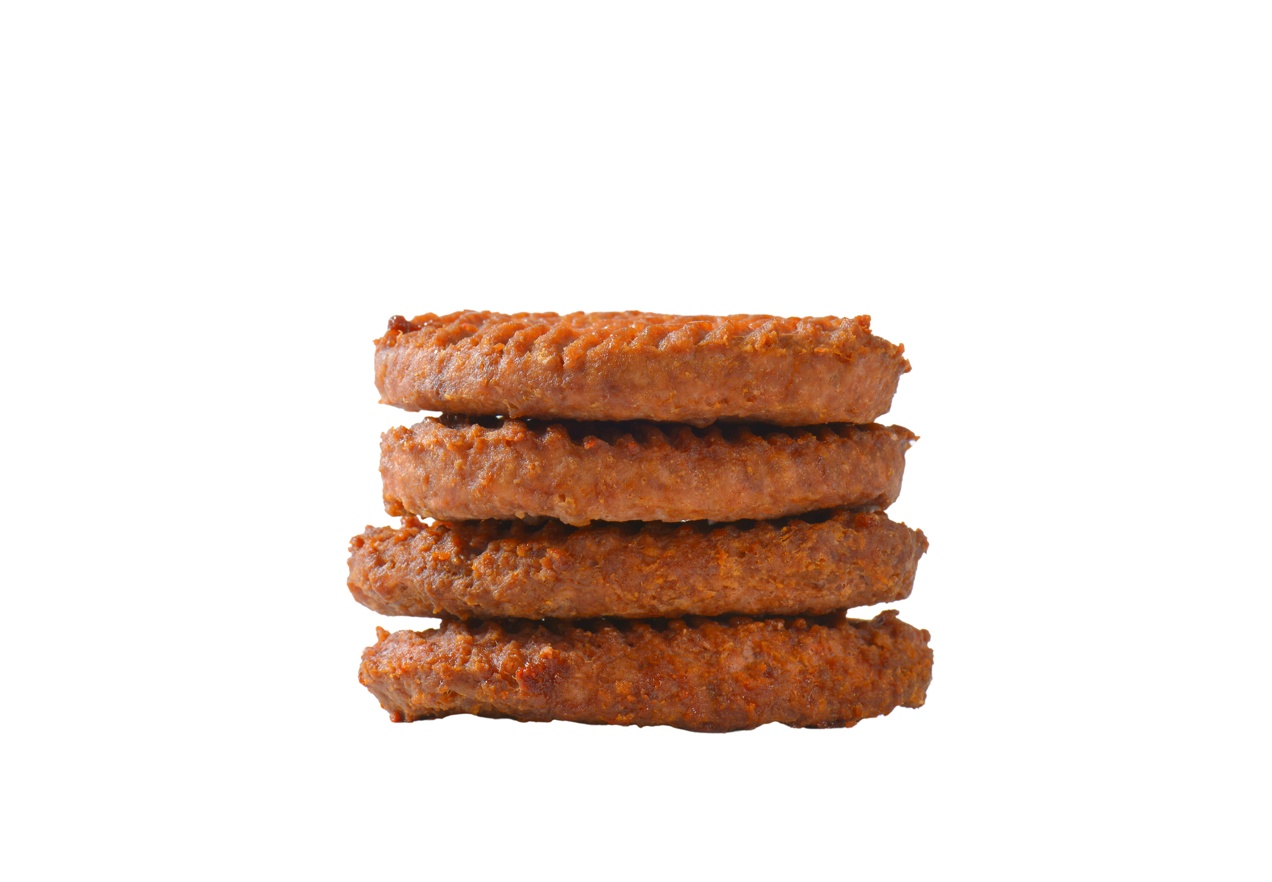
How does a burger help us build a paragraph?
Top Bun = Topic Sentence
Supporting Sentence 1
Supporting Sentence 2
Supporting Sentence 3
Bottom Bun = Concluding Sentence
Notes:
Explain that there can be more than three supporting sentences in a paragraph, but three is the minimum.

Slide 8
The top bun = the topic sentence and focus of the paragraph.
This part introduces the main idea.

Slide 9
The fillings = the supporting details.
They provide facts, reasons, and examples.

Slide 10
The bottom bun = The concluding sentence.
This summarises the main point and wraps up the paragraph.
Notes:
Explain that the concluding sentence often also provides a link or gives direction towards what will be covered in the next paragraph, unless it is the final paragraph in the report/essay/book, etc.

Slide 11
The burger method will help you to organise ideas into a clear paragraph.

Slide 12
Activity time!
I had a great day yesterday. We went to the park and met our friends there. Afterwards, mum took us to get ice-cream. I picked chocolate because it’s my favourite. It was a really fun day.
I like chocolate ice cream. We went to the park. Yesterday was a great day. It was fun. Mum took us to get ice cream. We met our friends there. Chocolate is my favourite.
Which one do you think follows the correct burger method?

Slide 13
I had a great day yesterday.
We went to the park and met our friends there.
Afterwards, mum took us to get ice-cream.
I picked chocolate because it’s my favourite.
It was a really fun day.
Notes:
Point out the role of “Afterwards” in this sentence as a conjunction. It adds context and time-framed order and provides extra information about when/where/how.

Slide 14
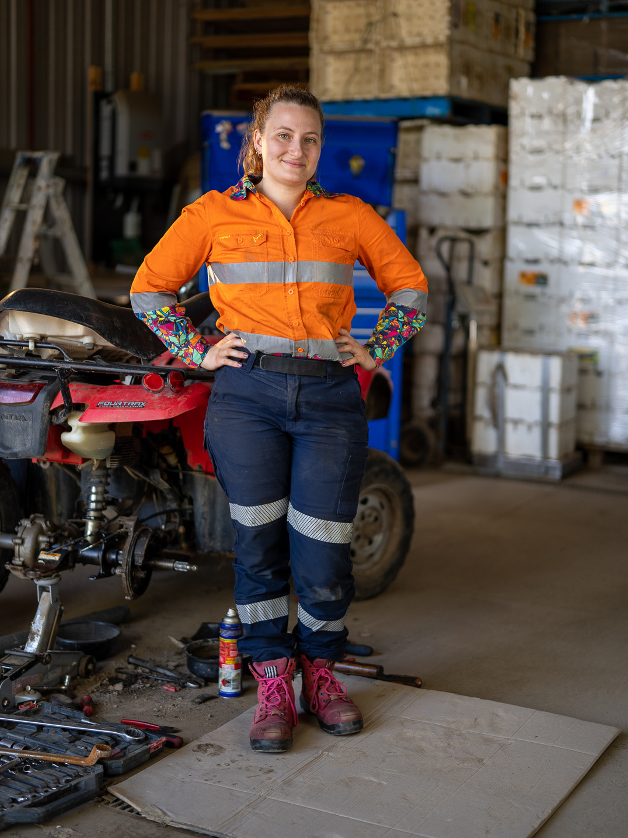
Back to Louise!
She’s a heavy vehicle mechanic.
She teaches people.
She fixes big things.
She works with her hands.
She uses tools.
She knows how things work.
She writes reports for her customers.

Slide 15
A report is an informative text.
Informative texts intend to inform the reader or viewer, or in Louise’s case, the customer.
They’re non-fiction texts that give information on particular subjects.
Informative texts use clear language and relevant terms.

Slide 16
Examples of informative texts:
  Instructions
  Newspaper reports
  Scientific articles

Slide 17
Examples of relevant terms Louise would use:
  mechanic (n)
  tyres (n)
  bench (n)
  brake pads (n)
  change (v)
  wrench (n)
  truck (n)
  check (v)
  diagnose (v)
  Tools (n)
  engine (n)
  oil (n)

Slide 18
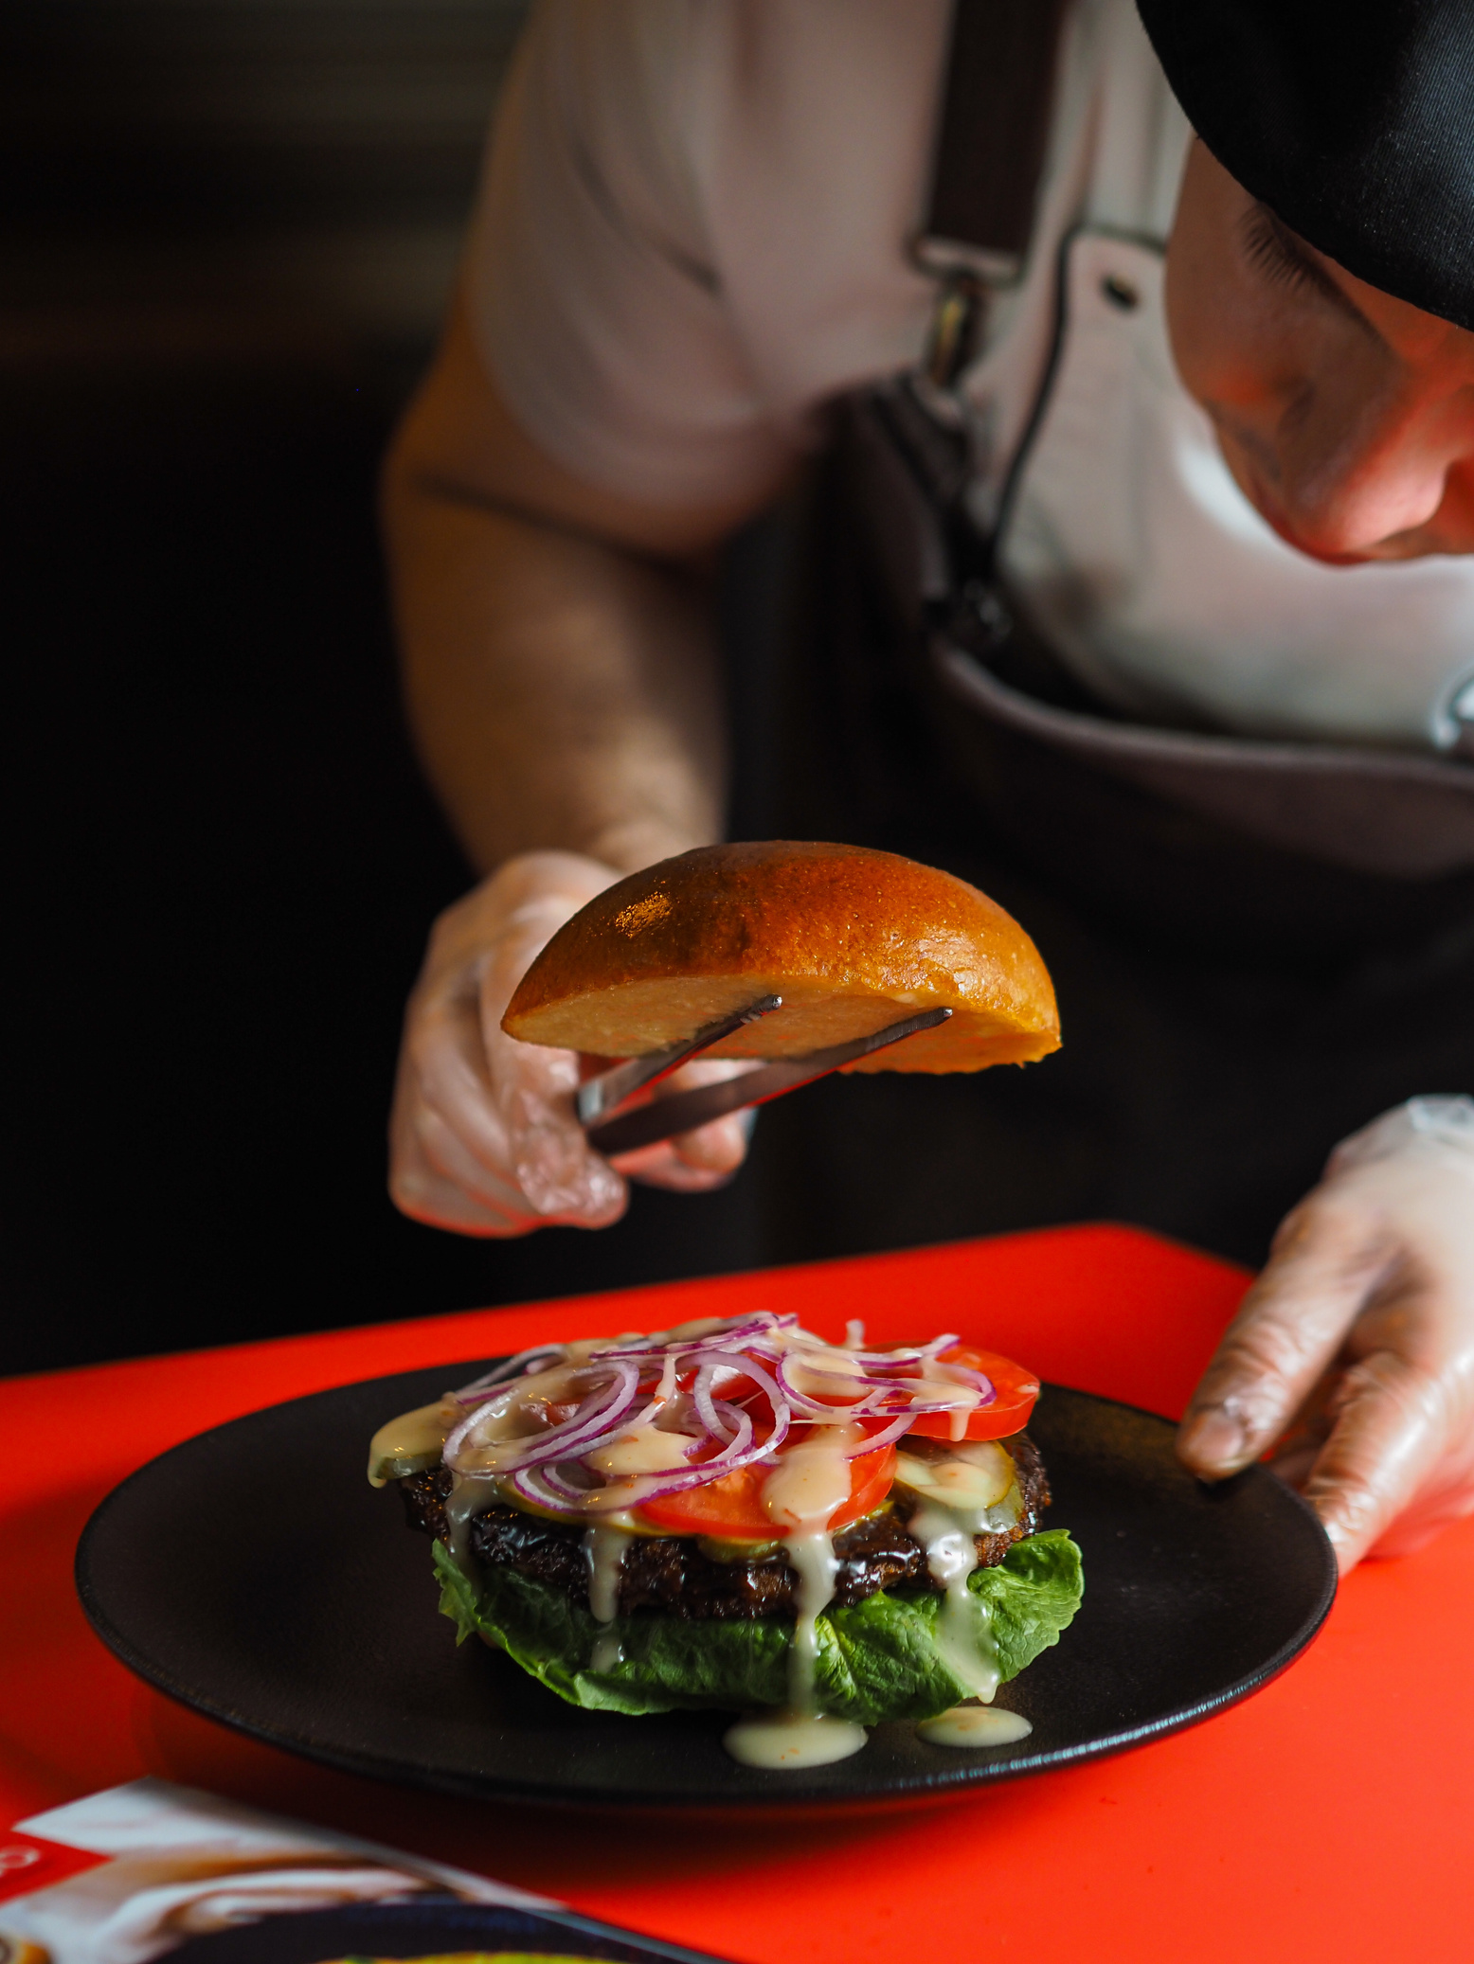
Activity time:
Paragraph elements
How it works:
  Work together in groups
  Using the provided sentences, determine which sentence is the topic sentence, which ones are the supporting sentences, and which is the concluding sentence.
  Identify the relevant terms in each sentence.

Slide 19
Paragraph elements: Structure
Topic sentence: Introduces the topic.
Louise is a mechanic who helps farmers keep their trucks safe and reliable.
Supporting sentences: Facts about the topic.
  First, she checks the brakes to make sure the trucks can stop safely.
  Then she uses her tools to fix problems with the engines.
  She also changes old tyres to make sure trucks can grip the road.
Concluding sentence: summarises the main point and wraps up the paragraph.
This is why Louise is an important mechanic in her community.

Slide 20
Paragraph elements: Louise’s terms
Louise’s terms
Louise is a mechanic who helps farmers keep their trucks safe and reliable. First, she checks the brakes to make sure the trucks can stop safely. Then she uses her tools to fix problems with the engines. She also changes old tyres so the trucks can grip the road. This is why Louise is an important mechanic in her community.
mechanic
trucks
checks
brakes
tools
fix
engine
tyres

Slide 21
Activity time:
Paragraph Prep
How it works:
  Work in small groups of 3-4
  Each student/pair/group gets a paragraph planning template, 1 topic sentence, 3 supporting sentences and 1 concluding sentence.
  Determine which sentence is which.
  Once sorted, organise sentences into a clear paragraph.

Slide 22
Remember!
Top Bun = Topic Sentence
Supporting Sentence 1
Supporting Sentence 2
Supporting Sentence 3
Bottom Bun = Concluding Sentence

Slide 23
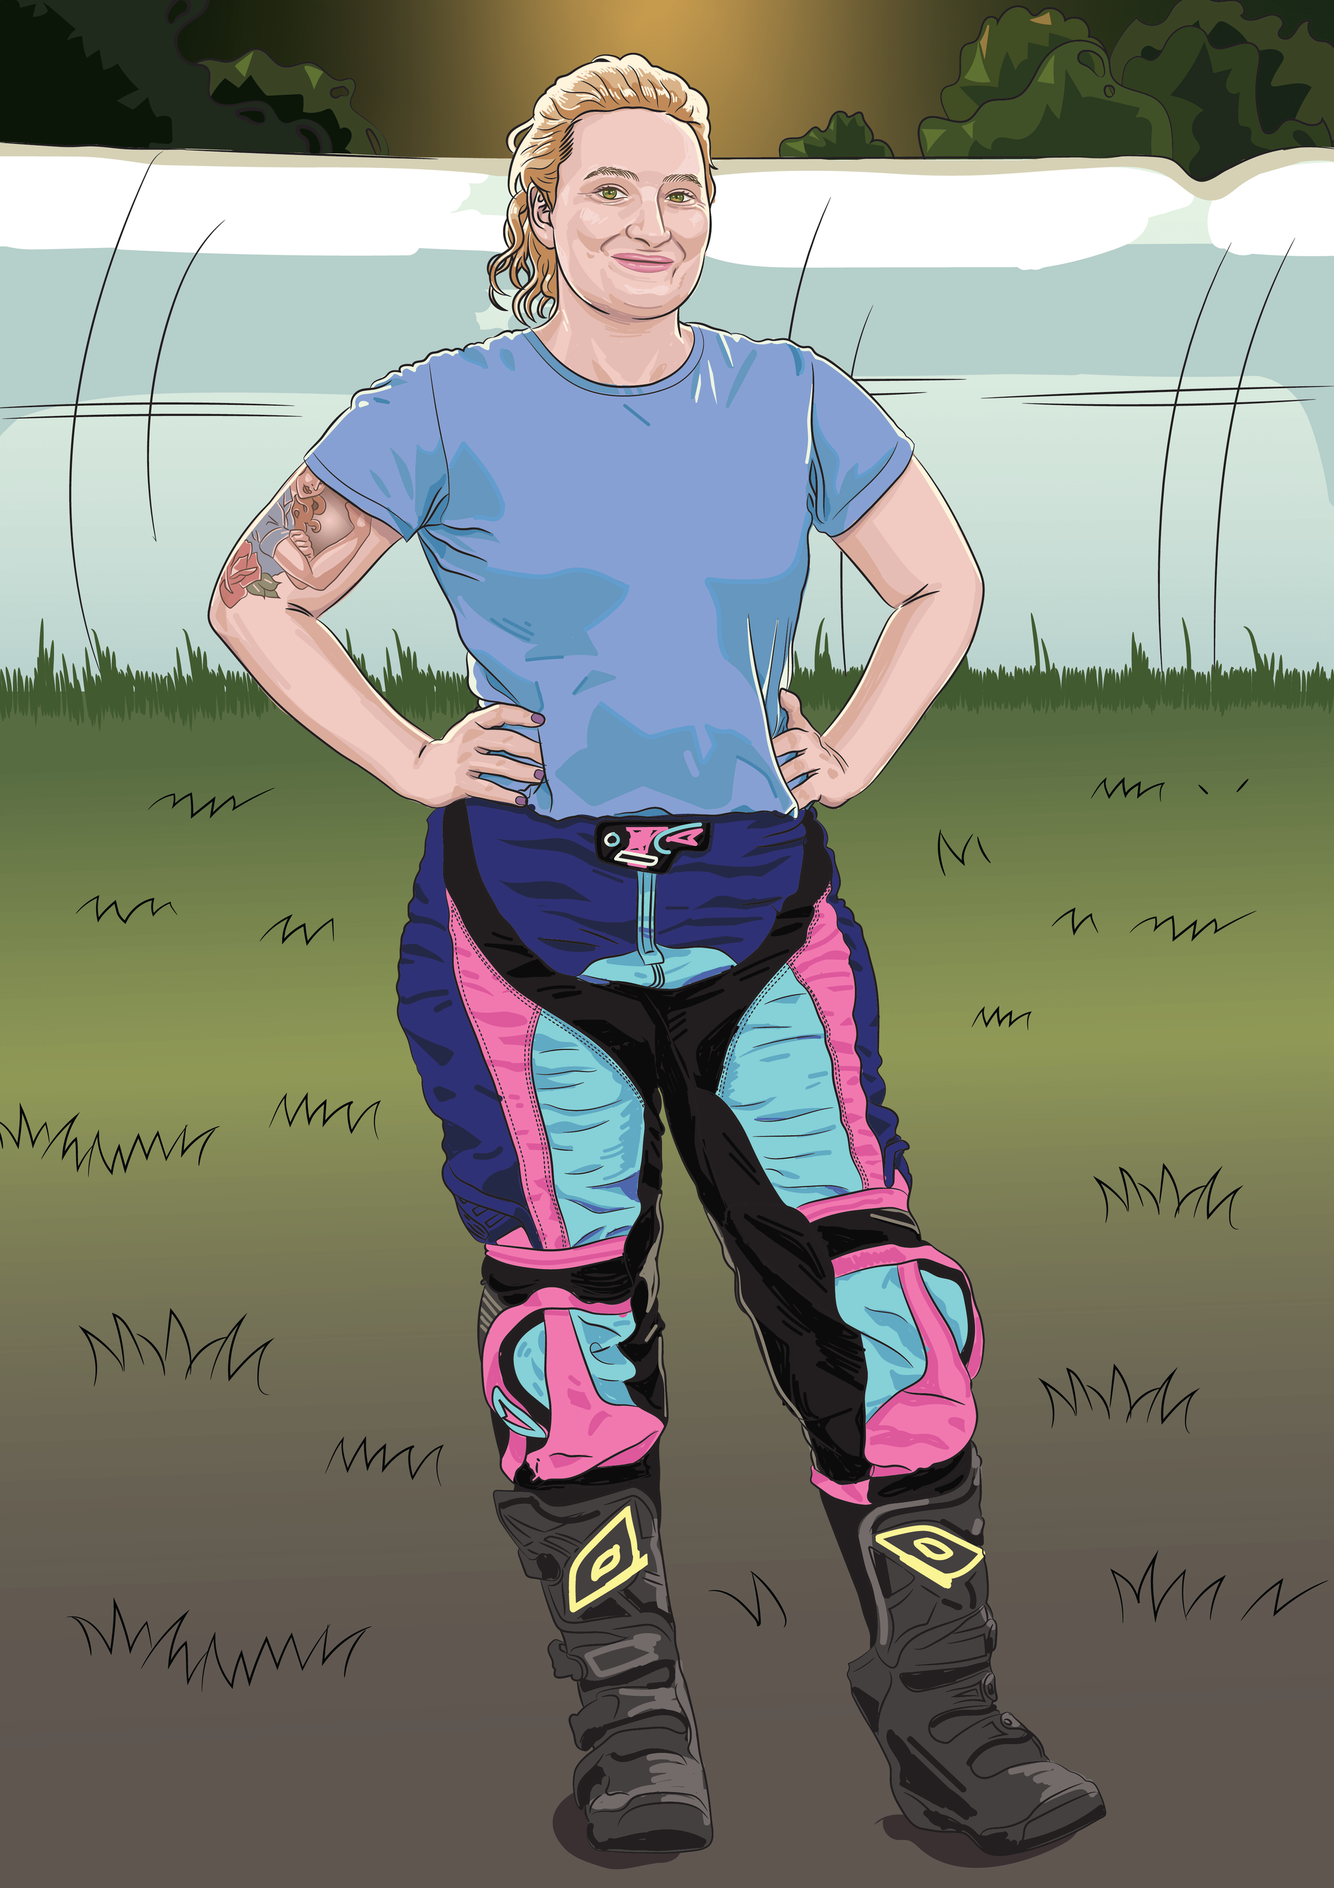
Reflect
Write down two things.
One relevant term you used today.
One paragraph element:
  topic sentence
  supporting sentence,
  concluding sentence
and write a short example of it.
Notes:
Extension: What are words that helped to show order or linked together sentences (cohesive devices). You could cut these up and get them to redo the paragraph with extra circumstantial information added. They could be phrases or clauses to add to the beginning of the sentence like, “When needed,” ”When the trucks are not working well, …“

Slide 24
Share
Did anyone else write the same relevant term?
Does anyone know which paragraph elements those sentences were?
Lesson 5

