Slide 1


Lesson 7:
Planning the Report
Map out a plan for your reports using the skills and knowledge learnt in previous lessons.

Slide 2
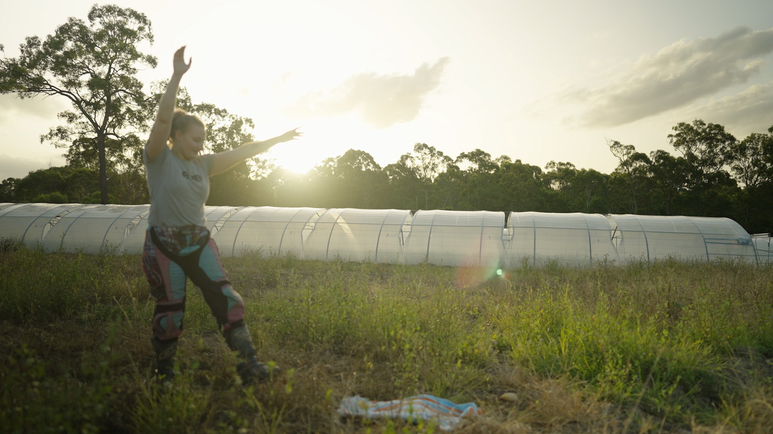
Lesson overview
Hook & Introduction
Group Work
Stretch & Share
Wrap-Up Reflection
10 mins
15 mins
10 mins
5 mins

Slide 3
Learning intentions
I can plan a technical report using the skills I have been learning.
I can organise my ideas into a clear plan.
I can use feedback to improve my technical report.

Slide 4
the tractor was loud. Louise look at it the wheel was broken and she think it needs new tyres also the engine is making a funny noise because it was old and she looked under the bonnet the brakes was not working good she told the farmer it is bad and she need to fix it. Tools. tyre. Machine. Loud noise Louise can check stuff.
Notes:
Provide students with hand-outs to identify problems,

Slide 5
What’s wrong with that paragraph
  No topic sentence
  No clear order of events
  No paragraph structure
  Technical terms not used correctly
  No capital letters
  Poor use of verbs
  No punctuation
  Incorrect grammar
  Mix of random words
  Difficult for a customer to understand

Slide 6
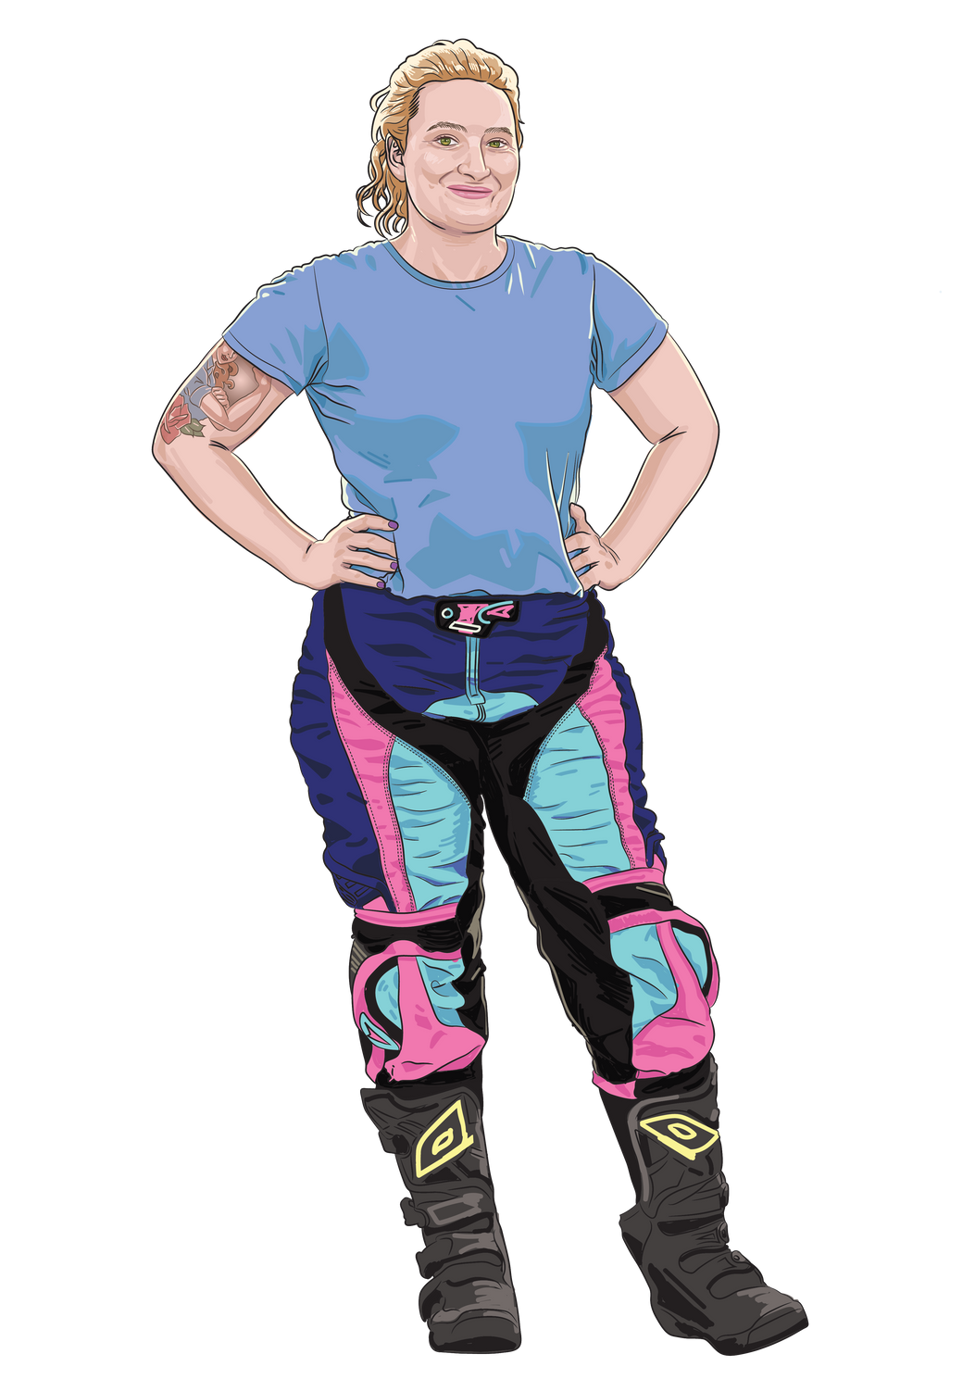
Today we are planning our reports

Slide 7
Let’s review!
What are the elements you need to include in your report?

Slide 8

Nouns and verbs
Simple and compound sentences
Independent and dependent clauses
Structured paragraphs (hamburger model)
Relevant terms

Slide 9

Activity time:
Let’s make a plan
How it works:
  Work individually
  Use the report planning template
  Plan your report! Make sure to include:
    Topic sentence
    Relevant terms
    At least 3 dot points (you will use these to write your supporting sentences)
    Concluding sentence

Slide 10
What I’m looking for
Is there a clear topic sentence?
Does the plan include relevant terms?
Are there sentence-type examples?
Have you used a range of different sentence types?

Slide 11
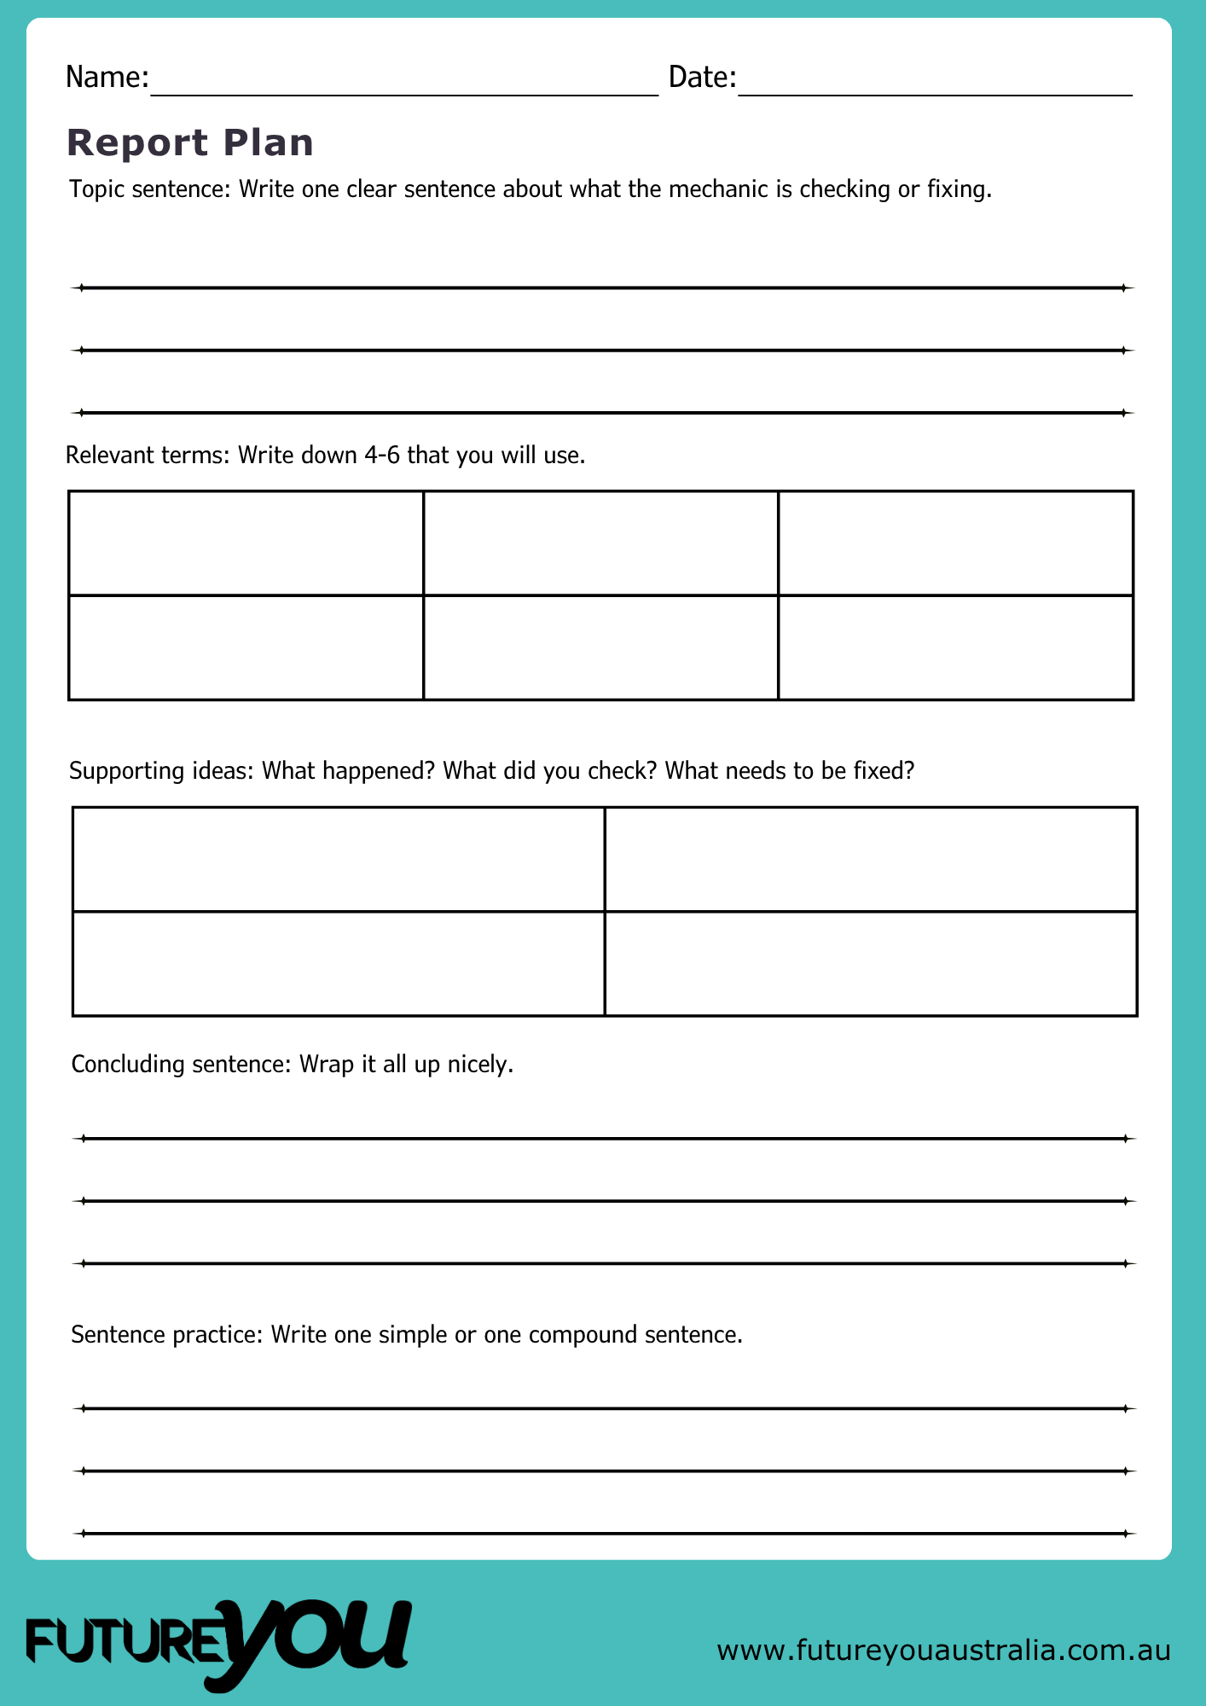
What I’m looking for
The customer is complaining about a bad smell when they turn on their tractor.
Check
Hose
Oil
Diagnose
Bonnet
Engine
I check under the bonnet
I see oil leak from the hose
It falls on the engine
I diagnose the problem
I seal the hose to stop the oil leaking onto the hot engine, which stops the bad smell.
I check under the bonnet, and I see oil leak from the hose, which falls on the engine.

Slide 12
Activity time:
Helpful feedback
How it works:
  Swap your plan with a classmate.
  Help them improve their plan.
  Look for these three things!
    Is it clear and easy to follow?
    Could it use more information?
    Have they used relevant terms?
  Make changes to your plan based on the feedback.
Notes:
Recommendation: Set up an edit code system on the wall that students and staff (TAs ) can all use. A smiley face can be for something liked. Highlights/Colours to show something needs changing/error. Circle to show something confusing. ^ to show something missing or could be included (more information). It’s also recommended that partners discuss the feedback on return and start with what they like first before moving to suggested improvements.

Slide 13
Helpful feedback:
Is it clear and easy to follow?
Could it use more information?
Have they used relevant terms?
Notes:
Give students time to rework and hand in the edited draft and rework with names, including editing partners name on the draft/plan.
Reward pairs and/or use a point system to show positive working together and to encourage responding to productive criticism.

Slide 14
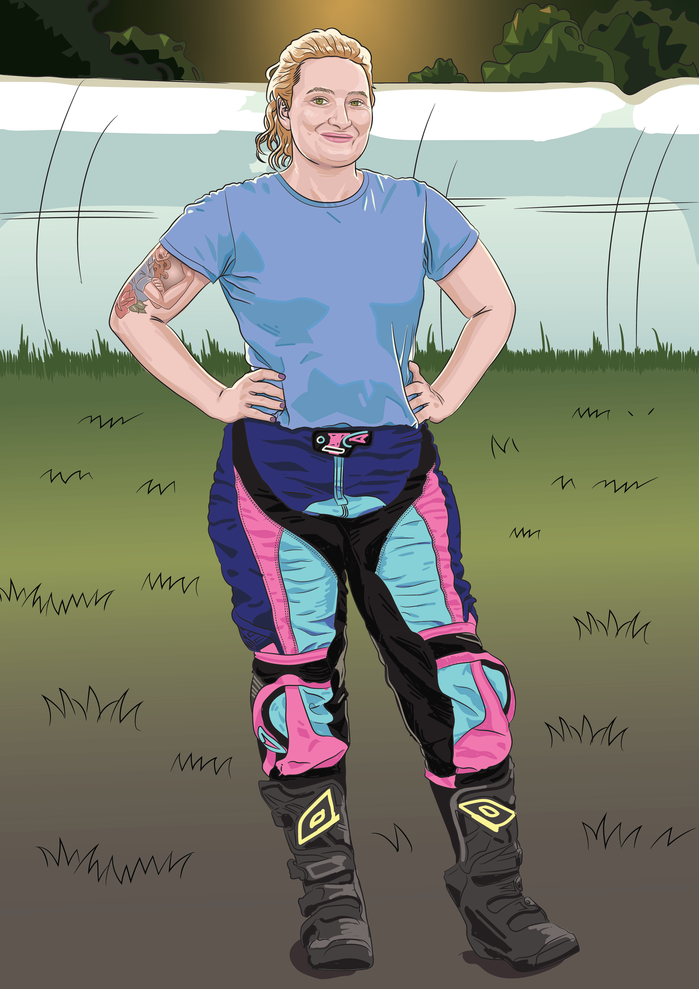
Reflect and Share
Write down your answers to these:
  One part of my report I am confident about.
  One part I think I need help with.
  One thing I learnt from my partners feedback and I am going to change/did change.

Slide 15
Lesson 7

