Slide 1
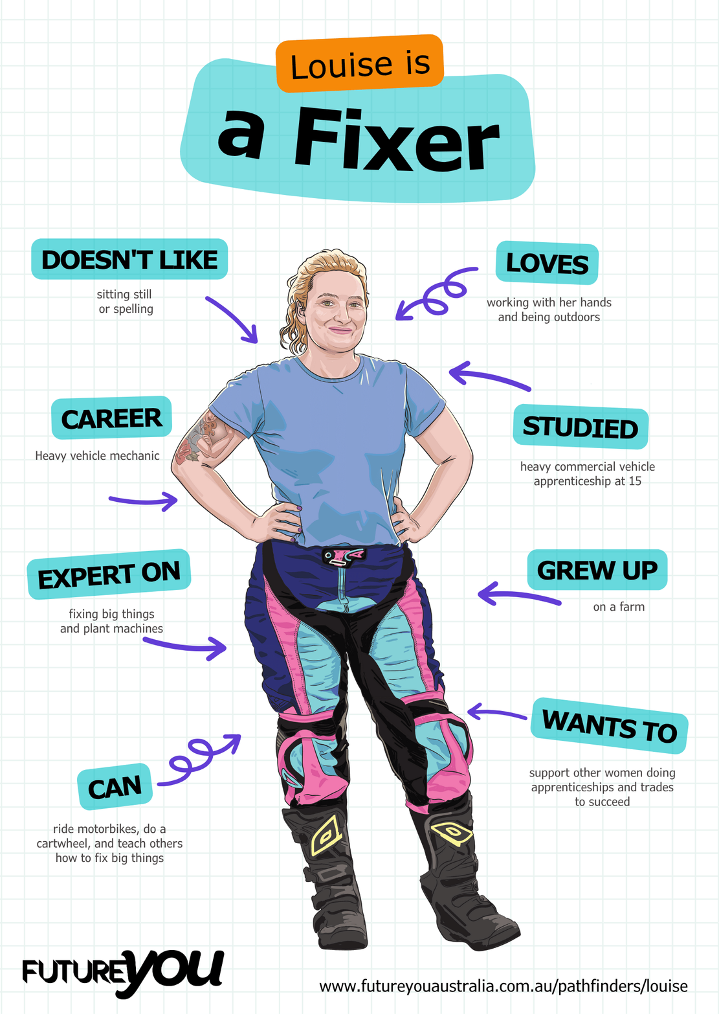

Lesson 8:
Writing the Report
Write your own full report using everything you’ve learned.

Slide 2
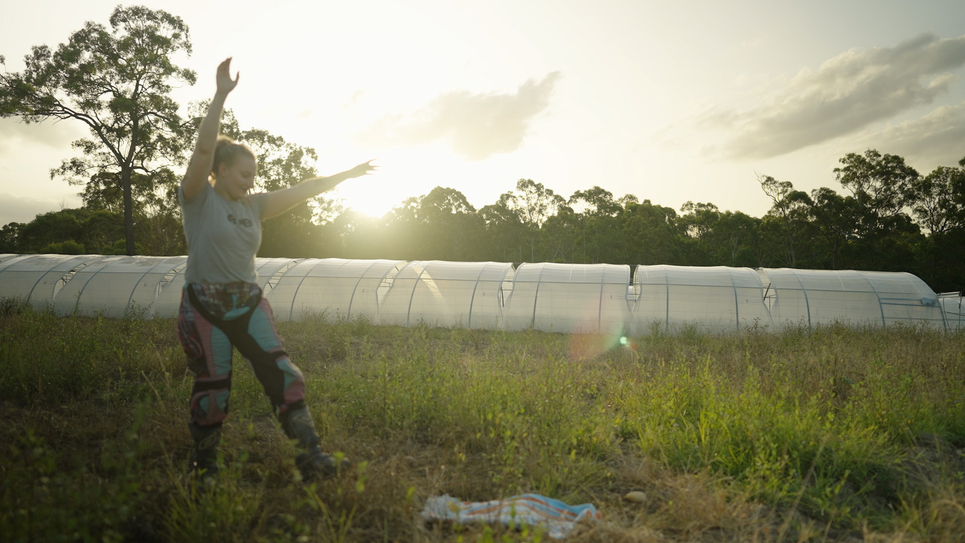
Lesson overview
Hook & Introduction
Individual/group Work
Stretch & Share
Wrap-Up Reflection
5-7 mins
25 mins
5 mins
5 mins

Slide 3
Learning intentions
I can apply all previously learned writing skills to produce at least one paragraph of an informative report.
I can use correct paragraph structure.
I can use a range of different sentence types and relevant terms in my writing.

Slide 4
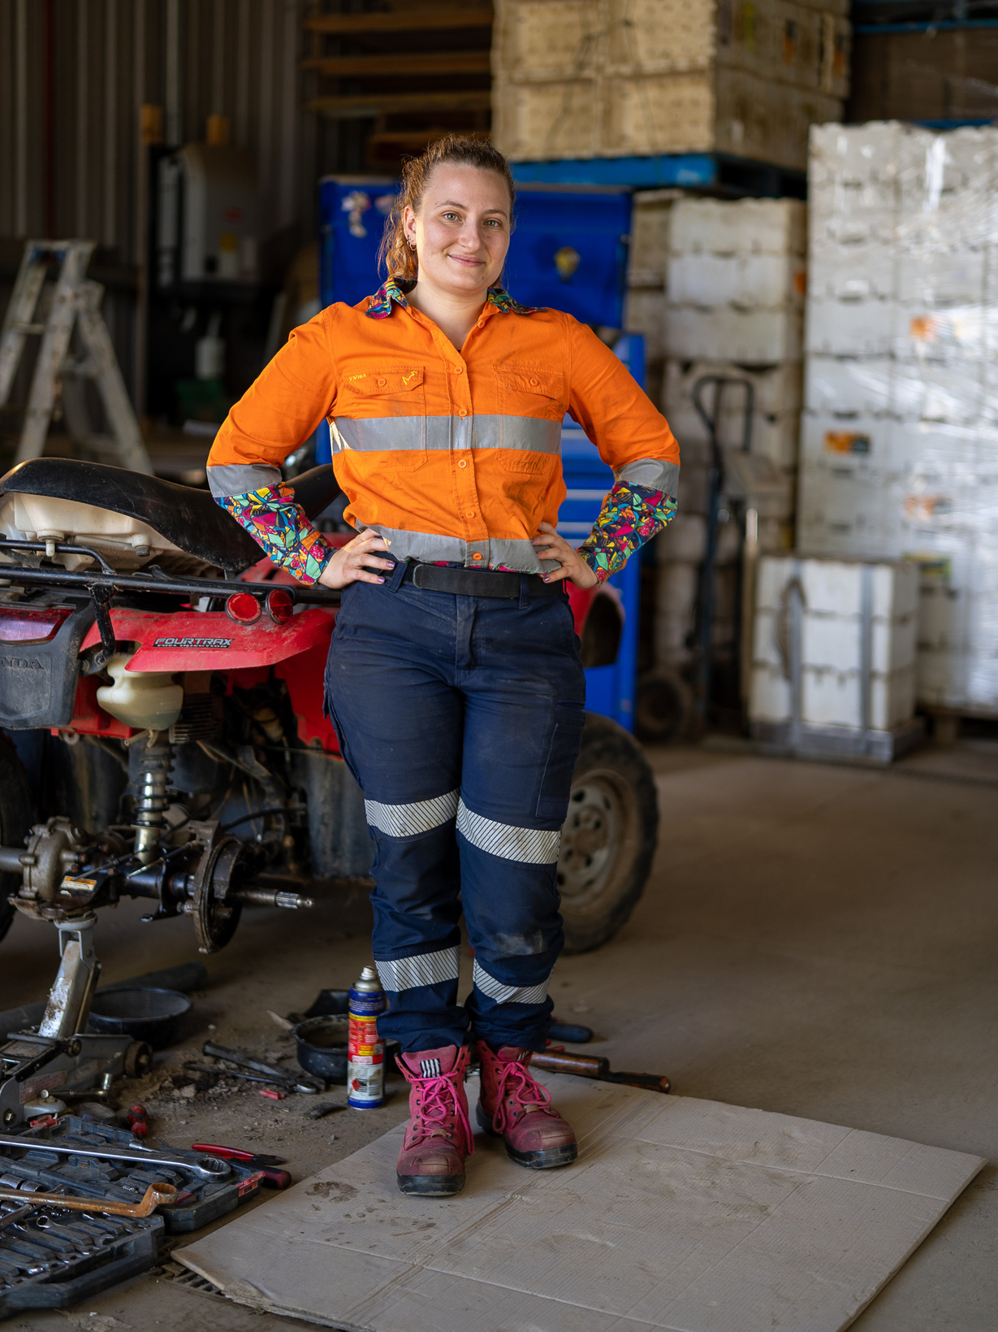
Today you are real mechanics!
You will write your own reports using everything you’ve learned.

Slide 5
Option 1
The tractor was brought to the workshop because it was making a loud squeaking sound it slowed down. The tractor is an older model and used every day. The farmer wants to make sure it’s safe to operate. An inspection has been booked to find out what’s causing the noise.
To start the inspection, the tractor was safely lifted off the ground. Then the tyres and brakes were looked at. The wheel cover was also removed to search for damage. After the inspection, the brakes were tested again while the wheel was slowly rotated by hand. This allowed the squeak to be easily located.
The inspection confirmed that the brake pads were the main cause of the loud squeaking. The brake pads had worn down because of their age and frequent use. This caused the loud noise when the tractor slowed down. Daily use caused the brake pads to wear out more quickly than normal. The worn brake pads were clearly responsible for the noise and required urgent attention.
New brake pads will fix the problem. To make sure this doesn’t happen again, the brakes should be checked again in three months, because the tractor is used daily. Regular checks and will keep the tractor safe, dependable, and ready for ongoing work.

Slide 6
Option 2
The tractor was noisy so it came in. We looked at it and checked some stuff. Something in the wheel area was making the noise. The brakes didn’t seem right. We think something is worn out. It probably needs fixing soon.

Slide 7
Let’s review!
Which one would help a customer
understand the problem?
What features made the
report clear and useful?

Slide 8
Your reports need at least one of these:
Background:
Describe the vehicle and the issue reported.
Use technical nouns (tyre, screw, engine, workshop).
Diagnosis:
Explain steps taken to find the problem.
Use precise verbs (lift, check, remove, tighten).
Findings:
Present the issue in detail using technical terms.
Include possible causes.
Recommendations:
Suggest repairs or replacements and explain why.
Use clear reasoning (e.g., “Replacing the belt will stop the loud squeal.”).

Slide 9

Remember to use:
A variety of sentence types
Relevant terms
Correct paragraph structure

Slide 10
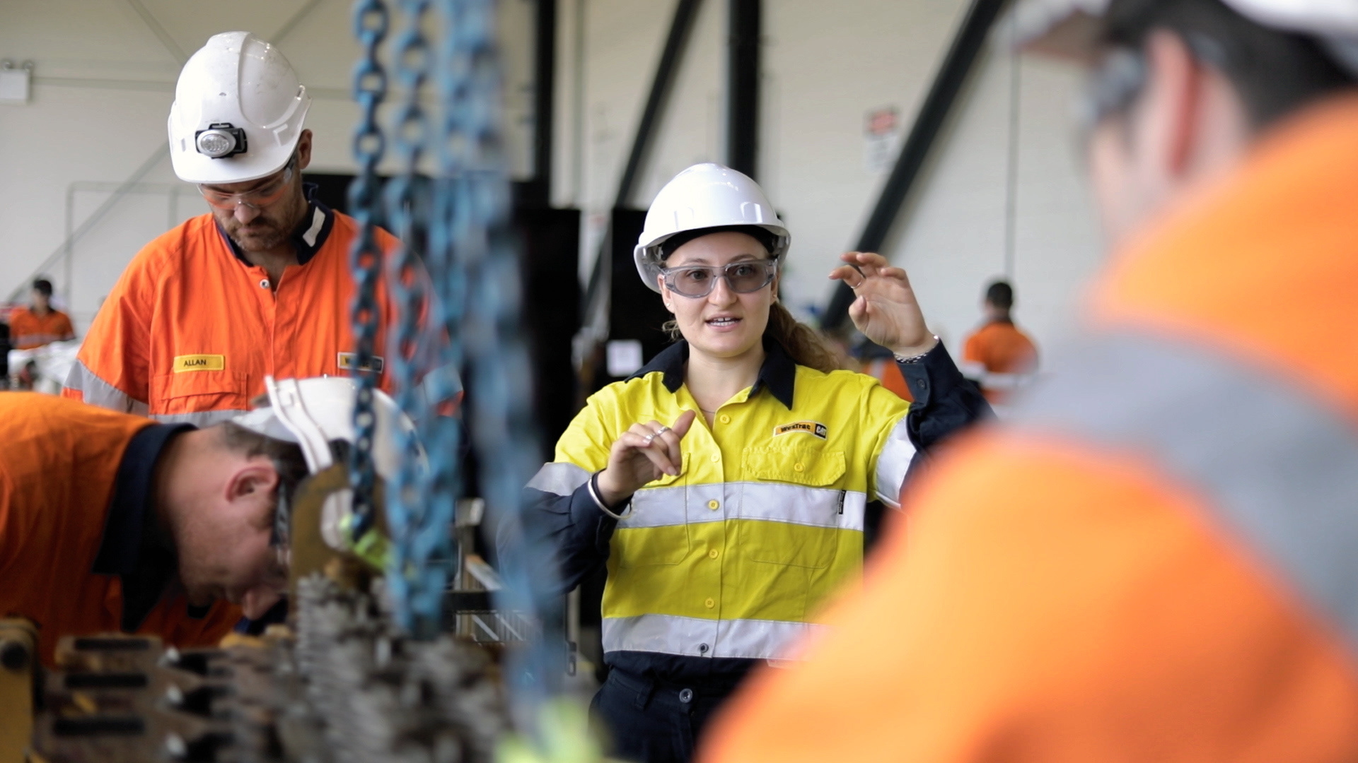
Let’s write!
How it works:
  Work individually
  Choose a scenario (next slide)
  Use the planning sheets to plan your section
    Background
    Diagnosis
    Findings
    Recommendations
  Check in with another student if needed.

Slide 11
Scenarios
The tractor has an oil leak, which is making a bad smell.
Someone left the headlights on all night, and the battery is flat.
The truck’s tyre is flat. It looks like a nail has gone through it.
The car is making a loud squeal because the timing belt snapped.

Slide 12
Seek feedback
How it works:
  Swap your report with a classmate.
  Answer these two questions.
    Is there a variety of sentence types in each section?
    Is the topic sentence clear?
  Make changes to your reports based on the feedback.
Notes:
Students can also use the Report Checklist for this task.

Slide 13
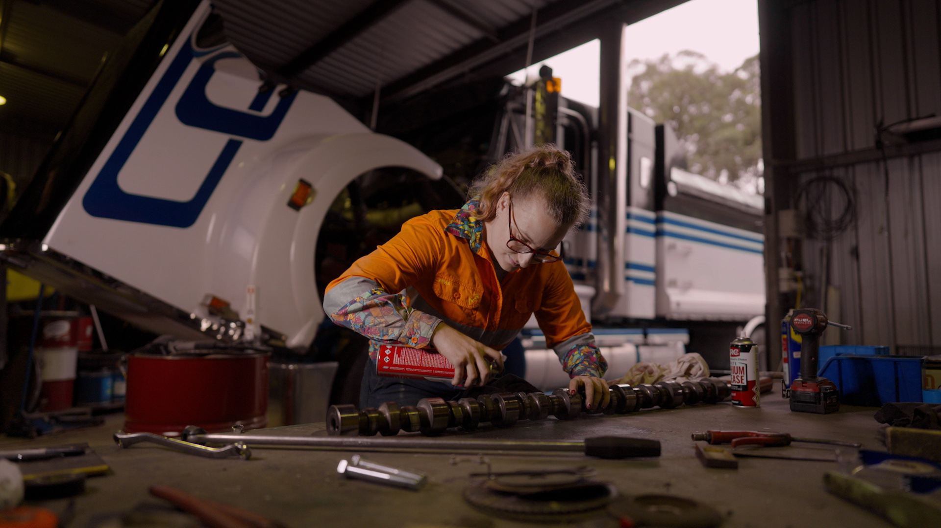
Level-up
How it works:
  Work individually
  Choose one paragraph
  Make the following improvements
    Add a dependent clause to create a complex sentence
    Choose one verb or noun to improve
    Add a relevant term for better clarity
    Can you edit/improve any sentences, like the concluding sentence, to be better and give direction to the next paragraph?
Notes:
Collect final work for formative assessment.

Slide 14
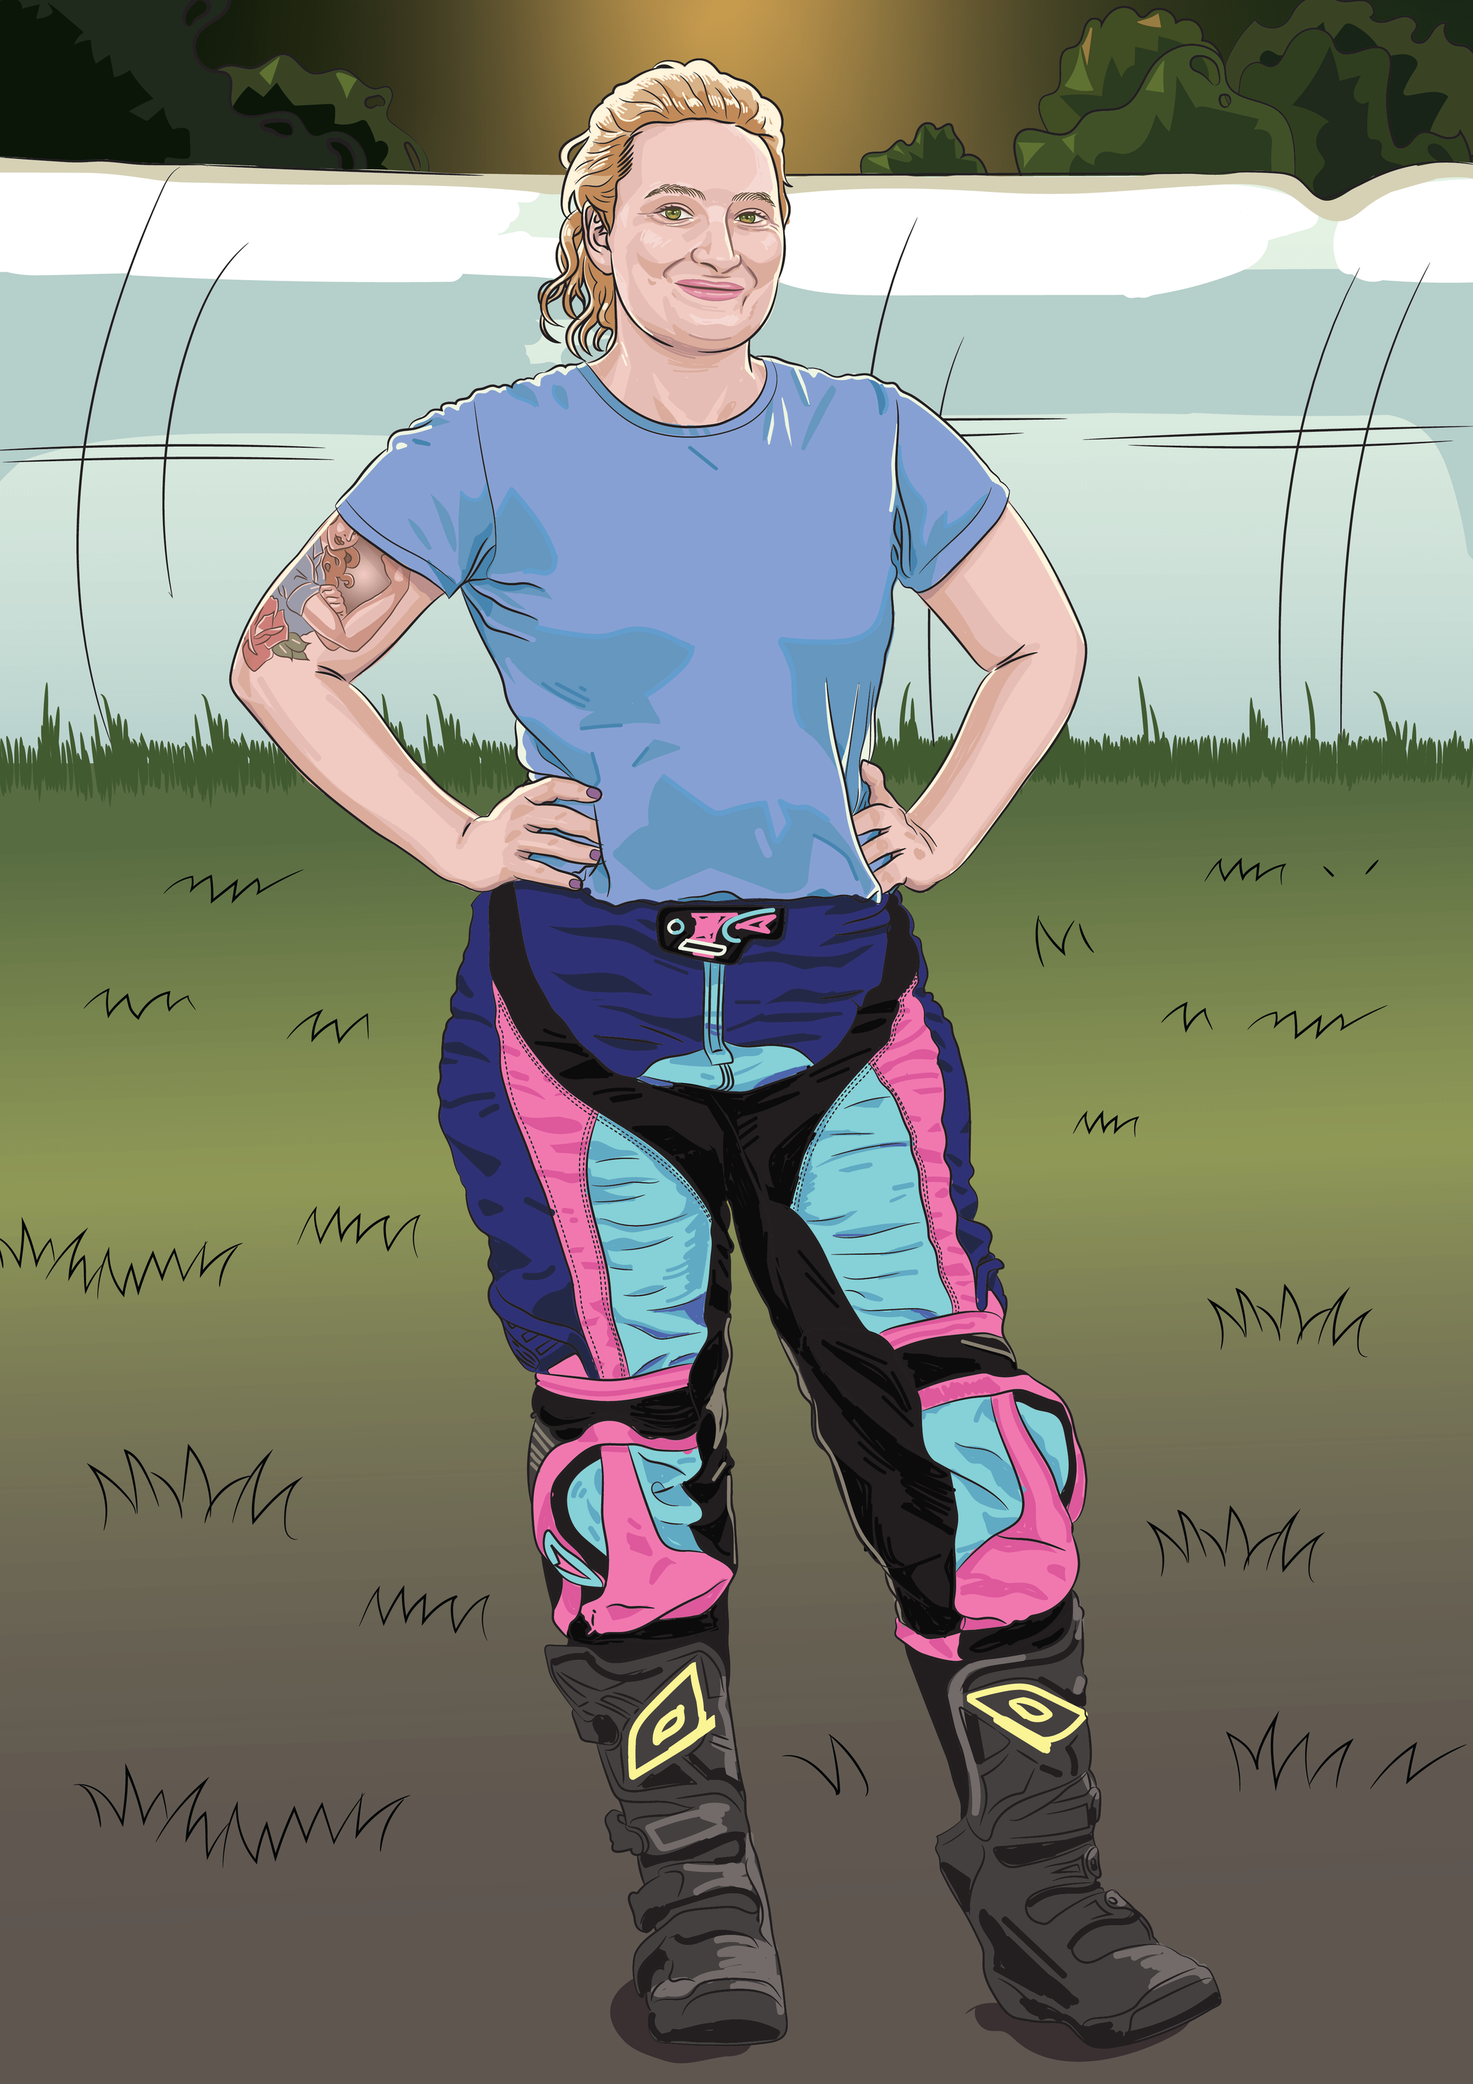
Reflect and Share
Write down your answers to these:
  One thing I used well in my report today was…
  One thing I want to get better at is…

Slide 15
Lesson 8

