Slide 1
Session 11:
From Humanitarian Aid to Human Rights Based Community Development
Notes:
Facilitators Notes
This session is about human rights-based approaches (HRBA). It will look at what HRBA is, why it is useful and what it looks like in practice in supporting refugee-led organisations.
Question: Ask the group what they know about HRBA and if any of them have experience of working in an organisation which uses this approach.
What does this mean for their practice?
What are some examples of how they have used it?
What have the impacts been?
What have been some of the challenges they have faced?

Slide 2
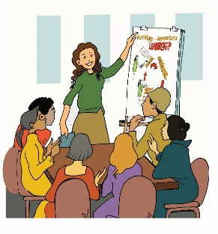
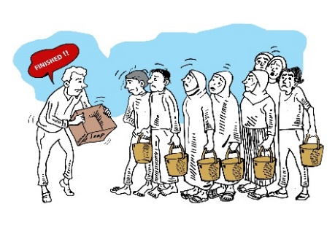
What is the difference?
Humanitarian aid is a rapid intervention designed to save lives, alleviate hardship, and get disaster victims back on their feet.
Development aid is designed to help people to access human rights for individuals, families and communities, to transit out of poverty and build sustainable futures. It is underpinned by community development principles of empowerment, inclusivity and participation.
Notes:
Facilitators Notes
The difference between Humanitarian and Development Aid has and continues to be the source of debate in academic literature and in policy and practice.
We share this simple definition as a starting point to briefly explore some of the recent policy changes and why these matter for efforts to advance HRBA based work with RLOs.
As the next slide will highlight- for many years now humanitarian and development policy makers and many practitioners have recognised the need to link these two different approaches.
It is important to remember that both humanitarian and development aid are both provided in deeply political contexts and are always impacted by donor and geopolitical interests. Both positively and negatively.

Slide 3

The Double Nexus
The humanitarian–development nexus has been increasingly been cast as the solution to humanitarian concerns, new and protracted crises, and to manage complex war-to-peace transitions.
Notes:
Facilitators Notes
The concept of linking relief, rehabilitation and development (LRRD) emerged in the 1990s when practitioners identified a funding gap between humanitarian assistance, relief, and development activities. Since then, agencies, academics and practitioners have attempted to find ways of reconciling the humanitarian-development nexus to provide both effective humanitarian relief, and sustainable medium- and long-term development action. The basic premise of LRRD is the need to link and create synergies between short-term relief measures, with longer term development programmes (Hinds 2015:1).
Mention that since the World Humanitarian Summit in 2019 that the concept of a Triple Nexus has emerged- linking - humanitarian, development and peace approaches, and that you will return to this a little later in the session.
Reference for this slide
Hinds, R. (2015). Relationship between humanitarian and development aid (GSDRC Helpdesk Research Report 1185). Birmingham, UK: GSDRC, University of Birmingham.

Slide 4
However!
Humanitarian action and development assistance represent two distinct discursive and institutional segments of the international system that are hard to juxtapose (Lie 2020).
Notes:
Facilitators Notes
These tensions and challenges have received some attention in the academic literature and if you wish to explore these debates in greater detail a number of articles are included or referenced in the Background reading materials.
Reference for this slide (Open access)
J.H.S. Lie 2020 The humanitarian-development nexus: humanitarian principles, practice, and pragmatics Journal of International Humanitarian Action volume 5, Article number: 18 (2020) https://jhumanitarianaction.springeropen.com/articles/10.1186/s41018-020-00086-0

Slide 5
Naming the Tensions
“Humanitarianism’s apolitical and imminent needs-based approaches building on established humanitarian principles are fundamentally different from the more long-term, political, rights-based approaches of development. As they rub shoulders, as intentionally instigated by the nexus, they affect and challenge each other” (Lie 2020:1)
Our challenge is how do we change these ideological positions?
Notes:
Facilitators Notes
In this and the next few slides we briefly consider some of the challenges before continuing to explore ways, despite these challenges we might apply an HRBA approach in both humanitarian and development contexts.
Reference for this slide (Open access)
J.H.S. Lie 2020 The humanitarian-development nexus: humanitarian principles, practice, and pragmatics Journal of International Humanitarian Action volume 5, Article number: 18 (2020) https://jhumanitarianaction.springeropen.com/articles/10.1186/s41018-020-00086-0

Slide 6
Some of the key debates
The aim of humanitarian action should only be to meet needs.
Rights-based approaches would lead to the abandonment of core humanitarian principles of impartiality and neutrality (Fox 2001)
Others argued that an HRBA would in fact enhance the legitimacy of Humanitarian work moving it ‘beyond a dysfunctional philanthropic mindset’ (Slim 2002)
Background reading: Borgrevink and Sandvik 2021
Notes:
Facilitators Notes
Despite these debates it is clear that in recent years both Humanitarian and Development Aid have adopted the language of HRBA, however as many scholars point out what is far less clear is the extent to which this has positively. or consistently influenced practice, particularly in the Humanitarian sector.
Reference for this slide
Kaja Borgrevink & Kristin Bergtora Sandvik (2022) The afterlife of buzzwords: the journey of rights-based approaches through the humanitarian sector, The
International Journal of Human Rights, 26:2, 285-305, DOI: 10.1080/13642987.2021.1916476. https://www.tandfonline.com/doi/full/10.1080/13642987.2021.191647

Slide 7

What does this mean for practice??
In emergency situations human rights can become ‘secondary’ as the focus is on immediate assistance, protection and basic needs.
Program and service delivery needs can trump human rights concerns
Concern about a trade-off between rights advocacy and humanitarian access in strong authoritarian states opposed to human rights
Notes:
Facilitators Notes
These are some of the findings of research undertaken by Kaja Borgrevink & Kristin Bergtora Sandvik as part of a recent project to explore the application of a HRBA in Norwegian humanitarian policy and in Norwegian-funded aid in Colombia, Palestine, Myanmar and Pakistan.
Continued on the next slide
Reference for this slide
Kaja Borgrevink & Kristin Bergtora Sandvik (2022) The afterlife of buzzwords: the journey of rights-based approaches through the humanitarian sector, The
International Journal of Human Rights, 26:2, 285-305, DOI: 10.1080/13642987.2021.1916476. https://www.tandfonline.com/doi/full/10.1080/13642987.2021.191647

Slide 8
Three HRBA Strategies in Humanitarian Practice
Neutrality Strategy – NGOs focus on traditional humanitarian principles – HRBA = the right of vulnerable people to have their basic needs met
Pragmatic Strategy –HRBA = the right for local people to be consulted, and for local organisations to be actively engaged as partners, and may involve working with national governments with questionable human rights records
Idealist strategy- HRBA = advocating for human rights, supporting local human rights organisations and holding powerful actors to account.
Notes:
Facilitators Notes
In practice INGOs and NGOs will often use a range of different strategies and approaches based both on their own mandates, organisational philosophies, the nature of the crises and political contexts.
In fact the same organisation may use different approaches at different times and in different contexts.
Reference for this slide
Kaja Borgrevink & Kristin Bergtora Sandvik (2022) The afterlife of buzzwords: the journey of rights-based approaches through the humanitarian sector, The
International Journal of Human Rights, 26:2, 285-305, DOI: 10.1080/13642987.2021.1916476. https://www.tandfonline.com/doi/full/10.1080/13642987.2021.191647

Slide 9

The Human Rights-based Approach
We argue that a Human Rights based Approach can and should be applied to both
Humanitarian Aid,
and
Development Aid.
Without the Meaningful Participation of ALL refugee groups, a Human Rights Based approach is not possible
Notes:
Facilitators Notes
While recognising all of the political and philosophical complexities we advocate an approach in the line with the core principle underpinning the development of this resource kit.
That is the principle that while ‘one size does not fit all’ when it comes to the approach taken to implement an HRBA that the core principles of human rights must and can inform all approaches.
To do this we draw on one of the core human rights principles which recognises that the implementation of human rights can be progressive and on the core community development principle of a bottom-up approach.
In short applying an HRBA approach in both Humanitarian and Development work requires both bottom-up, community engaged work as well as more top-down higher- level advocacy work.
What is possible and what is prioritised will depend both on community priorities as well as higher level political considerations. In the mean time key stakeholders at every level from UN agencies to refugee-led organisations and academics can all focus on getting ‘our own houses’ in order to ensure that core human rights principles including self-determination, agency, gender, race, class equality, inclusivity inform all of our work with refugees and RLOs and indeed will all communities.

Slide 10
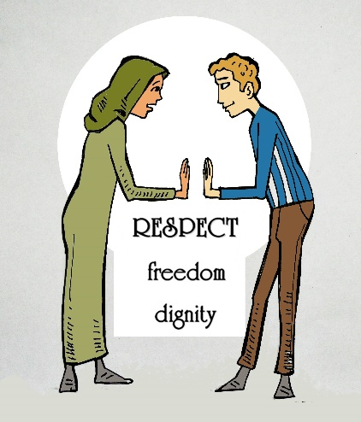
RESPECT
DIGNITY
AUTONOMY
SELF DETERMINATION
Notes:
Facilitators Notes
These core principles underpin HRBA and must be applied in all our work.

Slide 11

Universal Declaration of Human Rights
International Covenant on Civil and Political Rights
International Covenant on Economic, Social and Cultural Rights
Notes:
Facilitators Notes
HRBA is based on the legal framework of universal human rights.

Slide 12

The HRBA is based on the legal framework of universal human rights.
But it is more than this. Rather than needs, interests or services, in Human Rights Based Approaches, (HRBA), human rights become the goals, objectives and outcomes of development projects or service delivery,
and services.
Notes:
Facilitators Notes
Building on empowerment approaches, HRBA focuses on collective action and campaigning. It brings community groups and people together to work in solidarity to plan advocacy and campaigns. NGOs link with local NGOs who work with communities. Issues are taken from the local level to regional, state and national level.
Explain that the main drivers of change are people themselves, who are supported by NGOs as allies and facilitators. NGOs stand side by side with people, rather than do-ers and experts.
Working with government wherever possible is essential. Sometimes this is to push for policy changes and at others it is building the capacity of government to fulfil rights or respond to rights denials.

Slide 13
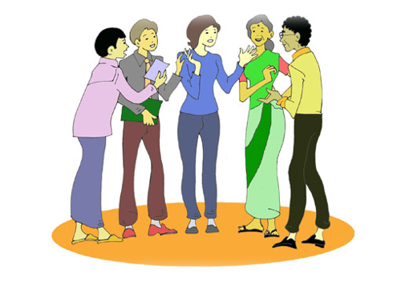
How is HRBA different?
How (the means by which) people achieve their rights is as important as the end result (the outcome). This means that how a project or service is designed, implemented and evaluated, is as important as what happens at the end.
Notes:
Facilitators Notes
HRBA is not interested in ‘clients’ or ‘beneficiaries’. It looks at who has rights, and who is responsible for making sure that people have access to their rights. This includes many stakeholders not just governments, though of course governments due remain the main duty bearers.
Rather than securing more resources, HRBA is about more equitably redistributing existing resources
How (the means by which) people achieve their rights is as important as the end result (the outcome). This means that how a project or service is designed, implemented and evaluated is as important as what happens at the end.
HRBA uses human rights legal framework as a benchmark for development programs and services. This means that project goals, objectives and outcomes are expressed as rights to be fulfilled. This moves away from what people need, to what rights they are entitled to and how those rights can be fulfilled

Slide 14
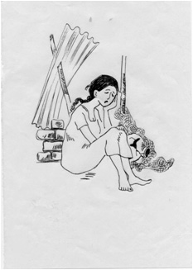
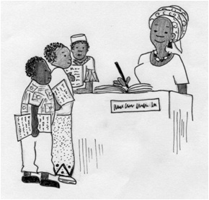
Human Rights turn beggars into claimants
Human Rights turn Beggars into
Claimants!
()
Frankovits, 1996
Notes:
Facilitators Notes
Way back in 1996 Andre Frankovits first argued that Human Rights Turn Beggars into claimants – “Stating that - Policies and programs which rest primarily on a perception of need and powerlessness subtly reinforce the powerlessness of the recipients who are seen as being given justice rather than as receiving their rights. The recognition of entitlement is in itself an act of empowerment”.
Reference for this slide
Frankovits, A. (1996) Rejoinder: the rigts way to development: a national human rights NGO speaks on donor aid policy, Journal of Food Policy 21 (1), 123-128
https://www.sciencedirect.com/science/article/pii/0306919295000615

Slide 15
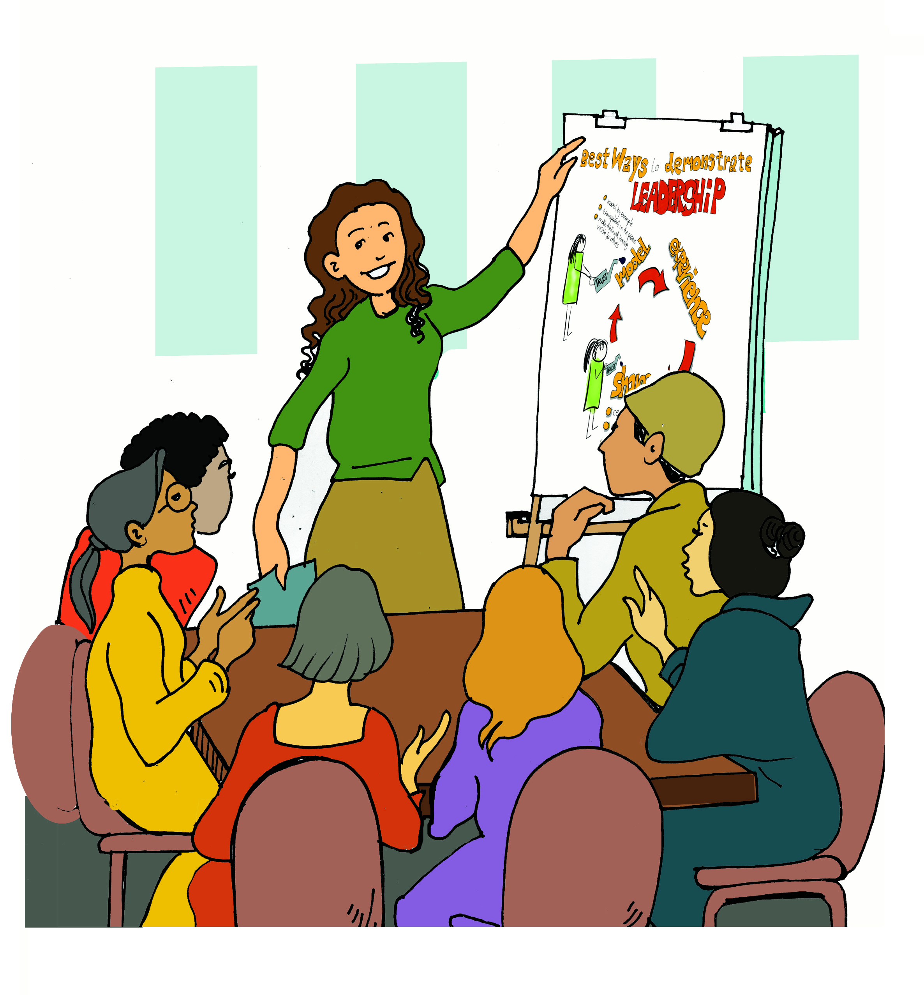
Key elements of a Human Rights-Based Approach
Notes:
Facilitators Notes
The key elements of HRBA are focused on the active participation of marginalised groups and building strengths and skills, rather than focusing on what people don’t have or are lacking (ie what they need).
TIP: emphasise here that HRBA takes us from looking at what people need, to what they are entitled to and who is responsible for fulfilling those entitlements.

Slide 16

Rights holders and duty bearers
HRBA is about the relationship between those who have rights (rights holders) and those who have a responsibility to ensure that rights are realised (duty bearers).
Rights holders are human beings – individuals and communities
Rights holders need to be informed about their rights and participate in decisions that affect them
Duty bearers are mainly governments. But they can also be non-state actors such as NGOs, service providers, family members, community leaders, and transnational corporations.
Notes:
Facilitators Notes
Every human being is a rights holder. Although the government is the main duty bearer, non-state actors are also people and groups with responsibility to fulfil rights.
Explain that sometimes we have dual roles, as both a rights holder and a duty bearer. For example children have a right to attend school, and parents are a duty bearer. But they are also a rights holder because if their right to employment is unfulfilled then they may not have the money to send their children to school and fulfil their obligations as a duty bearer.
Duty bearers may be unable to fulfil rights for many reasons. Sometimes it is political will, but often it is resources and capacity.

Slide 17
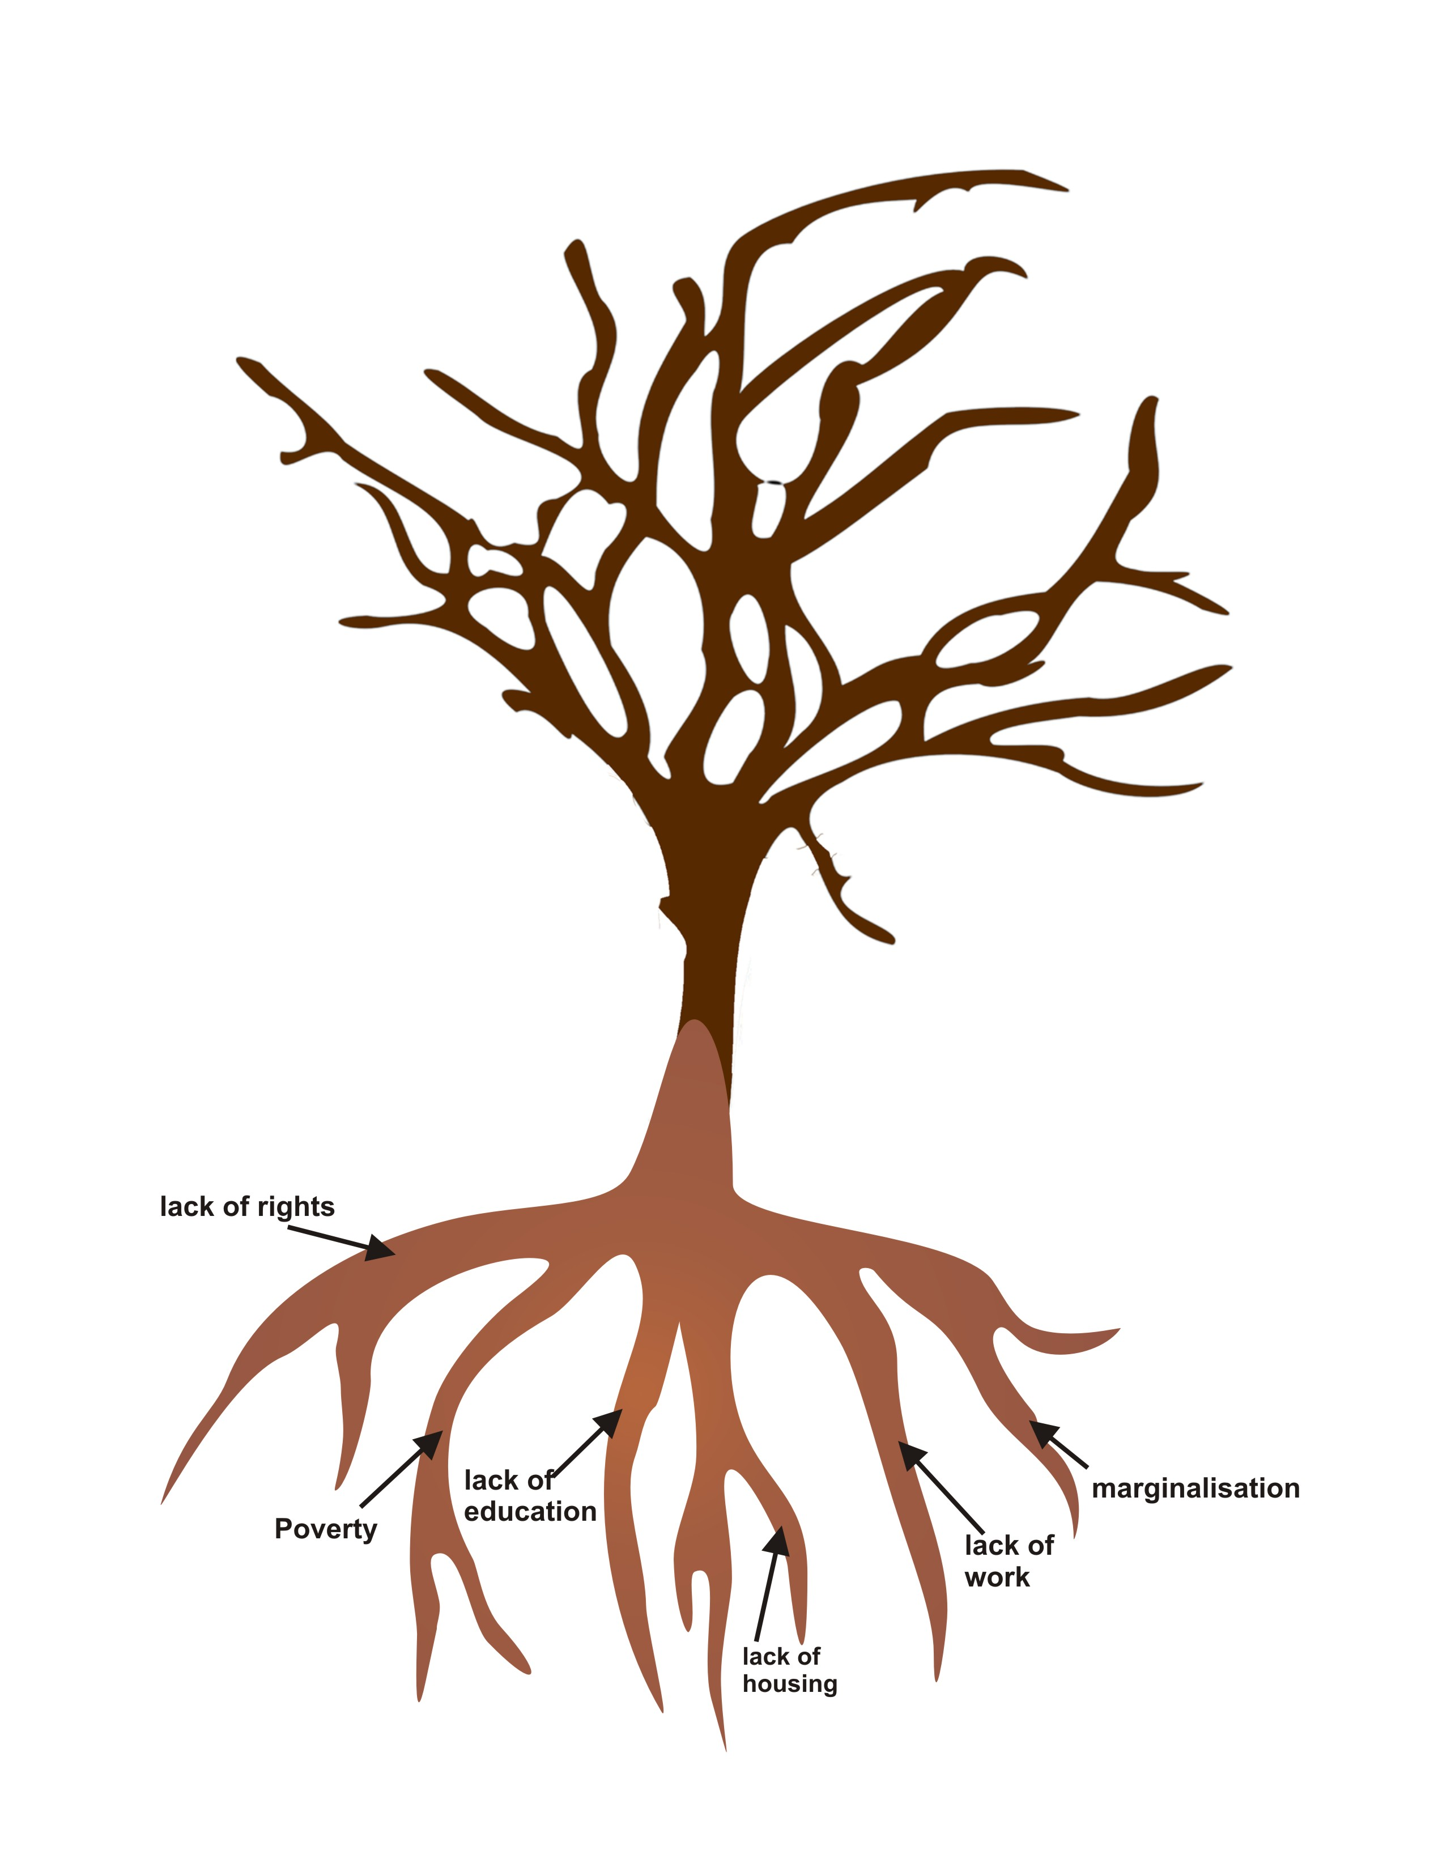
Looking at the root cause of the problem
Projects should not be only about what people need.
Instead they should focus on helping people to work towards claiming the rights they are
entitled to
Remembering the struggle for human rights is progressive and aspirational
Notes:
Facilitators Notes
Project plans should include strategies and activities that can promote and respect rights, rather than just how services can be delivered.
To fully understand a problem and why it happens we need to look beyond obvious and immediate causes. Obvious and immediate causes these tell us the effects of the problem, not what causes it in the first place.
For example children may not be attending school because their parents cannot afford school fees.
If we planned project to reduce school fees this may not solve the problem. This is because we need to understand why parents can’t afford school fees. The reasons may be different reasons for different groups including women, men etc.
Looking at root causes in HRBA enables us to ask what is really happening here? Why are some rights not being fulfilled?

Slide 18
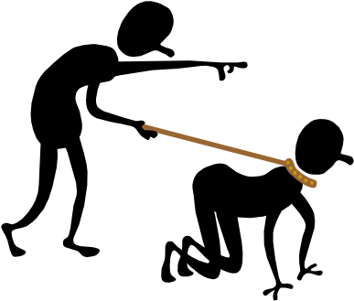
Thinking about power
Human rights are often unfulfilled because of unequal power between people, groups, or citizens, and duty bearers including NGOs, UN agencies and the state
People who have power can prevent others from accessing their rights.
Notes:
Facilitators Notes
People who have power can prevent others from accessing their rights. They might do this because:
They force people to do or not do something.
They have the power to stop people from having their opinions heard.
They make people think that this is the way things should be. People then start to feel that they are not entitled to human rights.
Power is everywhere. Sometimes it is very obvious, like when someone is forced by another person to do something. Power can also be less obvious – like keeping issues out of the spotlight, or over time making people think that they have no rights or this is the normal way that things should be.
People are marginalised and poor because of other people. It is power that enables some people to benefit at the expense of others.
The denial of human rights is an exercise of power. Therefore we need to think about who has power to stop rights from being fulfilled, why they are doing this (what do they gain? Rarely is any actor neutral, including governments) and how duty bearers can build their own power to influence change.

Slide 19

How do people/groups exercise power?
Authority and position, or roles in society
Access to information
Access to resources and wealth
Networks
Skills, education and expertise
Notes:
Facilitators Notes
Before showing the slide ask the group how people exercise power.
Ask for examples. Brainstorm these on a whiteboard.
Authority and position, or roles in society
Access to information
Access to resources and wealth
Networks
Skills, education and expertise

Slide 20
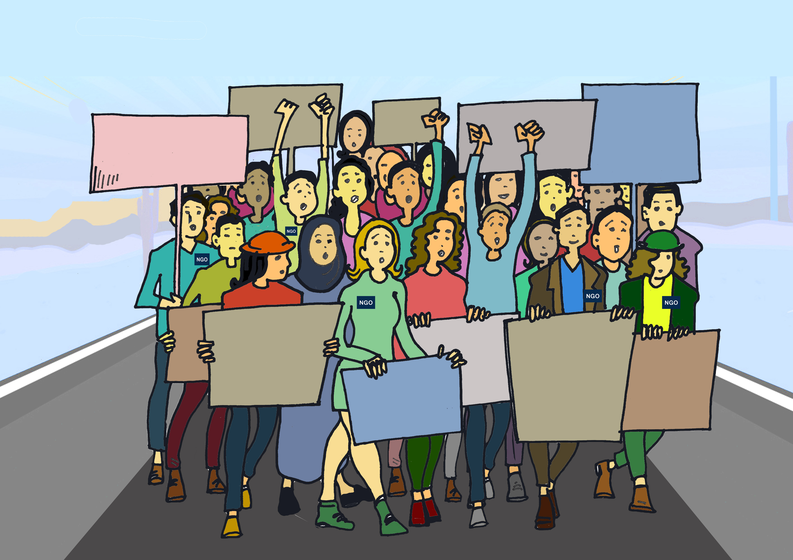
Accountability
A right that is not respected leads to a violation. People can make legal claims when a violation happens.
How are duty bearers held accountable when they fail to uphold rights?
Legal remedies
Administrative mechanisms
Open dialogue and discussion
Social power and protest
Notes:
Facilitators Notes
When someone gives you a gift you can not complain if the gift isn’t what you expected, or what you were promised. This is a welfare/charity way of delivering services.
When you have a right to something, you should receive what you are entitled to. Someone is responsible for making sure that you receive it as promised.
A right that is not respected leads to a violation. People can make legal and legitimate claims when a violation happens.
HRBA aims to make duty bearers accountable. There are laws and conventions that outline the rights that people are entitled to. Individuals and groups are responsible for fulfilling those obligations. If they don’t, then can be held to account for their actions or failure to act. This is what makes HRBA different from other development approaches.
Ask the group:
- Thinking about your organisation, how are you accountable to community groups?
- What avenues do they have to complain if they feel they are not being treated properly by a staff member?
- What might prevent them from bringing this up with people who work within your organisation?
- Is there anything else your organisation could be doing to make it more accountable to the people you support?

Slide 21
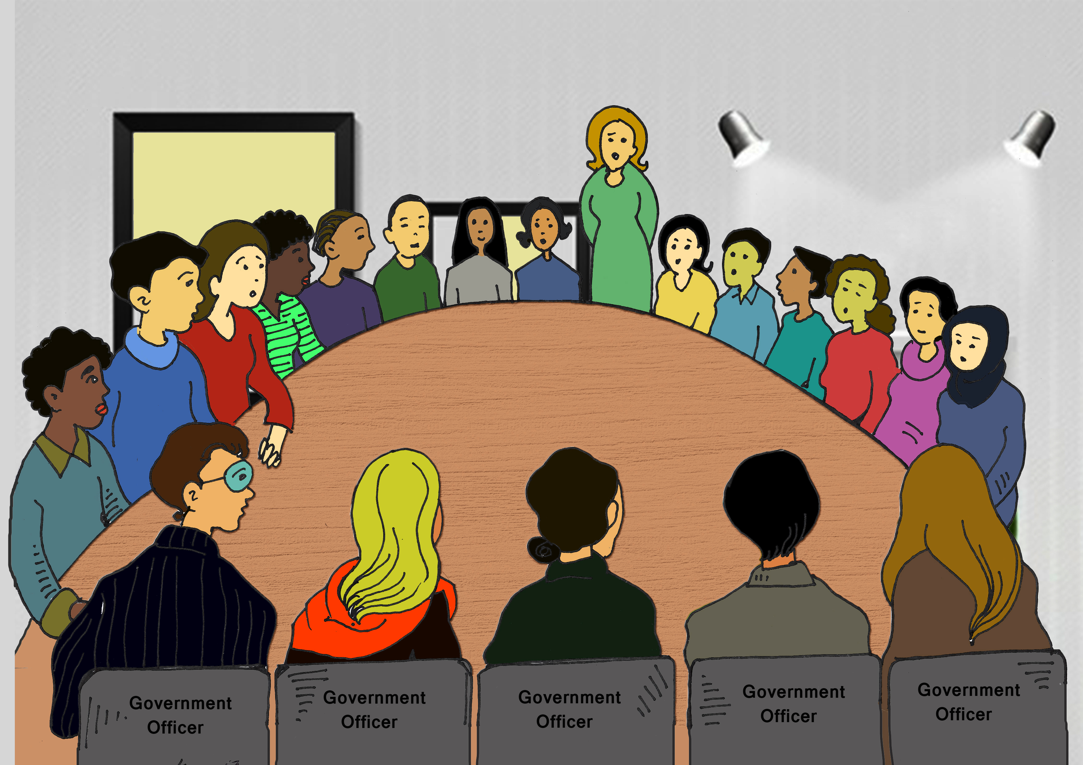
Participation
Individuals, families and communities should participate in decisions that affect them.
Participation must be free and meaningful. It must take into consideration factors that might prevent genuine and equal participation (particularly of those who are most marginalised) including gender, disability and other factors.
Notes:
Individuals, families and communities should participate in decisions that affect them.
They should also be part of developing and testing solutions.
This means more than asking people about the most important issues their experience, seeking their feedback on a service, or asking them what services they want.
It means involving people in making decisions and implementing solutions.
Participation must be free and meaningful. It must take into consideration factors that might prevent genuine and equal participation (particularly of those who are most marginalised) including gender, disability and other factors.
Full and meaningful participation of all groups is essential in HRBA. Meaningful participation is about a two way dialogue. For example a consultation where you ask communities their ideas is a one way street. Communities should make decisions about what programs /projects /service to run, how they should be run and how they should be evaluated. They should have an opportunity to be involved at all stages.
Explain that it is important to think about the factors that might prevent participation for some groups. If people have been invited to participate but they don’t, this does not necessarily mean they are not interested.
Ask the group to think about some of the barriers to participation in their programs and services. Some example might include:
Where a meeting is held with community representatives in a venue that does not have disability access
If information is given in written format, and only in English, and feedback requested in writing by email. This will exclude those who communicate through non-written forms, or in languages other than English
Inviting only community leaders to a dialogue assumes they have consulted widely with people in their community about these issues and are representing these diverse views (rather than their own beliefs). It is important to engage not only community leaders, but other views and voices from the community.
If a meeting is held for both men and women, women may be reluctant to share information about their particular experiences in front of men.
Ask the group:
What are some practical thing you could do in the next month to ensure active participation of communities?

Slide 22

Non-discrimination and equality
Notes:
Facilitators Notes
Explain that HRBA should focus on the most vulnerable and marginalised. No one should be left out. It may take considerable effort on the part of organisations to work with the community to identify who is most vulnerable – sometimes it is not those we often think of first.

Slide 23
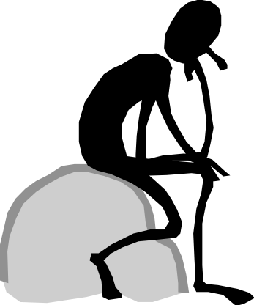
Empowerment
To be disempowered is to be denied choice (Kabeer, 1999)
Empowerment happens when people who have been denied choice are able to think about possible alternatives and act on them; or, the ability to have chosen something else
Notes:
Facilitators Notes
Explain that empowerment is about expanding choices.
This means that people cannot only think of alternatives, but act on them. It does not mean that people or communities should have to do things on their own with no assistance. It is about service providers and communities working in equal partnership, and sharing decision-making power. Sometimes this is difficult because government contracts and funding streams give us little choice or control.
Ask the group:
Can you think of a time when you were not given any choices about something?
How did this make you feel?
Make sure that when people are sharing personal stories that you listen actively and validate their experiences. Thank people for sharing such personal stories and listen with empathy. Feedback how difficult these experiences must have been for them.

Slide 24
Group Exercise 1:Case Study
A big international donor has decided that for 2024-2025, the focus of its work will be providing services for refugees currently in camps in South Sudan. They have recruited:
Volunteers from Australia to go and build a number of new houses and schools for the population.
A team of experts in the field of Humanitarian aid involved in food distribution to organise food and non- food items, with the help of a local NGO.
A number of counsellors from an Australian voluntary group to deliver counselling and training support to women-refugee led organisations.
An education focused NGO to establish co-educational schools for adolescents.
Set up a clinic with volunteer paramedics from the UK.
Notes:
Facilitators Notes
We suggest you print these exercise slides as handouts and divide the group into smaller group to discuss and complete the exercise.
They should first read this case study and then address the questions on the next slide.

Slide 25
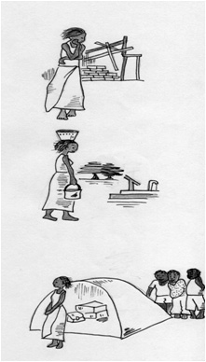
Exercise 1 - Questions to ask to test if a program addresses Key Principles of a Rights Based Community Development Approach
To what extent is the proposed model:
Grounded in international human rights laws?
Transformative – does it support more equal partnerships with communities?
Participatory – does it involve affected communities in identifying their needs and priorities?
Emancipatory- does it increase community power to in claim their rights and accountability from development agencies and other duty bearers?
Self-aware – does it challenge agencies to recognise and address structural power inequalities not just focus on the individual or personal problems?
If not, What needs to change?
How will you achieve this?
Notes:
Facilitators Notes
Ask the participants to think carefully about which elements of the program are either clearly rights-based or are aiming towards more rights based practices. For example with a clear plan for the progressive realization of rights.
The checklist on the next slide will assist the group to do this.

Slide 26
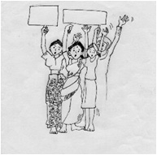
A tool to assess projects at a practical level
Does it?
Support the agency and active participation of communities?
Provide people with knowledge about their rights and support them to claim their rights?
Support people to analyse the challenges they face and to be active participants in finding solutions?
Support people to advocate for action by duty bearers?
Recognise that women’s rights are central?
Recognise the need to change practices, attitudes and behaviors as well as policies?
If not, What needs to change?
How will you achieve this?

Slide 27
To be considered.
How can these principles be applied to both Humanitarian and Development Aid and to Peace given the current focus of this new Triple Nexus?

Slide 28
The Triple Nexus
Links humanitarian, development and peace approaches
It is underpinned by the recognition that sustainable development cannot be achieved without peace.
Notes:
Facilitators Notes
There is significant academic and policy work which explores the aims and challenges associated with this new approach.
Rebecca Roberts (UNRISD) 2020 notes that :
“While many of the challenges and unknowns remain, the United Nations, its partners, and UNDP and UNHCR have made structural changes to break down the barriers between their humanitarian, development and peace interventions; created new coordination mechanisms; and instigated systems of information sharing, capacity development and sharing of expertise and research. For example, the UN Secretary-General’s Reform Agenda, the New Ways of Working (NWoW) initiative and the creation of the Joint Steering Committee to Advance Humanitarian and Development Collaboration (JSC) are designed to improve coordination and shared understanding. UNDP and UNHCR have developed a joint action plan, initiated staff exchanges and made specific commitments to the SDGs, the GCR and to working toward long-term solutions to protracted displacement”
Brown and Mena (2021) have identified some positive progress in application of this principles. They include:
Connecting the triple nexus approach to a framework such as resilience, helps to ensure alignment of activities to higher level collective outcomes or long- term change.
The peace component in practice has many different meanings ranging from grassroots peacebuilding to security interventions to conflict sensitivity. This creates confusion and tensions, particularly among humanitarians, who fear that aid may be instrumentalised for political or security purposes under triple nexus approaches.
Flexible systems and skills are needed to progress triple nexus programmes. It requires strong and flexible financial systems, management skills, technical expertise, attention, diplomacy, and clear processes that allow for modifications as needs change.
Long-term partnerships can support increased local ownership through a clear engagement strategy with national and local government (as appropriate), community members, and local partners, which focuses on both short-term need and long-term change.
References
S. Brown and R. Mena (2021) A review of the triple nexus approach in discourse and practice: with a focus on Islamic Relief’s triple nexus programme. Birmingham, UK. Islamic Relief Worldwide
Roberts, Rebecca (2020): Responding to protracted displacement using the Humanitarian-Development-Peace nexus approach: Scoping study, UNRISD Working Paper, No. 2020-12, United Nations Research Institute for Social Development (UNRISD), Geneva

