Slide 1
How to conduct a Skills,Asset and Needs Audit
and Develop a Succession Plan
Notes:
This session has been designed to work with participants to identify their skills, expertise and the resources available to them. It also identifies their training and support needs.
It includes developing a strategy for Succession Planning.

Slide 2
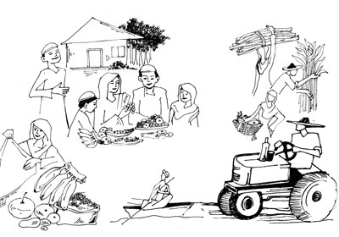
Community Skills and Assets
Some of the things individuals and communities bring include:
Resilience
Determination to succeed
Knowledge of what they need to succeed
Effective cultural traditions and practice
Previous qualifications and skills, both practical and professional
Survival skills
Prior knowledge and wisdoms
Notes:
It is important to begin by identifying all of the skills, knowledge and expertise that the groups already has. Ask participants to add to this list.
Informal knowledge is just as important as formal training.
For example, women who manage household budgets well are often very good at financial management in organizations. They are very similar skill sets!

Slide 3
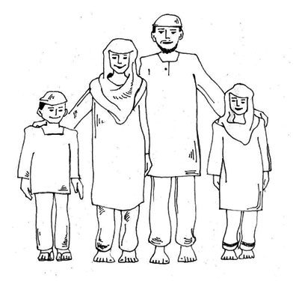
Continued:
Hopes and aspirations for themselves and their children
Commitment to other community members
Strong loyalty to extended family, and orphaned children
The need to participate in society
Community structures
The desire to work
Many other attributes
Notes:
These attributes are not to do with class privilege or education, they are innate and personal strengths which are often ignored.

Slide 4

Social resources
Social resources include
• informal networks and social connections with family, friends and community but also with customers, suppliers, others with shared interests. They enable people to work together to access other resources or institutions that enable livelihoods
• membership of more formal groups such as women’s networks, political networks, labour organisations
• relationships of trust, and mutual benefit or exchanges. These create informal safety nets
Notes:
Please see the Reading on Social Capital for discussion points.

Slide 5
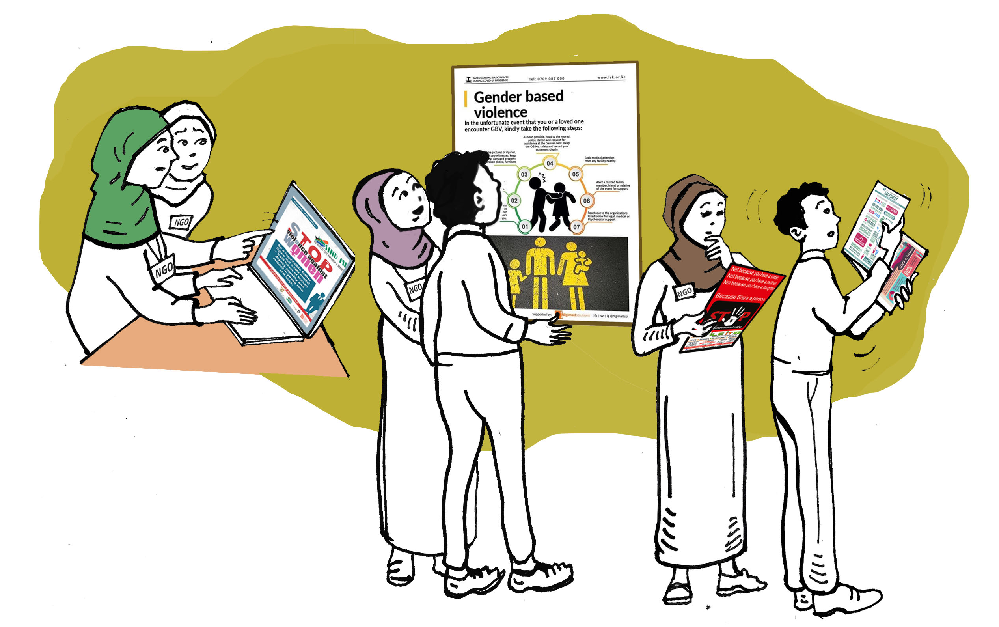
Physical resources
Physical resources include
• Infrastructure
• tools and equipment
• affordable transport;
• secure shelter and buildings;
• adequate water supply and sanitation;
• affordable energy and internet access
• access to information (communications).
Notes:
This slide leads into the exercise which follows.

Slide 6

Assets Audit Exercise
In your groups,
1. List the Social Resources that you have in your groups, and communities.
2. List the Physical assets that you have as a group
Notes:
This is a good small group exercise, and is useful if it is done by individual WRLOs.
When the answers are fed back to the large group list them on flip charts and discuss if any of these resources could be shared?

Slide 7
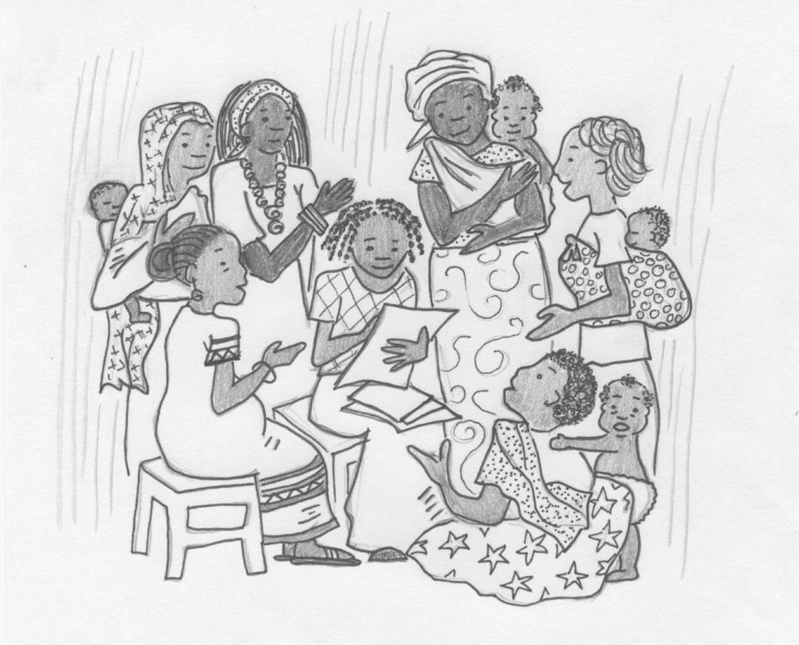
In your groups, list what Physical resources you still need to run your WRLO?
Notes:
As in other exercise.

Slide 8
Skills and Knowledge Needs Audit Exercise
List all the skills and knowledge a WRLO needs to function well:
These will include:
Leadership Skills,
Specialist Knowledge in the areas in which they want to work
Good Management
Financial management
Accountability procedures
Good communication skills
Being in touch with and responsive to their community
Good personal skills
Notes:
We now move onto less tangible areas, in particular, which skills are needed to run a successful WRLO and what skills the women already have.
Brainstorm areas which may not be on the slide.

Slide 9
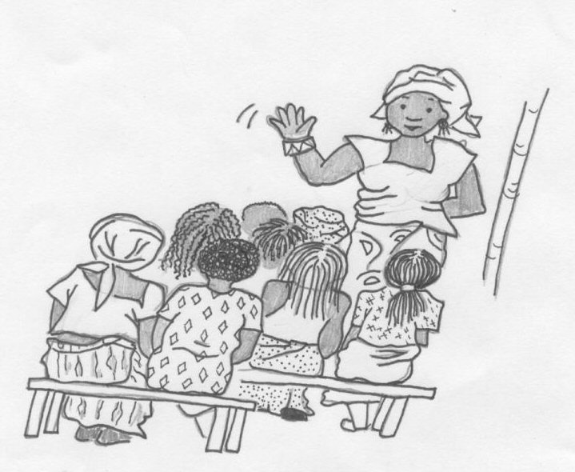
In your groups:
List which of these area the participants would like more training and support with.
Notes:
At the end of the exercise, draw up a comprehensive list, and if there is time brainstorm to see if the participants know if any of these trainings are available locally.

Slide 10
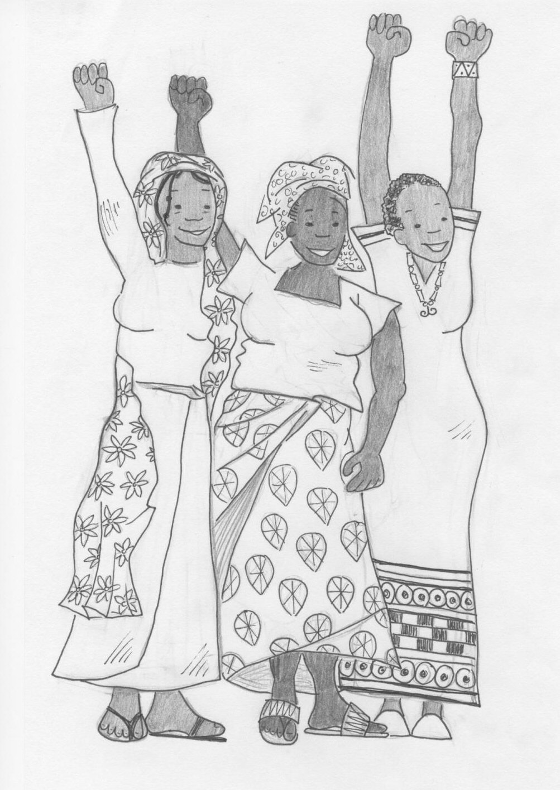
A Succession Strategy
How many Trainee Leaders and/or managers do you need
What will be their role
What Training and support will they need
What is the criteria for the position
How will they apply
Who will select the new people
What will their Contracts say
Who will mentor and support them?
Notes:
This is the basis for the small groups exercise which follows.

Slide 11
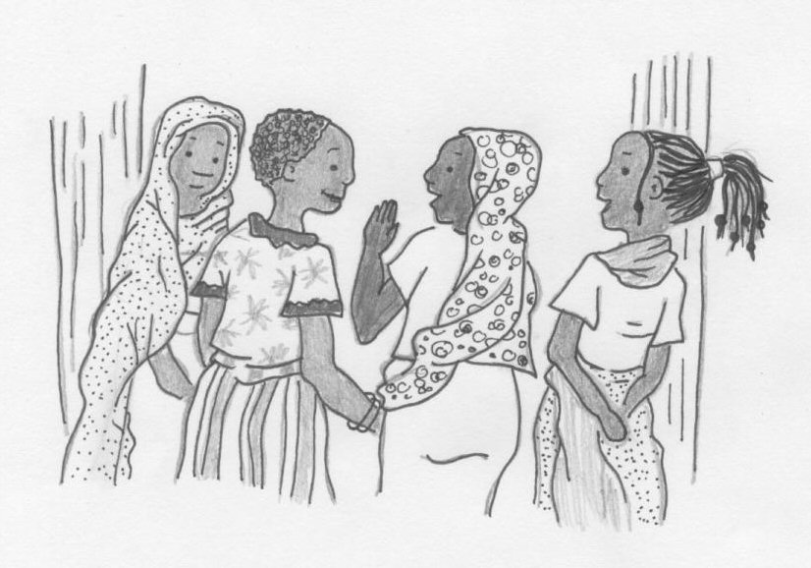
In your groups develop a Succession Strategy for your organisation addressing these points.
Notes:
Once the response from all of the groups are discussed, see if you can draw up one list which encompasses all suggestions.

Slide 12
Now to work!
The answers to these exercises will help you to structure a succession strategy and Training Program to suit particular WRLOs.
Notes:
If you have members of several WRLOs participating, it might be useful to ask them to appoint a committee to work on this. They can then submit a proposal for adoption by the full membership of the various groups.

