Slide 1
Refugee Women and Girls, the Key to Implementing Commitments made in the Global Compact on Refugees
Session 3
Major Gender Based Social Barriers For Women Refugee Led Organisations, (WRLOs)
Developed by Eileen Pittaway and Linda Bartolomei, 2023 The Forced Migration Research Network UNSW
Notes:
Facilitators Notes
In this Session we will:
Examine the Gender Based challenges for Women Refugee Led Organisations
Look at some tools and exercises to help identify these and develop solutions.

Slide 2
Aim of the session
The aim of the session is to use our understanding of the broad meaning of gender equality and analyse this in the context of refugee women and girls and WRLOs.
Notes:
Suggested Timing for sessions
A sound knowledge of the meaning of Gender Equality is essential for this session. It should either follow Session 2 of this module, or if the groups already have a sound knowledge of gender equality, just do a quick brainstorm of key points before starting this session. Material can be covered in 2 hours, with the use of one exercise. A more thorough coverage and analysis, using both exercises will take 4 hours,
This session is closely linked to the session on Meaningful Participation, Session 8.

Slide 3
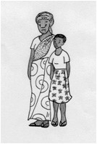
Gender Based Social Barriers faced by Women Refugees - A useful Definition.
This is drawn from our research data and discussions with refugee women from many countries. Please feel free to add your own.
Forced Displacement means that Refugee women and girls do not have even the minimal protections that should be provided by one’s country of birth. This includes citizenship, access to individual registration, at times even birth certificates.
They have less access to legal procedures, and services such as health and education, and no legal rights to work. They are placed into often hostile vulnerable situations, and SGBV is endemic. (See SGBV Section)
Notes:
Ask the group to brainstorm additional barriers they have encountered in their work. They may want to give examples from their own lives, or families and friends.

Slide 4
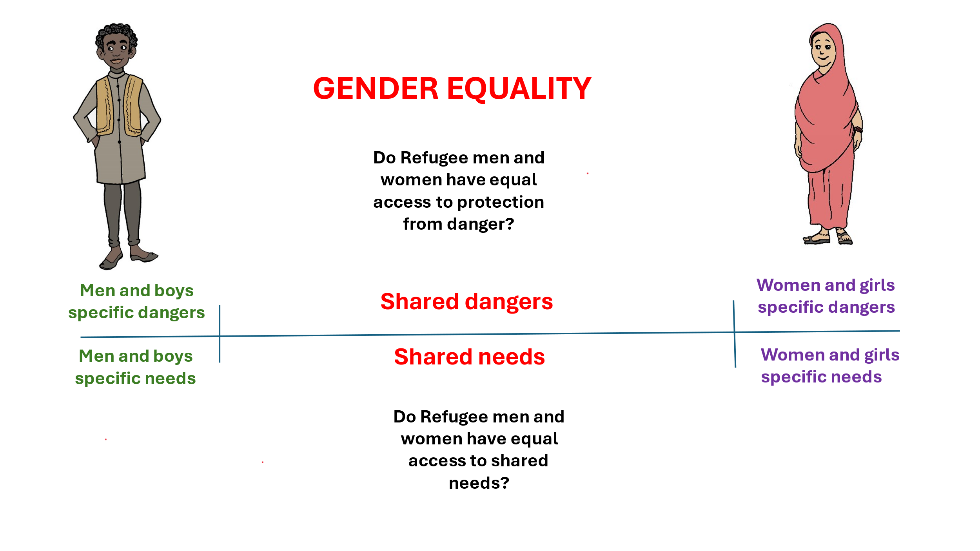
Gender equality means that all of these needs must be
addressed – equally!
Notes:
If there is time, ask the group to work in small groups to discuss:
Specific dangers for men and boys
Specific dangers for women and girls
Shared dangers
Shared needs
And to answer the question
“ Do men and women have equal access to shared needs and resources?”
If there is not time for a small group exercise, do a quick brainstorm.

Slide 5
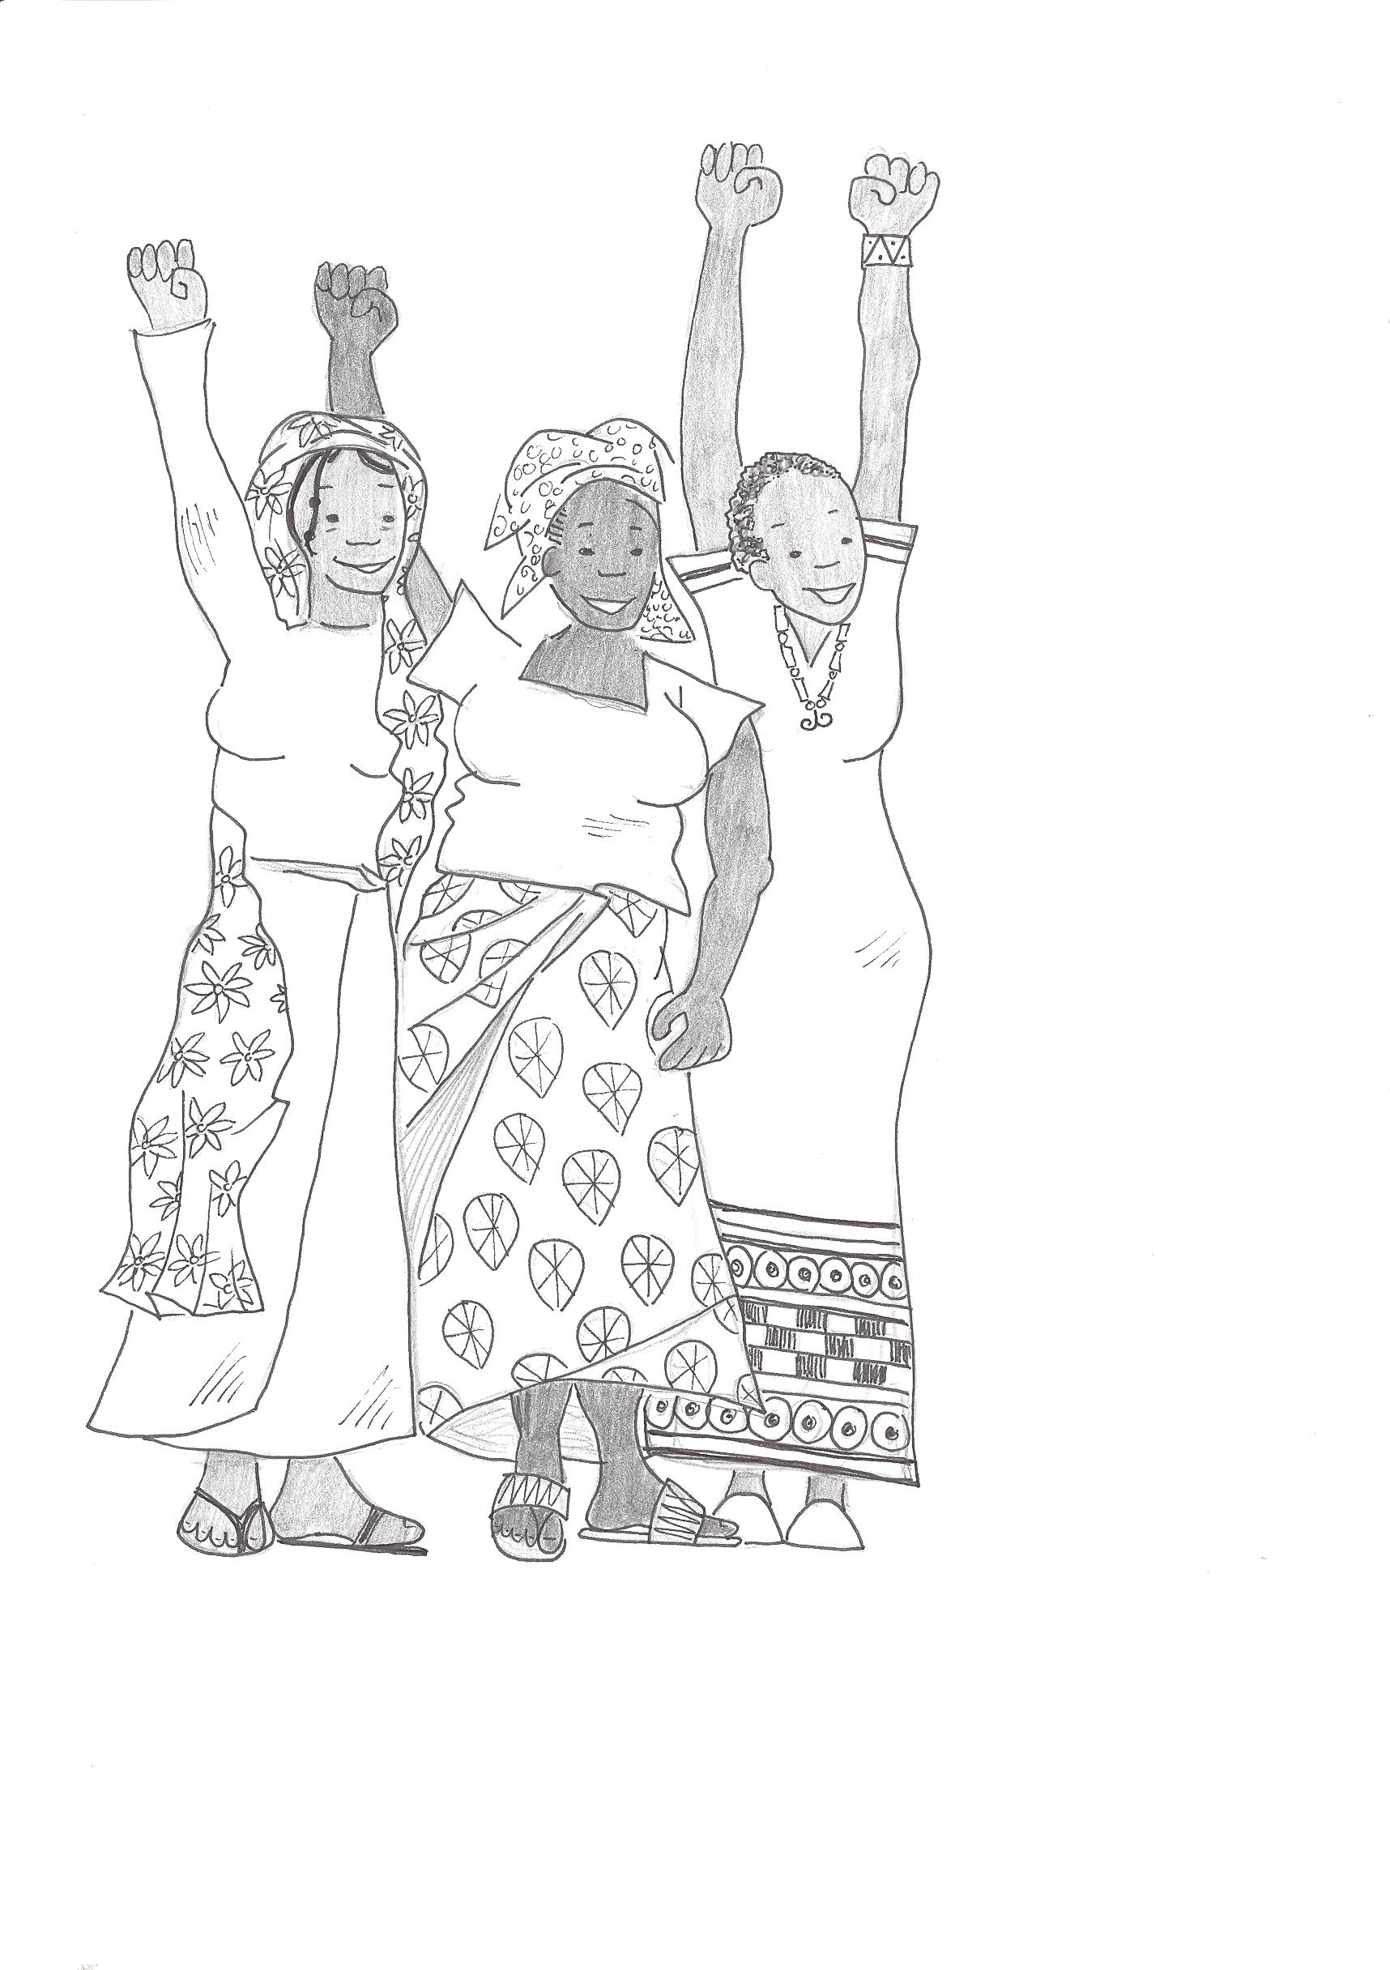
Refugee Women and Girls: A Vulnerable Minority?
For far too long, the prevailing discourse about refugee women and girls has been about a “vulnerable minority.” Women and girls are not a vulnerable group, nor are they a “minority,” constituting more than 50 percent of the diverse groups within refugee populations. While sharing with men and boys the same basic needs for food, water, shelter, sanitation and security, they do have additional and significantly different needs. The most pervasive difference is that of endemic and often systematic SGBV against women and girls, and pregnancy from rape.
Men and boys also are victims of SGBV, and this generates the need for different and appropriate responses.
Notes:
Acknowledge that this is a universal and proven truth, and that it will be discussed and analysed in Sessions 5 and 7

Slide 6
Refugee Women are Strong and Resilient
If we focusing only on the vulnerabilities of women and girls, we create a discourse of helpless victims. In many camps and refugee sites, women run crèches, arrange care for orphaned children, provide safe spaces for women who have experienced SGBV, manage scarce rations to ensure that families are fed, run small businesses to support their families, organize basic schools, and provide protection. Women have formal skills, as well as a wide range of informal skills, and have a huge capacity.
Notes:
Brainstorm the strengths and capacities of refugee women and girls, and list some of the services or programs they are currently running, either formally or informally.

Slide 7
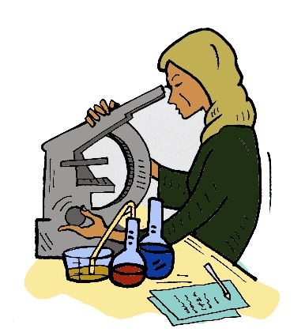
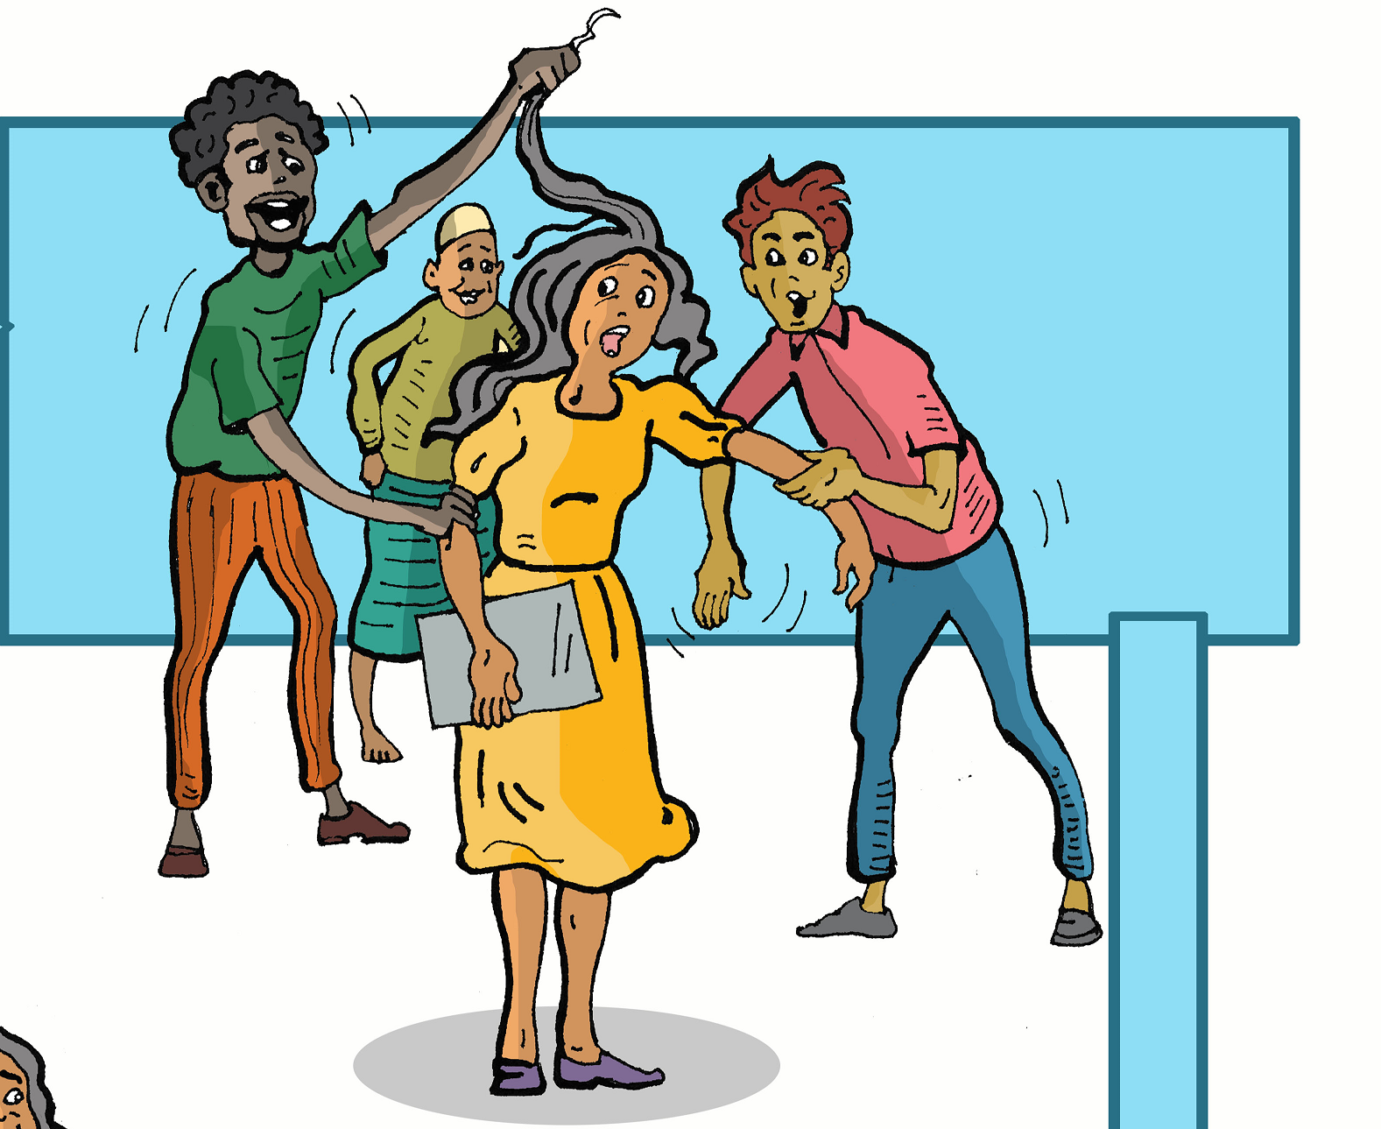
Both Strong and Vulnerable
However, to focus only on strengths is to ignore the widespread challenges, discrimination and abuse that refugee women and girls survive. They are simultaneously strong and resourceful, victims and marginalized.
We must address structural vulnerabilities that result from pervasive gender inequalities, as well as creating opportunities for their strengths to be capitalized.
Notes:
It is important that while acknowledging the strengths of refugee women and girls, we must also acknowledge the discriminations and hardships they suffer. Both sets of experience shape the lives of women and their families and we need to work with the strengths and the vulnerabilities at the same time.
For example, a strong and influential woman leader may also have suffered rape, and need counselling and support for herself. This support will help her build her strengths and continue to assist her community.
See Session 4, Age Gender and Diversity, and Session 6, Including Lived Experience for exercises if time permits.

Slide 8
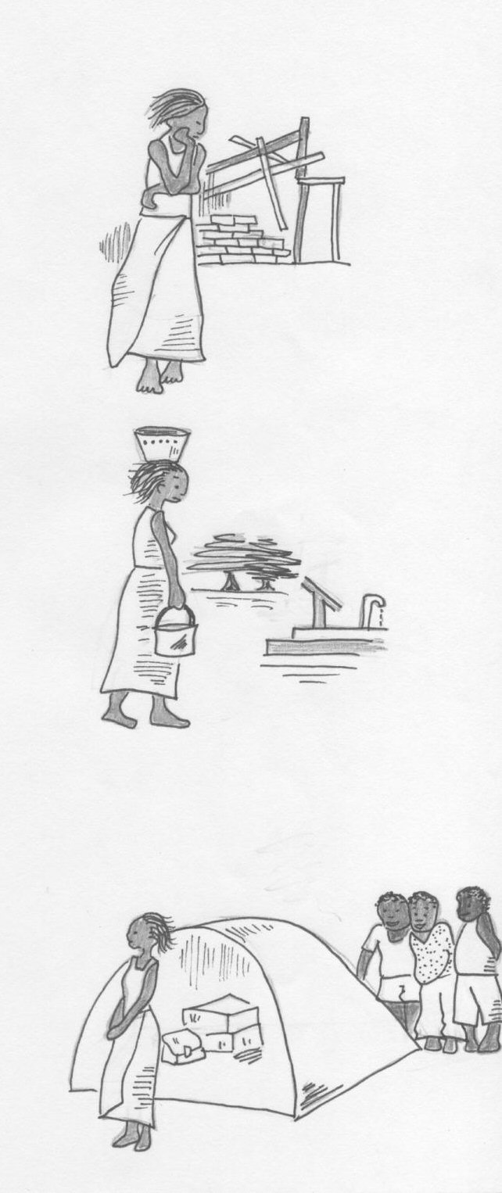
Examining the Impacts of inequality in refugee sites
In what ways does gender inequality impact on women and girls in situations of displacement?
Notes:
The following three slides pose a series of questions for the group to consider, either in small groups or a large group discussion.
How do the structural contexts, ie shelter, access to transport, camp or urban site, access to safe bathrooms etc of where they live affect them?
How do cultural norms, both theirs, and those of the host community impact on them?
How does poverty, discrimination and lack of legal protection impact on them?

Slide 9
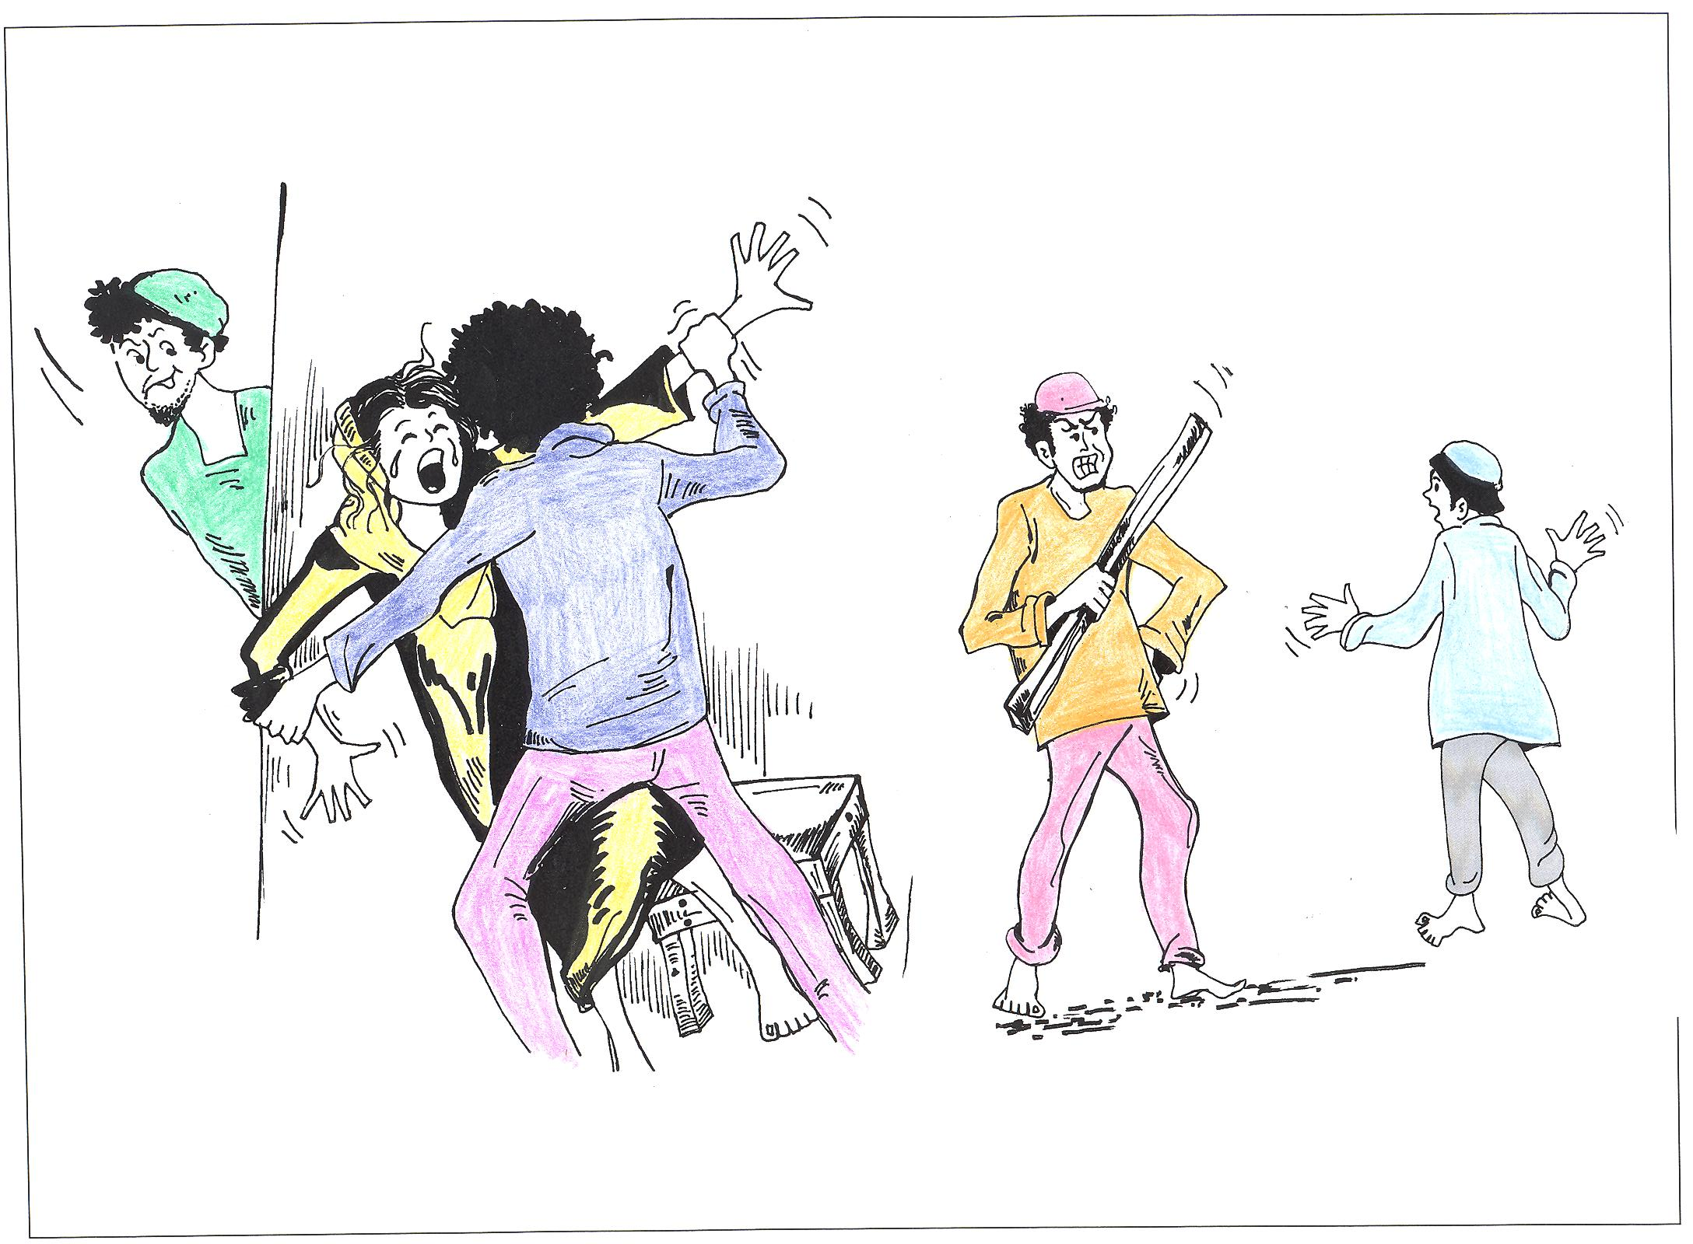
Questions to be asked
How did culture and religion, including gender roles impact on women’s lives in your/their home country?
How did the conflict and persecution change this?
How does ‘gender’ impact on women’s lives in the camp?
Notes:
As above

Slide 10
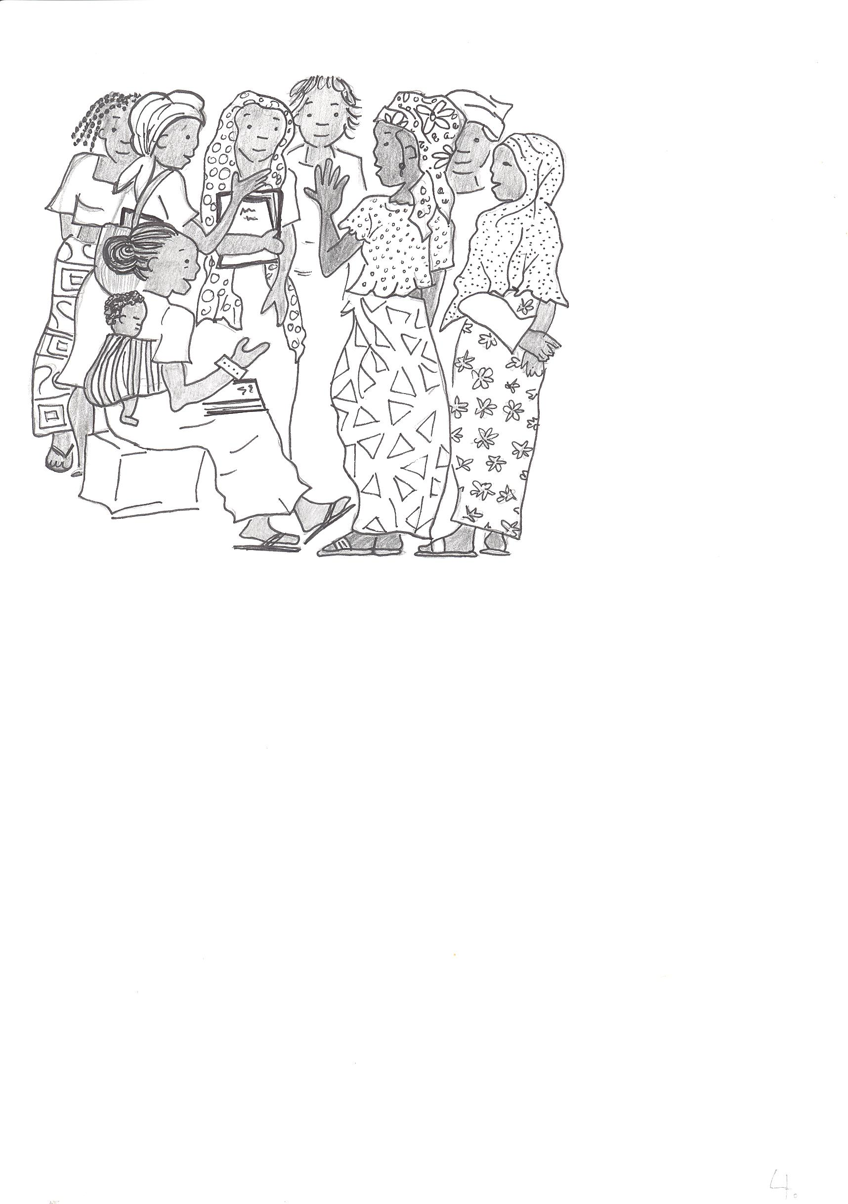
How do these differences in create difficulties for refugee women leaders and WRLOs?
How do we overcome this?
Notes:
This is best done as a small group exercise, with the group suggesting a solution for each difficulty they list.

Slide 11
A Tool to Identify Gender Based Local Barriers
This tool is designed to identify the types of support that might be needed for different women and WRLOs to enable them to build their capacity and move towards self-reliance, and sustainability. (They are closely linked to Structural barriers). The findings from the two exercises in this section should be combined and analysed to draw a comprehensive picture of the resources and support needed to assist women and WRLOs to reach their full potential in all areas of their lives.
(please note that many pre-literate refugees have the pre-requisites to lead WRLOs and with support are fully able to design and run excellent projects.)
Notes:
The Tools on the next three slides are designed to be used as a check list when designing programs and projects.
You will find Word and PDF versions of the exercises in Module 3 on the website.

Slide 12
Audit of support needed
Do refugee leaders and/or WRLOs have the experience knowledge and support to run local projects in the following areas: | Yes/No Partially | Is there appropriate training and support to enable the development of leaders, emerging leaders and groups in this site? | If not, what can be done to change this?
Have they previously worked in an NGO, CSO or RLO?
Have they taken a management role in an organisation?
Have they had an opportunity to learn management skills such as Financial management Program Planning Evaluation Managing people Others?
Notes:
Word versions of these Tables are available to download in the Training Notes on the website

Slide 13
Audit part 2
Are they pre-literate?
Do they speak the language of the host community?
Do they speak English?
Have they done Human Rights Training?
Have they done Gender Training?
Have they done Training on SGBV?

Slide 14
Gender based barriers and solutions to achieving meaningful participation
Places where women and girls would like to participate in decision making | Barriers to this happening, Why can’t women and girls participate fully | What would meaningful participation look like? | What can be done to make this happen?
In the family
In their Ethnic community
In refugee led groups and organisations
With NGOs, INGOs and UNHCR
In health services
Education
In Livelihoods
As an advocate
Other places not mentioned

Slide 15
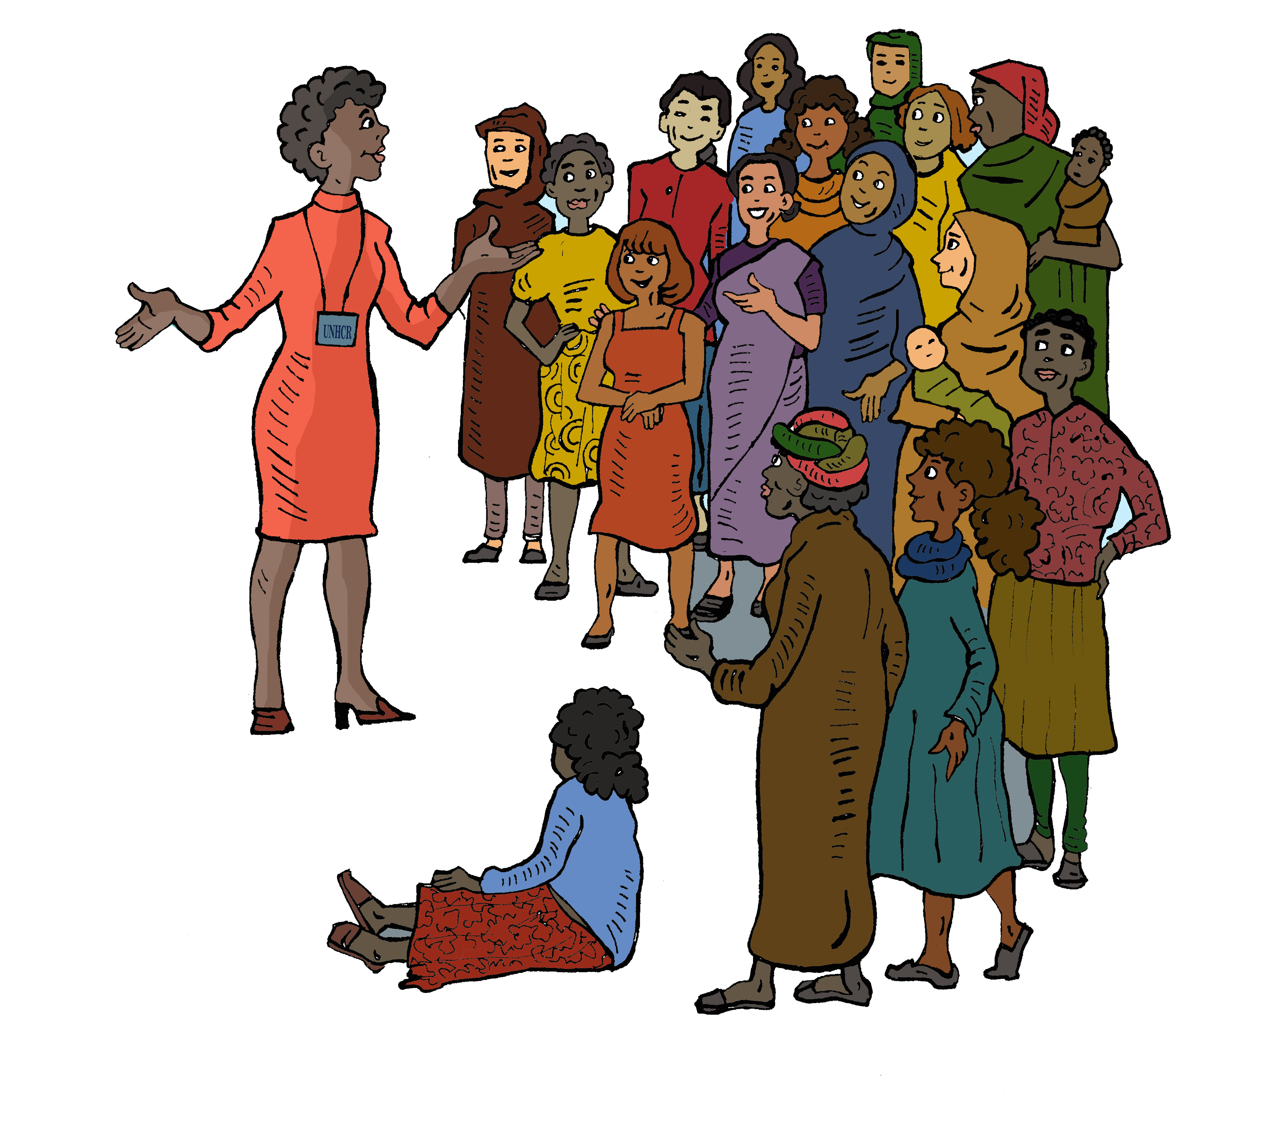
Working with the Community
A very similar exercise is on the website and can be used to explore these same questions with community members. It is always valuable to compare the findings from the community, with those from other stakeholders.
The best results happen when they can come together and discuss their often different perspectives and agree ways in which to work on agreed approaches.
Notes:
Just a reminder
While as service providers and leaders, it is essential that we answer the questions in the tools, it is equally important for the grass roots community members to add their knowledge and expertise. Encourage the participants to consult with the community at every available opportunity, and to include resources to do this in their funding applications.
If you find that there are different view from different stakeholder groups, if possible arrange a session where they are given the opportunity to discuss and resolve these.

