Slide 1
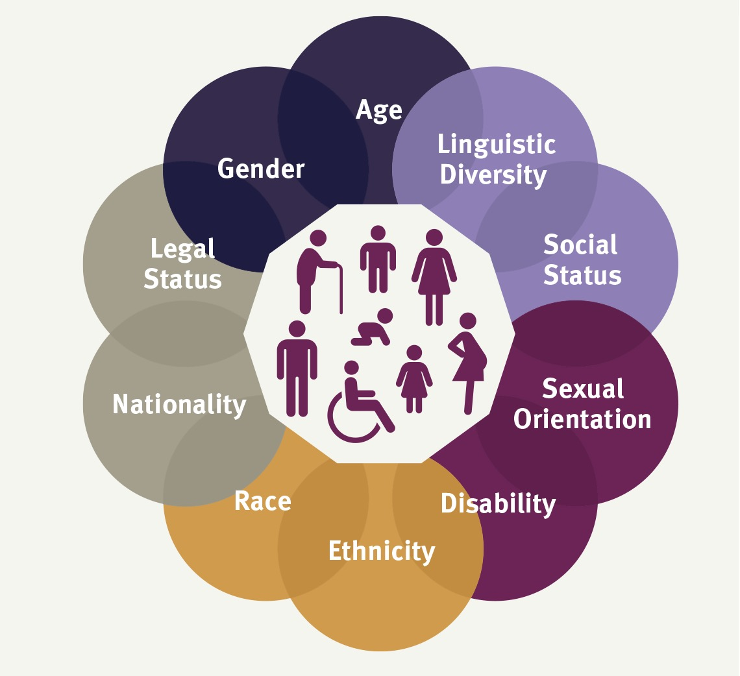
Session 4
UNHCR Age Gender and Diversity Framework, and the Concept of Intersectionality
How can we apply it to our work?
Notes:
The Age Gender and Diversity Framework and Policy underlies all of the work of UNHCR.
Please familiarise yourself with it before presenting this material.
https://www.unhcr.org/publications/unhcr-age-gender-and-diversity-policy
Activists and supporters of gender equality and diverse groups of refugees have been fighting to develop and strengthen it for many years.
It applies to all of the Commitments made in the Global Compact on Refugees, and Pledges made by Stakeholders to implement these.
It would be useful to make it available to participants.

Slide 2
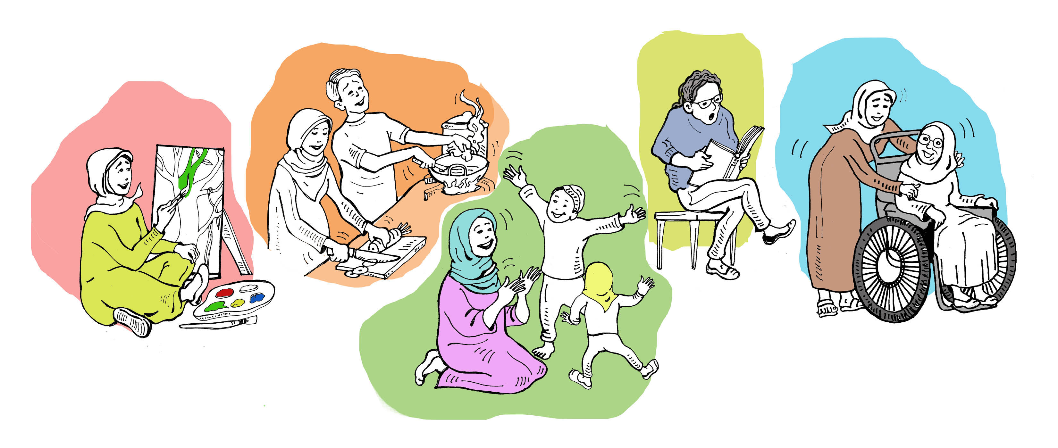
Age, Gender and Diversity
Means
Respecting Difference in Refugee and Displaced Communities
… and Ensuring the Inclusion of
Diverse Groups in All Our Work.
Notes:
It is about ensuring that diverse groups do not suffer from further discrimination in law, policy and service provision.

Slide 3
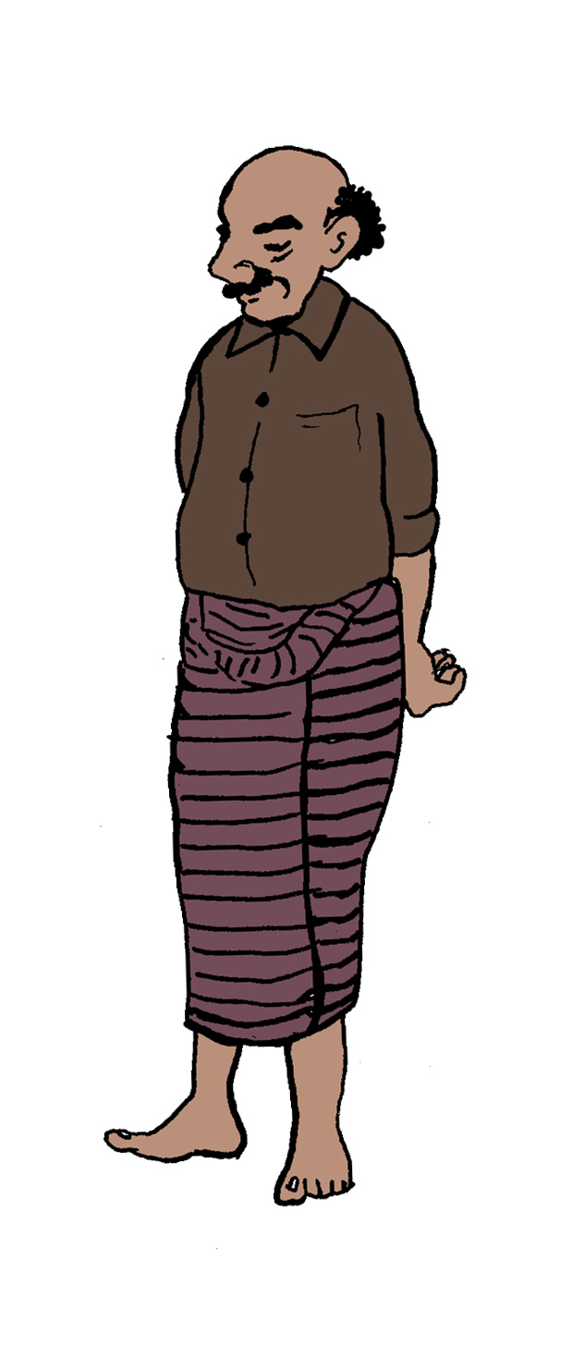
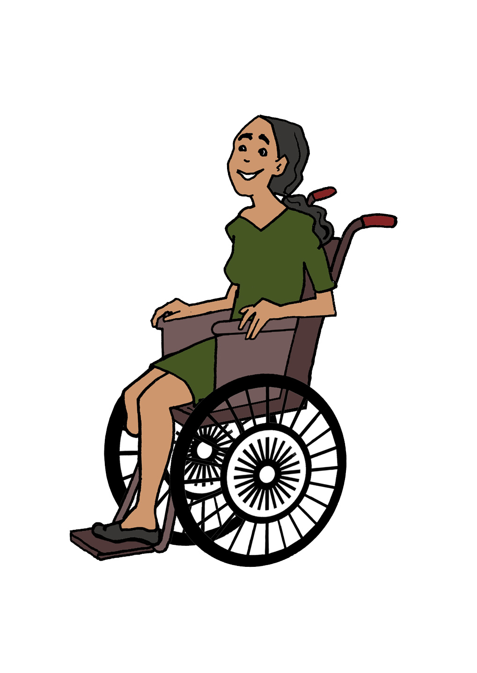
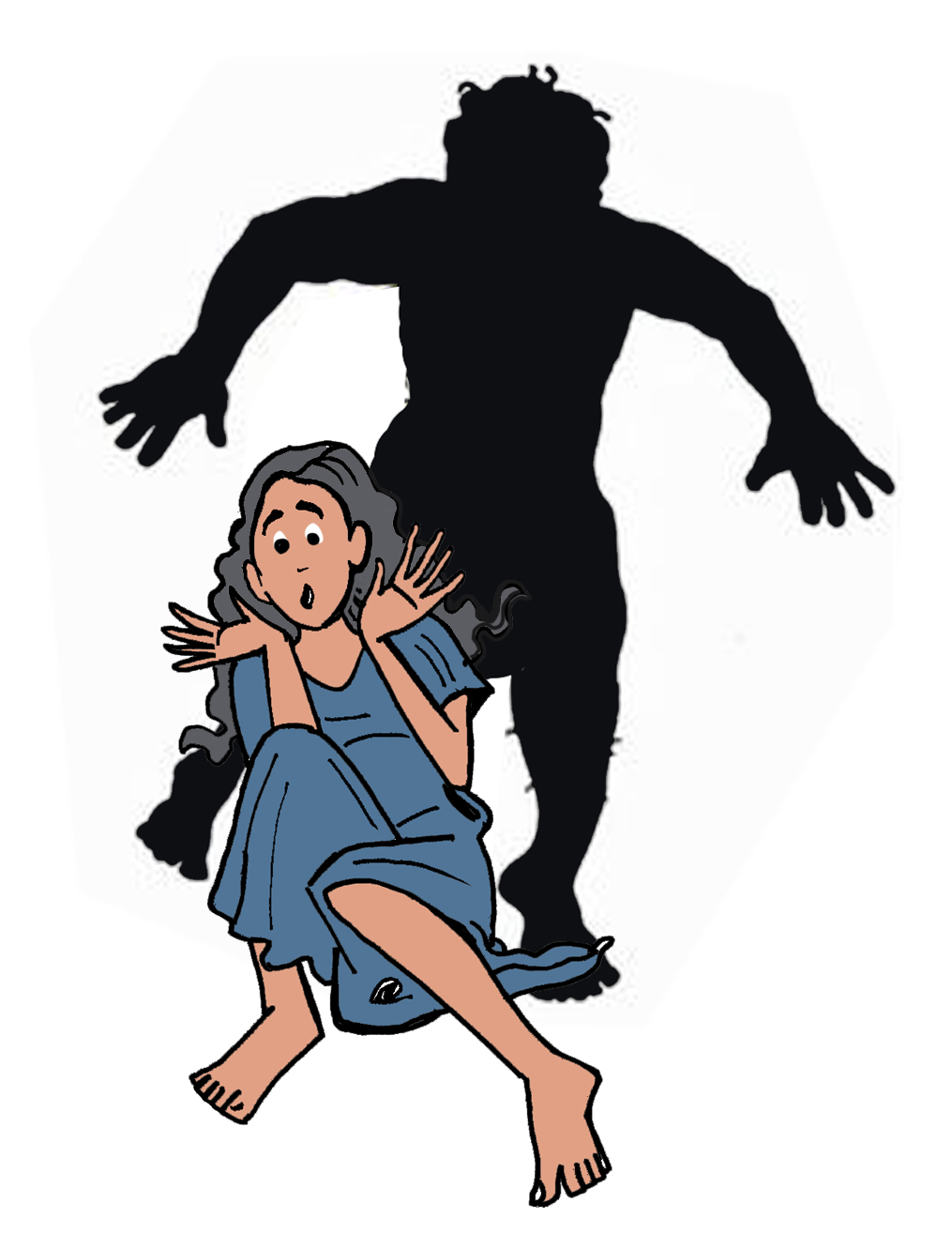
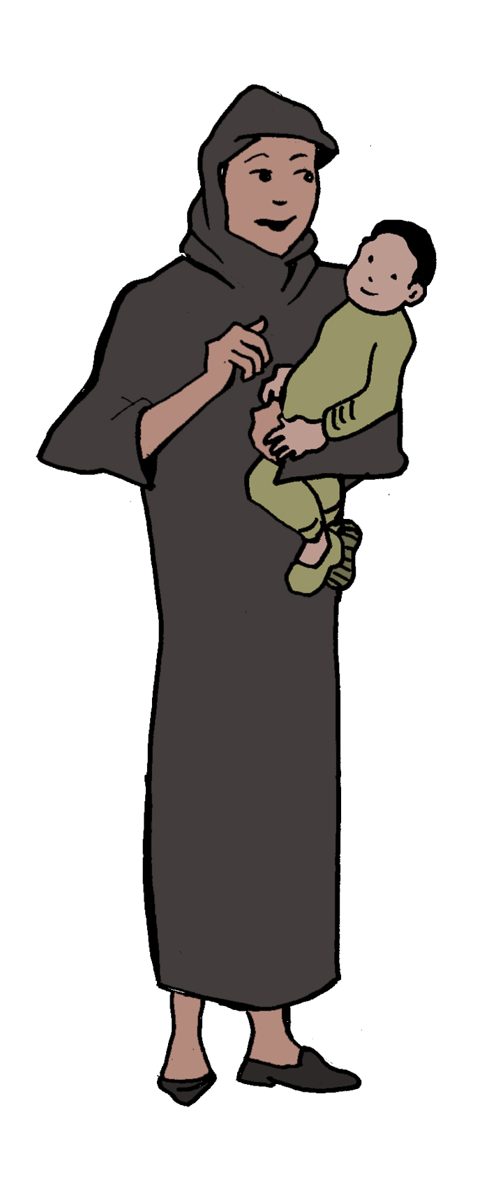
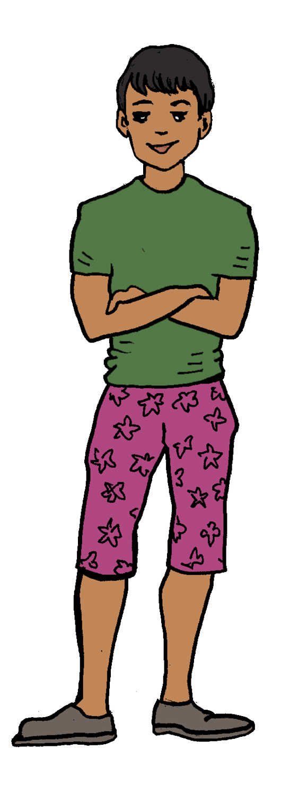
What does it cover?
There are four modules which together cover this important approach. They are Module 4. Age Gender and Diversity, 5. Addressing Sexual and Gender Based Violence, 6. Harnessing Lived Experience, and 7. Including Refugee Men.
Notes:
Please See the Reciprocal Research Power Point Slides in Additional Materials to access these tools.

Slide 4
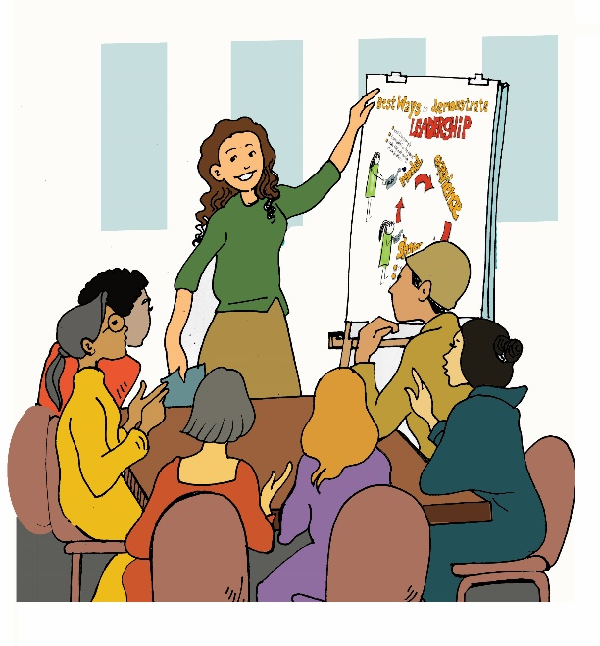
What are the promises in the UNHCR Age Gender and Diversity policy?
Notes:
The following slides cover the major commitments in the AGD Policy, which cross into the gender commitments in the Global Compact on Refugees.
If there is time, ask participants to discuss how these promises are impacting on their work and lives at the moment, and what might be done to implement them more effectively.

Slide 5
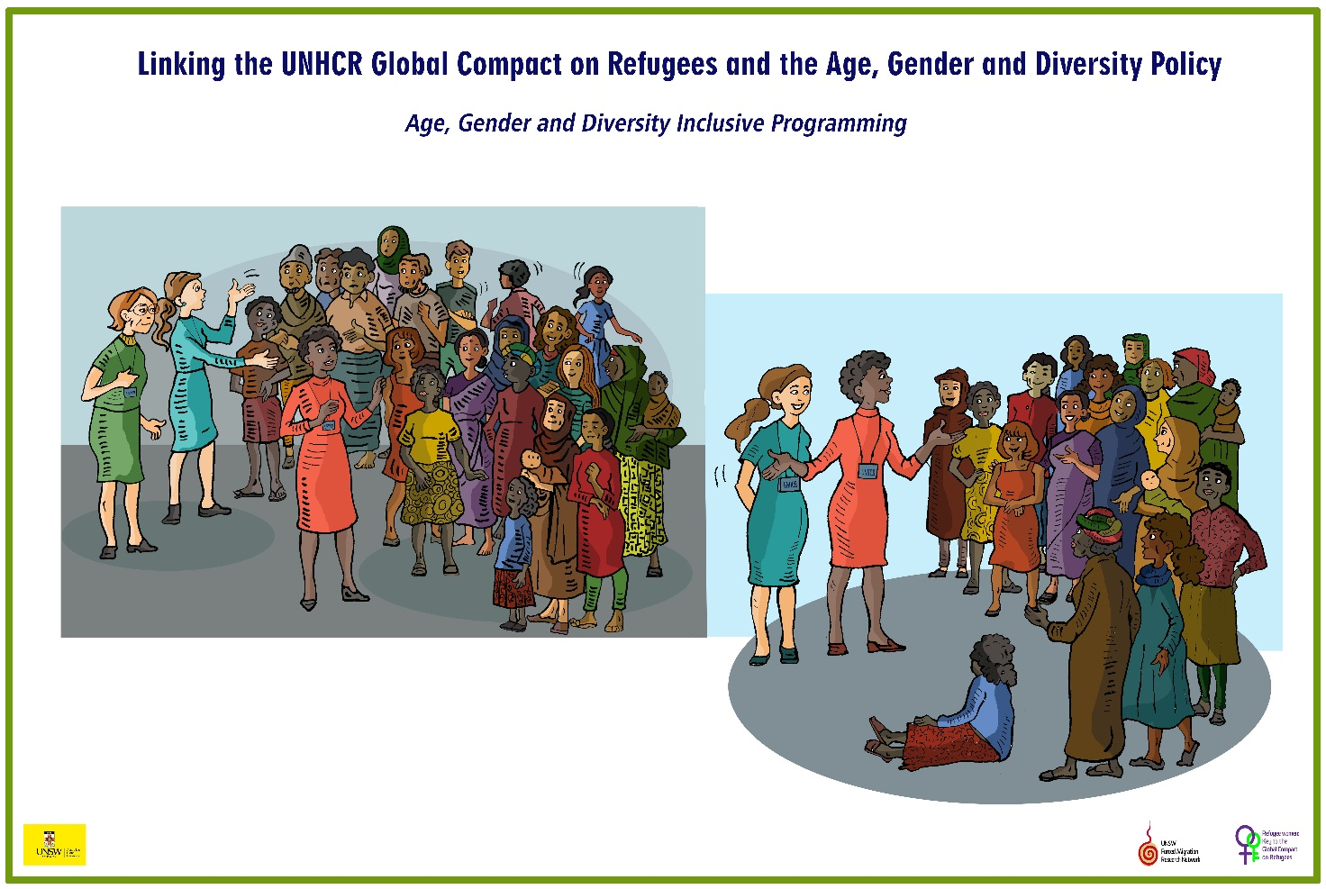
ADG Inclusive Programming

Slide 6
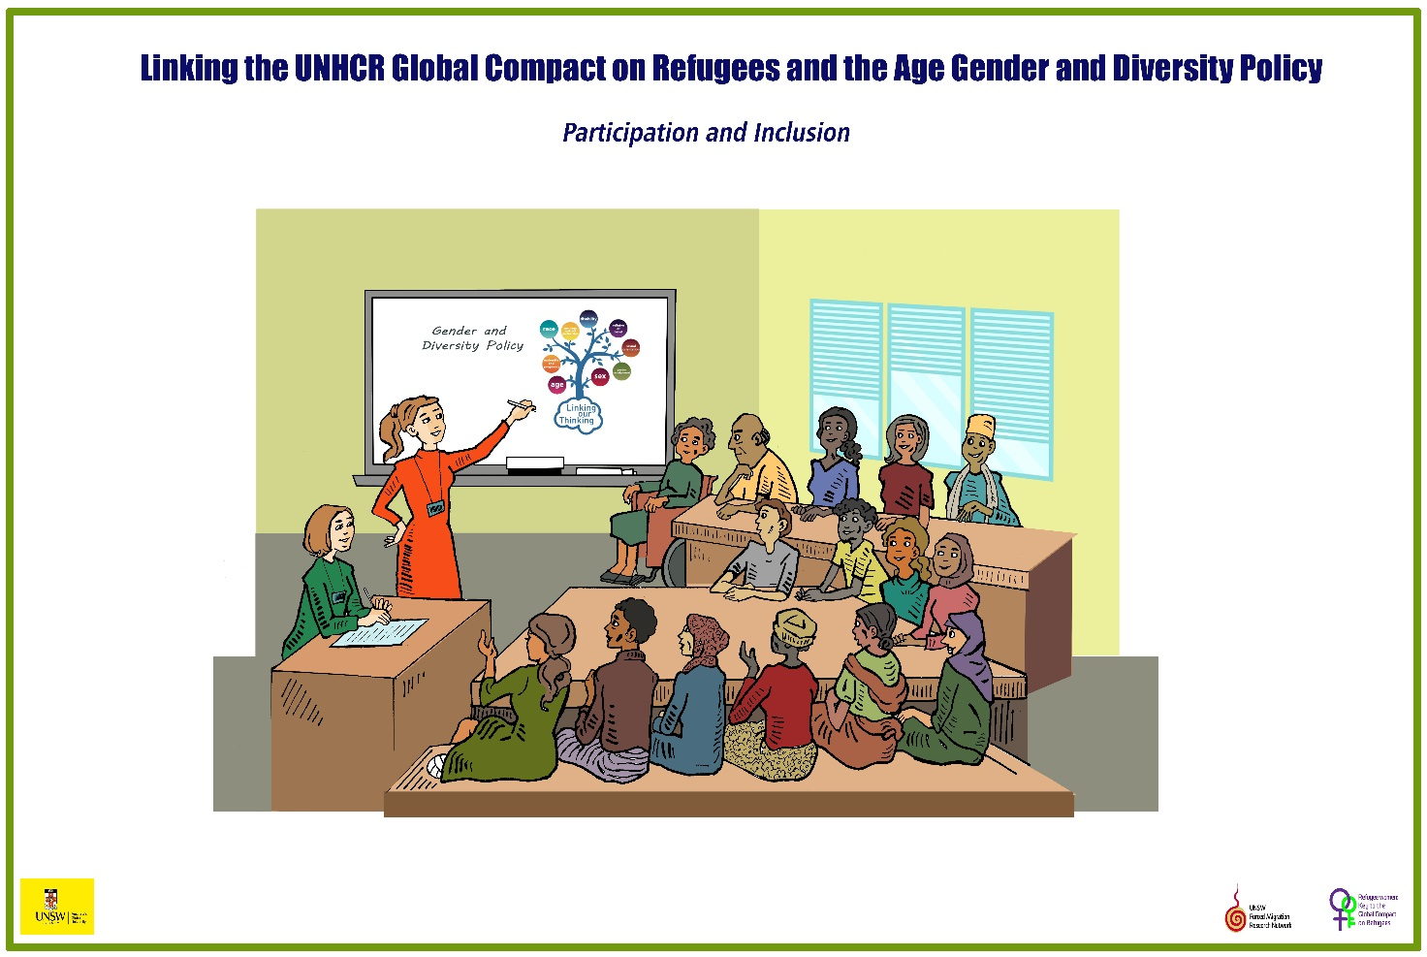
Participation and Inclusion

Slide 7
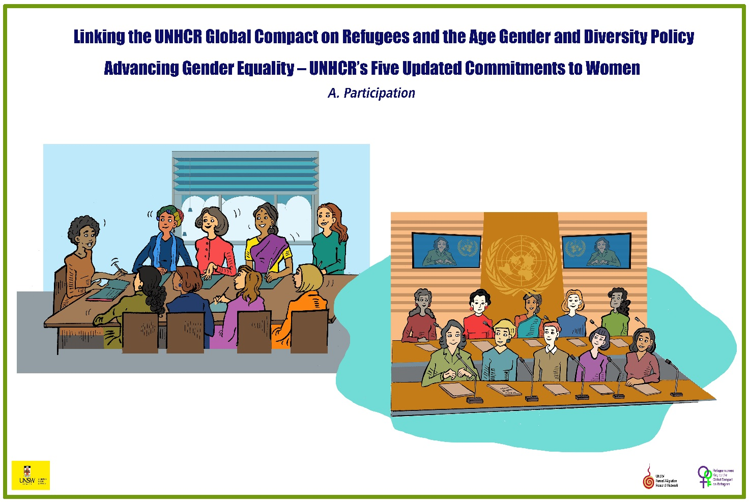
PARTICIPATION

Slide 8
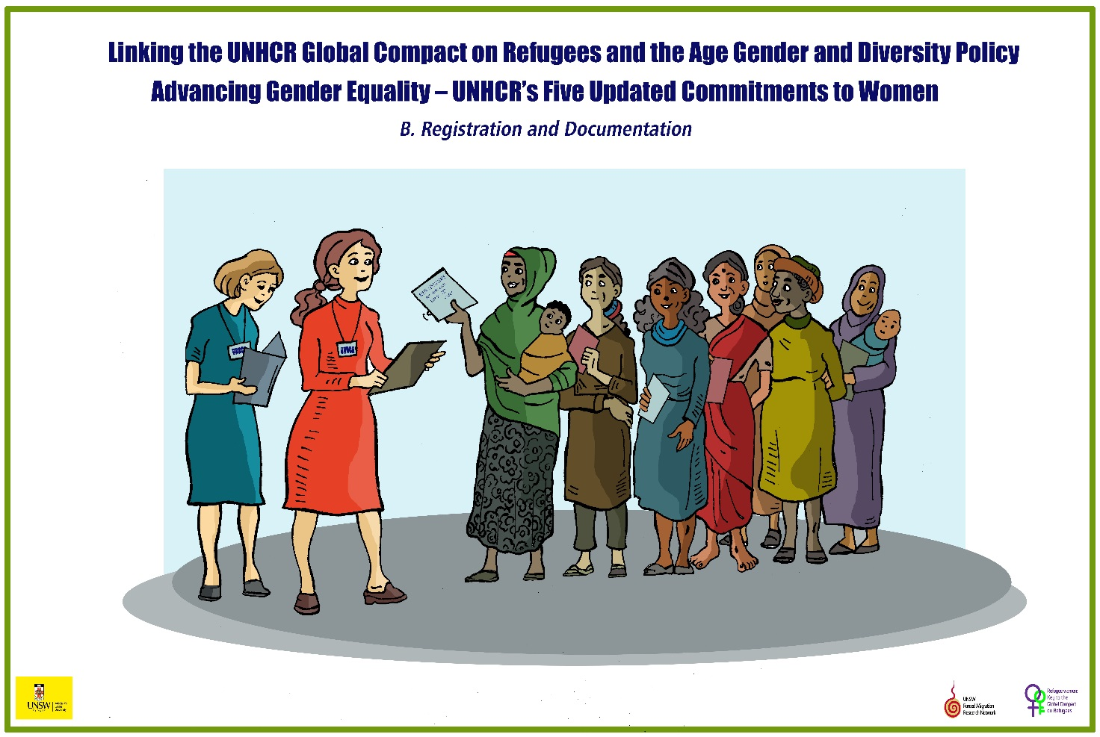
Registration and Documentation

Slide 9
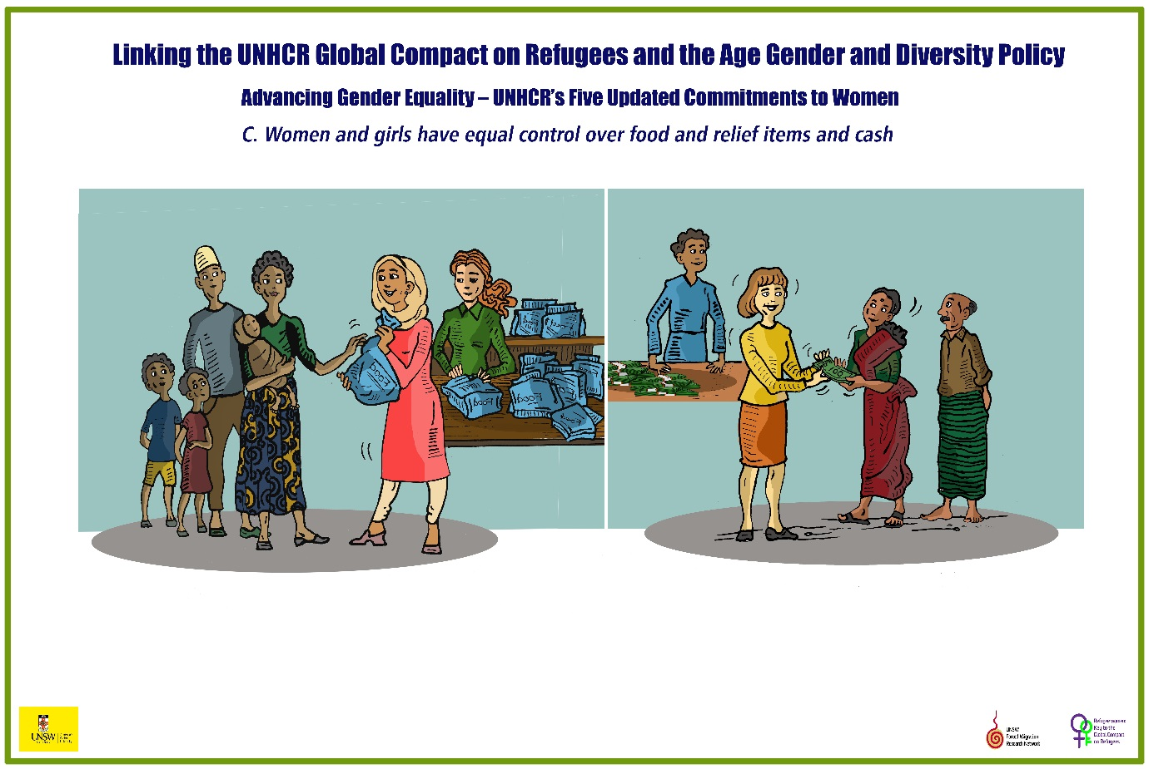
Women and Girls have equal control over Food, Relief Items and cash

Slide 10
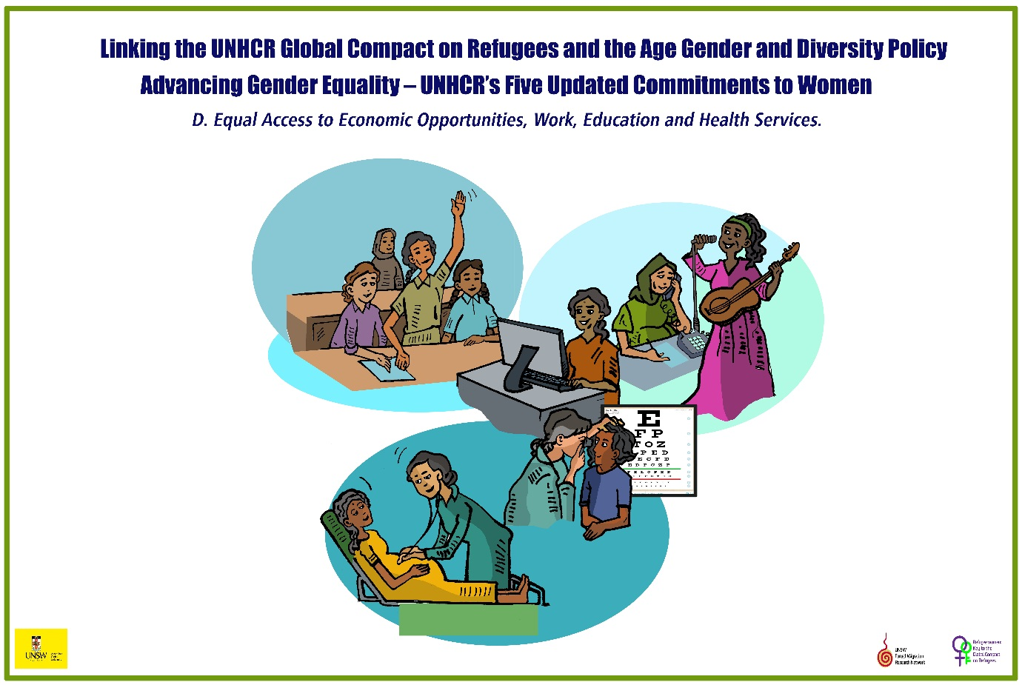
Work, Education and Health Services

Slide 11
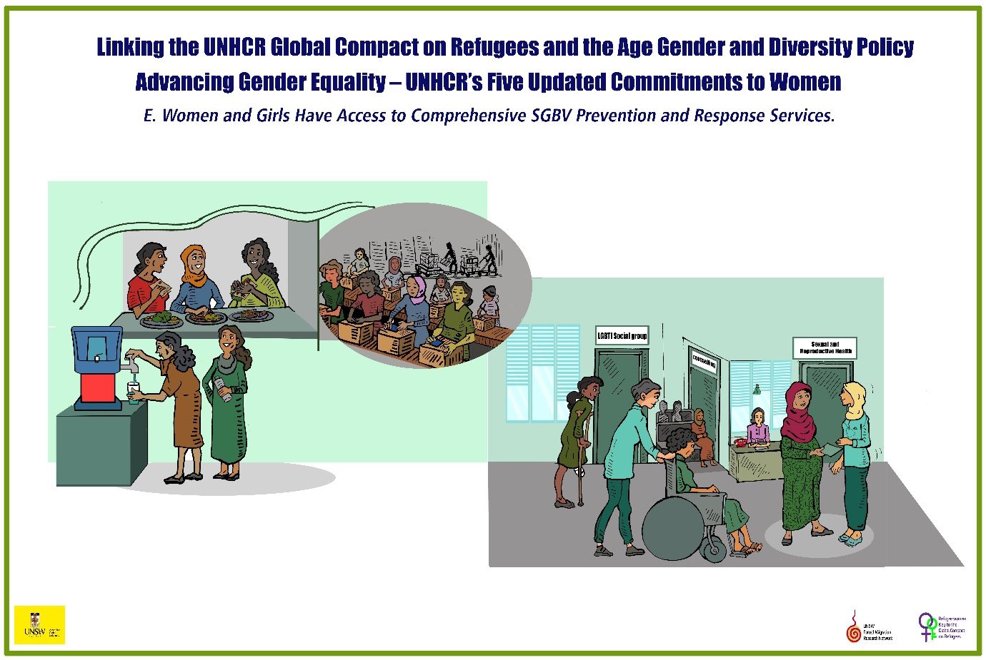
SGBV Prevention and Response

Slide 12
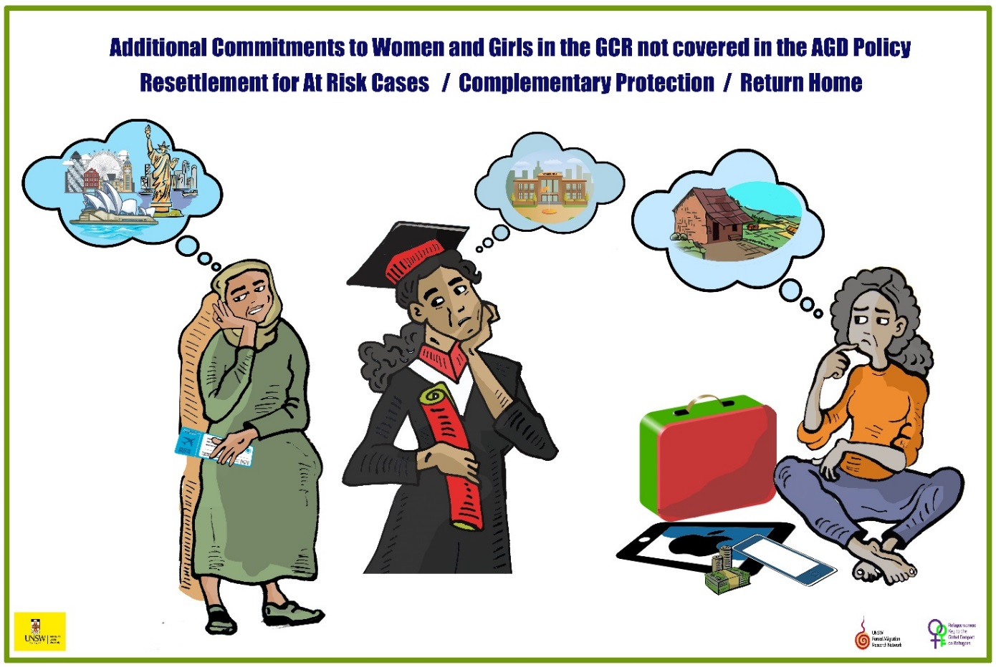
Additional GCR Commitments Resettlement Complementary Protection, Return

Slide 13
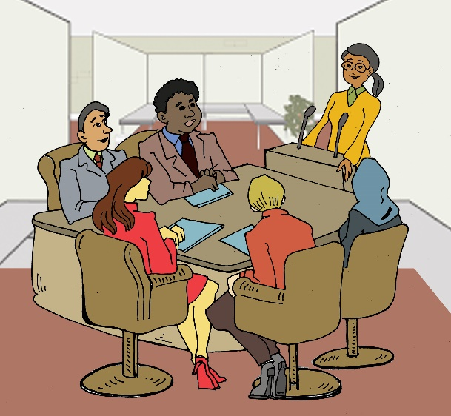
Intersectionality and AGD What is Intersectionality and why we are using it? To cover this topic in detail, we suggest you use the following Training kit which has an excellent video
Notes:
Intersectionality is a conceptual framework which enables to understand how the many discriminations endured by refugees and displace people interact and compound problems.
It also allows us to look at the many facets of each refugee and not to just focus on the negatives, or the positives, but to see each refugee as a complex and many sided person.

Slide 14



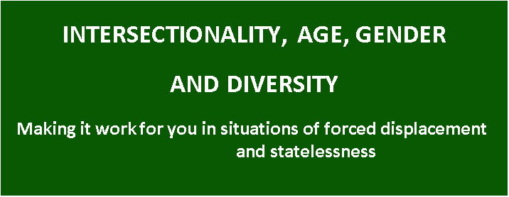
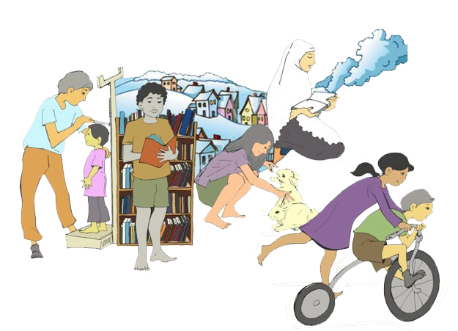
A Training Manual
https://www.unhcr.org/au/what-we-do/how-we-work/safeguarding-individuals/intersectionality-and-age-gender-diversity-approach
Notes:
We strongly recommend that you use this package, and then complete the exercises below.

Slide 15
In summary!
Intersectionality refers to the ways in which the different aspects of a person’s identity affect the way they are viewed by others and thus affects their life. It examines how various socially and culturally constructed categories, such as gender, race, class, disability, and others interact on multiple levels and contribute to systematic social inequality. Racism, sexism, and religion-based bigotry etc. do not act independently of one another.
Notes:
You can invite participants to add other street names to the sign post.

Slide 16
The impact of labels on how we perceive people
They create a system of oppression that reflects the ‘intersection’ of multiple forms of discrimination. We often ‘label’ people according to these discriminations.
Notes:
An exercise about exploring the labels which people are given is in Module 6 of this Training Program, Harnessing Lived Experience.

Slide 17
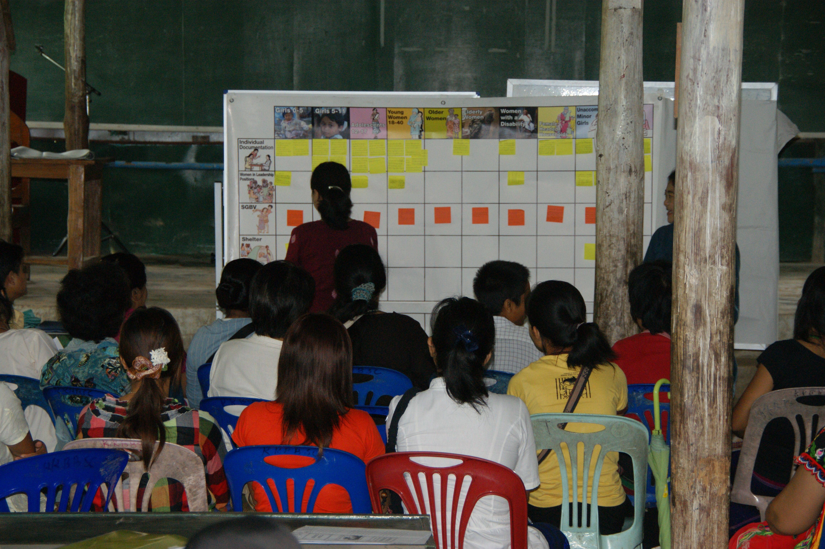
Tools of Analysis
To investigate and understand these complex issues we introduce two major Tools, which are part of the Reciprocal Research Methodology. They are The Matrix AGD Analysis Tool, and Storyboards.
The Matrix Exercise
Notes:
The Matrix was specifically designed for addressing Age,Gender and Diversity.
For full information about how to use the Matrix exercise, go to Session 5, Reciprocal Research in Additional Materials.

Slide 18
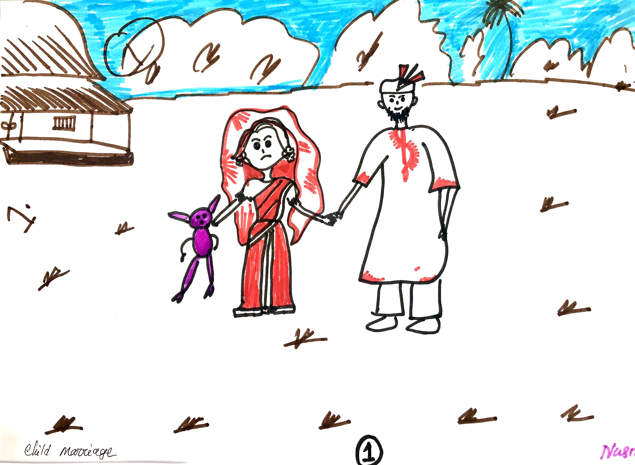
Storyboarding
These tools are designed to be used with stakeholders at all levels, including refugee community members, service providers and policy makers. They can be employed to collect data and analyse a wide range of issues.
Notes:
Notes to Facilitators
The story board technique involves asking participants to prepare six panels, using drawing, or collages of pictures.
The six stages MUST take participants through from describing a problem or issue to be worked on, to a solution and an outcome. In this case it would be barriers and solutions to including diverse groups of people
For full information about how to use the Storyboards exercise, go to Session 6, Reciprocal Research in Additional Materials.

Slide 19
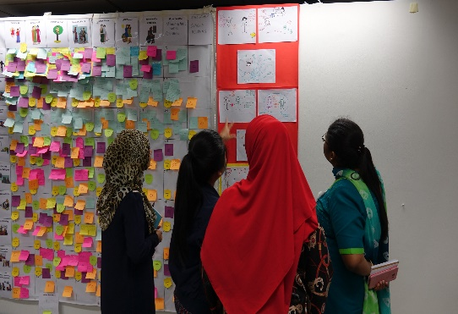
How do they work?
The Tools can be adapted to understand the ways in which specific issues, such as, for example, access to education or livelihoods are experienced by diverse groups in refugee communities, and examine the impact of, and potential solutions to SGBV.
They clearly identify the different needs of refugee women and girls, men and boys, and other diverse groups.
Notes:
If there is time, it is important to use both of these tools.
If not, there are some additional exercises below.

Slide 20
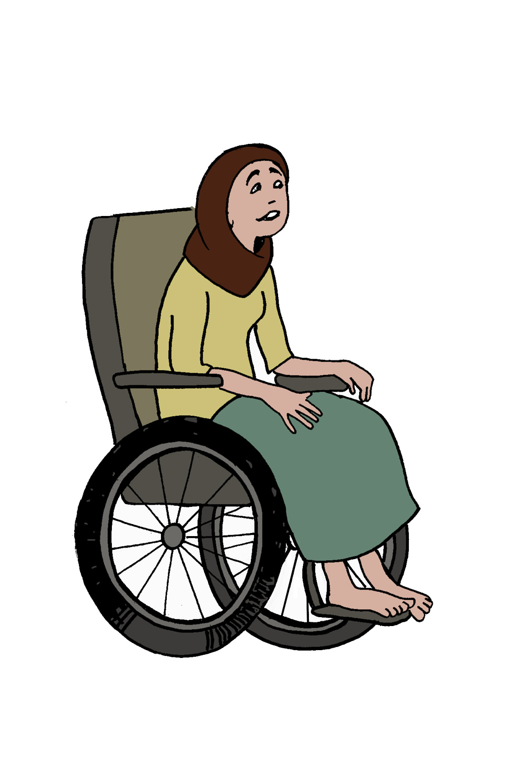
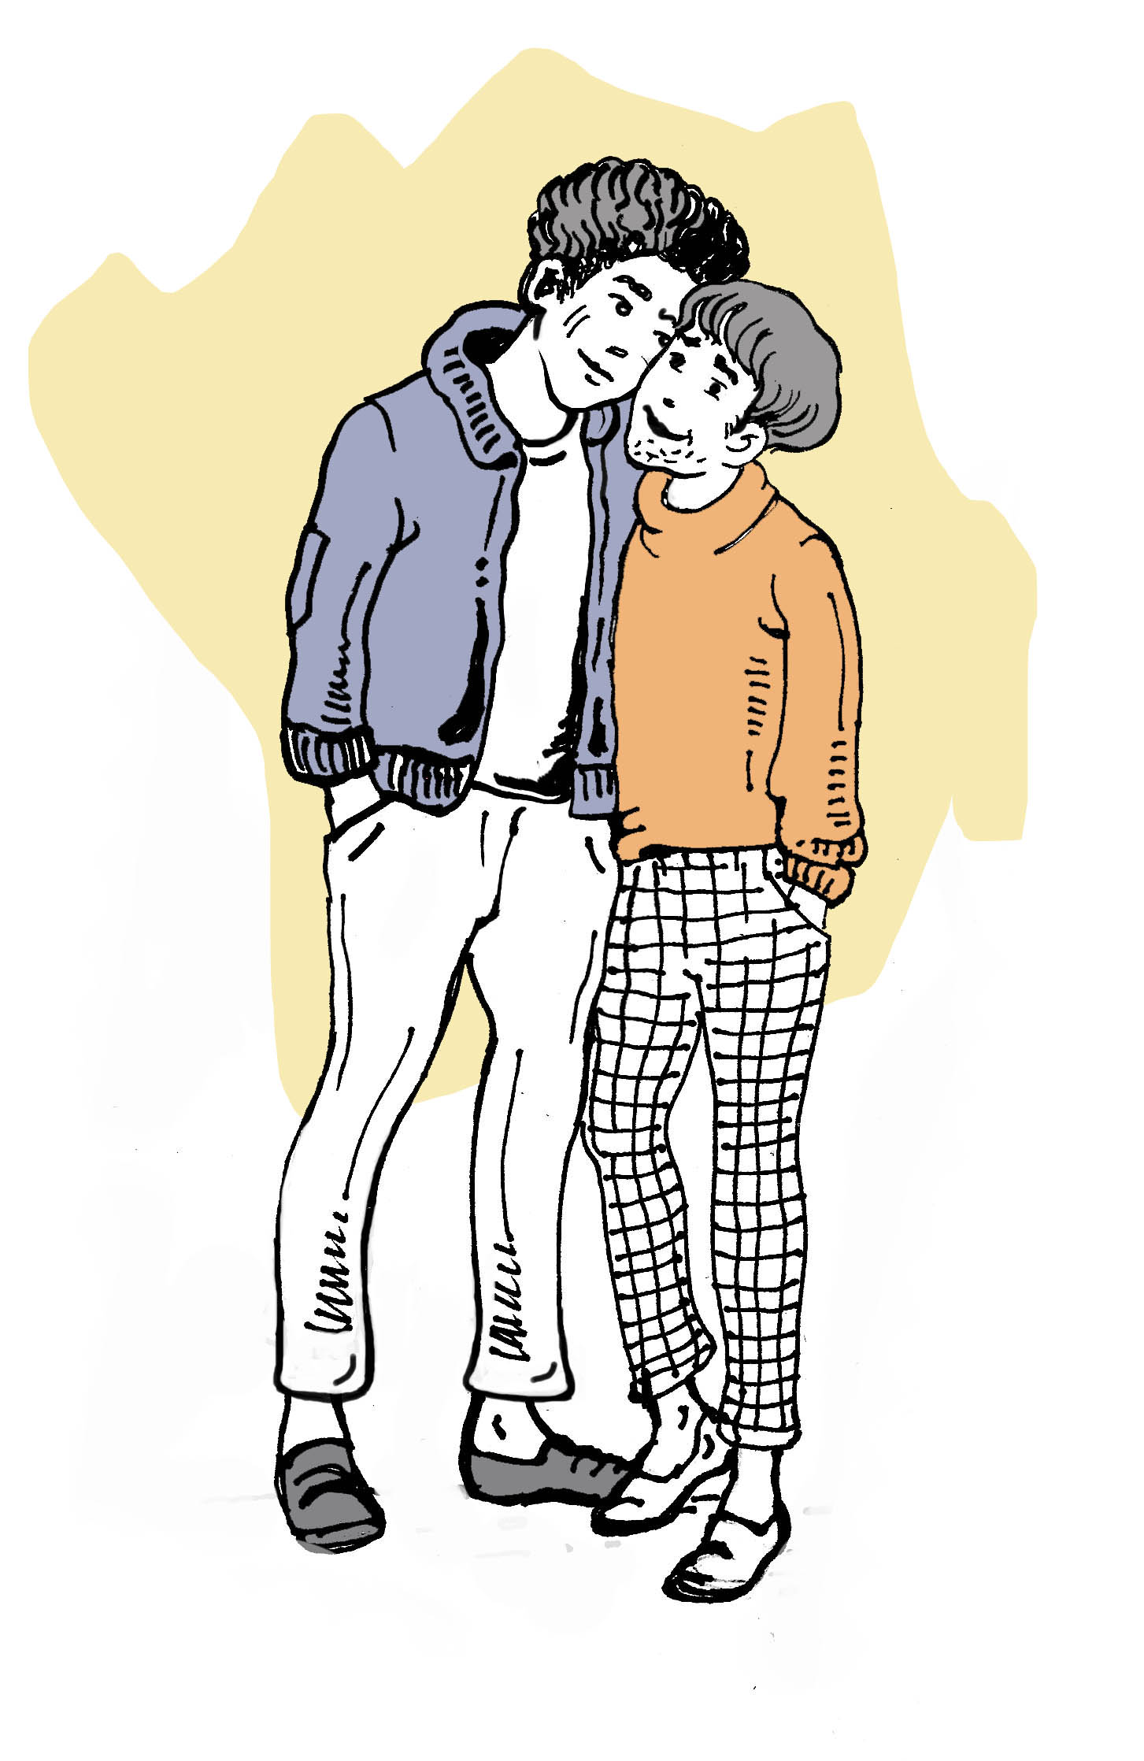
An Exercise in Acknowledging Diversity
When you design a project with the community, how will you demonstrate that the needs of diverse groups have been considered?. It is not enough to say “we will include people with a disability – youth, older people, men, members of LGBTQI+ communities etc” You need to say how you plan to support the community do this.
Notes:
This is a small group exercise. When feeding back, ensure you explore how the groups will reach out to diverse groups.
You may have to specifically push for them to discuss including members of the LGBTQI+ communities. If you are not comfortable doing this, try and find a colleague or service provider who can assist you.
There are some excellent material on https://pridefoundation.org.au/key-area-lgbtqia-refugee-asylum-seekers/

Slide 21
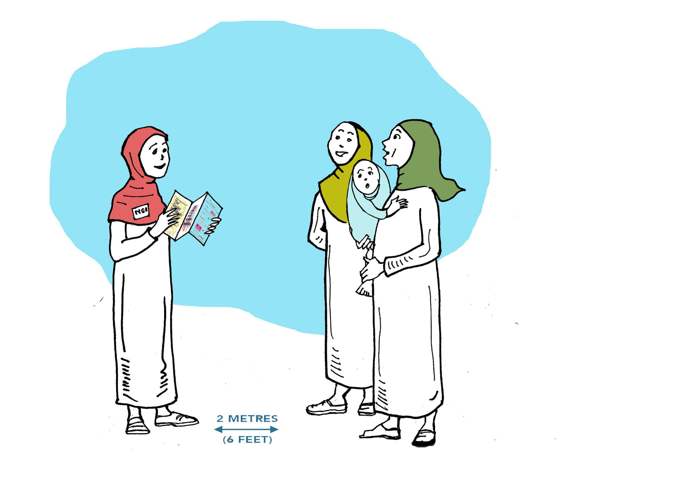
Discuss and list how will you will work with the refugee community to find out the needs of diverse groups who may be involved in projects?
Young people
Women with young children or caring for the sick or elderly
Members of the LGBTQI+ communities
People with a disability
People who are pre-literate
Other vulnerable groups
Notes:
As above

Slide 22
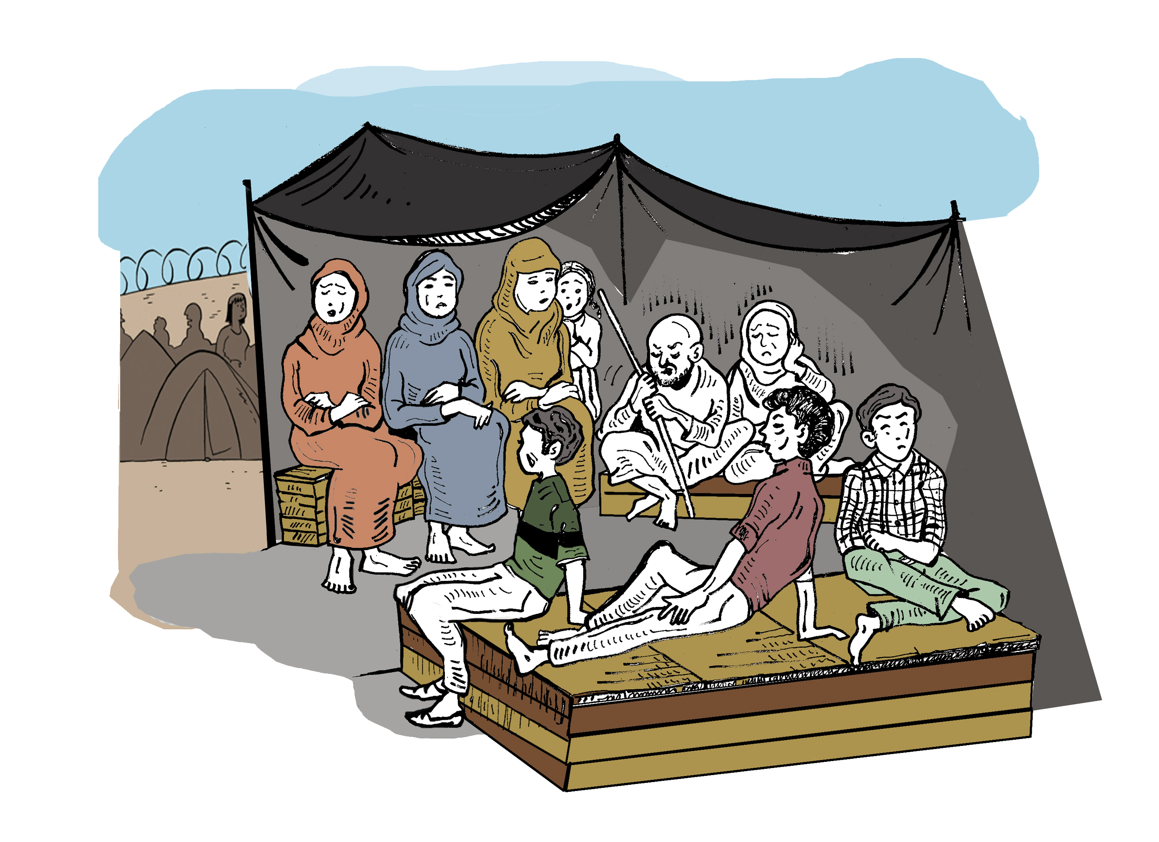
What can you do to make sure that diverse groups are included in the projects?
How will you monitor whether you are succeeding?
How will you address discrimination that may happen in your own community and or organisations?
Notes:
This is important. It is often easier to focus on discrimination coming from outside one’s community, than what is happening within it.

Slide 23
Everyones view is important
The same exercises are equally important to use with all stakeholders, and the most value is gained when the results from each group involved are brought together to inform program design, implementation and evaluations.
Notes:
Finish the session by reminding the groups that the Human Rights framework is for ALL human beings. There is no hierarchy of rights, and no-one should be excluded.

