Slide 1
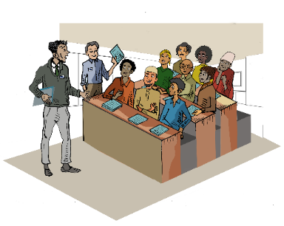
Session 7
Working with men as Partners in Gender Equality
Presented by Dr Linda Bartolomei and
Adjunct Professor Eileen Pittaway
Forced Migration Research Network UNSW
Notes:
Facilitators Notes
If you are not familiar with this area of work, please read the Background reading before conducting this session.
In all of the consultations we did as part of the research project on which this Kit is based, the importance of including men as part of the solution was mentioned by all the various stakeholders.
However, few actually discussed the fact that refugee men and boys also face their own specific problems and barriers.
Gender Equality means that the specific needs of both men and boys, women and girls are addressed. Please see Module 2 Gender Equality
In the module, we have presented materials to address both sides of this coin.

Slide 2
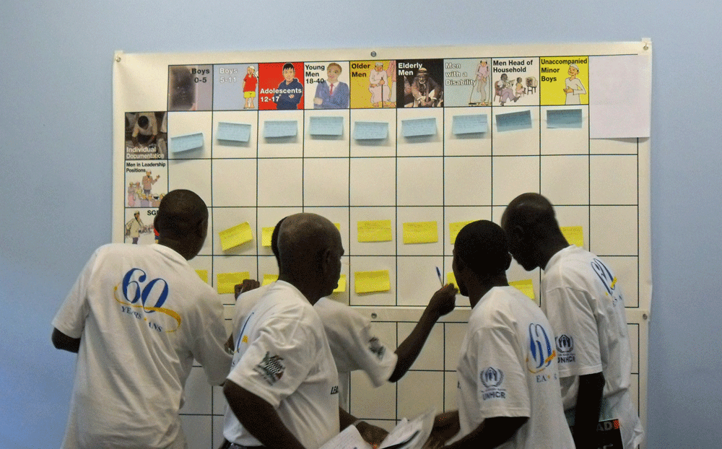
The Aim of the Session
To identify all ways in which to include the specific needs of male refugees, and to foster male champions for gender equality.
Notes:
Suggested time needed to run the full module. The material can be introduced in a presentation of one hour, with an additional two hours for participants to complete the Matrix exercise
Storyboarding will take an additional 3 hours

Slide 3
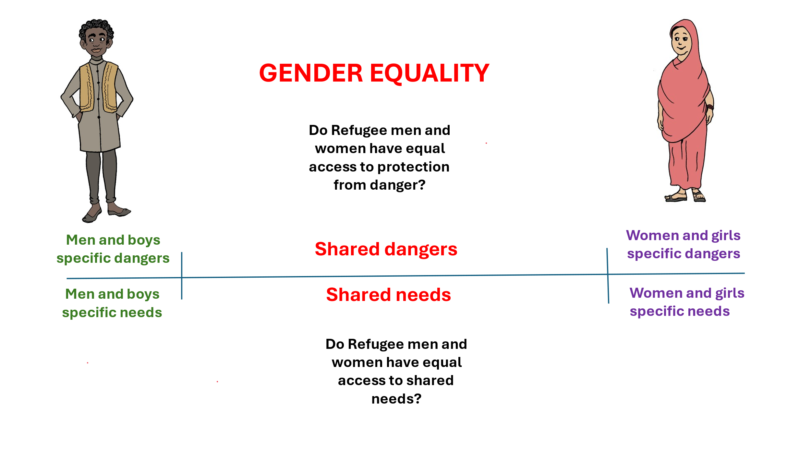
An exercise to identify different needs
Notes:
If you have completed Gender - Social Barriers Module 4, you might have already completed this exercise. If not, divide participants into small groups
to discuss:
Specific dangers for men and boys
Specific dangers for women and girls
Shared dangers
Shared needs
As part of your feedback to the group work pose the question
“ Do men and women have equal access to shared needs and resources?”
If there is not time for a small group exercise, do a brainstorm.

Slide 4
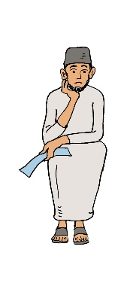
The specific need of male refugees
What are some of the barriers experienced by men and boys in having their voices heard in refugee situations?
How does this make them feel?
What is the impact of them not sharing their knowledge and experience?
What needs to be done to address these barriers, what support, and resources would the groups need to feel confident to speak out?
Who can help with this?
What would be the positive outcomes of this happening?
Notes:
Depending on the time available, either get the group to workshop these questions, or do a large group brainstorm.
Ask the group to take their answers forward into the following exercises.

Slide 5
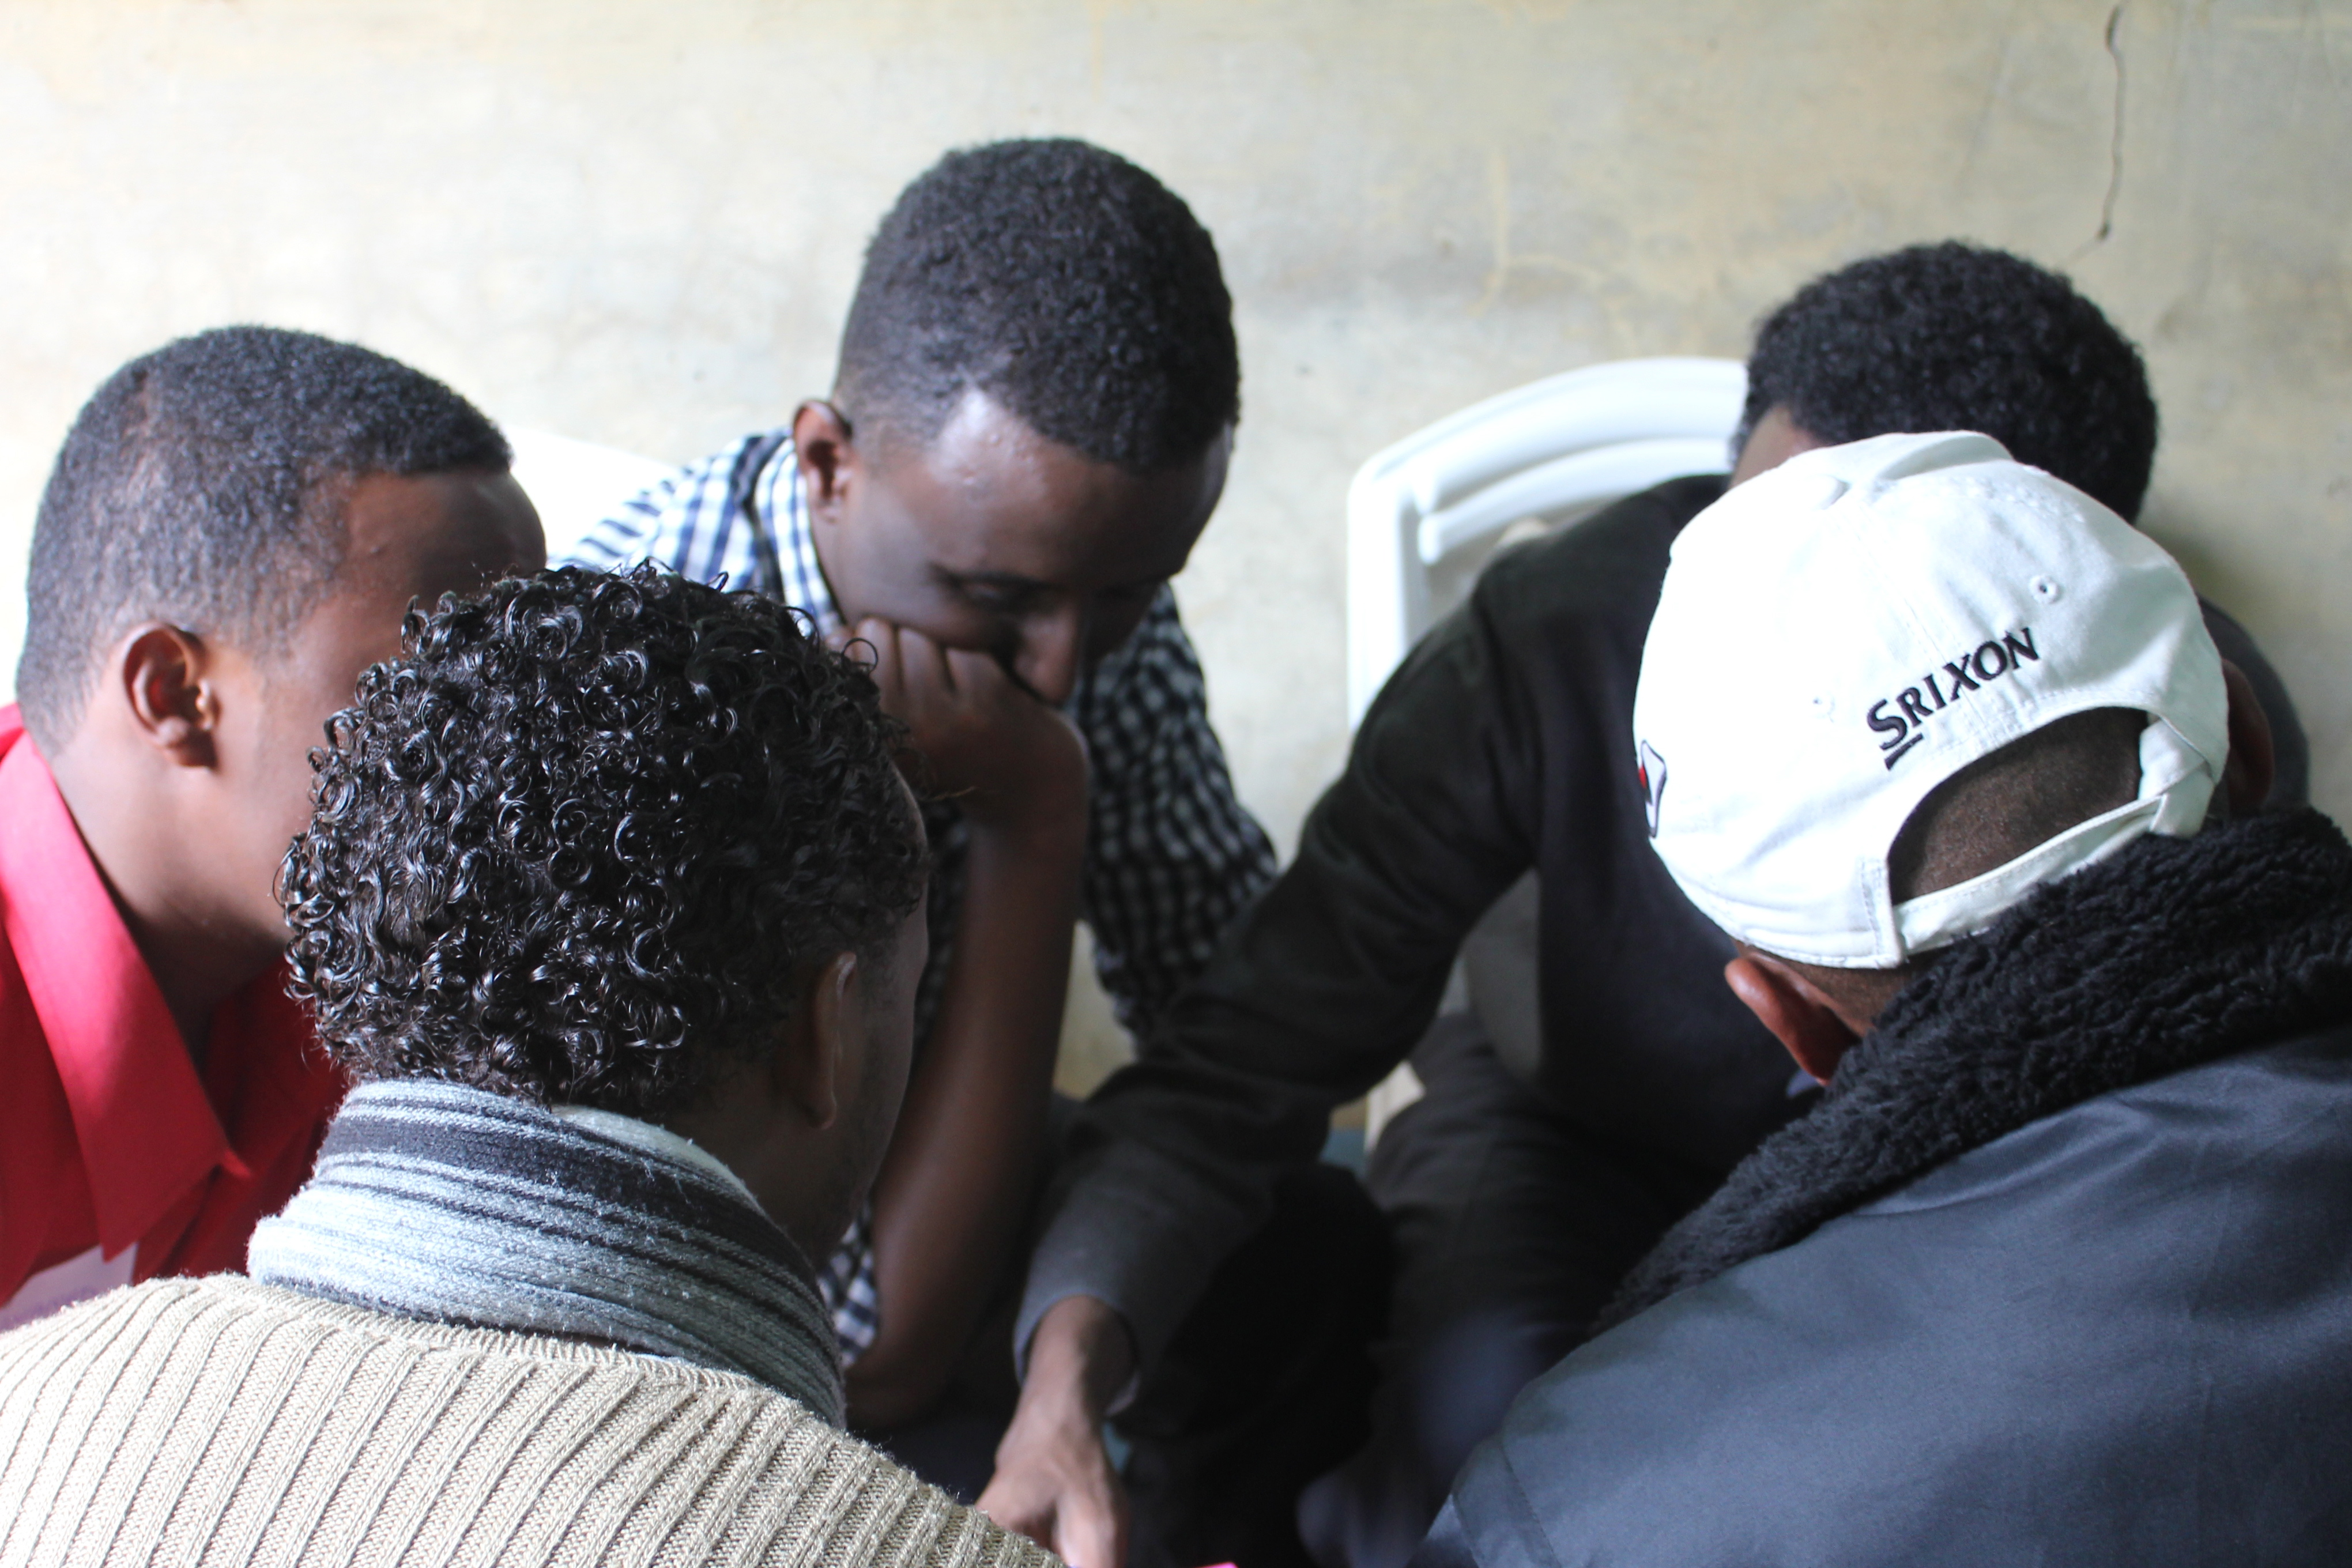
We must include men in the fight for gender equality
Many single young men take dangerous journeys to seek asylum, as a result of forced recruitment into terrorist groups; they face human rights abuses, including rape (Freccero et al. 2017; UNHCR 2017b).
“I saw my single Mum, who did so much to keep our family and community together in the camp while the men just sat around, then she got constantly put down and shut out of meetings with UNHCR and NGOs by the men. It made me very angry”.
(Male refugee youth representative from Sudan, November 2017)
Notes:
Does the group have other examples of issues which particularly impact on refugee men.
How do you think young men might feel, seeing their mothers and sisters treated so badly?

Slide 6
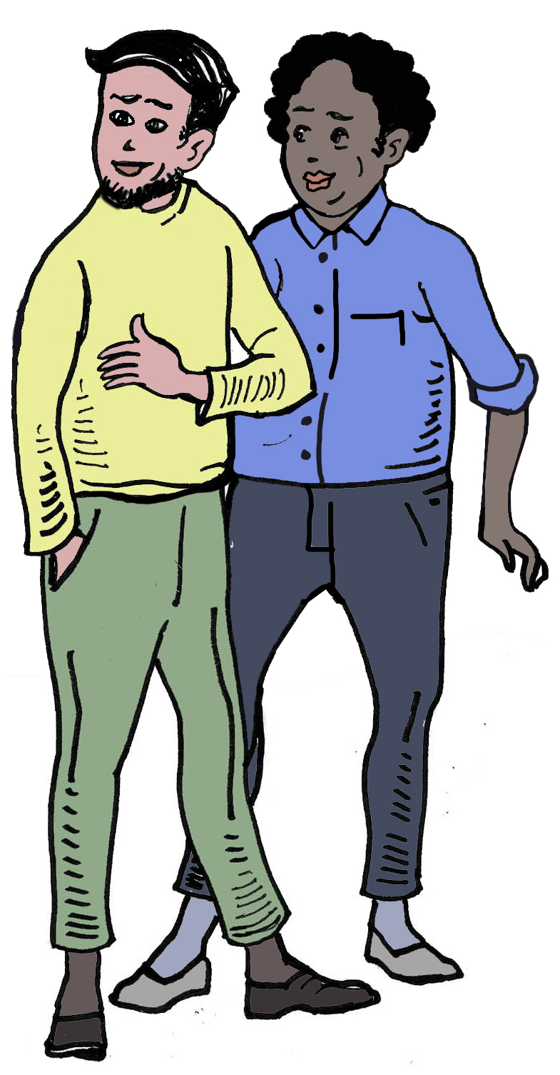
Exercises for working with men
All of the exercises which can be used when working with women and girls are also applicable when working with men, including when examining SGBV.
Notes:
Power and Privilege, Module 10, is also extremely useful for exploring Male Privilege

Slide 7
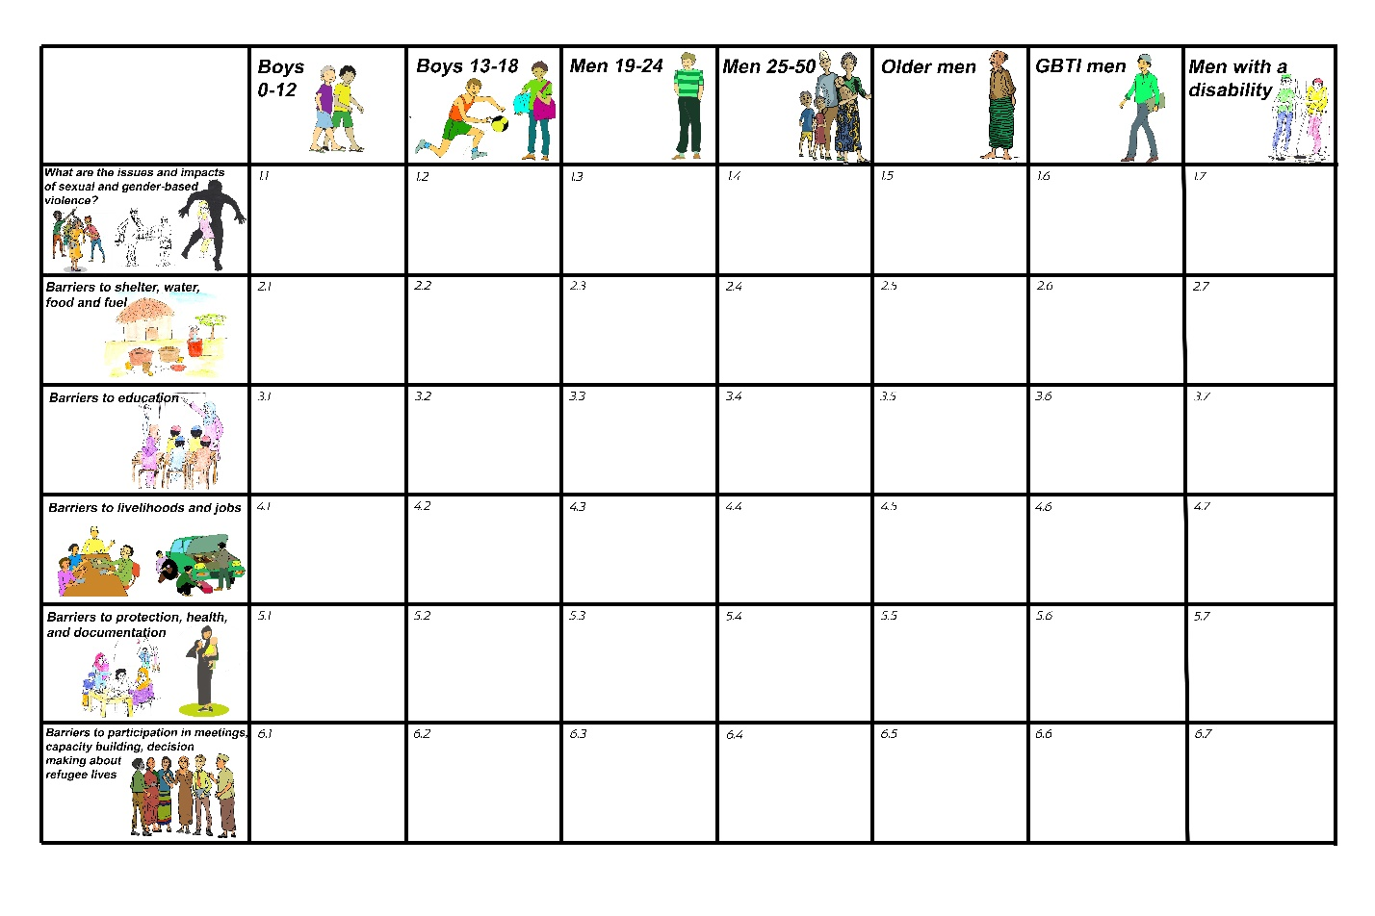
Use the Men’s Matrix
Notes:
If you have not yet used the Matrix, please see The AGD Matrix Exercise Reciprocal Research Session in Additional resources
If you have already used the matrix exercise focusing on diverse groups of women, it is very useful to compare and discuss the answers in the men's and women’s versions.

Slide 8
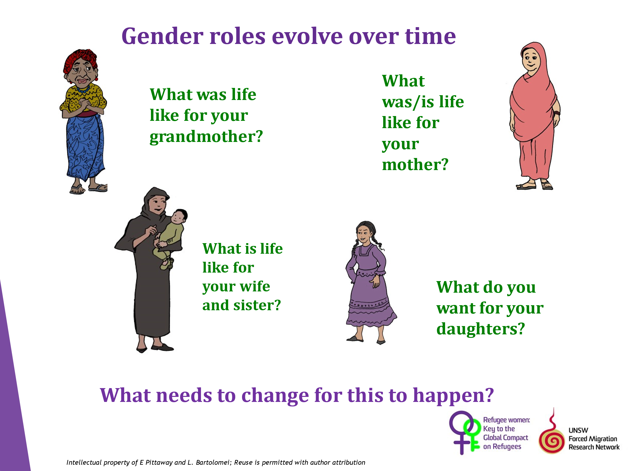
Challenging Cultural Roles
Notes:
This is one of my favourite gender exercises, which challenges cultural gender stereotypes.
It is very simple.
It works best if you begin by sharing the story of your family if you are prepared to do this.
For example, I was born in England in 1947. My Grandmother was a live-in servant in a big house and left school at 12.
She was determined that her children would be educated, and get good jobs.
My mother won a scholarship and got a good job, but was made to leave work when she married my father.
I also won a scholarship, but my father would not allow me to leave home to go to university. I did all my study as an adult, part time.
My daughter went straight to University after school and has the freedom to do what she chooses with her life – yet we all come from the same culture!
Give the men a sheet of paper divided into four and ask them to list the answers to the questions on the slide.
In over twenty years I have never worked with a group who did not want a better life for their daughters than their grandmothers had.
To complete the exercise, discuss what needs to change.

Slide 9
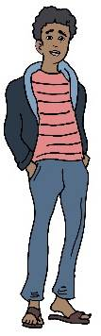
How refugee men might be able to assist in the fight for gender equality
What are some of the reasons men resist programs aimed at creating more equality for women?
What would be the worst things that could happen if women gained more equality?
What would be the benefits to the community if women and girls did gain more equality?
What needs to be done to address these fears and encourage gender equality? What support, and resources would the groups need to do this?
Who can help with this?
What would be the positive outcomes of this happening?
Notes:
If time permits, use these questions as a large group brainstorming exercise.

Slide 10
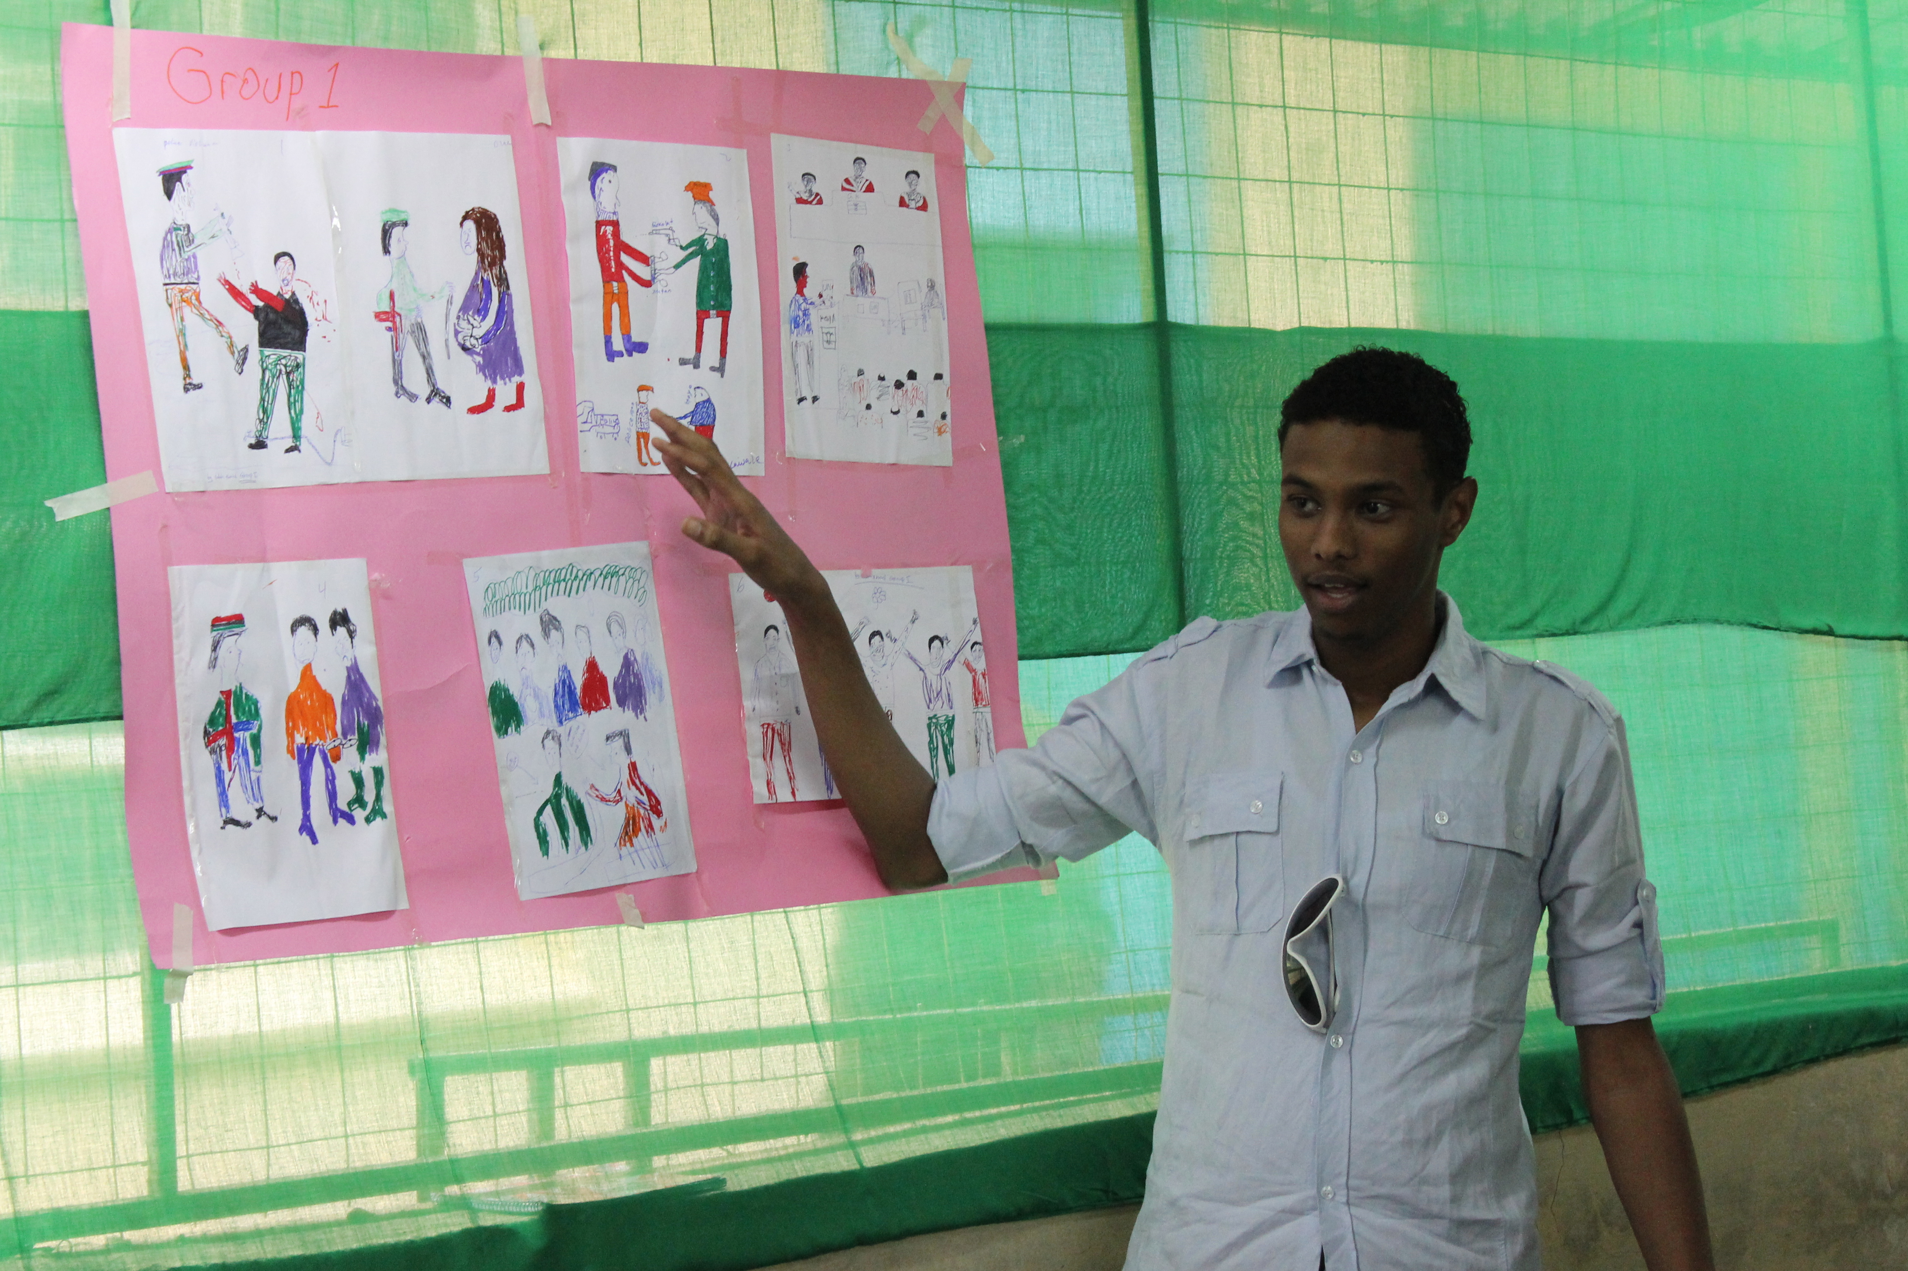
Suggested storyboard questions to use with men
What are some of the barriers experienced by refugee men and boys in having their voices heard?
How does this make them feel?
What is the impact of them not sharing their knowledge and experience?
What needs to be done to address these barriers,
What support, and resources would the groups need to feel confident to speak out?
Who can help with this?
What would be the positive outcomes of this happening?
Notes:
This is an excellent way to explore ways in which to foster men's participation in the fight for gender equality.
If you have not completed the storyboarding exercise, Please see Reciprocal Research, Session 6 in Additional Resources

