Slide 1

COMMUNITY CONSULTATIONS USING RECIPROCAL RESEARCH:
Session 2
CONFIDENTIALITY
Notes:
This session addresses the concept of confidentiality and is designed for facilitators and participants to agree on a set of principles which respect privacy and provide a safe space for sharing issues.

Slide 2
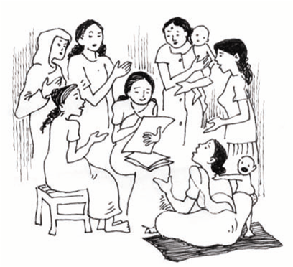
Discussing confidentiality and coming to
an understanding with the group about what
this means, is a critical part of the methodology
It helps to build trust and creates an environment in which we feel comfortable to talk about difficult issues.
Notes:
Activity - Presentation and group discussion
Introduce the idea of Confidentiality
Go around the group asking participants what “confidentiality” means to them, in relation to a number of different settings, such as between friends, in families, in community, between refugees and service providers.
Ask them for examples of what happens when confidentiality is broken. How do people feel when this happens.
Prepare an example of what happens when confidentiality is broken. Perhaps the facilitators can role play a situation where confidentiality is broken. This can be done effectively using mime.
Discussion Points
Talk about the importance of confidentiality in this training
If people believe that they can share things in confidence it builds trust.
Good leaders respect confidentiality.

Slide 3
Confidentiality means that we all promise not to discuss anything we hear in this training without the permission of the person who tells the story.
It is a promise which we give to each other – the trainers, the participants, service providers, interpreters and staff.
If we all agree to do this, then we can learn to trust each other and discuss things openly, because we know it will not be spread around the community or used in reports without
our permission.
Notes:
Discussion Continued:
Discuss what confidentiality means to people when they seek help from service providers. What do they expect and what do they fear?.
Ask for agreement from the participants to keep all discussion in the training sessions confidential. Ask them to describe what this means.
What are they promising when they agree to confidentiality.

Slide 4
Photographs and Videos
Confidentiality must be extended to the use of peoples images and videos. This is particularly important on Social media.
A quick group verbal permission is not enough. People sometimes do not understand the implications of being identified as taking part in trainings and workshops. There have nben reprcussions inb many countries.
Always check before photos are used, and pixelate or remove pictures if permission is not clear, or withdrawn.
Ask participants not to use social media without the explicit permission. This applies to NGO’s, interpreters and all stakeholders

Slide 5
Group Confidentiality Agreement
We the participants and facilitators of this “Community Consultation using Reciprocal Research” training agree to keep confidential any of the stories shared by individual participants during this training.
Date:
Name Signature
Notes:
Activity Continued:
Introduce the sample agreement on the slide
Prepare a confidentiality agreement with input from the participants and write it on a large sheet of flip chart paper.
In the next break, if necessary ask the interpreters to translate it into all relevant languages.
Ask every person in the group to sign.
If there are interpreters present also ask them to sign.

Slide 6
Confidentiality Agreement
We, “the trainers” representing the UNSW Forced Migration Research Network and [your organisation’s name] promise that any information that we gather as part of this training will be totally confidential.
We guarantee that any written reports, photographs and film produced from this training will not be published or shown without written permission from the [..…] communities involved. No names will be used in any reports from this training.
If this information is used with your permission, you will be sent copies of the reports and multimedia presentations within two weeks of their publication.
Trainers’ signatures: Date:
I understand and accept this agreement.
Participants’ signatures:
Notes:
Prepare a Confidentiality agreement for facilitators before the session and have it ready for signature on the wall.

Slide 7
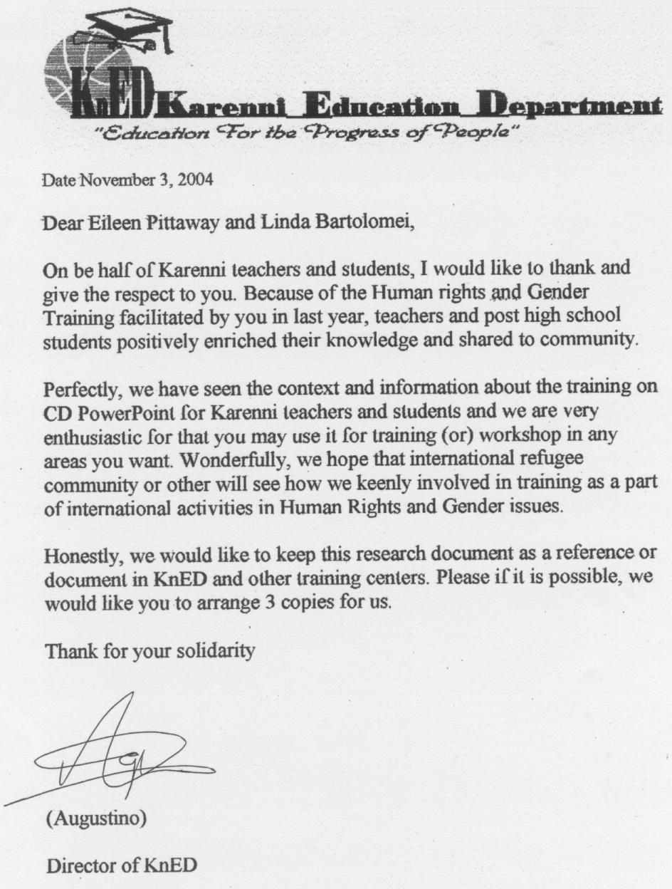
An example of a permission letter from a Refugee Organisation
Notes:
Note to Facilitators:
This is an example of a letter from a group giving their permission for the use of the materials from their training.

