Slide 1
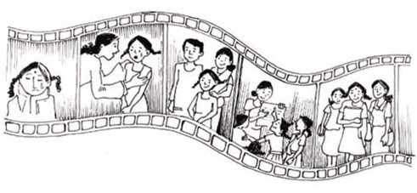
COMMUNITY CONSULTATIONS USING RECIPROCAL RESEARCH: Session 5:
The Matrix Exercise
Notes:
Notes to Facilitators
The story board technique involves asking participants to prepare six panels, using drawing, or collages of pictures.
The issues to be covered in the story boards can come from the storytelling, or from human rights training, or from any other source that is meaningful for the participants.
The six panels represent 6 stages of a process of analysis and you need to decide before the exercise what the stages are.
This can be done either by the facilitator or with the participants.
The six stages MUST take participants through from describing a problem or issue to be worked on, to a solution and an outcome.

Slide 2
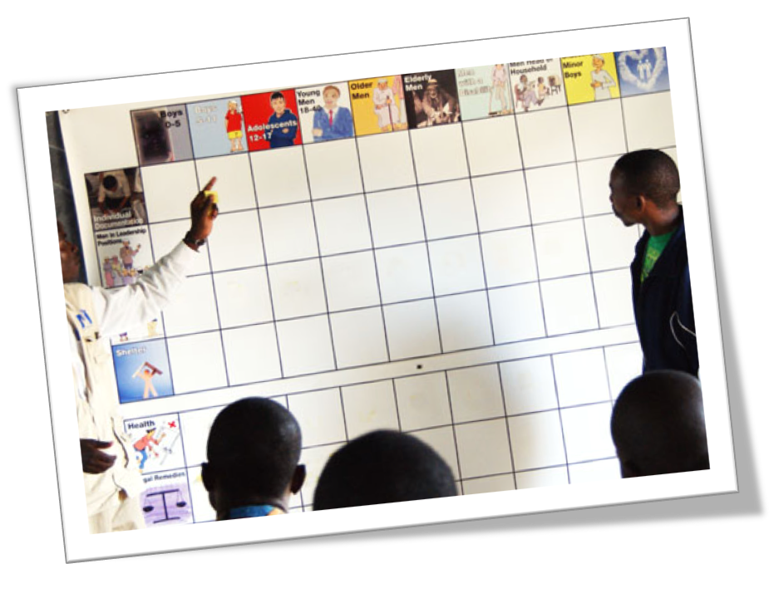
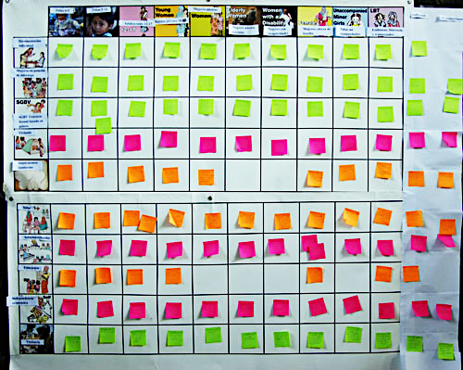
The Matrix exercise helps to explore ways that different groups in the community are affected by different issues. It focuses around discussion of each section of a complex matrix of issues of concern to the community.
Notes:
In order to run this exercise, you need to design a matrix. You need to be very clear about the information you wish to collect before you do this. The Matrix can be prepared in advance if there is already a clear agenda for the consultation
or
If the consultation is more open, the matrix can be prepared by the facilitators in a break, building on the outcomes of previous sessions, or can be constructed with participants.
If a matrix has been pre prepared, it can be adapted with the participants.
As in all stages of the consultation, you must carefully record all of the discussion as the participants post their “notes” onto the matrix. This will be an important part of your data, or “evidence” collection.

Slide 3
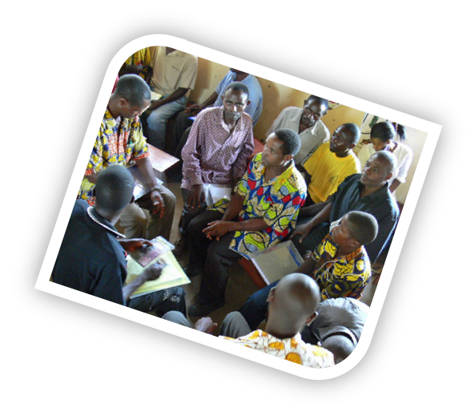
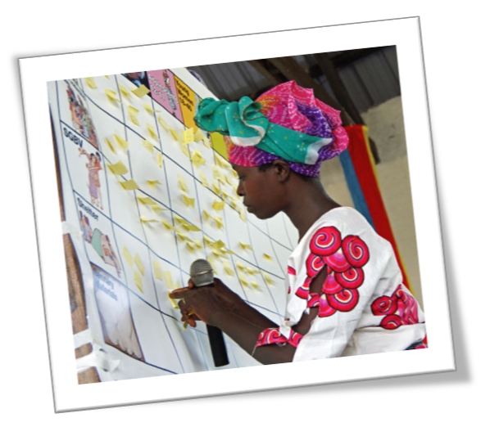
It is a method that facilitates an in-depth exploration of some of the issues identified in the discussion on human rights or in the stories shared by participants.
It builds a more detailed picture of how different groups in the community experience human rights, and what the main issues of concern to the community are.
Notes:
This exercise allows facilitators to get a sophisticated understanding of the experiences of participants in various areas of their lives.
It gives participants an opportunity to fully explain the details of their experiences.
It provides evidence for advocacy for change.

Slide 4
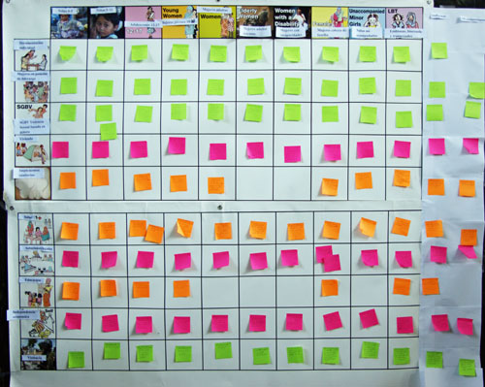
The matrix is a table of different ‘issues of concern’ or human rights (shown on the left side of the matrix), along with different categories of people in the community (shown along the top of the matrix).
In small groups, participants discuss the different ways that each issue of concern impacts on each category of people. They write their responses on ‘post it’ notes, one for each issue they want to put in box in the matrix.
Each small group presents the points they have discussed to the rest of the participants, adding their sticky notes to the correct box on the matrix.
There are often many issues for each box.
Notes:
In the example in the pictures, we were working with refugee women and girls. In the horizontal access we examines issues of concern as they related to:
Babies
Young girls
Adolescents
Young women
Mature women
Old women
Women with a disability
Single parents
Unaccompanied minors, and
Lesbians.

Slide 5
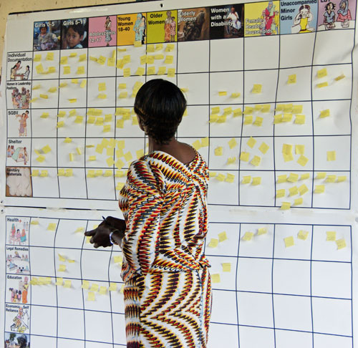
Notes:
In the example in the pictures, we were working with refugee women and girls.
On the left side we were looking at these issues for each of the diverse groups.
1. Individual Documentation
2. Leadership
3. SGBV
4. Shelter
5. Sanitary Materials
6. Health
7. Legal Remedies
8. Education
9. Economic Self reliance
10. Violence

Slide 6

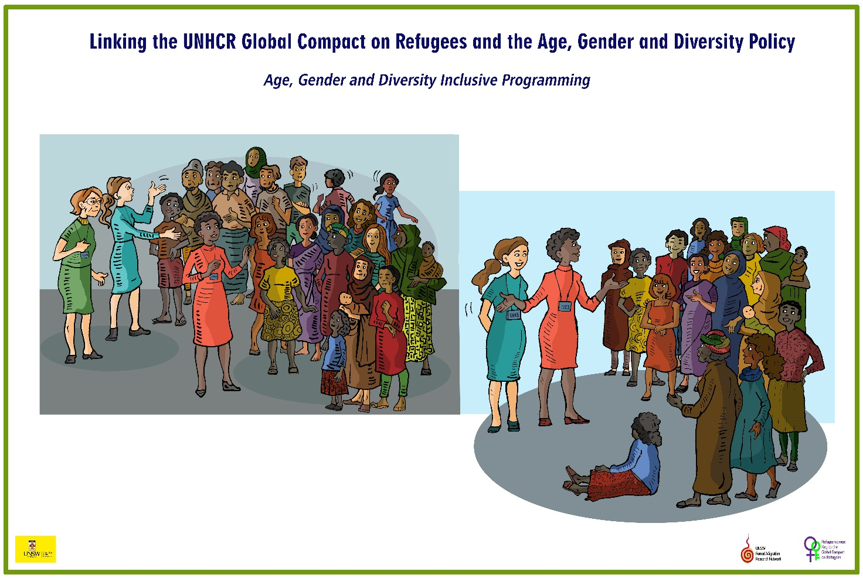
The matrix developed for this project looks at the barriers women and girls face in achieving the aims of UNHCR’s Age Gender and Diversity policy, including the 5 revised Commitments to refugee women.
Notes:
You do not have to use these headings. They are just an example.
Shape the exercise to suit the group you are working with and the aim of the consultation.

Slide 7
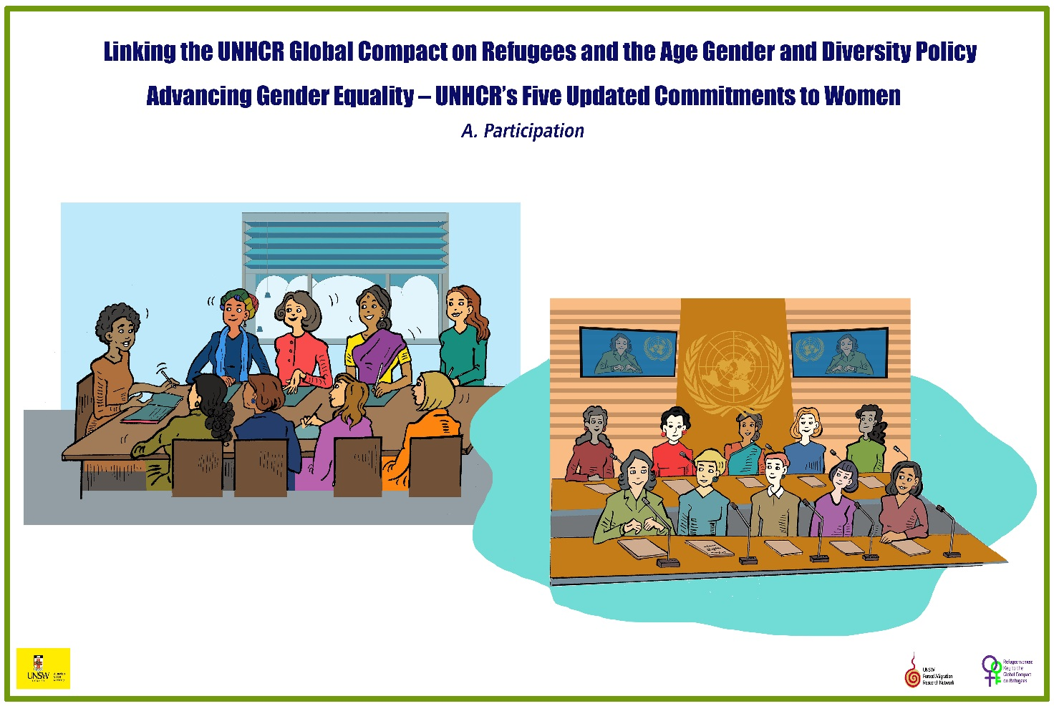
Participation

Slide 8

Registration and Documentation

Slide 9
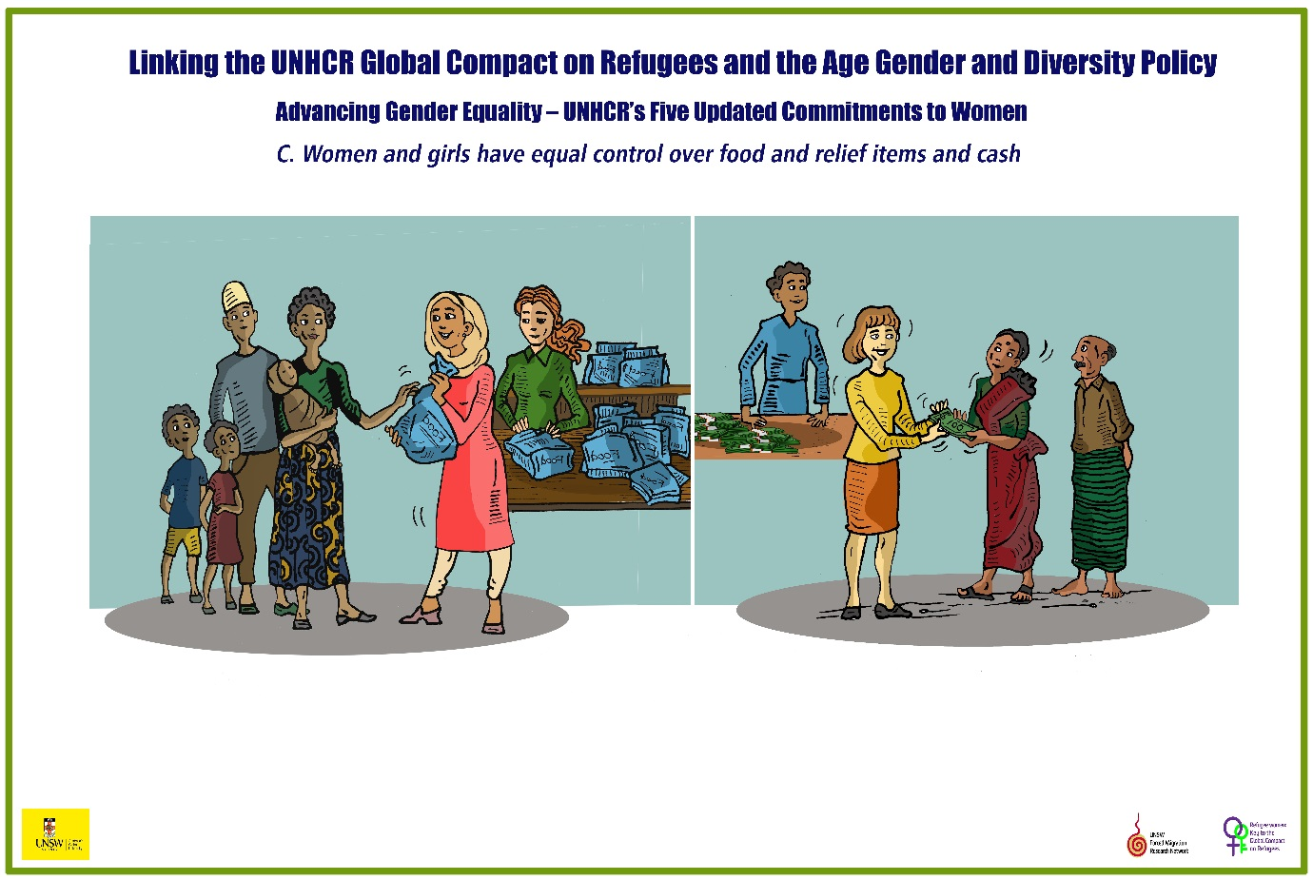
Equal control over food, relief items and cash

Slide 10

Work, Education and Health Services

Slide 11
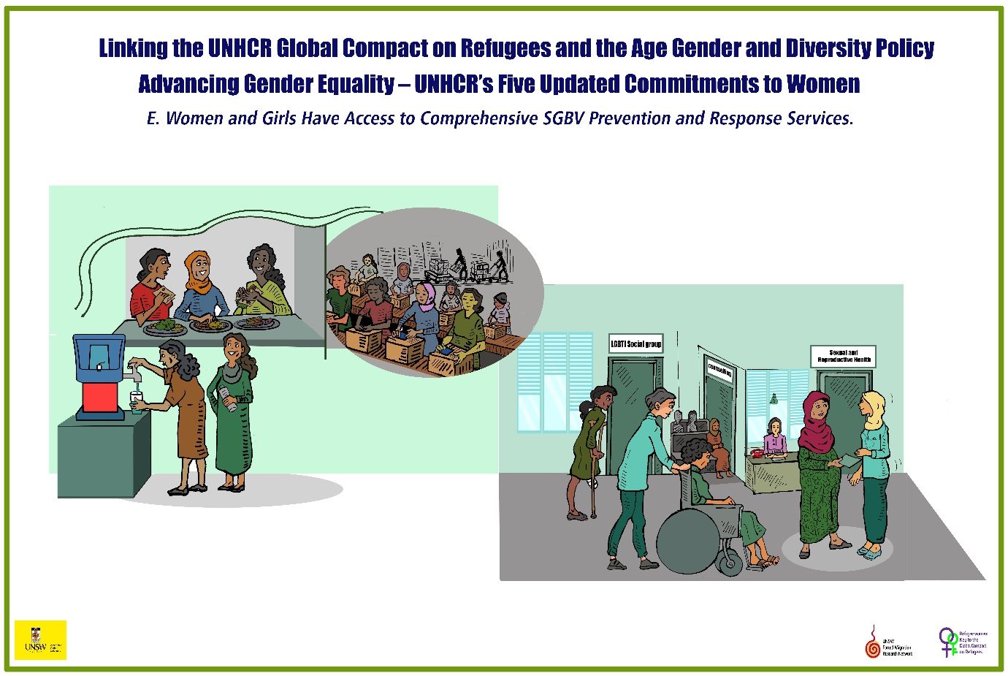
SGBV Prevention and Response

Slide 12
Matrix Group Exercise
Divide participants into small groups, and depending on time, ask them to work with all categories, or two or three sections of the matrix, ensuring that all sections are covered. to work on.
Their task is to identify the particular barriers faced by each different group of women and girls along the top, to the human rights on the left hand side
Notes:
You do not have to work on these issues.
Develop the areas to be covered in the left hand bar to suit the needs of the participants, and the reason for the consultation.
You will need to do this before the session starts.

Slide 13
Documentation
Have one or two people carefully documenting what participants say as they post their notes onto the matrix.
This is an important part of your evidence about what is happening in any particular site.
Notes:
Work with the documenters before the session, so that they understand that thy must record as closely as possible what participants say. It is not the role of the documenter to edit or screen the comments, even if they do not agree with them.

