Slide 1
Refugee Women and Girls, the Key to Implementing Commitments made in the Global Compact on Refugees
Session 2
What do we mean by
‘Gender Equality’?
Developed by Eileen Pittaway and Linda Bartolomei, 2023 The Forced Migration Research Network UNSW
Notes:
Facilitators Notes
This module presents material which is a pre-requisite for Session 3, Major Gender based Social Barriers For Women Refugee Led Organisations, (WRLOs).
If the group with whom you are working are familiar with the concept of, and application of the principles of gender equality in their work, you do not need to use it.

Slide 2
Aim of the session
The aim of the session is to provides a base-line against we can use when discussing gender equality in the context of refugee women and girls.
Notes:
The basic material can be covered in 2 hours, with the use of two short exercises. A more thorough coverage and analysis can take 4 hours, using additional exercises provided, or through accessing some of the excellent gender equality Training to be found online.

Slide 3
What is gender?
In this resource kit, we are referring to gender as
social and cultural attributes and roles assigned to women and girls, men and boys.
It is not about the biological sex we are assigned at birth, but the way in which this shapes our lives
It examines the social relationship between men and women, and how this affects our place in family and community, the kind of work we do, who makes decisions.
Notes:
Please see the background readings if you need more information when presenting these concepts. The slides are designed to foster group discussion and brainstorming of ideas.

Slide 4
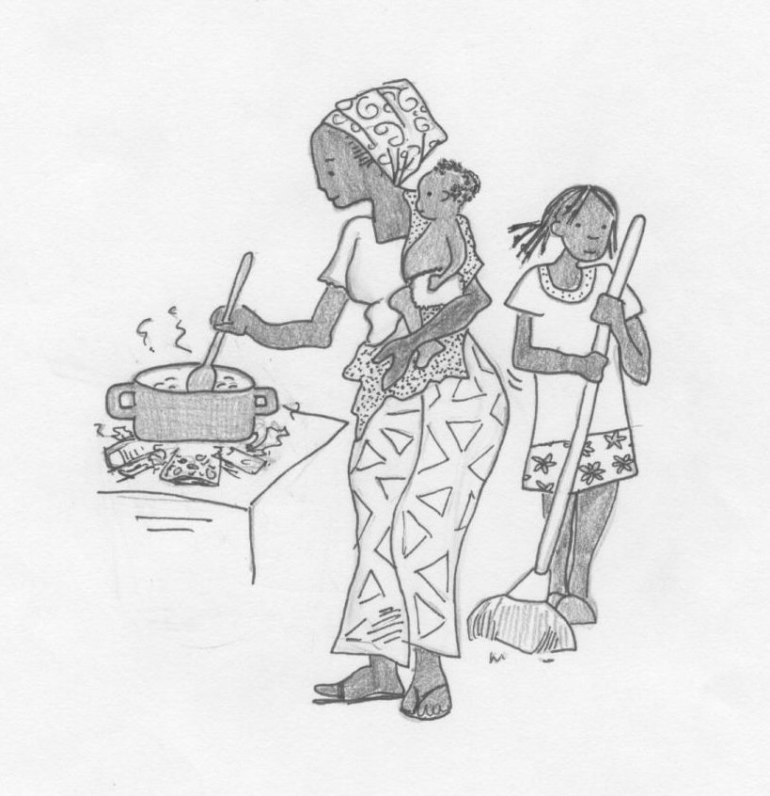
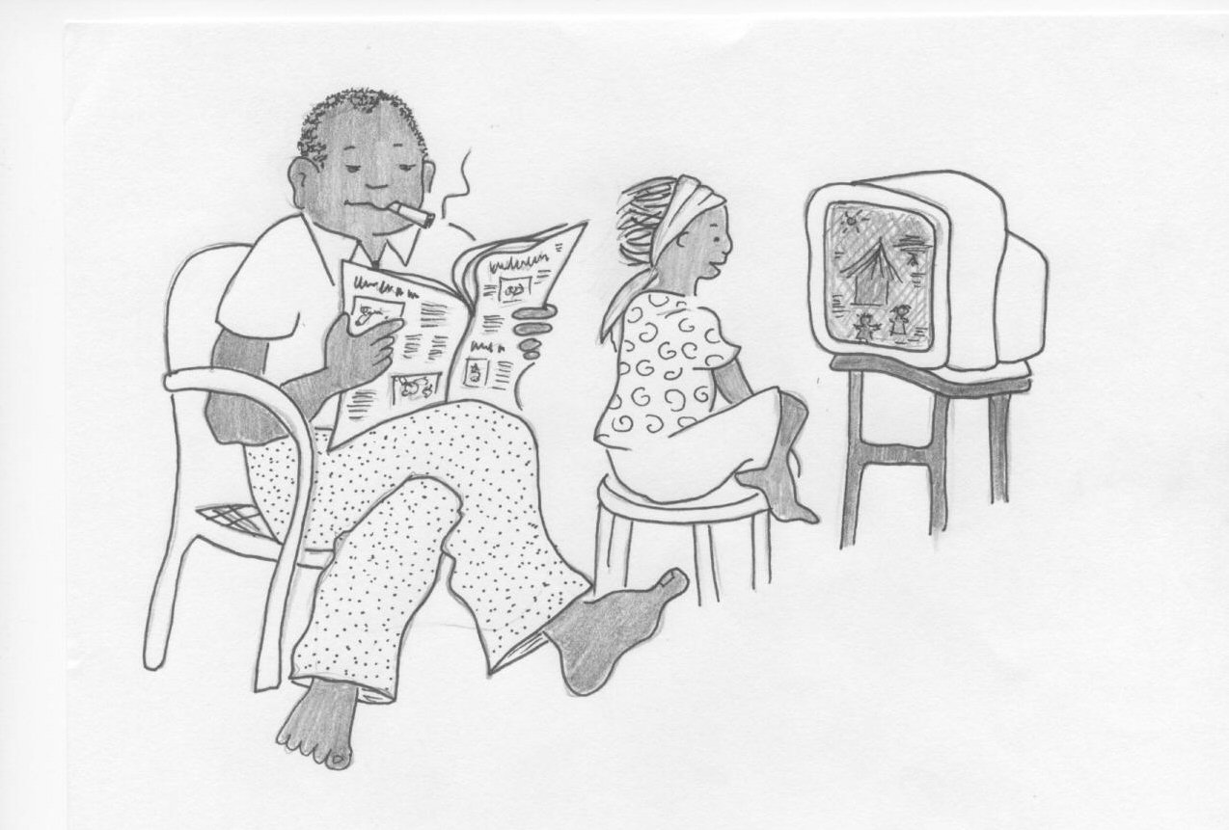
Gender…
is about beliefs, assumptions, expectations, and obligations regarding ‘men’ and ‘women’ – what they do, how they look, how they behave, what they have access to. Gender differences are imposed by society.
Notes:
If you have time, discuss the gender differences experienced by the participants. How does this differ from the people with whom they are working, fro example the refugee and displaced communities?

Slide 5
How does this affect us?
Norms and values about men’s and women’s roles inform how we relate to each other as human beings.
Expectations about gender-related behaviors are also perpetuated by social institutions: the household, the community, the state, legal structures, schools, workplaces, in aid, development and assistance programs and within the UN itself.
Notes:
As facilitator can you draw examples of this from what the participants have shared.

Slide 6
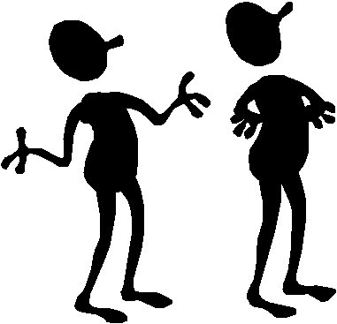
Gender and power
Gender is about how power is used and shared
It influences economic, political, and social roles, interactions with others and our needs.
It determines who can access resources and decision making within a society.
Notes:
Read through slide with the group
Ask participants if they agree or disagree with these statements, and if they have any questions

Slide 7
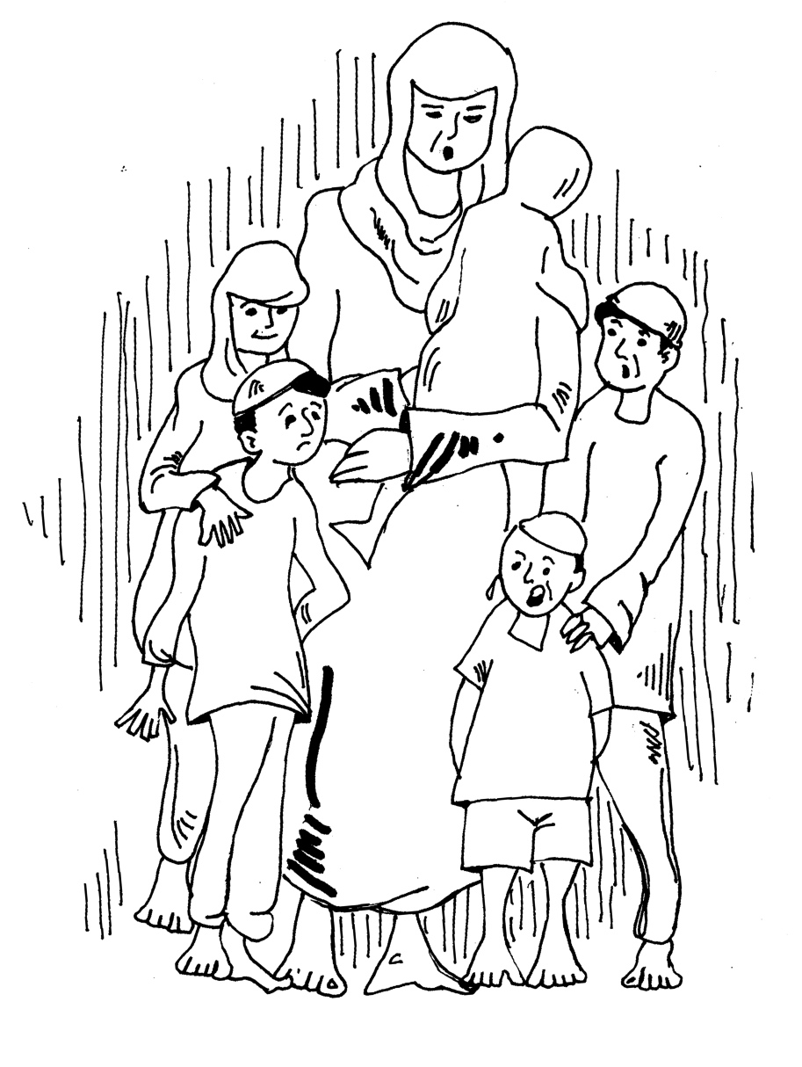
Public/Private Divide
Women have less power because their biological ability to have children and the associated social roles often confine them to the home and family.
This often excludes them from decision making and leadership roles outside the home.
Notes:
Ask participants what implications this divide might have for women’s ability to participate in all walks of life, decision making, in WRLOs.?
Could it be linked to SGBV?

Slide 8
Gender Inequality
Differences in access to resources and decision-making based on gender, results in Gender Inequality
Notes:
Ask the group to brainstorm some of the things, both personal and structural which lead to gender inequality.

Slide 9
Patriarchy and gender inequality
Gender differences based on patriarchal values that privilege male power and ‘masculinity’ over ‘femininity’ result in gender bias, inequality and systematic disadvantage and discrimination for women and for those who do not comply with social expectations about male and female accepted roles, appearance and behaviour.
Universally, men have more power than women
Notes:
This is an uncomfortable truth for some people. If there is disagreement, we suggest you just politely hold your ground and point to the enormous amount of research from both the global south as well as the global north, done by men and by women which indicates it is true.

Slide 10
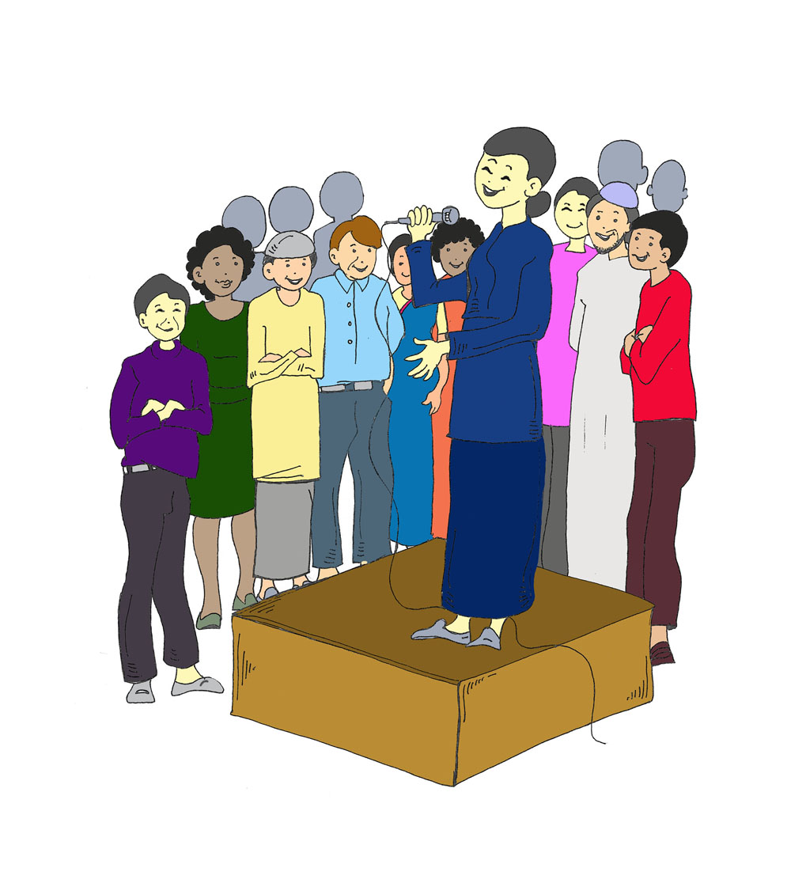
Gender & culture
Understanding and beliefs about gender roles are shaped by culture, religion and ideology
Ideas about gender are formed from childhood and are often unconscious
We have assumptions and expectations about our lives and the lives of others that come from our own ideas about gender and gender roles –
Gender is about our IDENTITY
Gender ‘norms’ are closely tied to gender identities and sexuality
They are not “fixed” – and change over time and vary between places.
Notes:
Boys and girls are taught though gender socialization the type of sexuality and gender identity that is accepted in their communities. Working with men and boys to express their sexuality in healthy ways can lead to more equitable attitudes and practices affecting both men and women.
Gender and sexuality norms are often “policed” by individuals, and when some individuals do not fit into dominant gender or sexuality categories, they can face violence and discrimination. This can apply to “effeminate men” or people who are homosexual, bisexual or transgender. In order to reach real gender equality, we must first understand that gender equality is not just between men and women, but also between everyone regardless of their gender identity.

Slide 11
Gendered effects of Globalisation
Globalisation is inherently gendered and is ‘restructuring social relations on a large scale.’
Industrialisation, urbanisation and labour force flows have led to the feminisation of poverty, a rise in human trafficking, and the HIV/AIDS epidemic.
These effects are rooted in deep-seated patriarchal values and gender inequalities.
Notes:
Please see background readings for more information.

Slide 12
Exercise
Gender norms and inequality are maintained by social, cultural, economic, religious, legal and political systems
Identify the differences between men/boys and women/girls in one of the following areas:
Culture
Religion
Law
Access to Resources
Politics and decision making
Access to Power
Include examples from your own experience or from other situations you are aware of .
Notes:
This is best done as a small group exercise.
List the answers on Flip charts when the groups report back their discussion.
Summarise the exercise by noting the similarities, and the many layers and sites of discrimination which impact on gender inequality.

Slide 13
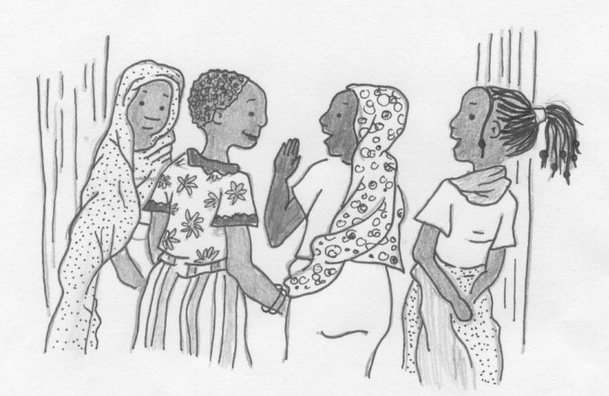
How do these differences in treatment create difficulties for women leaders?
How do we overcome this?
Notes:
This is an extension of the exercise, if time allows.

Slide 14
This is why Women have their own human rights convention.
Their rights are set out in the Convention to Eliminate Discrimination against Women (CEDAW)
(and the Universal Declaration of Human Rights)
Notes:
You will introduce participants to CEDAW. Link
It is important to stress that these rights are in addition to the rights contained in all other Conventions.
The next four slides provide a very simple introduction to CEDAW and are designed to trigger discussion, especially if the participants have had no previous exposure to the Human Rights Framework.
If available, distribute copies of CEDAW in appropriate languages

Slide 15
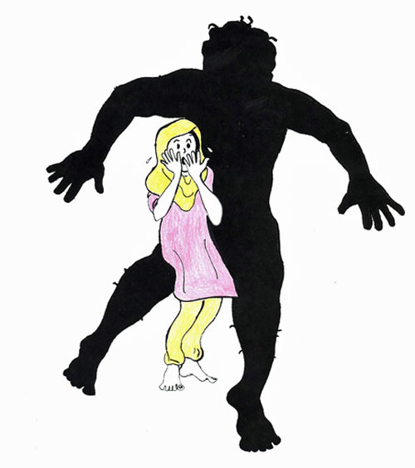
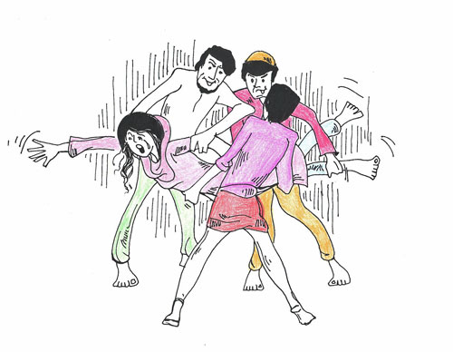
They Include
The rights of women to be free from sexual and gender -based violence and to live free from FEAR of sexual and gender- based violence
Notes:
Brainstorm
What is happening to the woman in this slide.
Discuss the fact that women should be free from the FEAR of violence, as well as from the act of violence.
This includes violence in the home and from social violence, it includes the violence of trafficking and forced prostitution.
Explain that these rights are detailed in CEDAW.

Slide 16

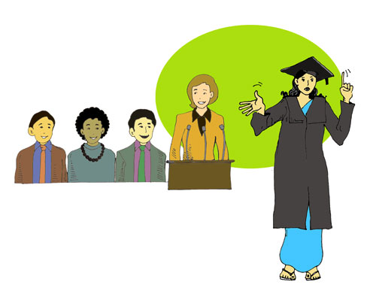
and
The rights of women to participate in decision making and political processes, and the right to life-long education.
Notes:
This slide can be used to trigger discussion about the rights of women to take part in decision making, in political processes and the right to life-long education.

Slide 17
Exercise
In small groups, share a story from your own experience where gender inequality has been a significant factor.
It can be a story from your personal life or your work. It can be your story or the story of someone you know or have heard about.
Consider what the gender issues were, what impact they had on the situation.
Suggest ways in which this could be changed.
Notes:
Women and girls from both the global north and the global south can relate to this exercise.
If you have a mixed group, as the men to think of their mothers, sisters, or women friends, and identify a story of something they have witnessed.
Discuss the fact that women in less developed and more patriarchal societies often
Greater levels of inequality, but no-where are women truly equal. We are fighting fro ALL women to be equal to ALL men.

