Slide 1
Session 5:
Human rights are women’s rights
Refugee women in leadership:
Power through participation
Notes:
Introduction
In this session we will explore what is meant by the Human Rights Framework.
Participants will be introduced to a range of Human Rights instruments and conventions. The material is presented in two formats, one can be used with people who have had some previous human rights training, and who would like to explore the meaning and value of the human rights framework, especially for women from the economic south.
The second is a graphics presentation which is useful to use with people who have had no, or little exposure, to the human rights framework.
You might use either sets of materials or both. It has been found that some women with previous experience also like to learn the simple presentation as they see the value of using it themselves to explain the human rights framework to others in refugee situations.

Slide 2

What is the United Nations?
Notes:
Presentation
Explain that the United Nations is the closest we have to a World Government, and that International Law is the set of agreed principles which are intended to govern the conduct of nations which are members of the Untied Nations. There are currently 191member states of the United Nations. Important issues to cover are:
Unlike individual countries, or states the United Nations does not have a world army and it does not have any mechanisms for enforcing international law.
It is based on a system of trust and moral commitment to do the right thing. Sadly as we all know this often does not work.
The Security Council has the role of preventing and maintaining peace and resolving conflicts.
The Economic and Social Council has the role of setting standards for the wellbeing of all human beings. To do this it relies on a system of Human Rights agreements which governments are asked to sign and incorporate into their own domestic legal system. Unfortunately we know that the United Nations is often unable to prevent or solve conflict, or to ensure the wellbeing of citizens in all countries.
While many criticize the United Nations for being ineffective, we must also realize that it is the servant of the countries which are members, totally dependant on them for funding. In fact United Nations Agencies do amazing work and the world would be a much harsher place without the United Nations.

Slide 3
What is the human rights framework?
The United Nations has produced many international conventions, declarations and legal documents which list our human rights.
These laws and documents together make up the human rights framework.
When governments sign these conventions and documents they are agreeing to respect these human rights.
Notes:
Discussion continued:
Provide the participants with a brief overview of human rights principles.
Explain that there are many human rights conventions, laws and declarations which have been produced by the United Nations system which outline our human rights. This has been done with the support of NGOs as well as governments. Together these conventions and declarations make up what we call the human rights framework. When governments sign these conventions and laws they are committing to an international legal obligation to respect these human rights.

Slide 4
What are human rights?
These are the rights to which all people are entitled regardless of race, gender, religion, age or any other social characteristic.
They are universal – this means they belong to everyone.
Notes:
Discussion continued:
Elaborate on these points. Emphasize that human rights are universal – that means they are for everyone, not just for white men or rich women etc but for everyone, everywhere.
Challenge participants to consider groups who are normally excluded, such as prostitutes, homosexuals, people with a disability, people from minority religions.

Slide 5
What are human rights?
They are indivisible – this means that all human rights are of equal importance.
They are inalienable – this means that although someone may stop you having them they are still your rights.
Notes:
Discussion continued
Emphasise that rights are “indivisible” that means that all of the rights listed in the Universal Declaration, and in the two Conventions are of equal importance. For example without the rights to land then the rights of shelter and livelihood are also denied.
That they are “ inalienable” that is that no one can take them away from you – though in some countries governments and others stop people from accessing their rights, these are still their rights!
For simple and enjoyable game which illustrates these complex concepts, see notes for slide 22.

Slide 6
The Universal Declaration of Human Rights
Notes:
Note to Facilitators
Slides 11 – 23 use graphics to make a simple presentation of the human rights covered in the UDHR.
Explain to the participants that each slide presents a groups of human rights. Ask them what they see in each picture and list these onto the flip charts.
The suggested answers are listed in the slide notes.

Slide 7
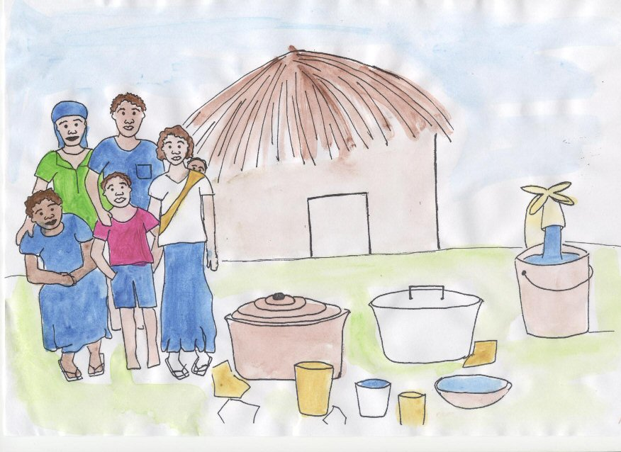
Notes:
This slide depicts the right to food, shelter and water

Slide 8
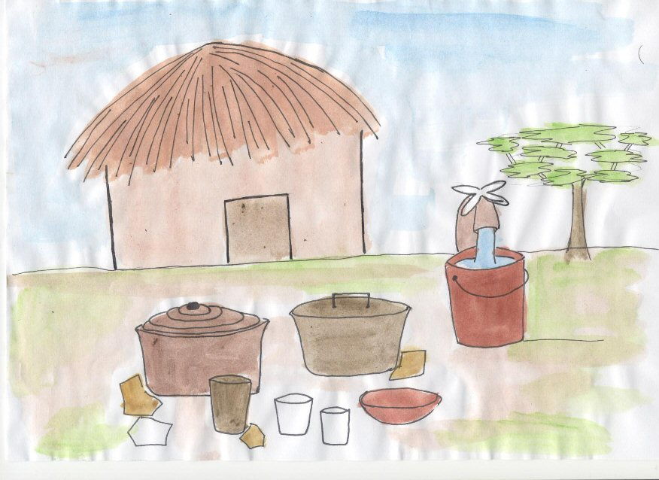
Notes:
This slide depicts the right to live with family in peace and security

Slide 9
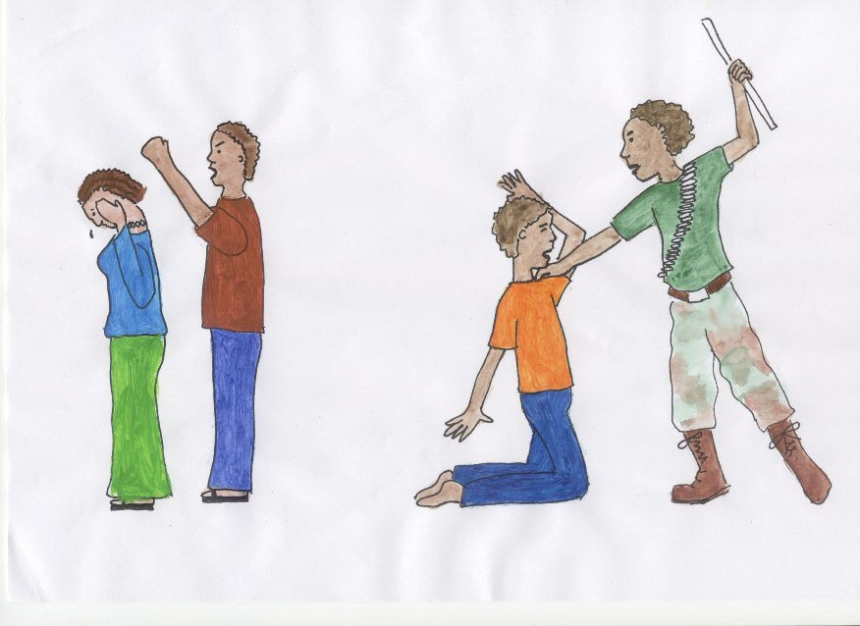
Notes:
This slide depicts the right to live a life free from any sort of violence

Slide 10
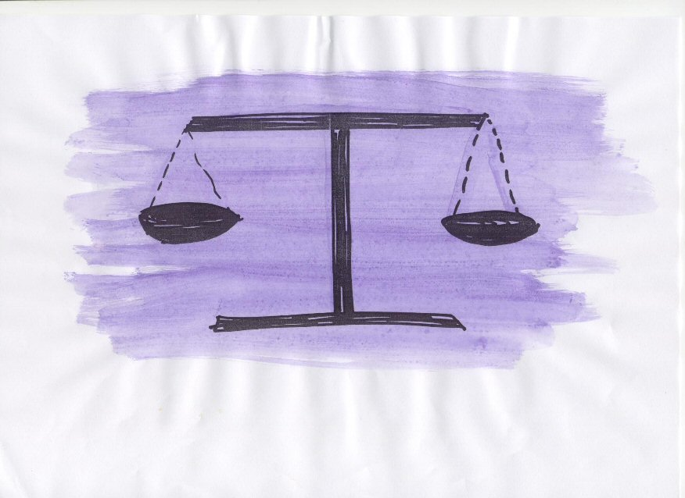
Notes:
This slide depicts the right to have access to and protection from the law.

Slide 11
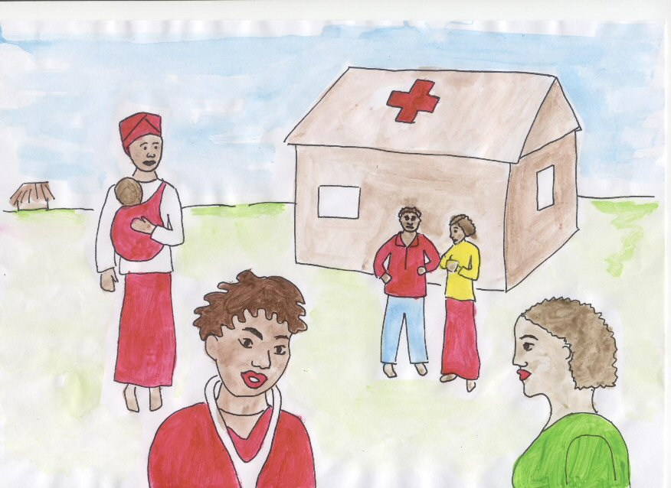
Notes:
This slide depicts the right to good health and health services.

Slide 12
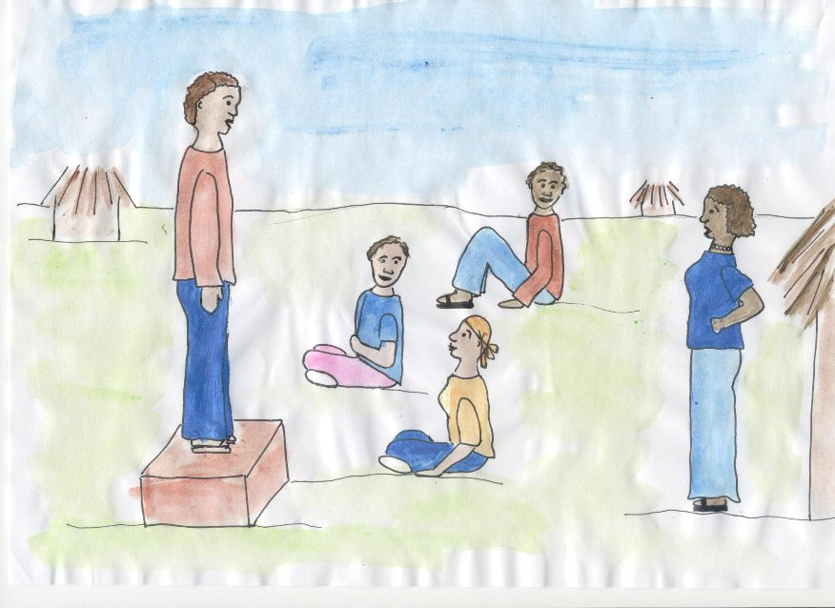
Notes:
This slide depicts the right to freedom of speech.

Slide 13
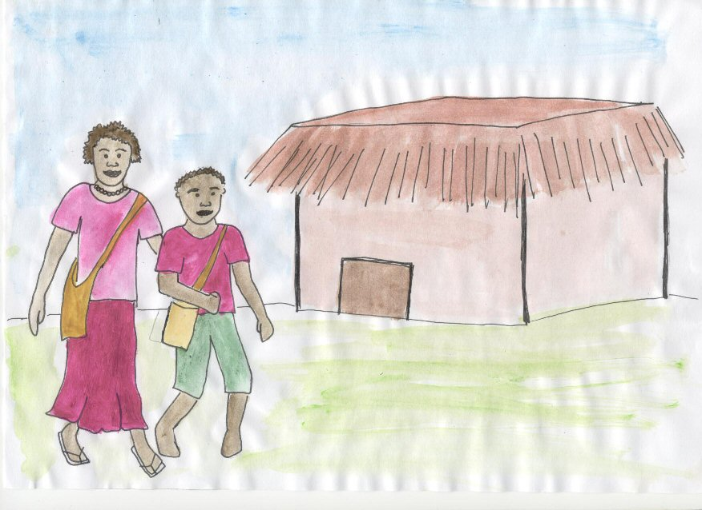
Notes:
This slide depicts the right to education for girls as well as boys, and also for life long education.

Slide 14
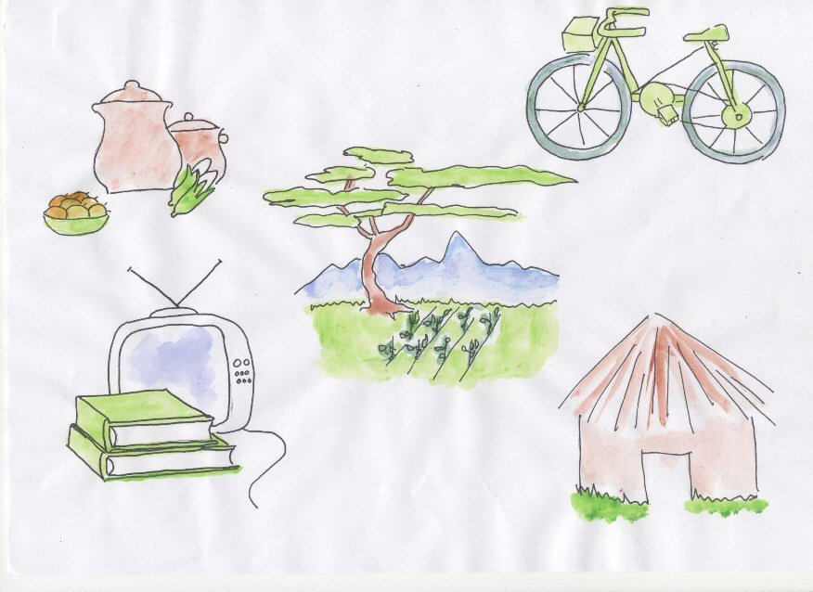
Notes:
This slide depicts the right to social security and access to resources.

Slide 15
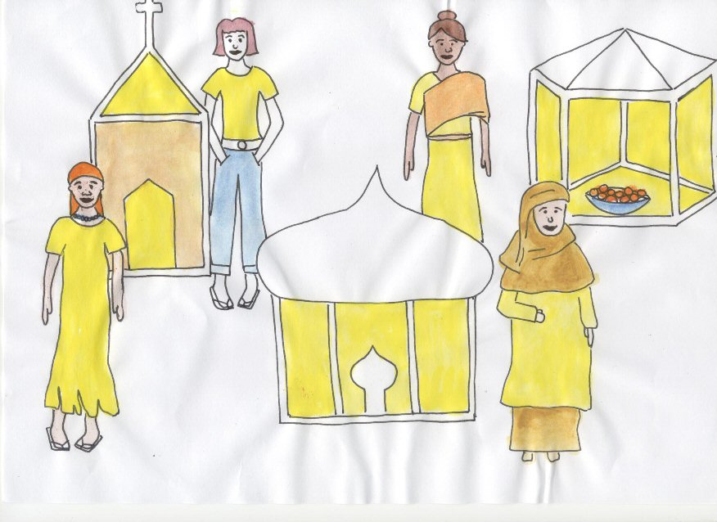
Notes:
This slide depicts the right to freedom of religion and religious expression.

Slide 16
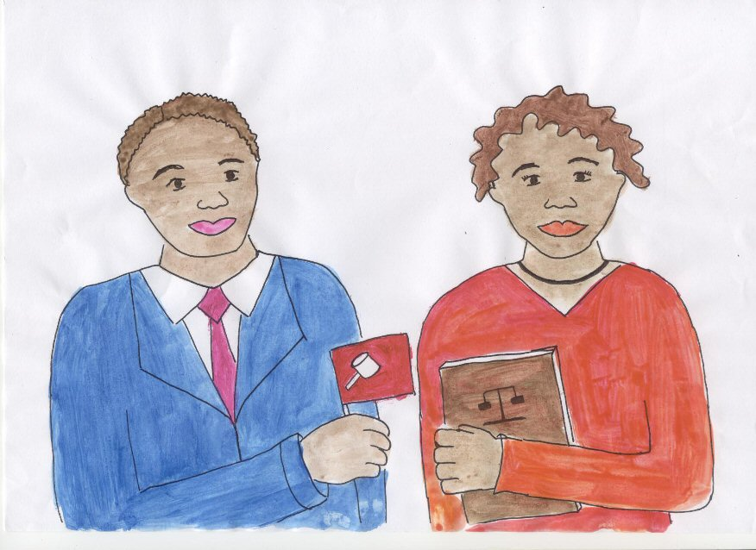
Notes:
This slide depicts the right to Political Freedom and representation by both men and women.

Slide 17
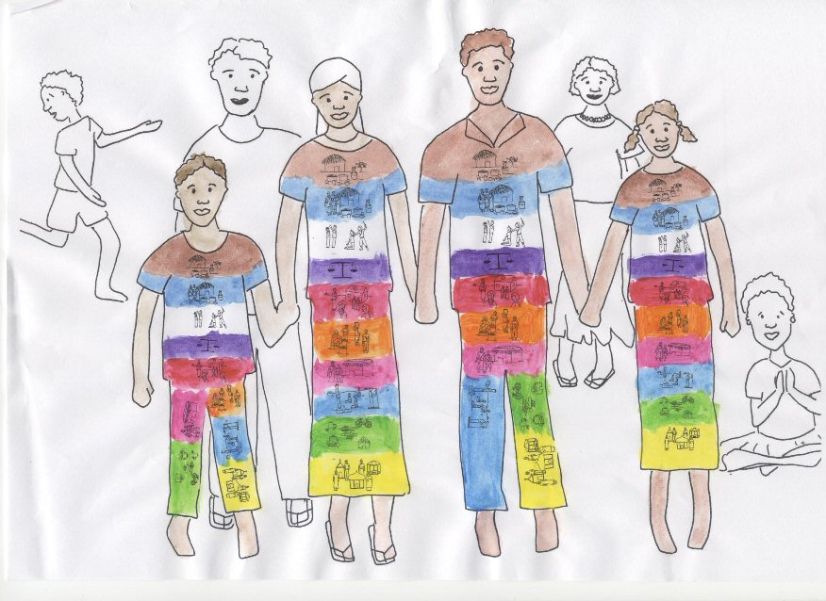
Notes:
By using the colours as striped on the clothing, this shows that all people are equally entitled to enjoy all of the rights.

Slide 18
Human rights groups
Food and water - Brown
Family - Purple
Freedom from violence - White
Justice and law - Gold
Health - Red
Freedom of speech - Blue
Access to education - Pink
Social security, shelter, income, resources - Green
Freedom of religion - Yellow
Political freedom - Gray

Slide 19
Human rights conventions
Universal Declaration of Human Rights
(UDHR)
International Covenant on Civil and Political Rights
International Covenant on Economic, Social and Cultural Rights
International Bill of Human Rights

Slide 20
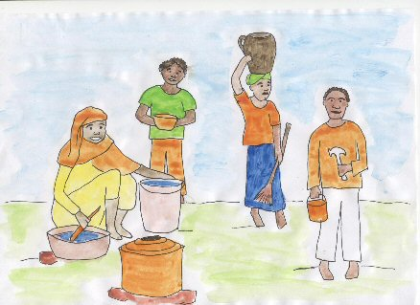
Economic, social and cultural rights
Food, water, shelter
Healthcare
Education
Family
Income and work
Religion
Cultural expression

Slide 21

Civil and political rights
Access to the law
Religious freedom
Political freedom
Access to income
Freedom from torture
Freedom from persecution
The right to seek asylum
Freedom of movement
The right to work free from exploitation
The right to life, security and freedom
The right not to be forced into marriage

Slide 22
Refugee rights
Refugees have rights.
All refugees have a right to full and effective protection from all forms of human rights violations.
Refugee rights are laid out in the 1951 Refugee Convention, its 1967 Protocol, and the Universal Declaration of Human Rights.
Notes:
Note to Facilitators
There will not be time in this training course to do an in-depth coverage of all of the Human Rights relevant to refugees and IDP’s in camps and refugee situations.
Women’s rights are explored in more depth on Day 2 of the training, linked closely to the role of women as leaders.
The following 9 slides are intended to introduce the idea that there are a broad range of human rights instruments and protections which are relevant to refugee women and communities and which they may wish to call on in their leadership roles.
If they are interested in pursuing these, it could be flagged for future training in the evaluation and training report.

Slide 23
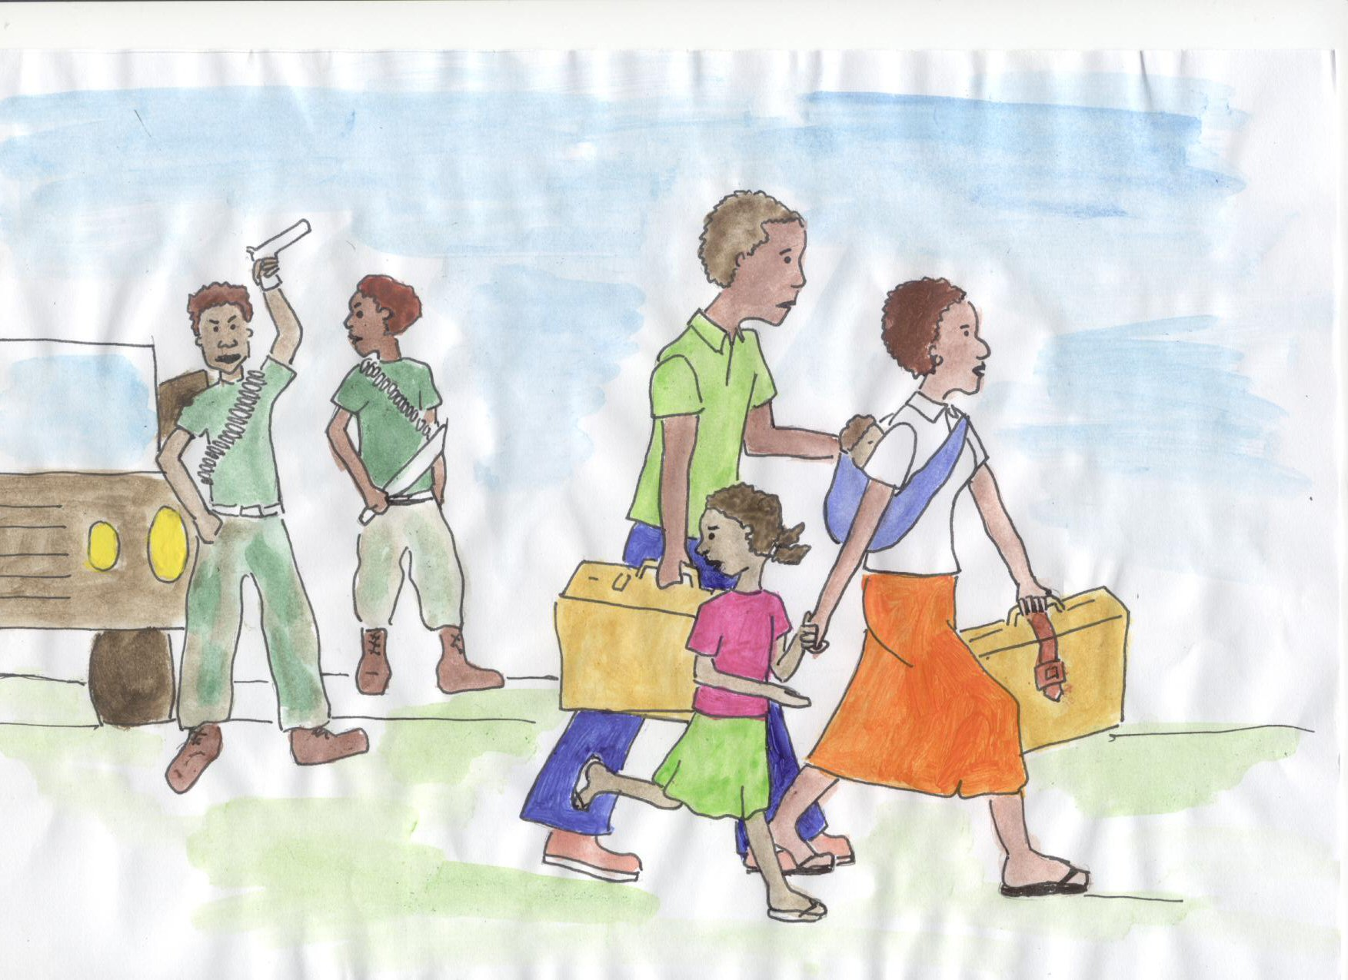
Who are refugees?
Refugees are people who are forced to leave their country due to persecution or armed conflict and are unable to return home due to fear of persecution.
Notes:
Mention that many IDP’s also fall into this category. If appropriate ask the participants to share some of the reasons why they were forced to leave their countries.

Slide 24
Children’s rights
Children’s rights are laid out in the Convention on the Rights of the Child.
Notes:
Note to Facilitators
It is useful to also make participants aware that people under the age of 18 are considered by the United Nations to be children, and that Children also have special rights under the Convention on the Rights of the Child (CROC).
All but two nations in the world have signed CROC. They are the USA and Somalia.

Slide 25
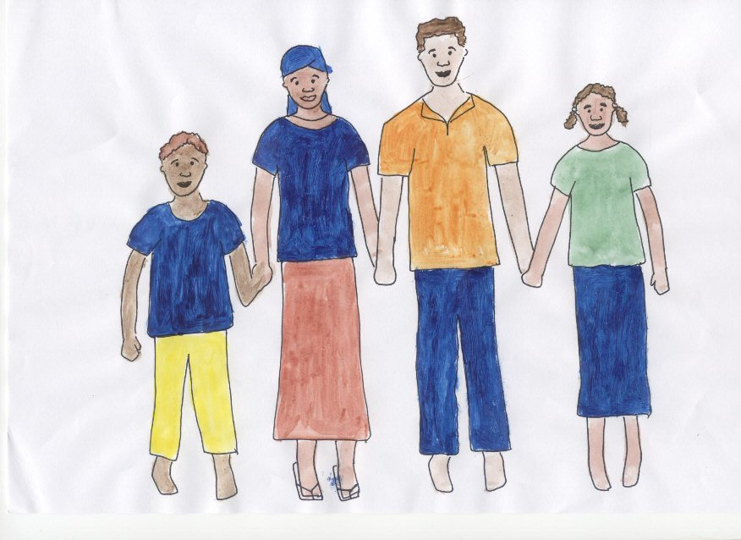
Notes:
This graphic depicts the right of every child to live in security with their family.

Slide 26
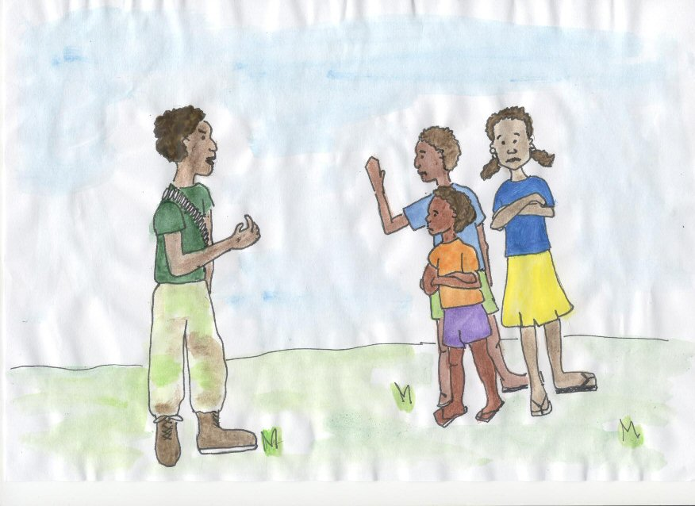
Notes:
This graphic depicts the right of every child not to be conscripted as a child soldier or sex slave.

Slide 27
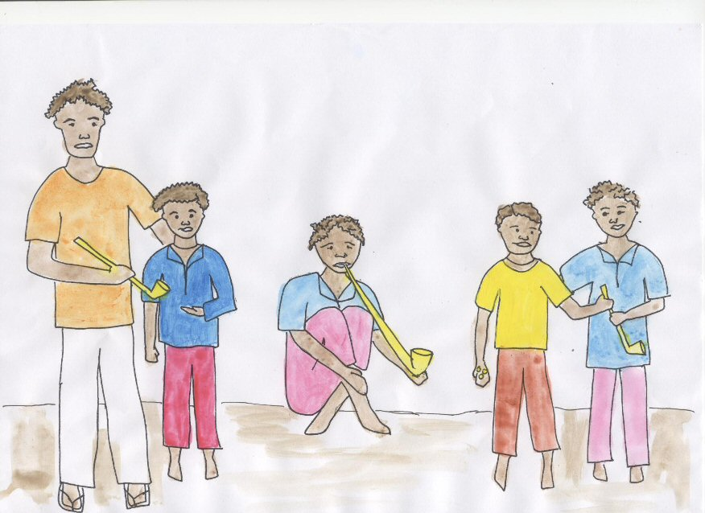
Notes:
This graphic depicts the right of every child not to be exposed to drug taking or drug trafficking.

Slide 28
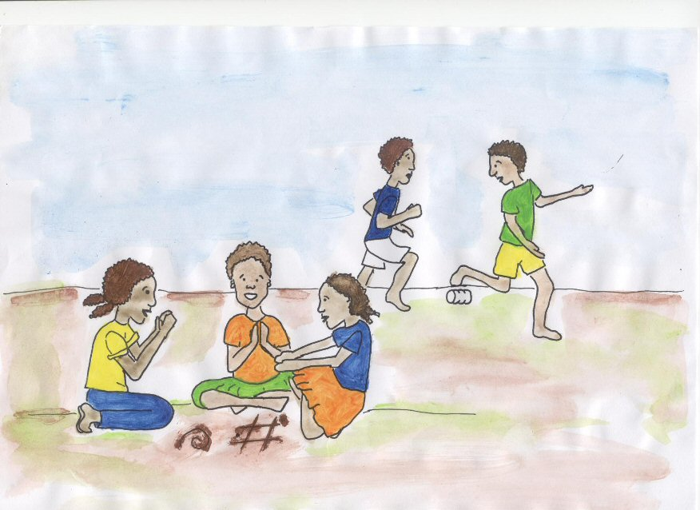
Notes:
This graphic depicts the right of every child to freedom from formal work and to leisure time.

Slide 29
Children’s rights
The right to go to school
The right to be with their parents
The right to have fun
The right to go to a doctor
The right not to have to work
The right to protection from sexual abuse
The right to be protected from drugs
The right to be safe – to live and grow in safety
The right to not be recruited as a soldier or to fight in a conflict
Notes:
CROC is often available in pictorial format from Human Rights Organisations or on the web.
Finish the session by explaining that we will be looking at the rights of women tomorrow.

Slide 30
Women’s rights
Women’s rights are laid out in the Convention to Eliminate Discrimination against Women (CEDAW).

Slide 31
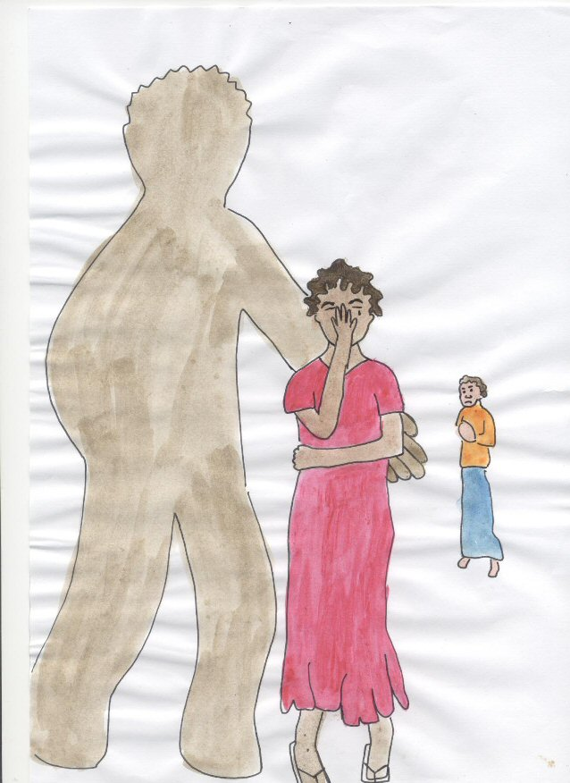

Slide 32


Slide 33
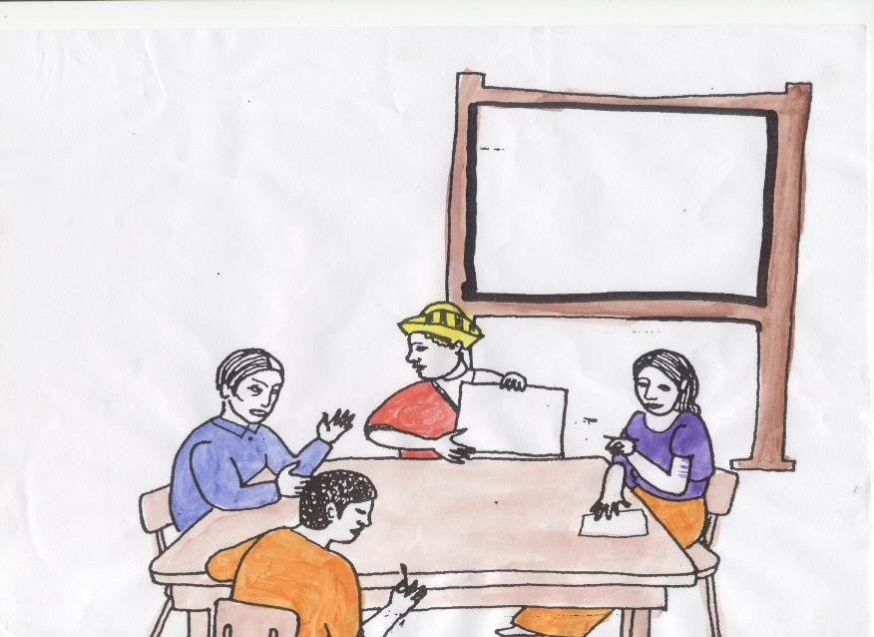

Slide 34
Women’s and girls’ rights
The right not to be discriminated against
The right not to experience violence in the home or community
The right to sexual and reproductive health services
The right not to be trafficked or forced into prostitution
The right to political participation
The right to education
The right to protection from violence

Slide 35
The BPFA
A document called the Beijing Platform for Action gives more detail about the women’s rights which have been agreed to by many governments at the United Nations.

Slide 36
Who can help us with this work?
Human rights activists
Universities
International lawyers
Overseas universities such as UNSW

