Slide 1
Session 6: The Beijing Platform for Action (BPFA)
Refugee women in leadership:
Power through participation
Notes:
The Beijing Platform For Action came from a huge United Nations International Conference on Women's Right in 1995, It has been regularly updated.

Slide 2
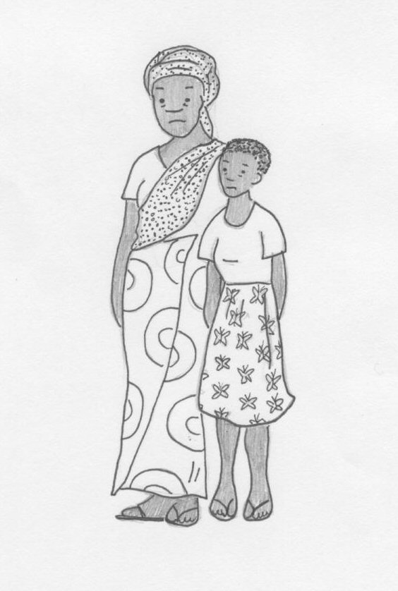
The BPFA The Beijing Declaration and the Platform for Action, adopted by 189 countries in 1995, is the most comprehensive and transformative global agenda for the achievement of gender equality and the empowerment of women and girls. (UNFPA) The 12 “Areas of Concern” cover
Women and poverty
Education and training of women
Women and health
Violence against women
Notes:
It cover 12 areas critical to Gender Equality and women's rights.
See:
https://www.undp.org/ukraine/publications/what-beijing-platform-action
https://www.unwomen.org/en/csw/previous-sessions/csw59-2015
Share the key commitments in each area with participants.

Slide 3
The BPFA continued
Women and armed conflict
Women and the economy
Women in power and decision-making
Institutional mechanisms for the advancement of women
Human rights of women
Women and the media
Women and the environment
The girl child
Notes:
Divide the topics among small groups and ask them how they applies to refugee and displaced women and girls.
How can you/they use this information in advocacy platforms?

