Slide 1
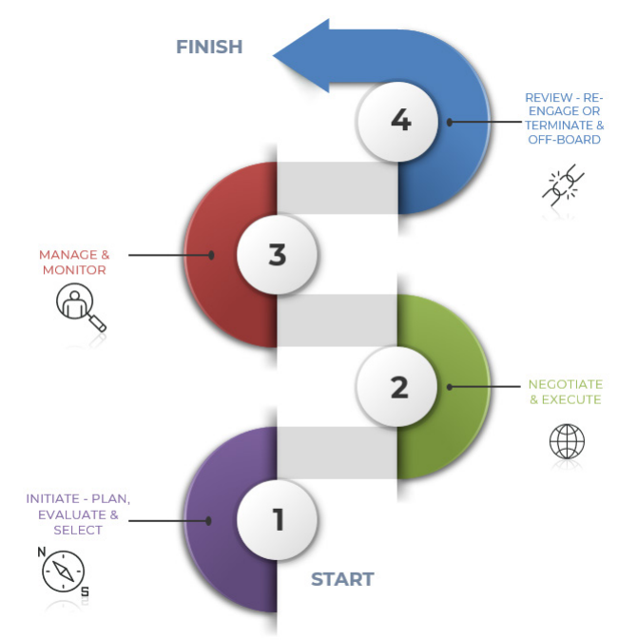
Controls for critical and high-risk third-party arrangements
All critical and high-risk third-party arrangements must follow the four-stage lifecycle:

