Slide 1
UNSW Centre for Primary Health Care and Equity Annual Forum 2020
Health equity impacts of new bicycle transport infrastructure in Inner Sydney
Christopher Standen
Research Fellow – Applied Urban Development
Health Equity Research and Development Unit
Part of the UNSW Research Centre for Primary Health Care and Equity
A Unit of Clinical Services Integration, Sydney Local Health District

Slide 2
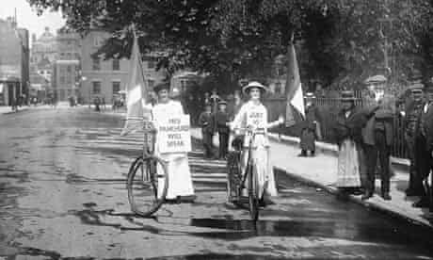
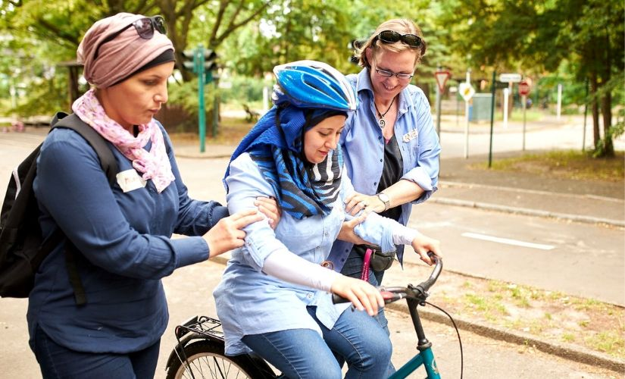
Health and well-being benefits of bicycle transport
Physical activity
Stress relief
Access to health care, services, social opportunities
Physical distancing
Independence and freedom
Photograph: Corbis
Photograph: Deutsche Fernsehlotterie/Jan Ehlers

Slide 3
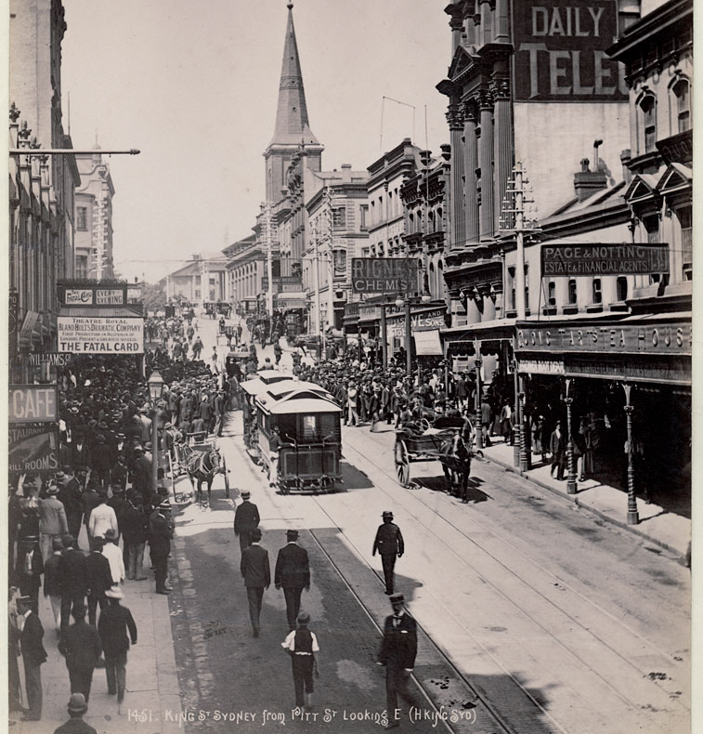
Photograph: State Library of NSW

Slide 4
Photograph: Paul Jeffers

Slide 5
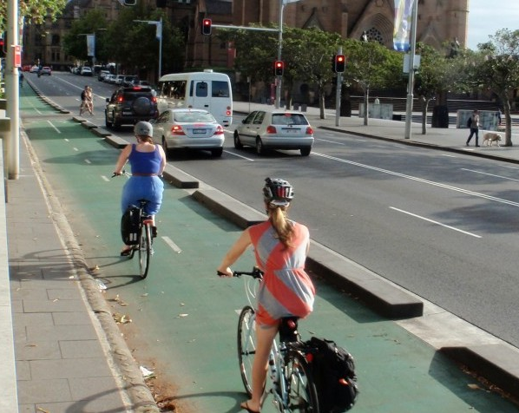
Photograph: Sydney Cycleways

Slide 6
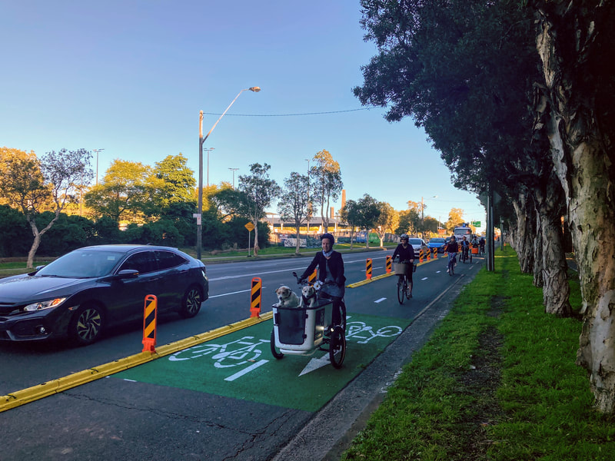
Photograph: Sydney Cycleways

Slide 7
Equity framework for transport policies (Lee at al., 2017)
Spatial
Modal
Procedural
Social

Slide 8
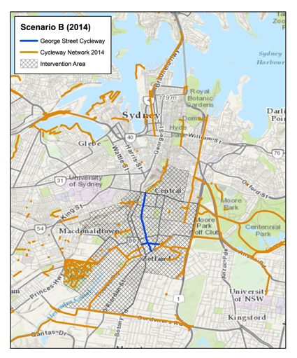
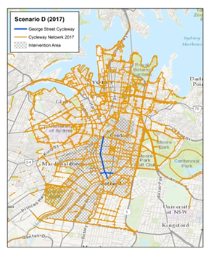
Research question
How does new bicycle infrastructure affect physical activity, for different population groups?
Two scenarios:
1. Single bicycle path
2. Complete cycling network

Slide 9
Method
Travel demand forecasting model built using ArcGIS with OpenStreetMap network data
Baseline travel behaviour data from n=600 residents aged 18-55
Forecast changes
Changes in annual hours spent cycling for transport
Changes in annual hours spent walking for transport
Forecasts aggregated by
Gender
Household income
Vehicle ownership

Slide 10
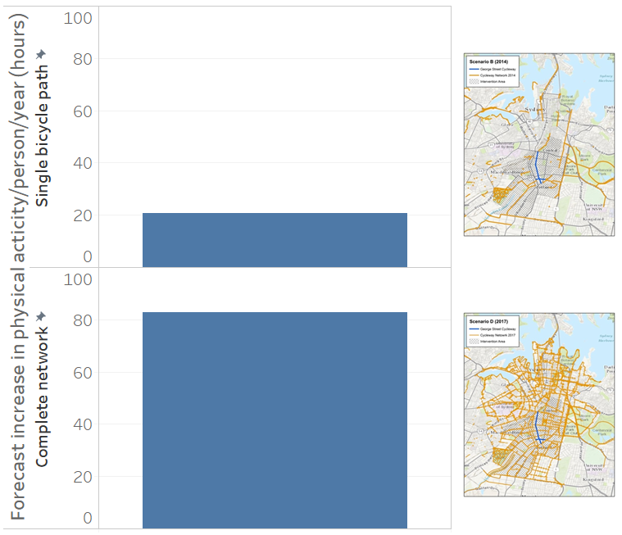
Physical activity increases for the two scenarios

Slide 11
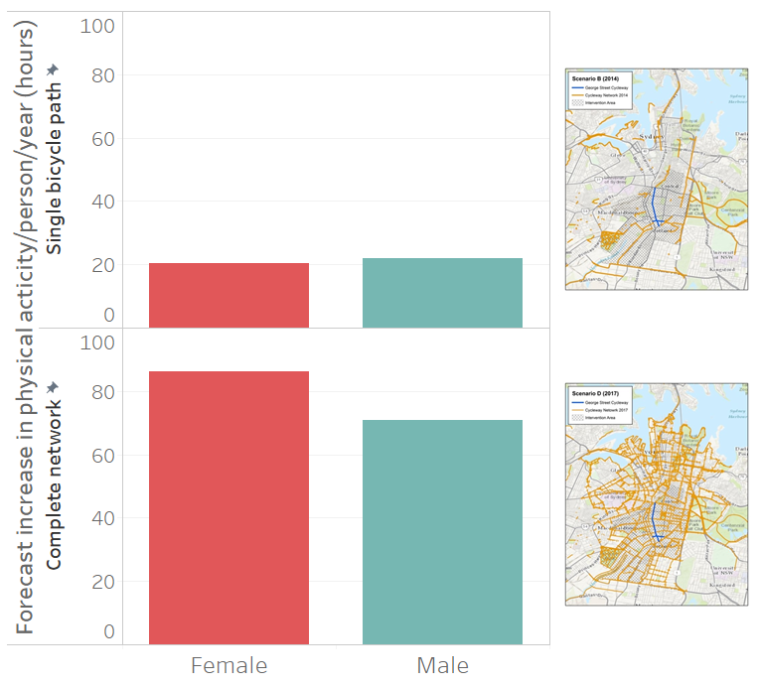
Physical activity increases – by gender

Slide 12
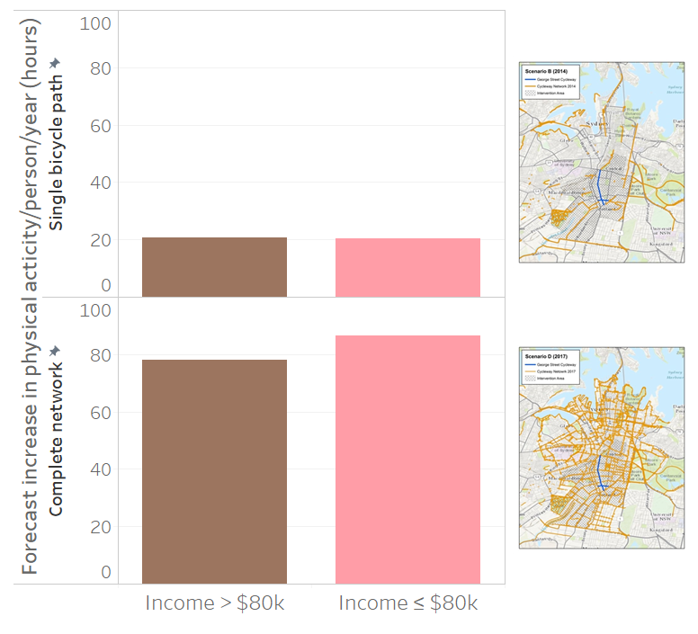
Physical activity increases – by household income

Slide 13
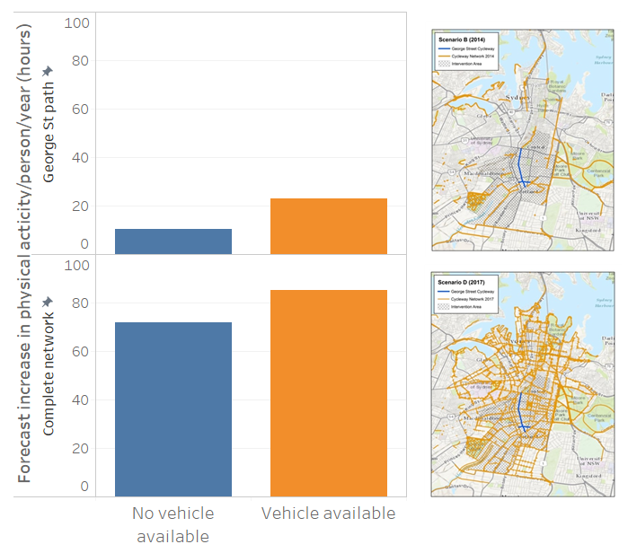
Physical activity increases – by vehicle ownership

Slide 14
Conclusions/recommendations
For optimal health and equity outcomes, cycling networks need to be connected.

Slide 15
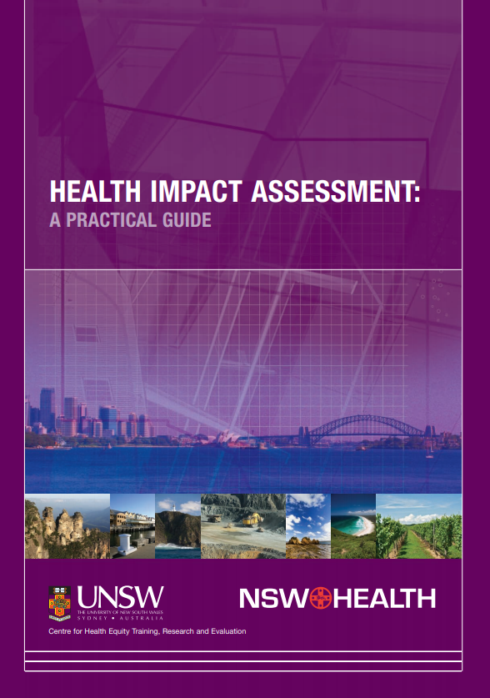
Conclusions/recommendations
Equity-focused health impact assessment for major transport projects and strategies.

Slide 16
Christopher Standen
Research Fellow – Applied Urban Development
Health Equity Research and Development Unit
Part of the UNSW Research Centre for Primary Health Care and Equity
A Unit of Clinical Services Integration, Sydney Local Health District
c.standen@unsw.edu.au
: @multimodalism

