Slide 1
e-Innovation in Cancer Follow-up Care
Jane Taggart
Mark Harris
Melvin Chin
Winston Liauw
David Tighe
Notes:
I would like to acknowledge the Bedegal people that are the Traditional Custodians of this land. I would also like to pay my respects to the Elders both past and present and extend that respect to other Aboriginal and Torres Strait Islanders who are present here today.

Slide 2

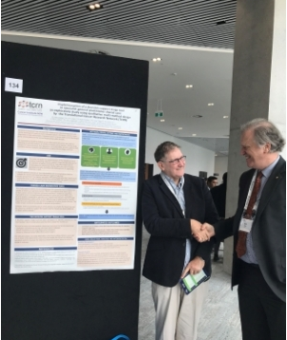
John Lewis
Notes:
Passed away in April
He was involved as an investigator, he assisted in developing and implementing the projects and presented the work at key conferences. He contributed through his lived experience with colorectal cancer, his expertise in health informatics and from his earlier work as a clinician in social work
He was on the Translational Cancer Research Network’s Consumer Advisory Committee
His research topic was to “Develop a Framework for improving Health Information Systems to support the care of colorectal cancer survivors in primary/shared care settings

Slide 3





Acknowledgements
Steering Committee
Millica Rigby – Consumer
David Goldstein – TCRN
Brendon McDougall – Integrated Care, SESLHD
Ed Kemp – ICT, SESLHD
Leshae Johnston – iHUB, SESLHD
Alex Dolezal – CESPHN
Teng Liaw – CPHCE & WHO Collaborating Centre on eHealth, UNSW
Andrew Knight – APICU, UNSW
Notes:
eHealth NSW is responsible for leading information and communication technology policy and programs for state health services

Slide 4
In the beginning
LIFE
GP
Hospital
Notes:
Thanks Melvin

Slide 5
At diagnosis of cancer
CANCER
GP
Hospital

Slide 6
The attachment
CANCER
GP
Hospital

Slide 7
A growing relationship
CANCER
GP
Hospital

Slide 8
Upon successful treatment
AFTER CANCER
GP
Hospital
Notes:
In existing models of care, cancer survivors continue to attend hospital-based follow-up appointments for many years, and may not necessarily require the expertise of a specialist oncology team.
Increased number of survivors + aging population → increasing demands on oncology clinics, and greater need for GPs to manage cancer long term with other comorbidities
Long term cancer care is currently fragmented between hospital outpatient clinics and general practice, leading to duplication and missed opportunities for prevention and early management not only of cancer but also of comorbidities and the long term physical and psychological sequelae of cancer treatment.

Slide 9
An increasing demand for services
Fig 1: Incidence and mortality 1968-2012
Source: AIHW. Australian Cancer Incidence and Mortality (ACIM) books: Breast cancer. Canberra: AIHW.
Notes:
The higher prevalence of diagnoses coupled with lower mortality rates means we have increased survivors, which have increased 20% since 1982 and are currently at 90% for breast cancer and 67% for colorectal cancer.

Slide 10
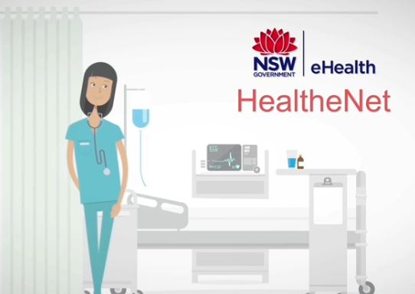








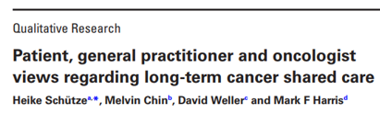
Development Process
Patients want support & shared care
GPs willing but disempowered and de-skilled
Is shared care acceptable?
Requirements
Options
Pilot
Information Needs, Functional Specifications & Governance
Notes:
Qual study published in 2017 that conducted 56 Interviews with patients, cancer specialists and GPs found that
GPs were willing to participate in shared follow-up care but required specialist knowledge
Reassurance that oncologists would oversee care
We consulted with a range of stakeholders within the LHD, including cancer services, integrated care, IT and communication, a consumer, CESPHN and GPs with eHealth NSW support through meetings and workshops to identify the information needs, functional specifications, governance and the options to share a care plan.
At the time, eHealth NSW finalised the first version of the functional and non functional requirements for a state based shared care planning system. As well as sharing a care plan this system could be integrated with eReferrals. Unfortunately, the work on a state based shared care planning system seems to have come to a stop.
The goal was a web or cloud-based shared care plan that was integrated with LHD and general practice clinical information systems. The care plan would be auto populated and shared between LHD services, consumers, GPs and allied health services all of which are external to the LHD. This system could support or enable collaboration. It was also important that it was scalable.
We conducted a systematic review on electronic cancer shared follow-up care plans.
Options for sharing the care plan included the use of My Health Record (MHR), HealtheNet and Sharepoint, a web-based collaborative platform. None of these options were integrated with ARIA or general practice systems.
Sharepoint met more of the identified requirements for sharing and collaboration than the other options, however, there were issues around the sharing of clinical information with GPs who are external to the Local Health District, the need for clinicians to log into the system would be a barrier and it would be onerous setting up access permissions.
MHR did not support the uploading of the care plan and a work-around solution ended with all the formatting being lost. MHR could be used to view diagnostic and pathology results.
HealtheNet could provide access to the care plan and securely send it to GPs.
We have a lot of interest in the results of the pilot evaluation.

Slide 11
Pilot study – Colorectal cancer follow-up eShared care
Evaluate the feasibility and acceptability
    Specialist-GP interactions
    Patient and clinician satisfaction with quality of care
    Usefulness / satisfaction with electronic care plan
Methods
    10 patients, their GPs and oncologist
    Interviews at baseline, 6 months and 12 months
    Observations
Notes:
We are currently implementing and evaluating this shared care plan model. This is a small proof of concept evaluation with up to 10 patients, their GPs and oncologist.
Our aim is to understand the impact of the care planning model on the specialist and GP interactions, their satisfaction with the quality of care and the usefulness of the electronic care plan in sharing care.
We are conducting interviews with clinicians and patients over a period of 12 months as the follow-up care takes place. Observations recorded at visits to general practices and the cancer centre will also be considered in the analysis.

Slide 12





An interactive care plan to support follow-up cancer care
Cancer Shared Care Plan
Cancer Services
Login to Inca
Integrated with General Practice systems:
Medical Director
Best Practice ….
Patient
Login to Inca
Notes:
This is the system we are piloting
Integrated with GP systems.
Not integrated with LHD information systems. Oncologist and Nurse Coordinator need to log into the web interface
Patients also have secure login
No link to My Health Record
Workaround – GPs to initiate care plan and oncologist to edit or create it
Inca have done some additional work on their system so now oncologists could initiate and create the care plan ready for GPs when they see the patient.

Slide 13
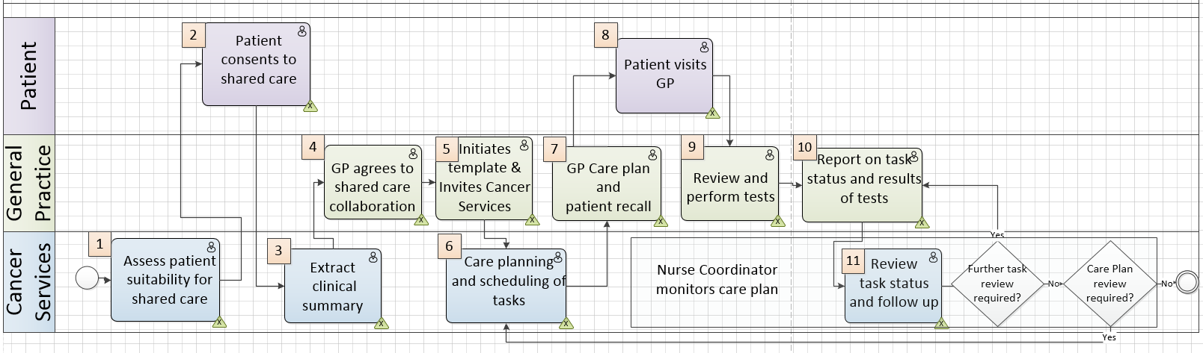
Care plan pathway
Notes:
Challenge – fitting model of care with e-solution

Slide 14
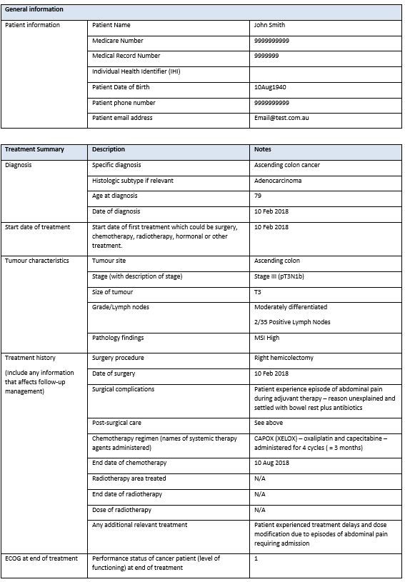
Treatment Summary sent to GP
Notes:
This can be uploaded to Inca
The treatment summary has been faxed to the practice but if the oncologist initiates the care plan it can be uploaded for the GP to view and decide if they will participate in shared care

Slide 15
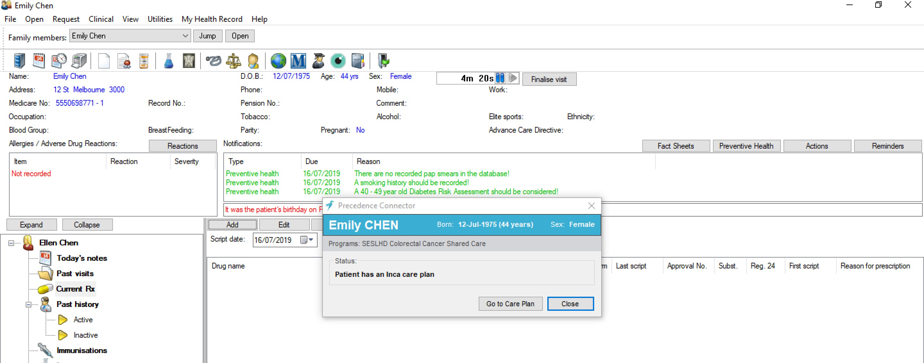

Follow-up care plan for colorectal cancer
Notes:
Once there is consent from the patient and GP, the shared care planning software connector is installed at the general practice and login details are provided to the specialist and patient.
The connector integrates with the GP clinical software which provides easy access for the GP into the patient’s shared care plan.
When the GP initiates the care plan a health summary is uploaded from the patient record and any other information such as medications that the GP chooses to share.

Slide 16
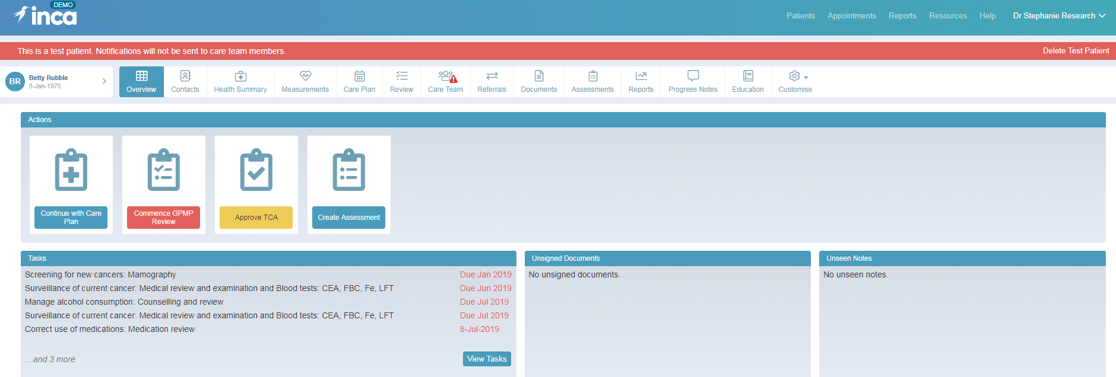
Inca Care Plan
https://demo.precedencehealth.org/inca/signin/SignInPage?0

Slide 17

Overview page of a patient’s care plan

Slide 18

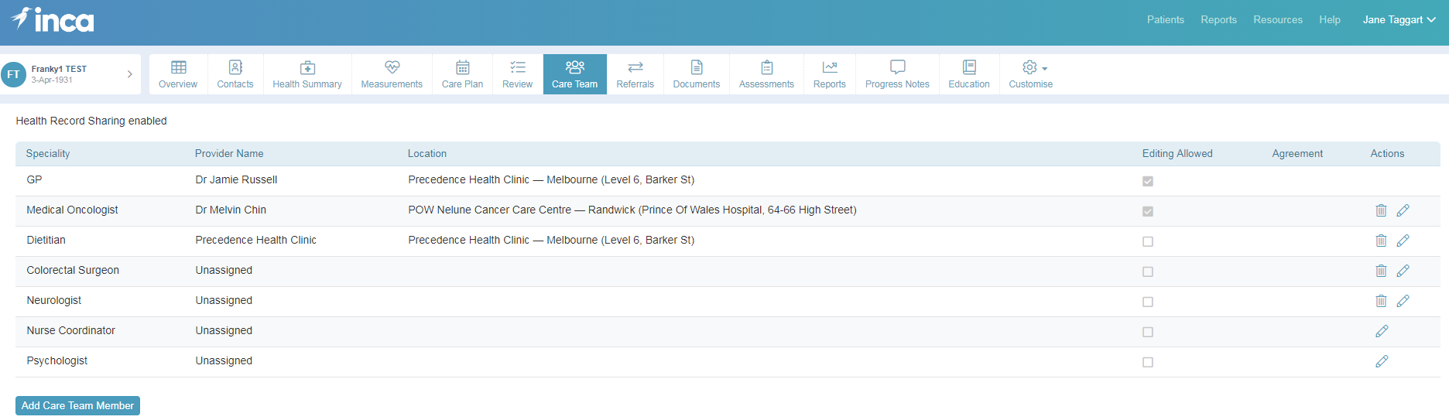
Defining Care Team

Slide 19

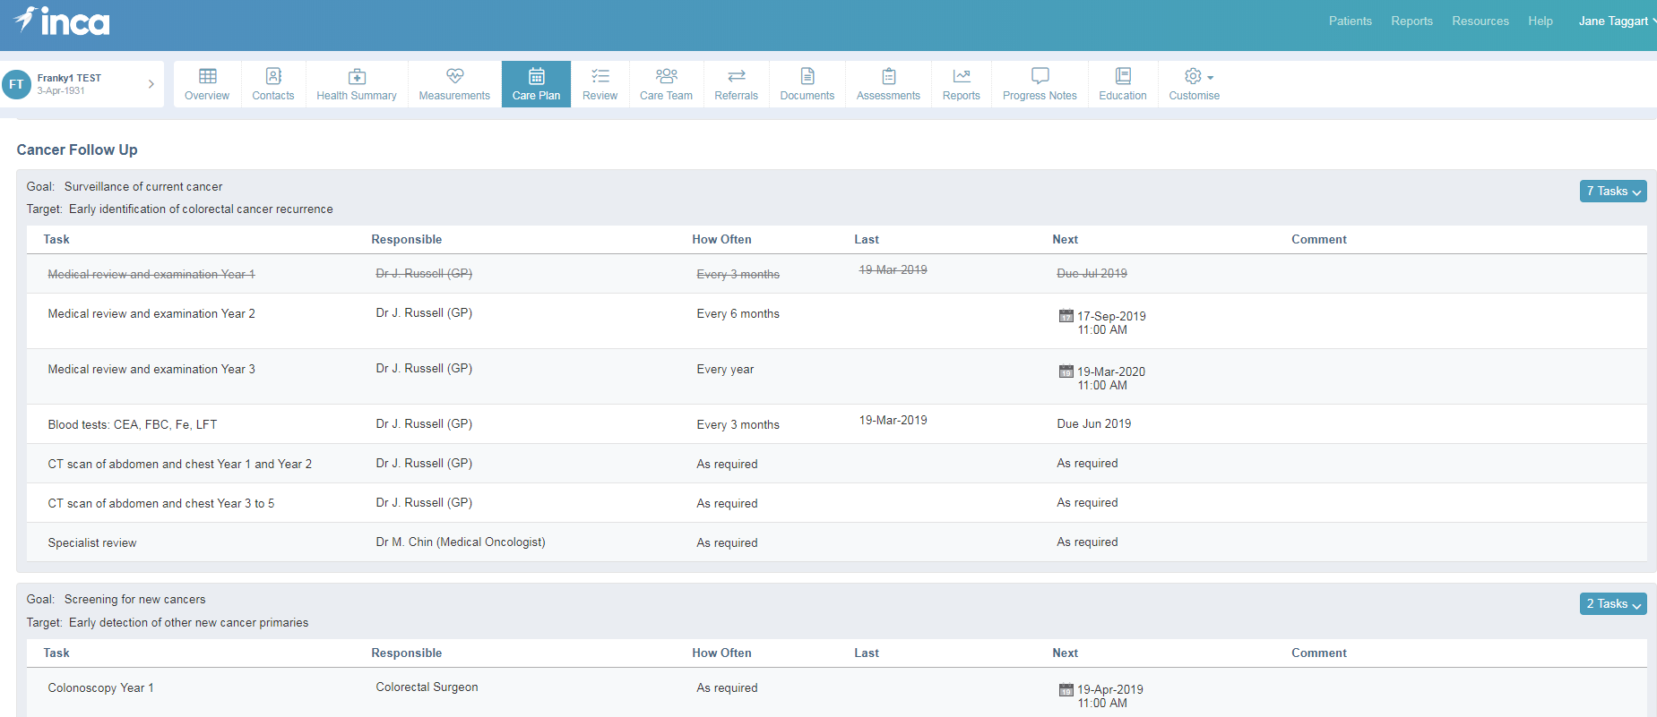
Care Plan: Goals, tasks, responsibilities and timeframes
Notes:
Care plan

Slide 20
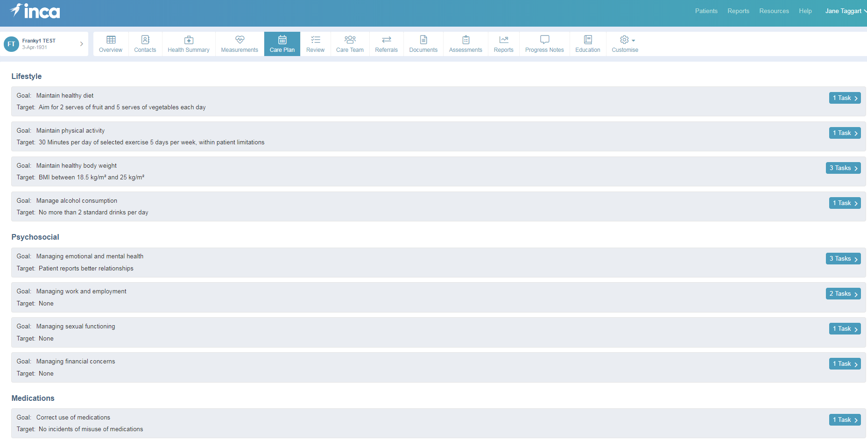
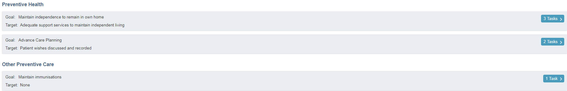
Notes:
Other goals in the care plan template. Click on the Tasks button on the right to drill down to specific tasks and timeframes
Documents can be uploaded and the care plan and a GPMP can be downloaded into the clinical record.

Slide 21

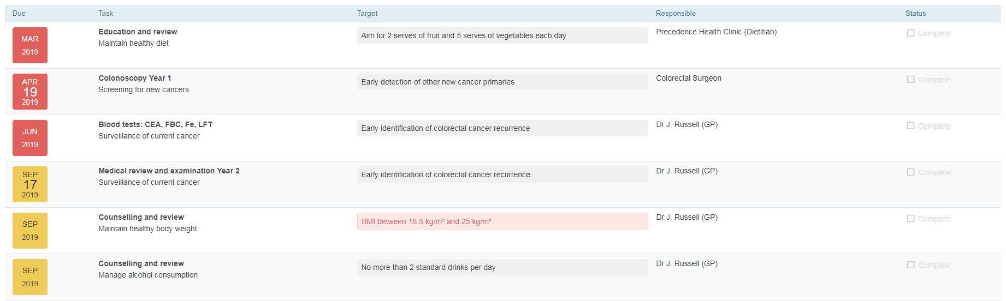
Reporting and monitoring

Slide 22


Early implementation issues
Technical issues
Computer literacy
GPs may only have one patient
Patient confusion about care
What about patients who do not have a usual GP?
What happens when a GP retires?
Notes:
Each step in the care pathway and use of the electronic shared care planning process requires a lot of hand holding as this is a new model of care, using new technology. Patients have been cared for by their cancer specialist and now their GP is being brought into the care team. This is a change for the patient, specialist and the GP.
We are visiting the GP at least twice and more if needed prior to them seeing the patient to install and train them in the electronic shared care plan. We are training the specialist to create the care plan, the Nurse Coordinator to monitor it and the patient to access and contribute to it. Email prompts are also used to ensure the care plan is ready prior to the patient visiting the GP.
Technical problem – Practice installation: 1 in a million chance this would happen according to IT support. Not a problem with CDMNet but a problem with BP installation.
Setting up access. Access set up links expired before oncologist and nurse coordinator got to them.
Computer literacy – Clinicians and patients will have varying degrees of computer literacy which may be problematic in the use of the electronic care plan. GP 2 only uses MD for scripts.
They can contact Precedence and us for assistance.
Which leads to Inca training – Our consumer rep who has an IT software business says that noone looks at manuals or user videos so the system needs to be user friendly and easy to navigate.
We also only have a short time to train GPs.
Training patients?
Doing training as close to visits as possible
GPs may only have one patient in cancer follow-up care which means they may only see the patient every 3 months in the first year or even longer between visits as time goes on. They may forget how to use Inca.
Our first patient was confused about the care she was going to receive and who were the people contacting her from the research team? It was only discussed once at her oncologist visit. She was also given a pathology form by the Cancer Centre to have a blood test that was meant to be done by the GP. The oncologist was able to discuss this over the phone with her and alleviate her concerns and to use the pathology form the GP had given her.
Patient 1 made a few comments: one about how everyone looks at their computer but no one seems to know what is going on. She is also concerned the other specialists she sees at St George might be confused
Patient’s comments - some communication at St George is good, some is abysmal and some people thought she was a mind-reader.
- being ill is full-time career
A lot of hand holding as the pilot progresses.

Slide 23
What’s next for this project?
Complete pilot study
TCRN follow-up study – evaluate patient suitability, communication and coordination and follow-up care
Interest from other SESLHD services – Drug and Alcohol and Mental Health Service
Controlled Trial
Notes:
TCRN qualitative study
there is a lot of interest from other public health services, such as Drug and Alcohol and Mental Health Services, to share care with GPs using an electronic care plan that supports collaboration and communication.
A more robust and substantive evaluation of this shared care system will be required.

Slide 24
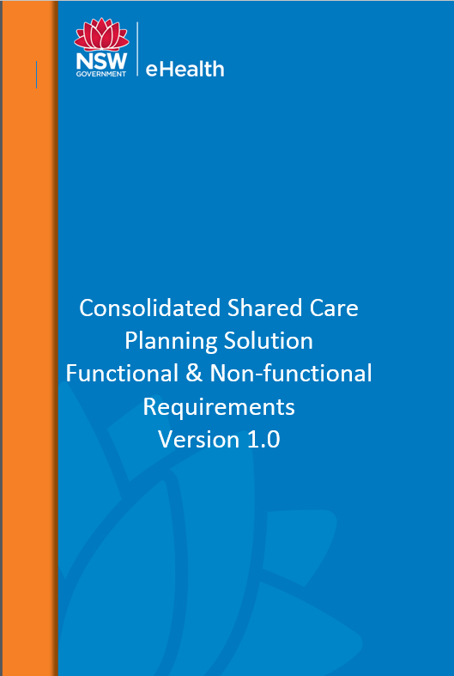
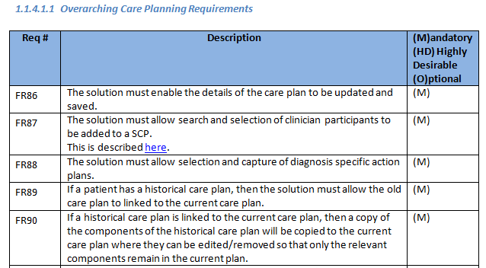
eShared Care Planning Challenges
Sharing clinical information between LHD services and external health providers
eShared Care Planning that meets requirements and
is scalable
Integrated clinical information systems
Who funds it?
Governance
Notes:
Sharing information:
Uncertainty - The state health service privacy manual for health information states that health information can be disclosed as long as it is directly related to the primary purpose which should include shared and integrated care.
Security check
Our solution provides a work-around for this
How will a shared care planning system be funded given health providers come from different jurisdictions.

