Slide 1
Year in review
Mark Harris
Centre for Primary Health Care and Equity
Notes:
Acknowledge the traditional owners the Bidjigal people of the Eora Nation and pay respects to their elders past and present. I would also like to acknowledge the gap in health and life expectancy between Aboriginal and non Aboriginal Australians

Slide 2
CPHCE: www.cphce.unsw.edu.au
Better, fairer health and health care in the community through research, evaluation and development that strengthens primary health care and addresses health inequities.
Notes:
My name is Mark Harris. I am Scientia Professor, executive director of the Centre for Primary Health Care and Equity and deputy director of the Translational Cancer Research Centre.
CPHCE mission is to achieve Better, fairer health and health care in the community through research, evaluation and development that strengthens primary health care and addresses health inequities.

Slide 3
Australian Charter of Healthcare Rights
Access
Safety
Respect
Partnership
Information
Privacy
Feedback
Notes:
Access
Health care that meets my needs
Safety
Safe, high quality health care
Respect
Patient centred, respect for culture, identify, beliefs
Partnership
Communication, patient involvement in decision making, community involvement in planning and decision making
Information
Information to inform choices, assistance to understand and use information
Privacy
Information kept secure and confidential
Feedback
Patient experience and quality improvement.

Slide 4
New Developments
PMCD: Cancer, PWSMI, Self-Management
PHC: Community Health Workers, Health Literacy, Integrated Care,
Informatics: Shared care-plans, m-Health, Data linkage
Equity: CALD/Refugee, Organisational health literacy,
Environment: Urban health, Health Impact Assessment

Slide 5
Achievements
Research Infrastructure
1. The Central and Eastern Sydney Primary and Community Health Data Linkage Resource
2. National Prescribing Service Medicine Insight data
3. Can Get Health in Canterbury
4. ACOSS collaboration health inequalities and poverty in Australia,
5. MBG SPHERE Health and Urban Environment Clinical Academic Group
6. Translation Cancer Research Network Cancer Continuum Flagship (led by Director Mark Harris)
Grants
$4,971 total income.
Ministry of Health Prevention Research support program ($0.5m).
Leveraged $2.7m in competitive funding,
Publications
92 publications, 10 reports, 31 conference presentations.
Teaching
Three courses (MPH and MHM), transitioned to online delivery
HDR Supervision
16 UNSW HD students 4 Scientia Scholars-5 New Students (2019)

Slide 6
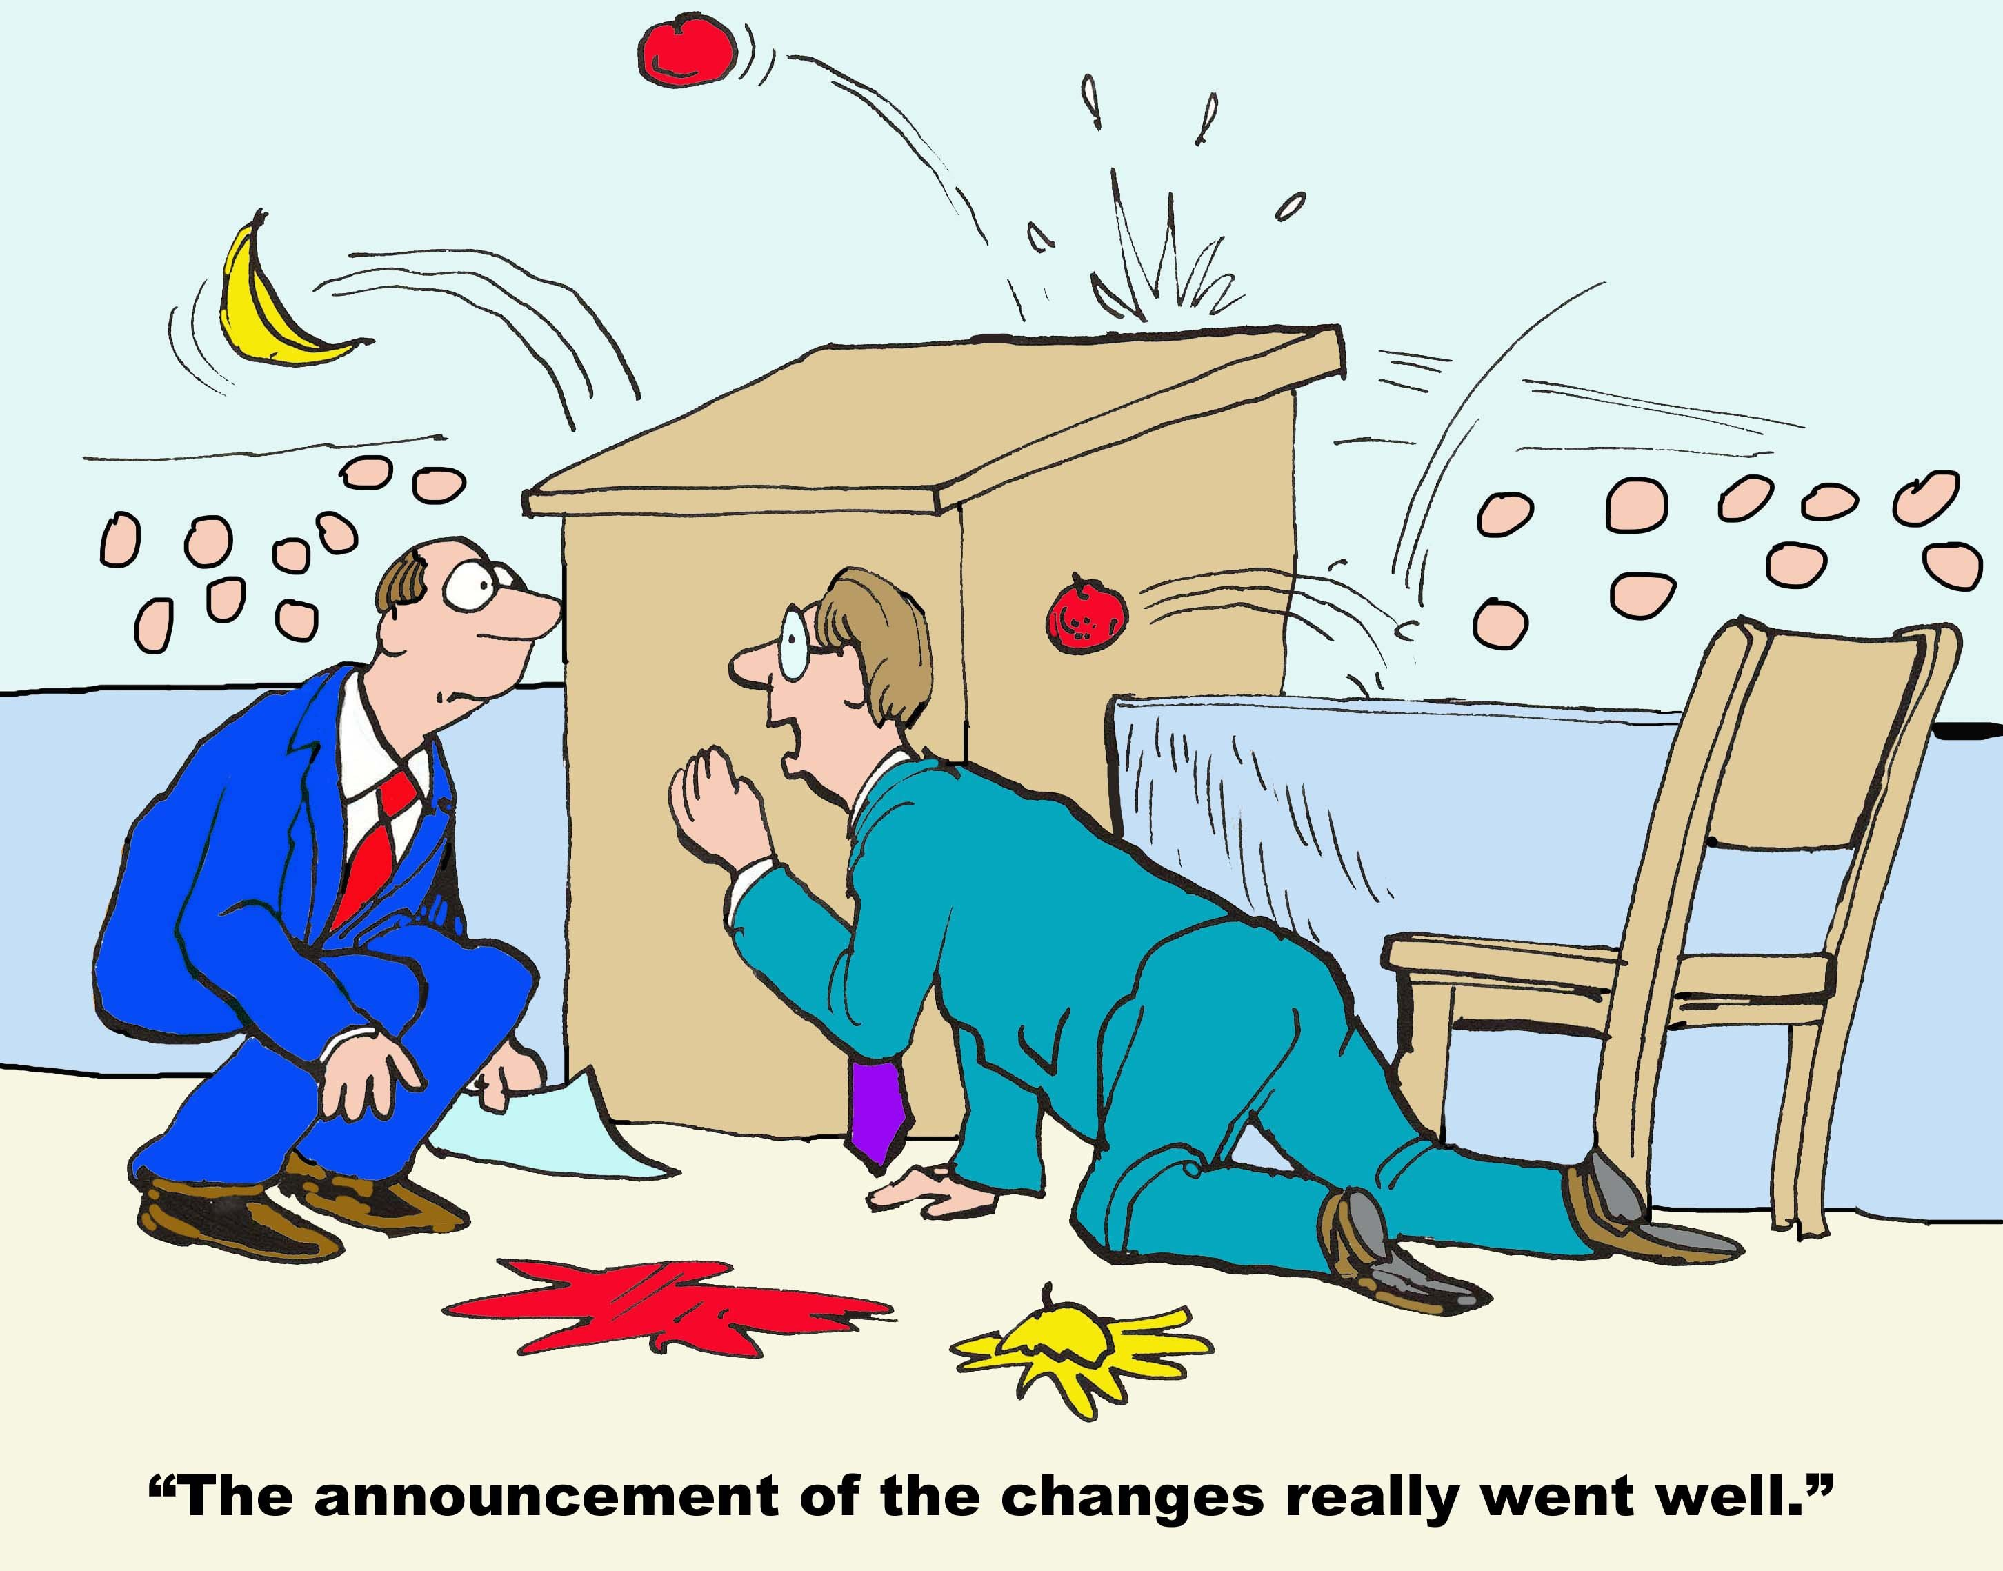
Challenges
Transitions
Alignment
Emerging areas of research
New Collaborations
Notes:
Transitions – senior staff, steering and advisory committee
Alignment – faculty strategic directions, NSW Health/LHDs/PHN
Emerging areas – such as carers, CHW, mental health, quality improvement – partly because of alignment, opportunity,
New collaborations – national (eg Swinburn, Flinders), international (WHO, partners in US and NZ)

