Slide 1
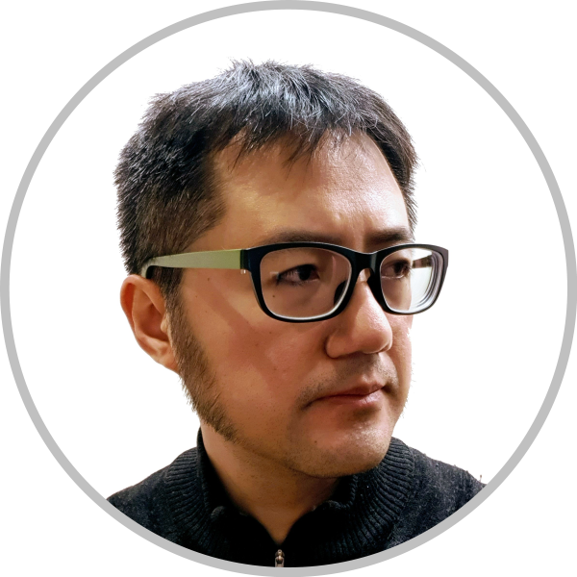
ED2GP – integrating General Practice
and Emergency Care
Fairfield Hospital Projects
MichaelTAM
Staff Specialist, Academic Primary and Integrated Care Unit, SWSLHD
Conjoint Senior Lecturer, SPHCM, UNSW Sydney
m.tam@unsw.edu.au
+61 2 9616 8520

Slide 2
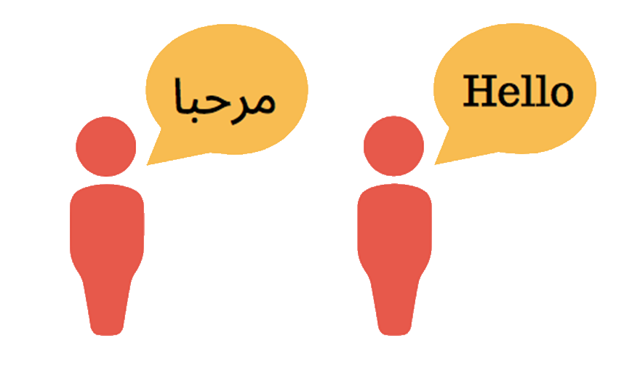
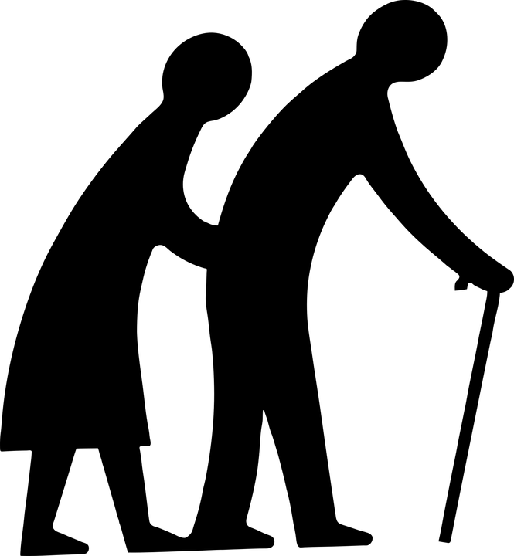
GP
“ED2GP” study
“Do you understand me?” study
2016
2018
2019
GP
“ED2GP4W” study

Slide 3
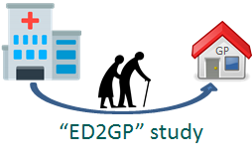
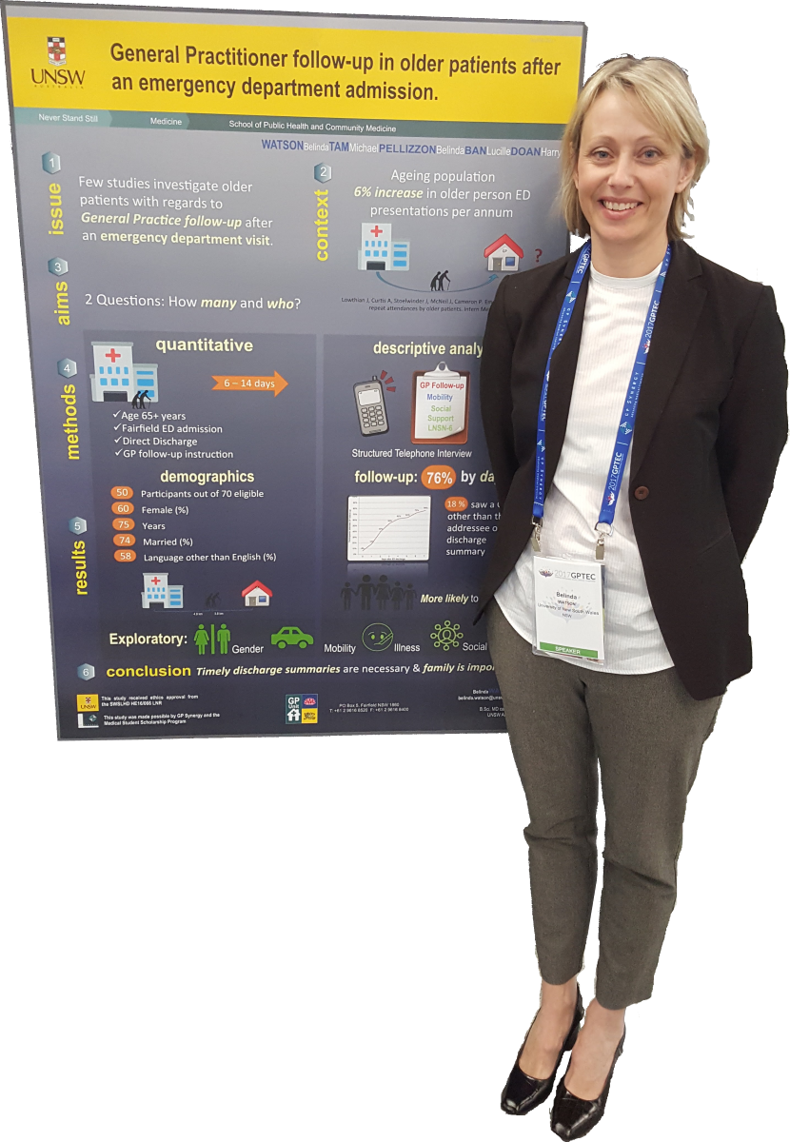
HREC: LNR/16/LPOOL/112
BelindaWATSON
Belinda
Lucille
Harry
PELLIZZON
BAN
DOAN

Slide 4
background

Slide 5
aim
?
GP

Slide 6
aim
?
GP

Slide 7
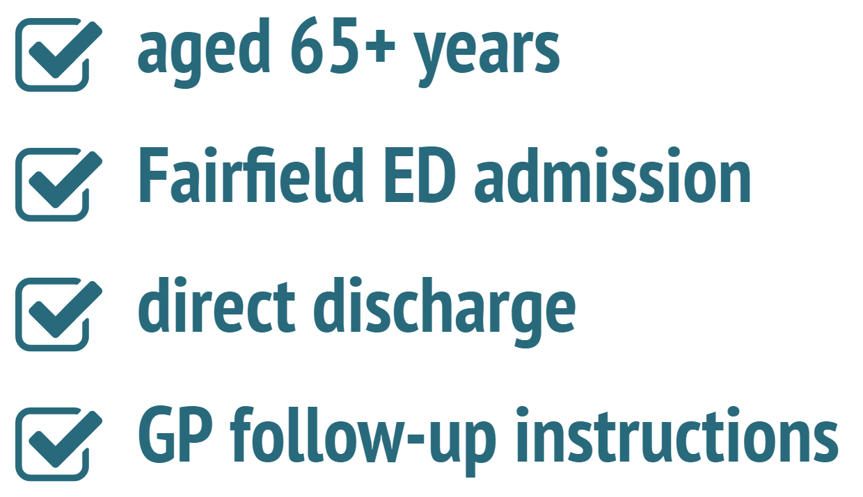
methods
8-14 days

Slide 8
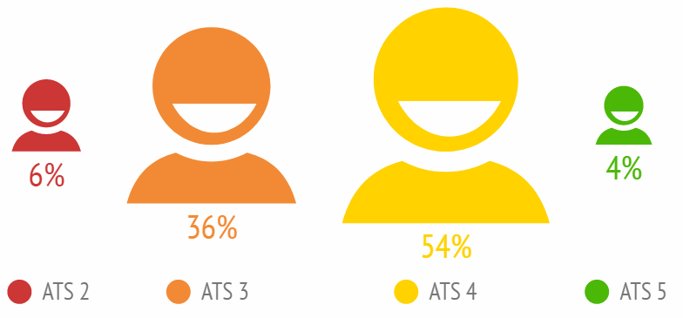
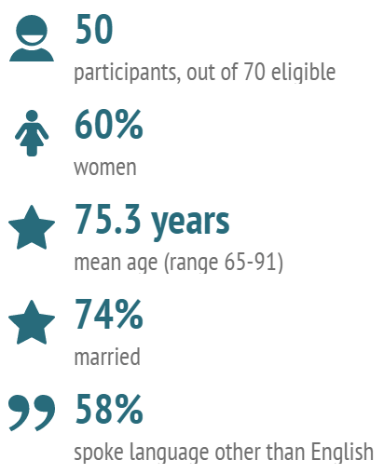
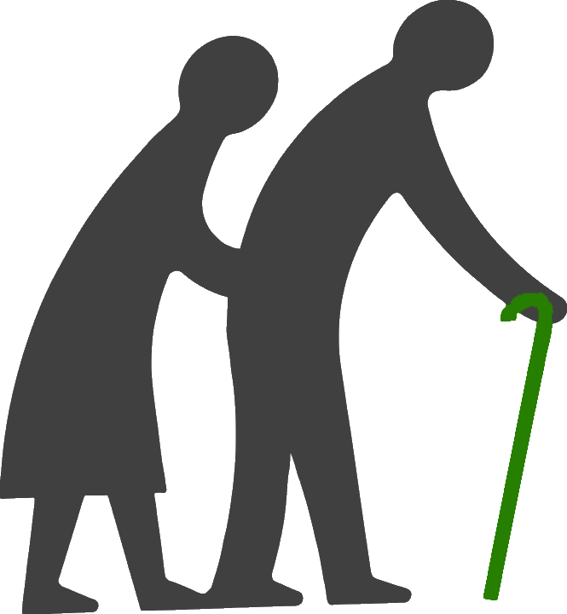
results
GP
4.8 km 3.8 km

Slide 9
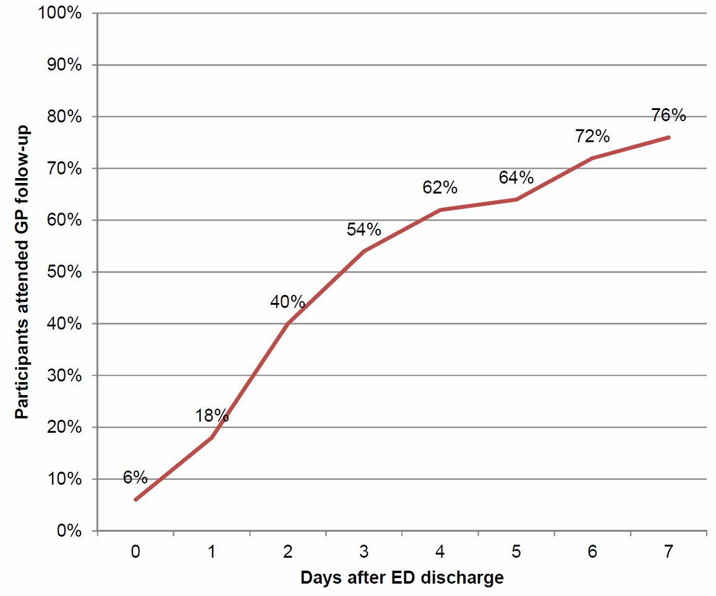
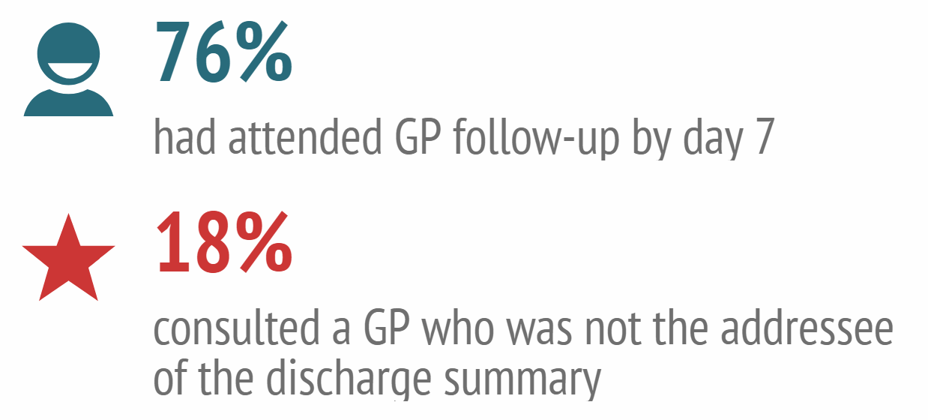
results

Slide 10
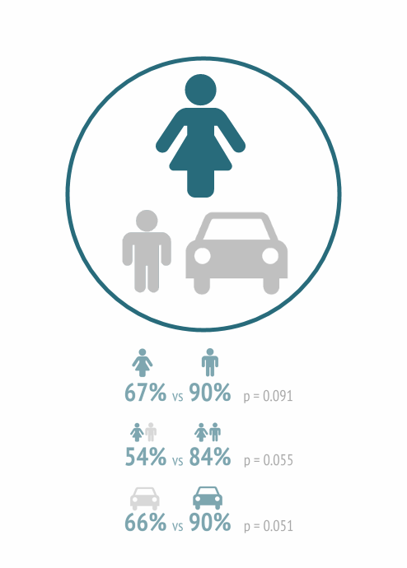
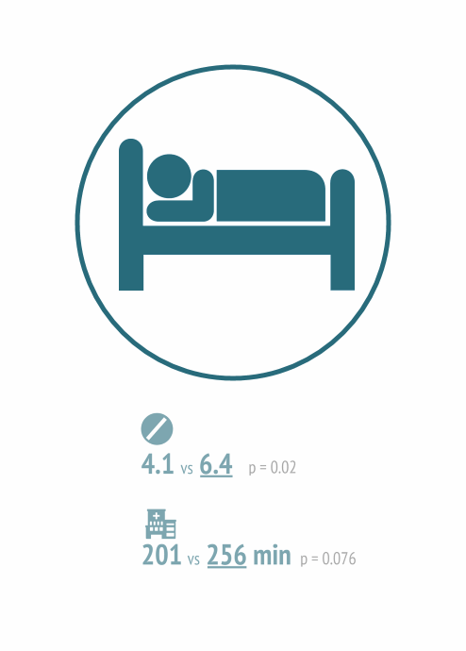
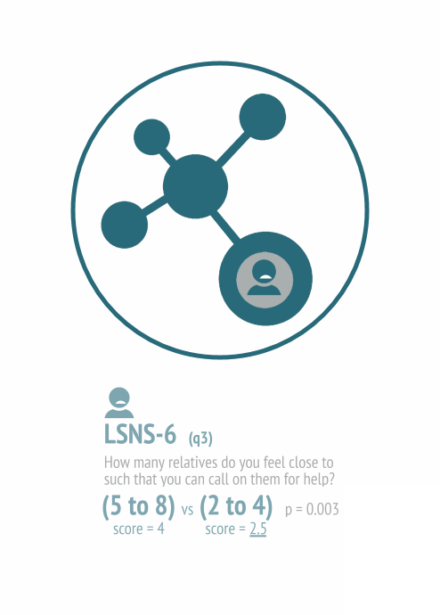
results

Slide 11
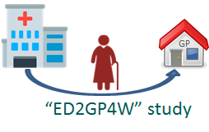
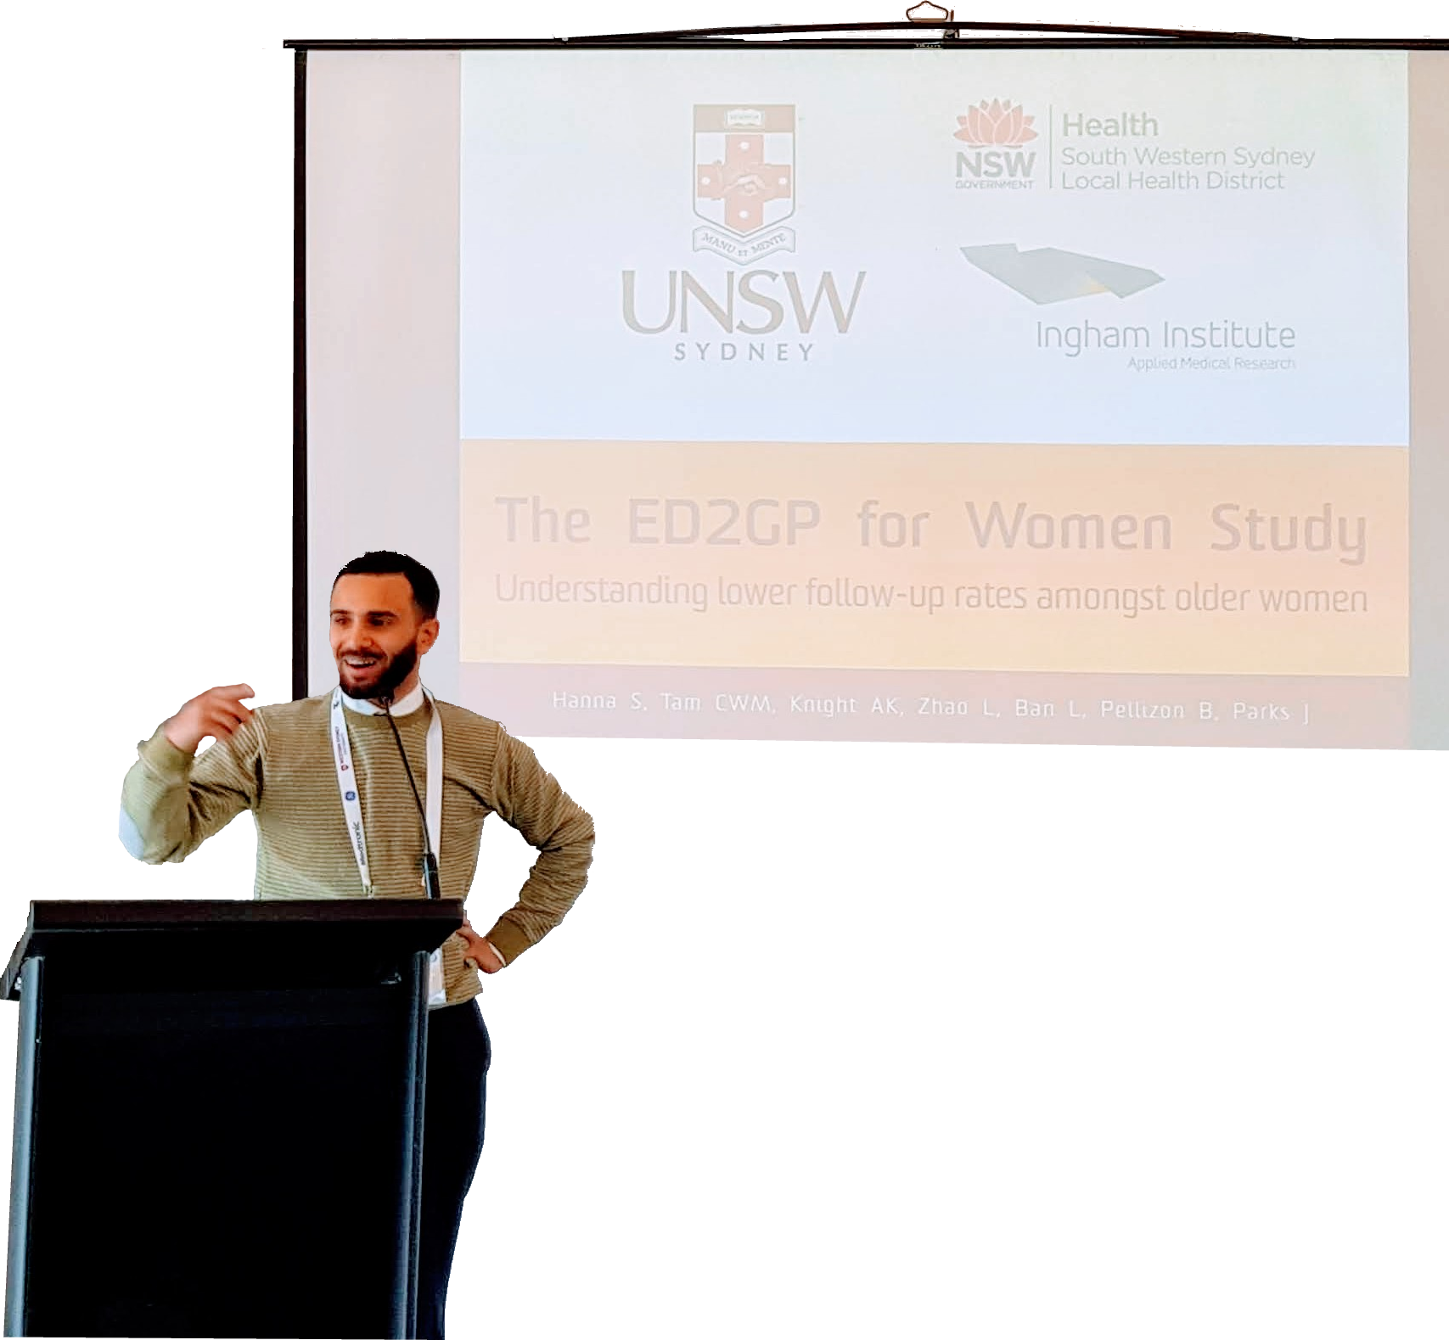
HREC: LNR/18/LPOOL/56
ShaddyHANNA
Andrew
Linheng
Lucille
Belinda
James
KNIGHT
ZHAO
BAN
PELLIZZON
PARKS

Slide 12
aim
Describe how older women access GP follow-up after an ED visit
Measure the proportion of older women who followed up with a GP
?

Slide 13
methods
female 65+ years
ATS 3, 4 or 5
Direct discharge
GP follow-up instruction.
Day 8-14
(telephone)
Day 0 (in ED)

Slide 14
Participants consented in ED (n = 176)
results
Excluded
Admitted as inpatient (n = 49)
Did not receive GP follow-up (n = 20)
Participants eligible for day-7 follow-up by telephone (n = 107)
Excluded for other reasons
Could not be contacted (n = 4)
Withdrew consent (n=3)
Participants included in analysis
(n = 100)

Slide 15
results
77 years
46%
mean age
widowed
67%
37%
spoke a language other than English at home
driving license

Slide 16
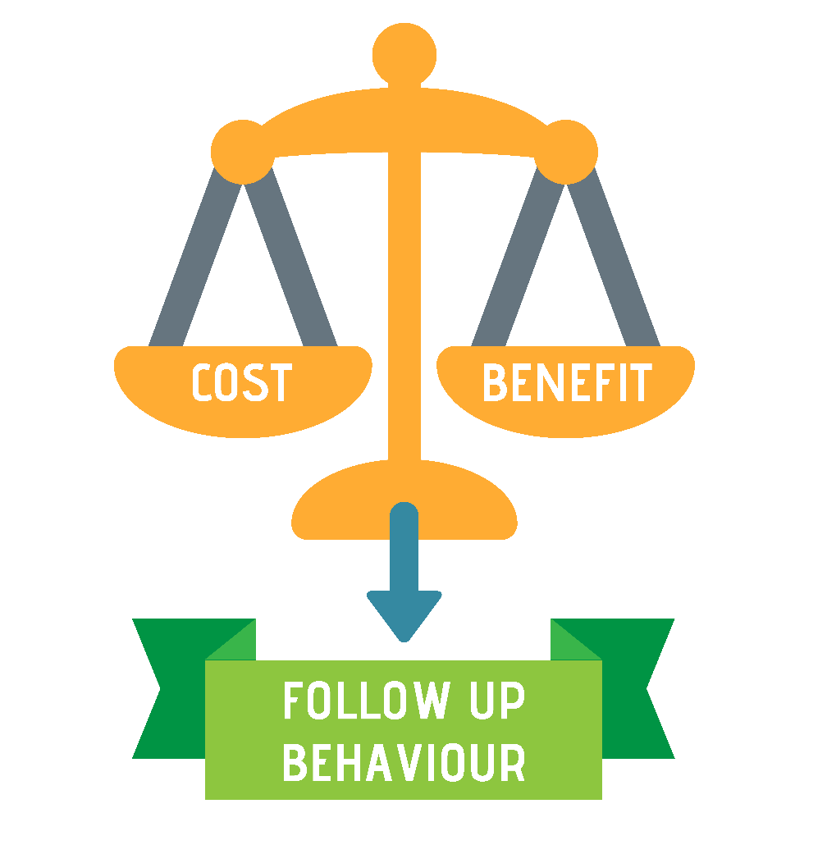
Describe how older women access GP follow-up after an ED visit
results
Inconvenience to self
Access to transport options
Perceived inconvenience to others
GP Availability
Previous experiences with healthcare system
Pre-existing health-seeking behaviours
ED messaging

Slide 17
Measure the proportion of older women who followed up with a GP
results
64%
95% CI: 54-73

Slide 18
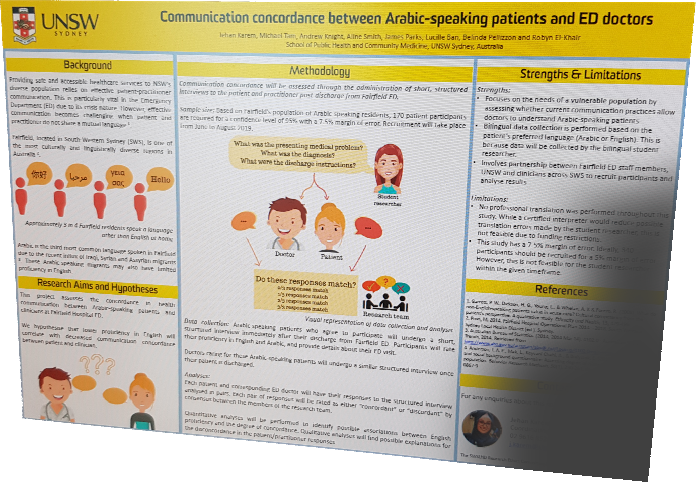
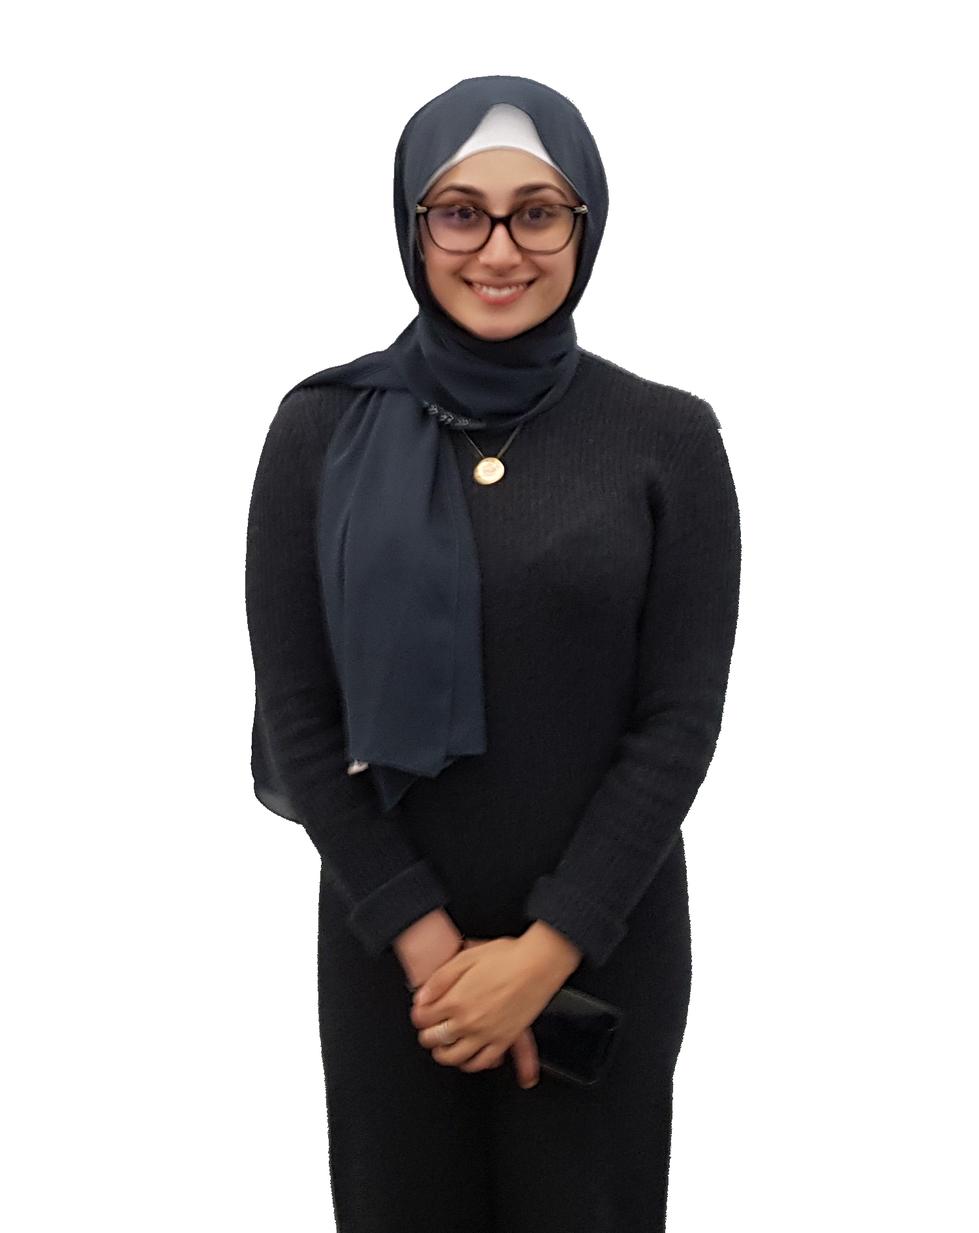
“Do you understand me?”
HREC: 2019/ETH00380
JehanKAREM
spoke a language other than English at home
58%
95% CI: 43-72
67%
95% CI: 57-76

Slide 19
“Do you understand me?”
HREC: 2019/ETH00380
JehanKAREM
Andrew
Robyn
James
Lucille
Belinda
Aline
Mary-Beth
KNIGHT
EL-KHAIR
PARKS
BAN
PELLIZZON
SMITH
MACISAAC

Slide 20
aim
“هل تفهم علي؟”
Measure concordance in health communication between Arabic-speaking patients and doctors

Slide 21
methods
“هل تفهم علي؟”
Measure concordance in health communication between Arabic-speaking patients and doctors
adult 18+ years
direct discharge from ED
ED doctor
Arabic-speaking patient
172 participant pairs recruited

Slide 22
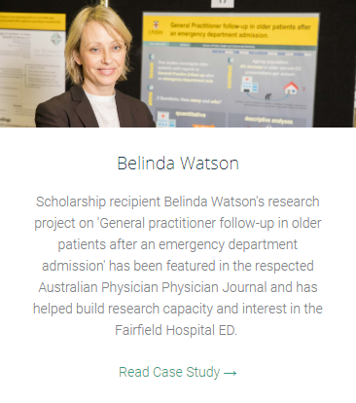
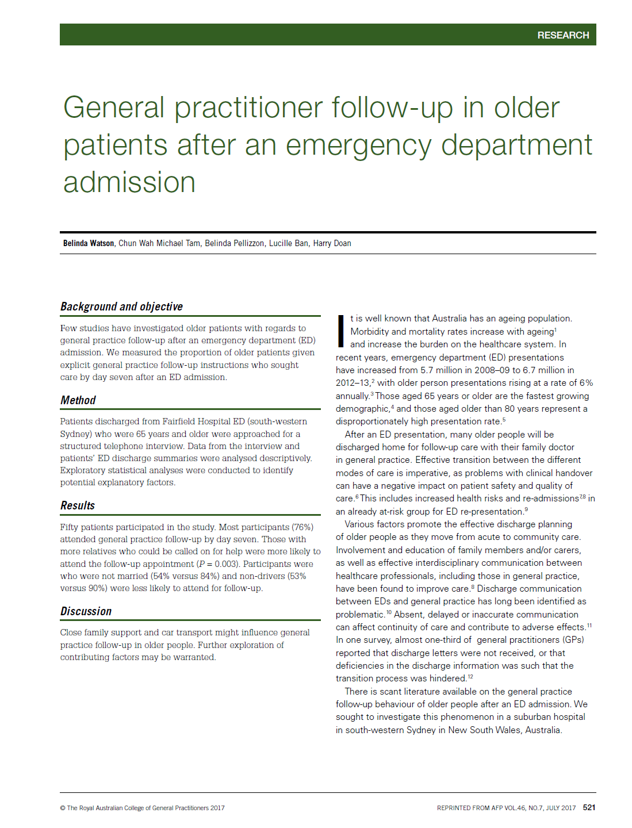
impacts
$2,000
Watson B, TAM CWM, Pellizzon B, Ban L, Doan H. General practitioner follow-up in older patients after an emergency department admission. Australian Family Physician 2017 July; 46(7): 187-192
$2,000
tiny.cc/ED2GP
“هل تفهم علي؟”
$15,000

Slide 23
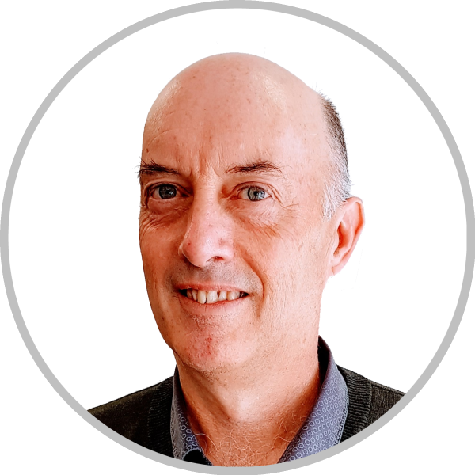
ED2GP – integrating General Practice
and Emergency Care
AndrewKNIGHT
Acting Director, Academic Primary and Integrated Care Unit, SWSLHD
Conjoint Senior Lecturer, SPHCM, UNSW Sydney
a.w.knight@unsw.edu.au
+61 2 9616 8520
MichaelTAM
Staff Specialist, APICU, SWSLHD
Conjoint Senior Lecturer, SPHCM, UNSW Sydney
m.tam@unsw.edu.au

