Slide 1
“Bla bla…” “??”
Response to
Language Discordance
In General Practice
- Findings from the OPTIMISE (Refugee Health) study-
Shoko Saito, Research Officer.
Mark Harris, Scientia Professor
CPHCE
Notes:
Thank you, Fiona, and Good morning. My name is Shoko, a Research officer at CPHCE. Before proceeding, I would like to acknowledge the traditional owners of the land where we stand today.
This presentation includes a brief explanation of the OPTIMISE study and findings on our inquiry on how general practice responds to language discordance.

Slide 2
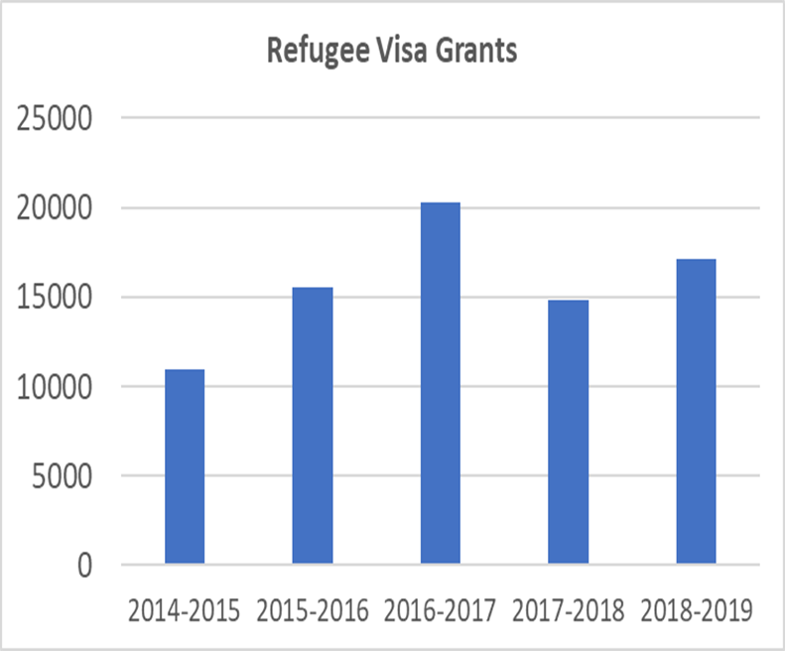
The OPTIMISE Study and its Backgrounds
The OPTIMISE study
Aimed to improve the quality of refugee health care at the general practice setting.
Practice-wide intervention with stepped wedge cluster randomised trial
A mixed methods study
3 sites (SWS/NSW, NWM and SEM/Victoria)
3 universities(UNSW, Monash U. and La Trobe U.) and regional partners (PHNs and specialised refugee health service)
Conducted from 2016 to 2021
Funded by NHMRC
Source: Australia’s Offshore Humanitarian Program: 2018-2019, Dept. Home Affairs,
Australian Government
Notes:
In recent years 15,000 to 20,000 refugees resettled annually in Australia. Refugees arrive with complex physical and mental health issues as result of traumatic experiences such as civil war. They face many challenges to access health care. The quality of health care they receive may not be optimal due to language and cultural barriers among other reasons. The health care providers on the other hand may not have adequate knowledge to provide care to meet the refugee patients’ needs. The OPTIMISE study aimed to improve the quality of refugee health care at the general practice setting. It was a cluster randomized control trial using mixed methods, carried out in 3 regions of high refugee settlement across 2 states; including South Western Sydney.

Slide 3
The OPTIMISE study: Practice-wide Intervention
Plan-Do-Study-Act (PDSA) quality improvement activity with action plans.
Practice facilitation by a facilitator from regional refugee health agencies
Support with resources
4 core foci of the intervention
Notes:
OPTIMISE implemented a practice-wide quality improvement intervention based on the PDSA cycle using action plans, facilitated by an OPTIMISE trained facilitator who was seconded from the refugee health agency of each study region. The intervention focused on four areas, refugee identification, Interpreter use, comprehensive health assessment and referrals. It was delivered through practice visits and follow-up phone calls, over a period of 6 months.

Slide 4
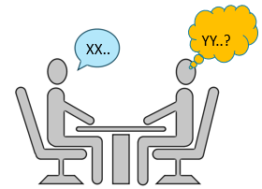
Our specific questions
What are linguistic characteristics of practice staff?
How well is the practice set up for interpreter use?
How do practices establish the need for an interpreter?
What is the level of credentialed interpreter use?
What are barriers to using interpreters?
Has the intervention resulted in any changes?
Image goes here
Analysed subsets of OPTIMISE data focusing on language and interpreter use.
Included data from 31 practices and 55 GPs who responded to both pre- and post-intervention surveys.
Notes:
We analysed subsets of the OPTIMISE data relating to interpreter use, from 31 practices and 55 GPs who completed pre-and post surveys over 6 months.
We examined linguistic characteristics of practice staff, the practice set-up and procedures regarding the use of interpreters, the level of interpreters and other methods used, GPs’ barriers to using interpreters and changes observed in them after the intervention. Please note that an “interpreter” refers to a credentialed interpreter in this presentation.

Slide 5
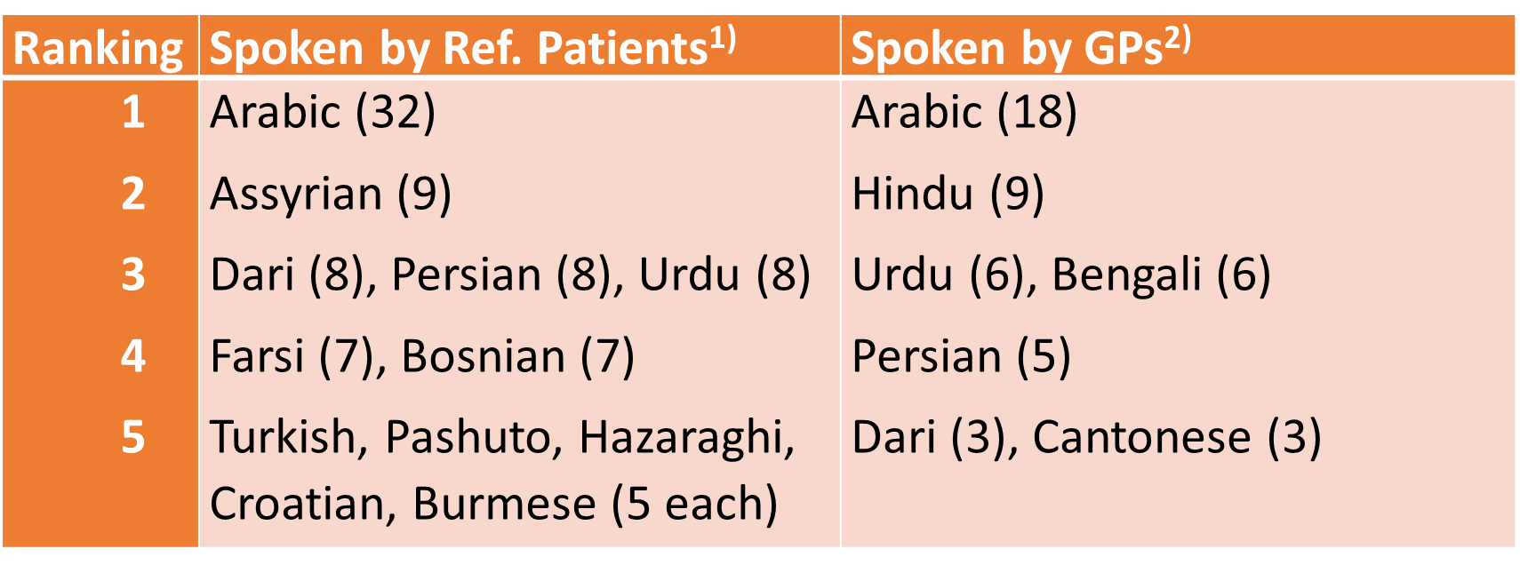
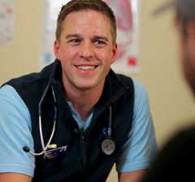
Characteristics of Practice staff and GPs
 |  | Speak LOTE¹⁾ |  | Speak Refugee language²⁾
Practice staff | n | Yes (n) | % | Yes (n) | %
GPs | 134 | 115 | 86 | 58 | 43
Nurses | 61 | 33 | 54 | 8 | 13
Reception | 117 | 75 | 64 | 36 | 31
Many speak languages other than English (LOTE). Fewer speak one of languages spoken by recent refugees.
GPs born in 19 different countries (including Australia)
Practice staff
GPs
Nurses
Reception
Photo from TIS website
Data source for LOTE: Practice description survey. 1) Chi-square test of 3 x 2 table for "Speak LOTE" p=0.000. 2) Chi-square test of 3 x 2 table for "Speaks Refugee language" p=0.000. Refugee languages refers to languages spoken by recently arrived refugees and are based on patients’ country of origin or ethnicity of the source countries of recent humanitarian entrants to Australia (Department of Immigration and Border Protection, 2013 to 2017). Date Source for the Ranking of languages: Baseline Practitioner survey.
Notes:
First, linguistic characteristics. Many spoke languages other than English and consulted in them. GPs were significantly more bilingual, as they were born in 19 different countries. 43% of them spoke at least one language spoken by recently arrived refugees. Conversely nurses were least bilingual and spoke languages spoken by refugees. A closer look at GPs’ and their patients’ languages (as reported by the GPs) indicated a moderate degree of language concordance.

Slide 6
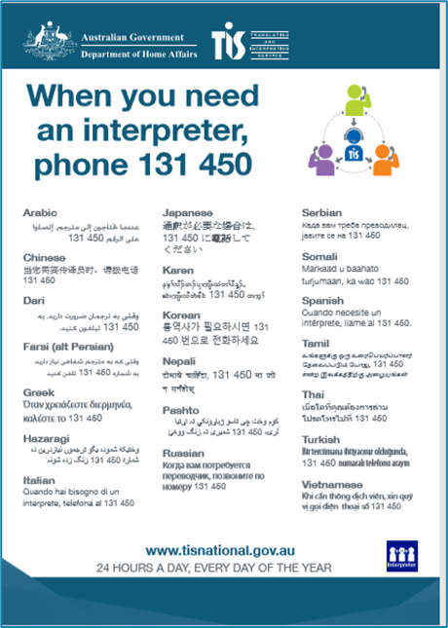
Practice set-up for using interpreters (n=31)
Poster of TIS 50 %
Speaker phone 97%
TIS Registration
97%
TIS 13 14 50
GP Code
XXXXXXX
TIS Sticker near the phone 19%
Training of GPs/PNs 0%, Recep.staff 9%
Clear procedures ?
Notes:
Effective communication is essential for delivering quality health care. The Australian federal government provides translation and interpreting service, called TIS, through which GPs can access to phone or on-site interpreters free of charge. GPs need to register with TIS to access the service. In addition, a speaker phone in each room, the TIS number near the phone and training of all staff would be needed. So, how well were the practices set-up? As shown here, while the majority was registered with TIS, one notable deficiency was the training of staff on the use of interpreter services. How about procedures for each staff to follow to ensure the patient’s need for an interpreter is met?

Slide 7
Procedures on establishing the need of an interpreter
Receptionists are mainly responsible for these tasks when registering new patient.
They use various ways to establish the patient’s language
Not clear if any designated place to record in the patient’s electronic clinical notes
Data source: Practice Description Survey (Baseline)
“The Dr may include the need for interpreter in progress notes, not a procedure followed by all Drs or staff. Unsure where it is recorded in the clinical notes …” [Comment in Baseline RHS]
Notes:
When a patient comes in and says “Muli Bwanji. Mumalankhula Chichewa?”, what happens? Receptionists are usually the first point of contact with patients. In our study, they identified the patient’s language often with a help of bilingual staff when the patient was unable to communicate in English. Referral letters from the refugee health or settlement services informed the patient’s need for an interpreter. This information, however, was not always shared. 39% of the practices reported recording such a need in the patient’s medical records. But where in the medical record? As this quote indicates, some practices lacked clear practice-wide procedures and none of the practice software had a specific place to record language or interpreter need.

Slide 8
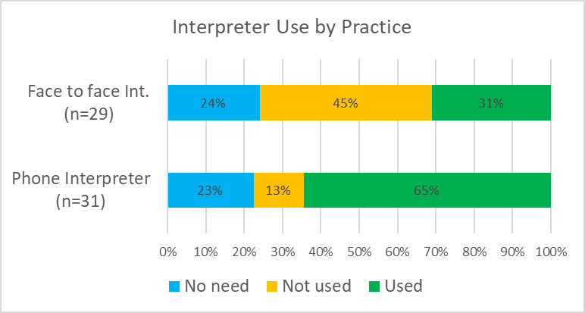
Use of interpreters (via TIS)
Data source: Baseline Refugee Health Survey
“ I speak the same language, so I don’t need an interpreter.” [GP]
“ It (interpreter) is mainly used by nurse….”[Practice manager]
Notes:
How did practices use interpreters? When combined both modes of the interpreter services, 48 % of the practice reported that they used interpreters, while 29 % of them did not use them. In addition, 23% of practices perceived no needs for such a service. The fact that many GPs were bilingual is an obvious factor for this result, as a GP’s quote here. Qualitative interview suggested nurses may be a main user group of interpreters in some practices.

Slide 9
Alternatives to using interpreters
50% of GPs reported using other methods like;
Bilingual staff
“If GP needs an interpreter, first seek among staff. If no, then asks a receptionist to make a booking with TIS” [Baseline RHS]
Family members (including children) or friend
“ Most times patient attends with family members or friend to interpret” [Baseline Interview, Practice Manager]
Notes:
At the same time, 50% of GPs reported using bilingual staff, family members including children and friends as alternatives. However, the use of these alternatives to using interpreters is not consistent with the current RACGP standards.
*****
[Bi-lingual staff may not be proficient in the language and may lack interpreting skills. While family members have important supportive roles, they may feel uncomfortable about relaying sensitive information. Using children as interpreter may pose “great burden of responsibility” on them, affect family relationship in addition to risk inaccuracy due to the lack of understanding of medical conditions and terms as well as the health care system. In other circumstances, the presence of a family member act as a deterrent for sharing sensitive information, for example, sexual health and domestic violence. For refugee patients, these issues may be compounded further by the impact of trauma requiring sensitive and effective communication.}

Slide 10
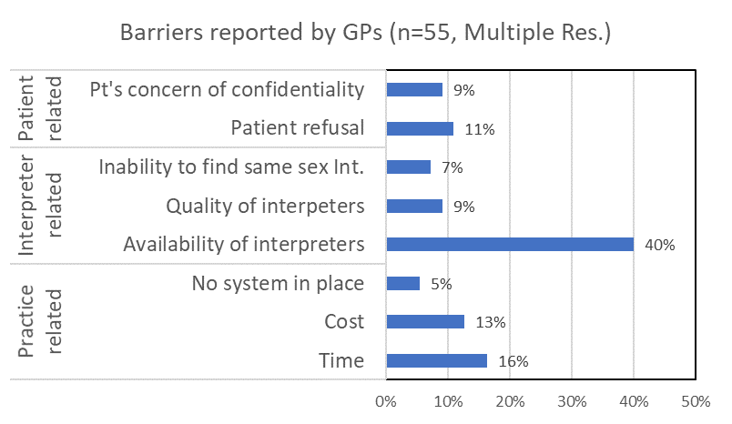
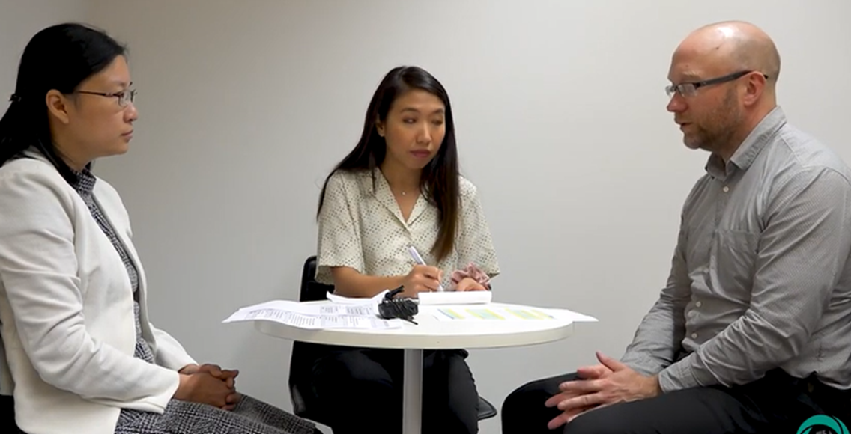
GPs’ Barriers to using interpreters at baseline
Photo: NAATI website YouTube
Data source: Baseline Practitioner survey.
“Takes too long to do a consultation with an interpreter present….” [GP]
Notes:
So, what are GPs’ barriers to using interpreters? The availability of interpreters topped the list. We are not sure whether this was based on their experience or just a perceived barrier. It is possible that as many of our GPs may be overseas trained, they are not fully aware of the services. Time and cost barriers may be related as a consultation with an interpreter takes extra time, which could be spend for consulting another patient. Patients’ refusal and concern of confidentiality are main patients’ barriers reported by GPs. *** Then, the intervention took place.

Slide 11
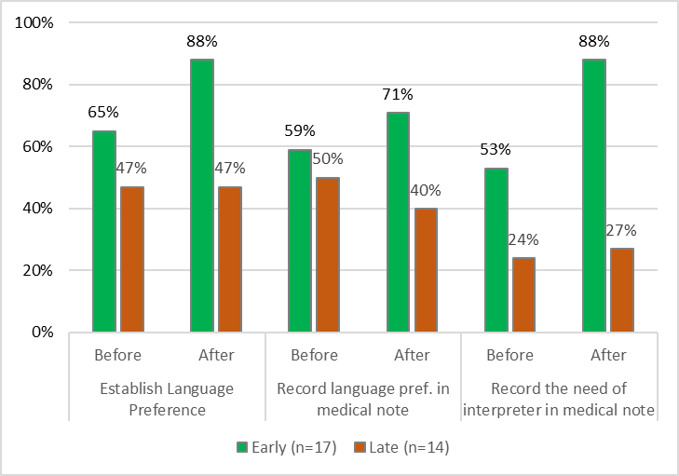
Changes after intervention: Procedures and Barriers
GPs’ Barriers: Significant reduction in the intervention group;
“cost” from 6% to 0% (p=0.021)
“availability of interpreters” from 44% to 28% (p=0.043) .
Data source: Baseline and Follow-up Refugee Healthcare Survey
“Because we changed the patient registration form, so they are much more onto whether an interpreter is needed or that sort of screening process that happens initially when they’re first coming in… which they wouldn’t have taken much notice..” [Post intervention interview, Practice manager]
Notes:
The graph shows the changes in performing language related tasks before and after the intervention by group. In all tasks, the intervention group indicated improvements, although they were not statistically significant. These improvements seem to be brought about by changes made in the patient registration form. In addition, “cost” and “Availability of Interpreters” as barriers among GPs have significantly reduced in the intervention group.

Slide 12
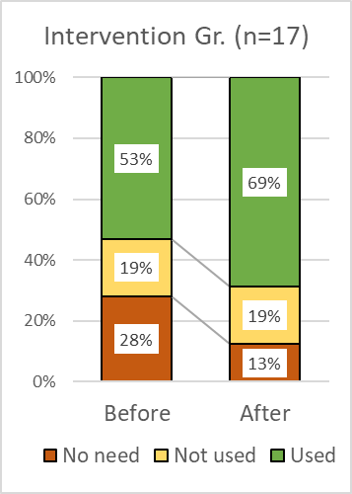
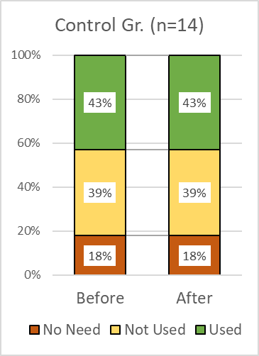
Changes after intervention: Interpreter use by practice
Use of alternative methods to credentialed interpreters (intervention group only);
37% of practices continued to use bi-lingual staff,
28% used family members.
Notes:
The use of interpreters tended to improve in the intervention group while the control group remained unchanged, although it was not statistically significant. Improved procedures and reduced barriers among GPs might have contributed to this trend in the intervention group. On the other hand, the use of bilingual staff and family members remained at a similar level.

Slide 13
“It raised awareness about involving interpreter early… that is always gonna result in a higher quality of care when the patient actually understands what’s happening in the consultation…” [Post intervention interview, Nurse]
Notes:
Overall the intervention had limited impact, but it increased awareness of the benefits of using interpreters as expressed by a nurse in this quote.

Slide 14
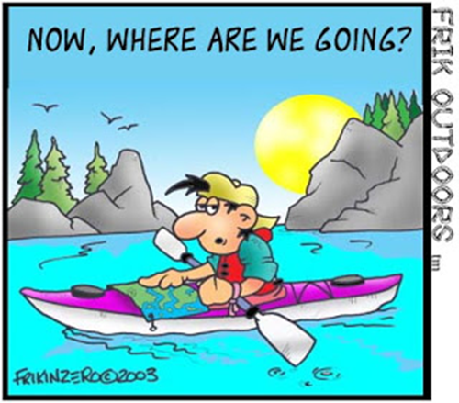
Conclusions and Implications
The interpreter service was readily available and used sometimes at the practice level.
The use of bilingual staff and family members as alternatives remained frequent despite this being against recommendations.
Time remained a barrier to use an interpreter by GPs.
A practice-wide approach is required with the involvement of reception/admin staff to develop clear procedures to improve the interpreter use.
Implications
Enhance awareness among all practice staff on benefits of using credentialed interpreters
PHN to facilitate such training based on practice-based needs.
Link with the accreditation for a practice-wide system change.
Medicare rebate for a longer consultation using interpreter.
Notes:
In conclusion, general practice responded to language discordance by having bilingual GPs, using interpreters, and relaying on bilingual staff or family members. While the interpreter service was readily available, family members or bilingual staff continued to be used despite this being against recommendations. Time remained a barrier to using interpreters. To improve the interpreter use, a practice-wide approach is required with the involvement of reception staff, who have a key role in identifying such a need of patients.
Implications may include enhancing awareness among all the practice staff of the benefits of using interpreters, so that they can inform patients and their family why and when it is necessary to use interpreters. The Primary Health Network agencies could facilitate this kind of training based on the needs of the general practice. A practice-wide interpreter friendly system could be built-up by linking it with the accreditation process of general practice. Finally, an interaction of patient with a GP or a nurse using an interpreter takes extra time. This could be subsidised by, such as Medicare rebate, to promote the use of interpreters in general practice.

Slide 15
https://www.google.com/search?q=thank+you+in+many+languages+images&rlz=1C1CHBF_enGBAU911AU911&sxsrf=ALeKk02TPlAkYiMybX6LR_mwZC4mAcKruA:1598841303059&tbm=isch&source=iu&ictx=1&fir=NJvDcx0jrydE7M%252C1uuK0xRvcD05aM%252C_&vet=1&usg=AI4_-kTMRNJULBaiGtvgQoWAoUpURD4emQ&sa=X&ved=2ahUKEwiV6K7_s8TrAhVKzDgGHVFGBw8Q9QF6BAgKECY&biw=1920&bih=969#imgrc=NJvDcx0jrydE7M

