Slide 1
Electronic shared-care with mental-health services, consumers, and GPs
Catherine Spooner

Slide 2
Partners on our journey (incomplete list) People with lived experience of mental illness, mental health clinicians, GPs. UNSW Sydney CPHCE C Spooner, M Harris, J Taggart, S Li, P O’Shea, S Parker, K Paine, K Thorburn. School of Population Health B Harris-Roxas B. Social Policy Research Centre K Fisher Centre for Big Data Research in Health J de Oliveira Costa . Local Health Districts Sydney LHD A Simpson B Lopez Portillo, A McDonald, K Searle, S Jun, L Parcsi, O Hutchins, P Vasalo, R Tippett. South Eastern Sydney LHD P Bolton Universities University of Sydney A Baillie, M Cunich. Swinburne University R Osborne Central Eastern Sydney Primary Health Network M Moore, N Hansen.

Slide 3
Why our concern with people with lived experience of mental illness?
Our journey so far
What have we found?
What have we learned?

Slide 4
Why our concern with people with lived experience of mental illness?
People with mental illnesses have higher* risk of:
Mortality: 15-20 years younger
Chronic diseases at younger age: obesity, diabetes, cardiovascular diseases, multimorbidity
Modifiable risk factors: smoking, excessive alcohol consumption, sleep disturbance, physical inactivity, and dietary risks
Medications with side effects e.g. weight gain
Socio-economic disadvantage and discrimination
*relative to the general population

Slide 5
People with mental illnesses have less* access to:
Preventive health care e.g. screening
Lifestyle interventions e.g. dietary support, fitness professionals, smoking cessation
Primary care:
aims to provide equitable, person-centred care
is optimal setting for addressing and coordinating prevention and management of complex chronic conditions
*relative to the general population

Slide 6
Our journey so far
Codesign: communication tool for PWLE & GPs
Two trials:
Electronic tool for shared care with MHS
Review:
What helps GPs engage in shared care?
2ndry data analysis:
Health profile of PWLE in Australia
Resource development:
Organisational mental health literacy
Qualitative study with PWLE:
What facilitates access to GPs in Sydney?
PWLE need support to access preventive care and GPs need support to meet the needs of PWLE
Confirms international patters: Higher prevalence of health risk factors and comorbidities among GP’s patients with mental illness
Multiple resources for PHNs developed – need local champions
Importance of relational coordination (shared goals, mutual respect, and problem-solving communication), supported by organisational structures such as shared information systems
Notes:
Importance of relational coordination shared goals; mutual respect; frequent, timely, accurate, problem-solving communication”, supported by
Organisational structures such as shared information systems and boundary spanner roles are likely to engage primary care in shared care arrangements
more than the traditional focus on incentives, education, and guidelines.
Further – cultural and organisational patterns within services are often deeply embedded. This has considerable
implications for practice. …some experimentation may be required. Achieving better working relationships across
services may need to happen slowly, through testing of strategies to see what works locally, and by making relevant
and incremental changes
(Relational coordination theory)

Slide 7
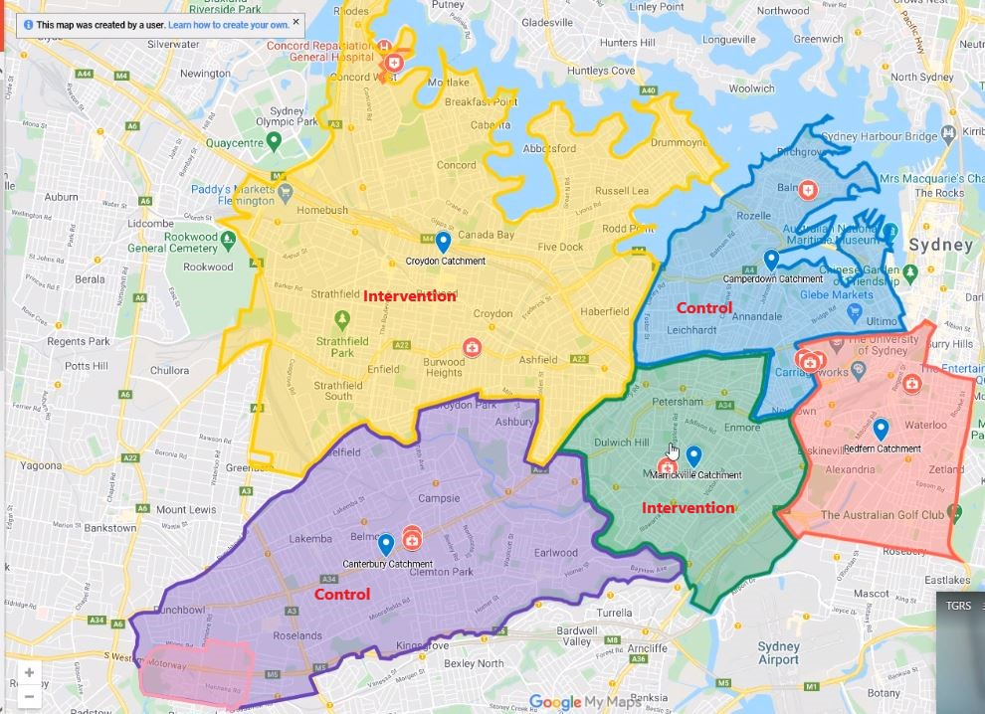
SHAReD: Shared Health Arrangements Research & Development
Question: Does an online shared care plan improve preventive care received by consumers of mental health services?
Design: Pragmatic randomised trial with mixed methods
Setting: SLHD – existing shared care program
Timing: Post COVID19
Notes:
Effective communication between healthcare providers is essential for improving the wellbeing of people experiencing severe and enduring mental illness.
The SHAReD Study is a pragmatic randomised controlled trial of an online shared-care tool that aims to enhance care planning and communication between mental health services (MHSs), general practitioners (GPs), and their shared consumers within the Sydney Local Health District (SLHD). The study aimed to recruit 500 consumers and their GPs. This presentation describes the multiple barriers to recruitment and intervention implementation experienced during a pandemic.
Reference:Morgan, M; Peters, D; Hopwood, M; Castle, D; Moy, C; Fehily, C; Sharma, A; Rocks, T; Mc Namara K; Cobb, L; Duggan, M; Dunbar, JA; Calder, RV. Better physical health care and longer lives for people living with serious mental illness. Mitchell Institute, Victoria University, Melbourne, August 2021

Slide 8
What happened?
Aim
500 consumers and their GPs
Barriers to:
Research – recruitment
Intervention implementation
Both
Achieved
52 consumers
34 GPs
For:
GPs
Mental health service
Consumers

Slide 9
General practices & GPs
 | Barriers
Both | Workforce: Highly stressed and busy Workforce capacity Consumers: Consumers see multiple GPs Lack relationship with consumer Software Concerns about the software Approval from practice manager to install software needed
Research | Remuneration
Intervention | Software Difficulties using the software
Notes:
Pick a 1-2 to explain

Slide 10
Mental Health Team
 | Barriers
Both | Workforce Highly stressed and busy Limited workforce capacity High staff turnover
Research | Confidence in value of research in general
Intervention | Software: Difficulties using the software Confidence in supporting GP to navigate software Privacy concern
Notes:
Removed from barrier to both: Lack of confidence in the SC model

Slide 11
Consumer
 | Barriers
Both | Impacts of mental illness Cognitive capacity Failure to attend appointments Engagement with GPs Change GPs Lack relationship with their GP Concerns Privacy concerns Lack of perceived benefit
Research
Intervention

Slide 12
Summary of barriers
Comprised:
Workforce issues
Software issues
Consumer issues
Mostly influenced both:
research
intervention implementation

Slide 13
Our responses
Extended time for recruitment and intervention
Increased reimbursement for GPs
Additional support to GPs to install and use software
Targeted repeat training of MHS clinicians
Work with MHS shared care clinicians
Personal contact from senior clinical investigators
Notes:
We made numerous adaptions – these are just a few

Slide 14
Impacts of challenges
Recruitment period increased
Follow-up period reduced
Reduced study power
Extended timeline with same budget
Multiple changes (plan, ethics) additional time burden
Research team burn out and turnover
Notes:
Some barriers not anticipated – dr shopping

Slide 15
Implications
Pilot work still needed if context is different
Community mental health services are organised differently to hospital cancer services
people with severe mental illness need more support to participate in research and in self management
Modest goals, generous timelines needed for complex intervention research
Include clinicians:
shared care coordinators were crucial
GPs are increasingly difficult to engage in research – how can we address this?
Notes:
Lessons from doing the ‘same thing’ in a different setting with a different population might not apply with mental health services

Slide 16
Conclusions
Our intervention research had difficulties in a complex system that is under a lot stress
The limitations of our health system constrain what we can do to improve healthcare and health outcomes
No one study will provide all the answers – need an ongoing program of research
CPHCE is in for the long journey
Notes:
Current system of applying for grants as they appear makes a continuous program of research difficult – pilot work might be needed but there’s funding for larger RCTs or vice versa

Slide 17
References
Spooner C, Afrazi, de Oliveira Costa, Harris M, 2022, 'Demographic and health profiles of people with severe mental illness in general practice in Australia: a cross-sectional study', Australian Journal of Primary Health, http://dx.doi.org/10.1071/py21240
Resources developed by CPHCE and Swinburne for Mental Health Commission of NSW https://www.nswmentalhealthcommission.com.au/content/mental-health-literacy-development
Parker, S.M., Paine, K., Spooner, C. et al. Barriers and facilitators to the participation and engagement of primary care in shared-care arrangements with community mental health services for preventive care of people with serious mental illness: a scoping review. BMC Health Serv Res 23, 977 (2023). https://doi.org/10.1186/s12913-023-09918-2
Spooner C, O’Shea P, et al. Access to general practice for preventive health care for people who experience severe mental illness in Sydney, Australia: a qualitative study. Submitted 2023 to Australian Journal of Primary Health
Thorburn C, Harris MF, Spooner C, Fisher KF. Mental Health Consumers and Primary Care Providers Co-designing Interventions and Services - A Scoping Review Protocol (2021) https://osf.io/

Slide 18
Thank you for listening (or please wake up – the panel is next)
C.Spooner@unsw.edu.au
Notes:
Thank you for listening

