Slide 1


Evaluation of the Virtual Health Hub for People Experiencing Homelessness
Presented by Dr Cathy O’Callaghan, UNSW
Team:
Cathy O’Callaghan, Margo Barr and Fiona Haigh
University of New South Wales (UNSW)
Paul Clenaghan, Nicole Lynch and Jude Page
Clinical Services Integration and Population Health, Sydney Local Health District (SLHD)
Freya Raftan, Sue Amanatidis rpavirtual, SLHD

Slide 2

Health equity at the Centre
- Better fairer health.
- Primary health care and equity research, development, evaluation and training.
- Promoting equity for all groups especially the most disadvantaged.
Notes:
- Better fairer health
- Primary health care and equity research, development, evaluation and training
–Promoting equity for all groups especially most disadvantaged – Miller community, Waterloo public housing,

Slide 3
Homelessness and health
Who are people experiencing homelessness?
Homelessness is associated with and contributes to poor health.
Population has complex health needs in accessing and receiving necessary medical services.
Notes:
Definition of homelessness.
“When a person does not have suitable accommodation alternatives, they are considered homeless if their current living arrangement:
• Is in a dwelling that is inadequate.
• Has no tenure, or if their initial tenure is short and not extendable.
• Does not allow them to have control of, and access to space for social relations.”^{[2]}
Using this definition, the ABS categorises people experiencing homelessness as those:
People experiencing homelessness
improvised dwellings, tents, or sleeping out
boarding houses
“severely” crowded dwellings
supported accommodation for the homeless
other households
temporary lodgings
Demographics - Street count shows 225 people sleeping on streets in Sydney metropolitan area
Homelessness is associated with and contributes to poor health
People experiencing homelessness have a range of unique and complex health needs in accessing and receiving necessary medical services.
Needs – no fixed address, lack of continuity of care, access to equipment and technology, inconvenience, low literacy
Solutions – support worker, carer

Slide 4
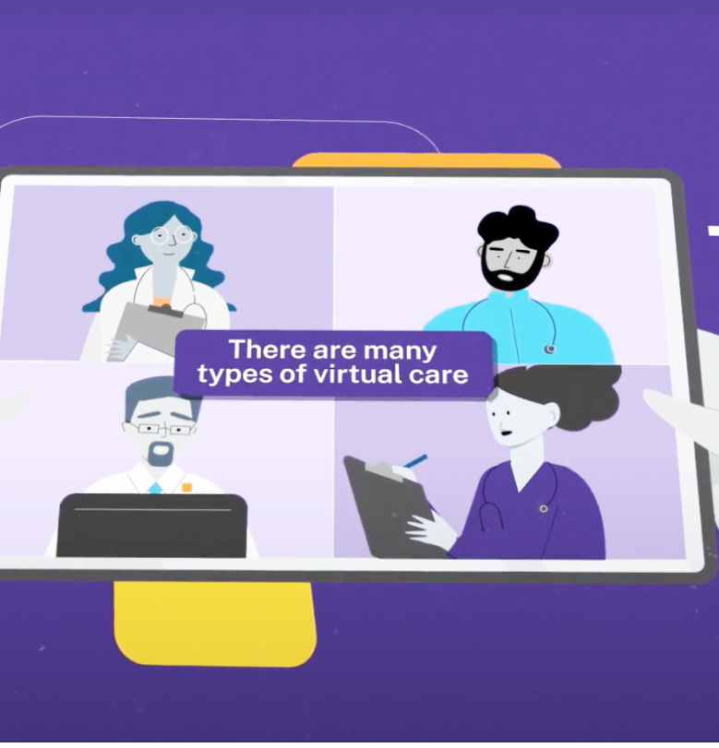
Virtual health care
Virtual care (including telehealth) is healthcare provided online or over the phone.
The model has proved successful in Australia and internationally.
It has the potential to address access barriers and reduce health equity. However, disparities still exist.¹
Partnerships are important.
1. Mistry et al (2021) Virtual care and health equity: A rapid literature review. RPA Virtual Hospital, SLHD, Sydney
Notes:
- Virtual care (or telehealth) is a way for patients to connect to their doctor, nurse or specialist online or over the phone.
The model has proved successful in Australia and internationally with the potential to:
address access and availability of services for different populations
reduce health equity concerns.
(inventive methods after COVID)
However disparities still exist.¹
Partnerships are important in the delivery of virtual care in different settings.

Slide 5

Virtual care for people experiencing homelessness
Telehealth is used less often in populations experiencing homelessness. ²
Virtual health care outreach is important but can be challenging.
2. Bekasi (2022) Telemedicine in Community Shelters, International Journal for Equity in Health, 21, 181
Notes:
Telehealth is used less in homeless populations ^{[3]}
Outreach to people sleeping rough and living in boarding houses is challenging
Solutions need to be multi-faceted – rough sleepers on the street are usually known to services
Digital health for vulnerable populations is difficult due to digital literacy, access to mobile phones/tablets, data and private area
Needs – no fixed address, lack of continuity of care, access to equipment and technology, inconvenience
Solutions – support worker, carer

Slide 6






Virtual Health Hub for people experiencing homelessness in SLHD project
rpavirtual, SLHD
Homeless Health, SLHD
Improve access to multidisciplinary support.
Better engagement and more collaborative care with partners.
Develop a cross-service framework for delivery of care in a culturally safe manner.
Commit to virtual health care and Communications Technology (ICT) infrastructure.
Virtual Health Hub at Haymarket Centre
Doctor/ psychologist
Case manager
Doctor/ psychologist
Nurse
Patient
Notes:
RPA Virtual Hospital (rpa.virtual) was introduced in 2020 in SLHD to provide a new way to deliver care to people in different settings
SLHD have developed the Virtual Health Hub Model of Care using RPA Virtual to ensure better access to and continuity of comprehensive health care for these populations.
Consists of a multidisciplinary team of nurses, doctors and allied health
Integrated care model – right care at the right time at the right place
The service will be trialled in a short-term accommodation model at the Haymarket Foundation
Notes:
By leveraging virtual health technologies, the model aims to bridge the gap and provide essential medical services directly to these communities.
Those experiencing homelessness in SLHD number 8348. SLHD has 44% of boarding house population in nsw with over 3500 resident
The Virtual Health Hub Model of Care will be utilised to provide solutions to promote accessible and comprehensive healthcare services for this population.
Early days
The objectives of the Virtual Health Hub include to:
Improve access to health care, including multidisciplinary support, for people who experience homelessness when access to traditional primary care is limited.
Better engagement and more collaborative care with partners who work with people who experience homelessness.
Develop a cross-service framework for delivery of care in a culturally safe manner for people who experience homelessness.
Commit to the provision of virtual health care and the required Information and Communications Technology (ICT) infrastructure.

Slide 7



People experiencing homelessness
Virtual health care at the Haymarket Centre
Remote doctor

Slide 8
Virtual Health Hub evaluation
Accessibility
Efficiency and cost-effectiveness
Technological Infrastructure
Quality of Care
Stakeholder experiences
Outcomes and Impact
Project partners
- CPHCE, UNSW
- Homeless Health, SLHD
- RPA Virtual Hospital, SLHD
- Haymarket Foundation
Notes:
SLHD enlisted CPHCE at UNSW to support the evaluation of the virtual model in the first pilot location of Haymarket.
Accessibility: Analysing the extent to which the virtual outpatient hubs or centres effectively reach and serve the target population, overcoming barriers to healthcare access.
Efficiency and cost-effectiveness: Assessing the efficiency of the Virtual Health Hub Model in terms of resource utilization, appointment management, and other aspects that may inform cost-effectiveness of the telehealth solution.
Technological Infrastructure: Reviewing the technological setup, connectivity, and reliability of the virtual platform, ensuring its suitability for delivering seamless telehealth services, and ability of all service users to use the systems.
Quality of Care: Evaluating the standard of service delivered through the telehealth platform, including the patient satisfaction, stakeholder and partner experiences; range of services provided, clinical procedures and guidelines developed;
Stakeholder Experiences: Examining the level of engagement and collaboration among stakeholders, including healthcare providers, partner organizations, and the target population, to identify opportunities for improvement.
Outcomes and Impact: Identifying and or measuring outcomes and impact of the Virtual Health Hub Model in terms of health outcomes, reduction in healthcare disparities, and overall improvement in the well-being.

Slide 9
Mixed method approach to analysis
Literature review
Stakeholder interviews (with partners)
Access to Patient Reported Experience Measures (PREM) survey data
Overseen by a Working Party and people with lived experience
Analysis
Both qualitative and quantitative descriptive methods

Slide 10
Challenges / opportunities
Maintaining consistency of evaluation approaches
Access to PREMS data when the population is transient
Whether virtual care is as good as face-to-face consultation
Lack of data reduces the ability to assess program success
Notes:
Maintaining consistency of evaluation approaches from rpavirtual to a unique population group of people who experience homelessness including to demonstrate the success of such approaches
Access to PREMS/PROMs when the population is transient
Whether care is as good as face-to-face consultation
Lack of data reduces the ability to assess program success

Slide 11

Results so far
Need for mental health treatment is high
After evaluation - expansion into new clinics
Competency in filling out PREMs

Slide 12

Thank you

