Slide 1
Sharing e-care plans between GPs and Health Services
Jane Taggart
DALL-E

Slide 2
Severe Mental Illness
Clozapine and SHAReD studies 2021>
Breast and colorectal cancers study 2021>
Qual study: Assessing suitability for colorectal shared care 2020
Qual study: Matching the right care with the right patients 2020-21
Feasibility study
Colorectal cancer 2019-21
Codesign development 2018-19
Qual study: Views on Cancer shared care (2016/17)
Notes:
Program of shared care

Slide 3
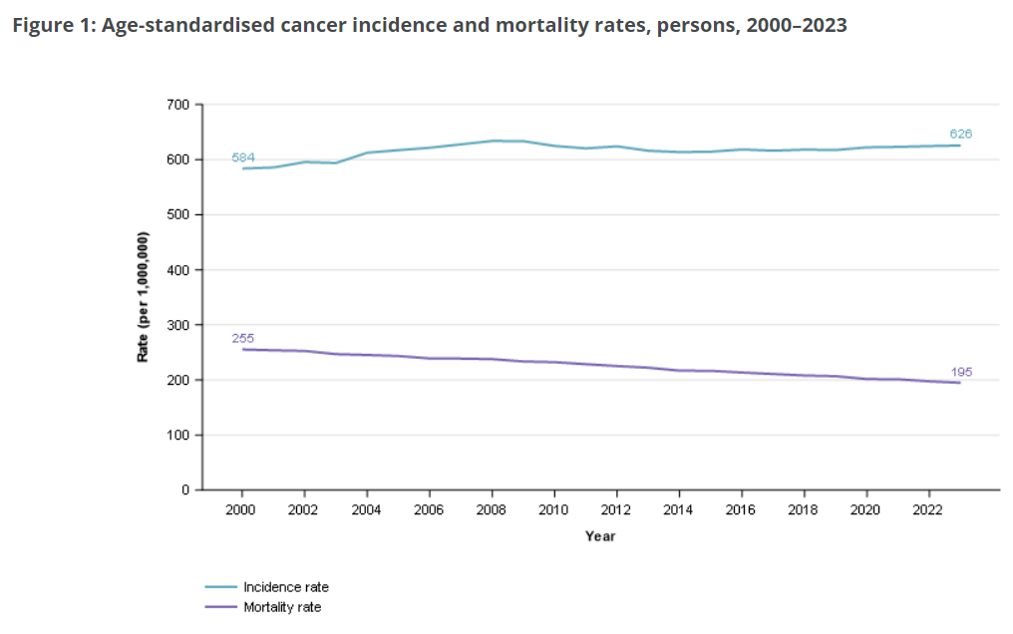
Why cancer shared care?
Increasing demand for specialist
cancer services
Cancer survivorship models not
optimal*
Meet diverse needs
More comprehensive care
Improve access
AIHW (2023)
*Vardy (2019), Jefford M. (2019)

Slide 4
Views of patients, specialists and GPs
Acceptable to most patients, GPs and specialists
GP role in holistic care (psychosocial support)
GPs need knowledge about cancer care and an interest
Specialist oversees care
Schutze H et al (2018)

Slide 5
Follow-up cancer care requires multidisciplinary care
1. Cancer follow-up
Surveillance of current cancer
Screening for new cancers
Managing late and long-term effects of treatment
2. Psychosocial
3. Lifestyle
4. Other preventive care
5. Medications review

Slide 6
Why e-care plans?
Support collaboration
Communication
Monitor care
Dynamic
Accessible
Notes:
Dynamic – not static

Slide 7
Codesign of Cancer shared care
Consultation
Stakeholders
Workshop
Consensus
Tools
Care pathway
GP e-care plan
Care pathway, care plan & digital options
Taggart J et al (2021)
Notes:
Could delete and discuss at the arrow timeline
GP Care plans
• Supports access and collaboration between
team members and the patient
• Integrates with general practice clinical
information systems so information can be
uploaded seamlessly
• Care plan templates for different cancers can
be added
• Includes prompts and notifications to
coordinate and monitor care
• Some systems are compliant with NSW and
Commonwealth standards
• GPs can claim the Medicare Benefits
Schedule item and receive payment for
generating or reviewing the care plan
• Less expensive than developing a new
system
• Scalable to other cancers, conditions and

Slide 8
e-care plan pathway
GP
Patient
Cancer Service
Assess and agree to shared care
Start e-care plan
Tailor e-care plan
GP visit, reviews, shares results, tasks
Specialist visit, shares results, tasks
Care coordinator monitor tasks and results

Slide 9
Notes:
Might delete this slide
Developed template based on best practice guidelines
Flexible templates

Slide 10
e-Care Plan Functions
Schedule tasks
Share information
Access for patient and care team
Notifications
Notes:
Could delete
Notifications
Also syncs with GP clinical information systems
Follow up care for cancers involves surveillance for cancer spread, recurrence and new cancers, preventive care, management of the acute and long term psychosocial and physical effects of cancer and the treatments, management of other chronic conditions and coordination of care between specialists and primary care providers to meet the needs of survivors

Slide 11
Findings: colorectal cancer follow-up feasibility study
St George Public Hospital Cancer Care Centre
Prince of Wales Private Hospital Oncology Service
Notes:
Interested in experience of participants with shared care and the e-care plan
Did it support collaboration and information sharing

Slide 12
Reported Benefits
Patients
Valued GP
Convenient
GP spoke Mandarin and Cantonese
Wanted information shared
GPs
Teamwork
A new facet
Long term relationship with patient
Reassured that specialist was engaged
Specialists / Care Coordinators
Less focus on non-acute care
Information when needed
A more structured interaction with primary care
Clinically adequate and safe follow-up
Patient access to care plan

Slide 13
Did the e-care plan support communication?
Information was shared by the GPs (pathology results, notes, health summary, measurements)
Information was shared occasionally by Specialists and not for all patients. Two patients and a GP reported no communication from specialists
One patient shared information regularly (CALD). Two asked for surgeon to be added.
Notes:
Two did not access it knew what they had to do (CALD). One saw no reason to add comment. Uncertain about use

Slide 14
Did the e-care plan support shared care?
The care plan assisted GPs with
managing patients
GPs reported it was easy to use
Some patients reported it was convenient and useful for knowing their schedule and sharing information. Notifications and reminders were helpful.
Specialists found it difficult to put into practice.
“I have to use multiple electronic systems and work out how to incorporate them into my workflow”
Specialist 1
Notes:
an optional item
“you add an extra layer of work and another platform, rather than incorporate it into an existing platform” Spec 3

Slide 15
Challenges
COVID impact
Implementing at cancer services:
E-care plan not integrated with cancer service systems
Limitations on access to LHD information systems
Difficulty changing routines - busy cancer clinics, small number of patients, accessing e-care plan infrequent
Care Coordinator turnover, unsure about their role, other priorities
Patient engagement

Slide 16
Implications for policy and practice
Introducing innovations takes time and requires funding
Health services need support to transition to shared care and utilise technology
Need to facilitate access to information and communication between GPs and specialist services:
Integrated with clinical information systems; and
Policies that support the sharing of information safely and securely
Care coordinators time needs to be supported, involved in planning, ways to deal with turnover
Scalability

Slide 17
Acknowledgements
UNSW
Mark Harris, Kerry Uebel, Andrew Knight, Kylie Vuong
SESLHD
Melvin Chin, Winston Liauw, David Goldstein, Carole Harris
CESPHN
Brendan Goodger, Alex Dolezal
Consumers: John Lewis, Millica Rigby, Phil Mendoza-Jones, Julie McKinnery
eHealth NSW

Slide 18
References
Australian Institute of Health and Welfare https://www.aihw.gov.au/reports/cancer/cancer-data-in-australia/contents/overview-of-cancer-in-australia-2023
Schütze H, Chin M, Weller D, Harris MF. Patient, general practitioner and oncologist views regarding long-term cancer shared care. Fam Pract. 2018 May 23;35(3):323-329. doi: 10.1093/fampra/cmx105. PMID: 29045632; PMCID: PMC5965078
Taggart J, Chin M, Liauw W, Goldstein D, Dolezal A, Plahn J, Harris MF. Challenges and solutions to sharing a cancer follow-up e-care plan between a cancer service and general practice. Public Health Res Pract. 2021;31(2):e31122108. First published 30 April 2021.
Vuong, K., Uebel, K., Agaliotis, M. Jun S, Taggart J, Suchy S, Liauw W, Chin M, Webster K, Harris MF. Assessing suitability for long-term colorectal cancer shared care: a scenario-based qualitative study. BMC Fam Pract 21, 240 (2020). https://doi.org/10.1186/s12875-020-01311-w
Vardy JL, Chan RJ, Koczwara B, Lisy K, Cohn RJ, Joske D, Dhillon HM, Jefford M. Clinical Oncology Society of Australia position statement on cancer survivorship care. Aust J Gen Pract. 2019 Dec;48(12):833-836. doi: 10.31128/AJGP-07-19-4999. PMID: 31774985
Jefford M. Improving the Care of Adult Cancer Survivors. Asia Pac J Oncol Nurs. 2019 Oct 30;7(1):2-5. doi: 10.4103/apjon.apjon_42_19. PMID: 31879677; PMCID: PMC6927155.

Slide 19
Thanks

